Slide 1
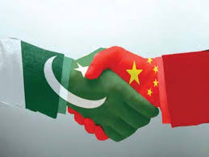
Politics of Economic Corridor: Prospects of Pakistan-China Nexus
The 33rd Annual Conference of the
Asian Association of Open Universities
Salma Amjad
Virtual University of Pakistan, Lahore

Slide 2
Sequence of Talk
Principal Argument
Objectives of the Study
Research Questions
Methodology
Pak-China Relations: A Reappraisal
Dynamics of Pak-China Relations
CPEC: A Flagship Project
Potential Benefits For Pakistan
Prospects For China
CPEC: Prospects & Challenges for Asia Region
Limitations & Concerns Regarding CPEC
Concluding Analysis
References

Slide 3
Principal Argument
CPEC has potential to become a significant expression of Pakistan-China Strategic Nexus, however it is primarily losing the Drive due to various Dynamics of Politics of Economic Corridor.

Slide 4
Objectives of the Study
To highlight the prospects of Pak-China strategic interests for Pakistan in particular
To assess the Ground Realities of CPEC
To evaluate the concerns of Stake Holders and related Limitations
To Analyze the Internal Dynamics of Politics of Pakistan Related to CPEC

Slide 5
Research Questions
Is CPEC A Win-Win situation especially for Pakistan?
How it will enhance the ‘Strategic Outlook’ of Pakistan?
What are the Limitations & Problems at Operational level?

Slide 6
Methodology
Qualitative in nature
Descriptive and analytical methods
Secondary sources

Slide 7
Pak-China Relations: A Reappraisal
Pak-China “All-Weather Friends”: Natural Partnership
Both support each other at regional & international fora
Relationship built Primarily on Diplomatic and Defense
Relationship Transformed from Bilateral approach to Strategic Interests

Slide 8
Dynamics of Pak-China Relations
U.S policy of ‘Pivot Asia’ has provided valid grounds for much wider degree of collaboration.
For many Chinese strategists, the ‘Pivot Asia’ denotes to augment U.S and allied exertions to contain China.
U.S sees China as “A strategic competitor rather than strategic partner”
Chinese notion of “Strings of Pearl Strategy” indicates the increasing China-Pakistan Nexus by establishing bonds with Myanmar, Sri-lanka and Bangladesh.

Slide 9
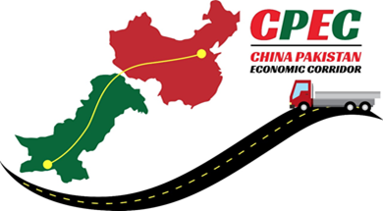
CPEC: A Flagship Project
Flagship, mega and high level Developmental Project
“One Belt, One Road” Initiative
Attempt to bolster economic ties between Beijing and Islamabad
‘A Game Changer’ to transformed Regional connectivity through shared economic Development

Slide 10
Areas under CPEC Development
CEPC
Energy Sector Development
Infrastructure Development
Road & Railway Network
Gwadar Port
Industrial Growth
Labor Market

Slide 11
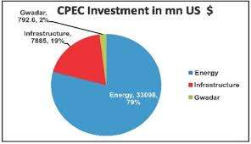

Slide 12
Prospects For China
Supportive to Peaceful Rise of China
Empower China to Easy access over Indian Ocean
Reducing reliance on the long, expensive and exposed Sea Routes through the Malacca Strait from China to Middle East & Africa.
Even if China uses CPEC for 50% of its Oil supplies then it will save $6 Million every day, almost $2 billion every year.
Counter Strategy to US-India Strategic Partnership

Slide 13
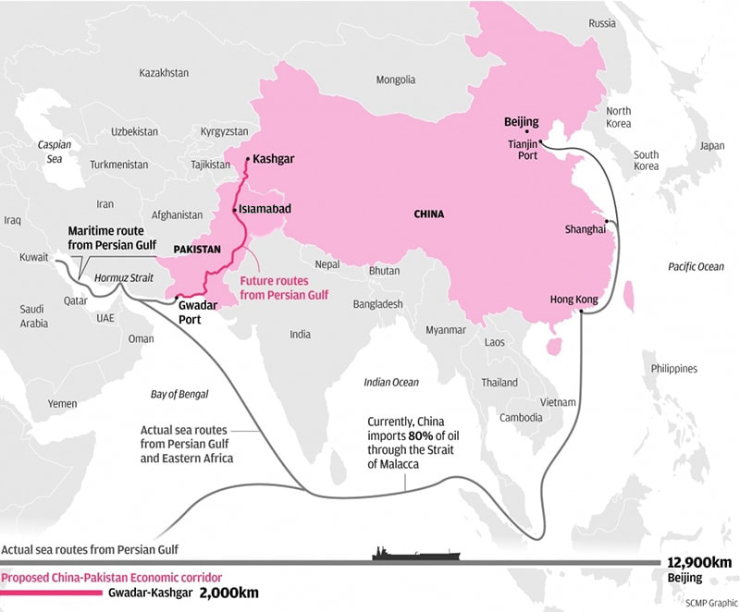
Proposed Map of CPEC

Slide 14
Potential Benefits to Pakistan
Potential to stun the Indian strategic planning for naval hegemony in Indian Ocean.
better prospects into CARs and Afghanistan means to reinforce material influence.
Scenarios for advancing the economic and military ties between China and Pakistan and conceivably Pakistan’s captivation into a “China Centric strategic partnership”.
Emergence of Pakistan as Labour Market: Opportunities of jobs and Industrial Growth
Possible ‘Developments in Infrastructure, Energy Resources & Transportation of Goods.

Slide 15
CPEC: Prospects and Challenges for Asia Region
CPEC could be a game changer for Pakistan and the entire region as well
Integrating and connecting other Sub Regions of Asia
Harmony, Peace and Development of Region
Enhance Security and Stability

Slide 16
Limitations & Concerns Regarding CPEC
Loss of Momentum: No Extensive Debate in Parliament /Provincial Legislatures in Pakistan
Political Discontent: Friction Between Centre & Provinces in Pakistan
Lack of Involvement of All Stake Holders: Civil Society, Businessman & Local Landowners
Changed Approach of Pakistani Government: More Focus on US-Pakistan Ties
Debt Risks for Pakistan
Fear of Expansion of Chinese Influence in Pakistan
Military’s Approach Regarding Cooperation With China

Slide 17
Concluding Analysis
Needs Careful Examination of the Prospects for Materializing the Strategic, economic and Political benefits.
Ability to Transform Pakistan’s geographic locale into a Strategic Asset
Needs to Initiate An Extensive Debate at National & Provincial Assemblies to Make it a ‘All Federation Project’
Needs to Enhance the Cultural & People to People Connections Between Pakistan & China to avoid Misperceptions.

Slide 18
References
Tarique Niazi, “Gwadar: China’s Naval Outpost on the Indian Ocean,”
The BBC's M Ilyas Khan looks at the significance of the plans under “Is China-Pakistan ‘silk road’ a Game Changer?”
Andrew Small, “Regional Dynamics and Strategic Concerns in South Asia: China’s Role” CSIS
Riaz Ahmad and Hong Mi, “China-Pakistan Economic Corridor and Its Social Implication on Pakistan: How Will CPEC Boost Pakistan s Infrastructures and Overcome the Challenges?”
Hasan Askari Rizvi, “The China-Pakistan Economic Corridor: Regional Cooperation and Socio-Economic Development”
Akber Ali, “China Pakistan Economic Corridor: Prospects and Challenges for Regional Integration”
China Daily, October 2, 2013
Christian Wagner, “The Effects of the China-Pakistan Economic Corridor on India-Pakistan Relations”
M. Zia-ur-Rehman, “Strategic National Perspective and CPEC Understanding the Changing National Paradigms”
CPEC Official Site

Slide 19
Thank you

