Slide 1
Digitalization of Examinations in OUJ: Current Situation and the Future Kenjiro JIN The Open University of Japan (OUJ)
For the 33rd Annual Conference of the Asian Association of Open Universities

Slide 2
Introduction of OUJ
Opened in 1983 to provide with university education
and lifelong learning
Largest distance education institution with
85,000 students.
Grants Bachelor of Liberal Arts, Master and Ph.D. in Arts and Sciences.
Offer about 350 TV/Radio Broadcast, 3,000 Face-to-face, 50 Online courses.
All courses (except face-to-face) are delivered through the Internet.
Most students are working.
One quarter of students are over 60 years old.
50 Study Centers and 7 Satellite Spaces at nationwide.

Slide 3
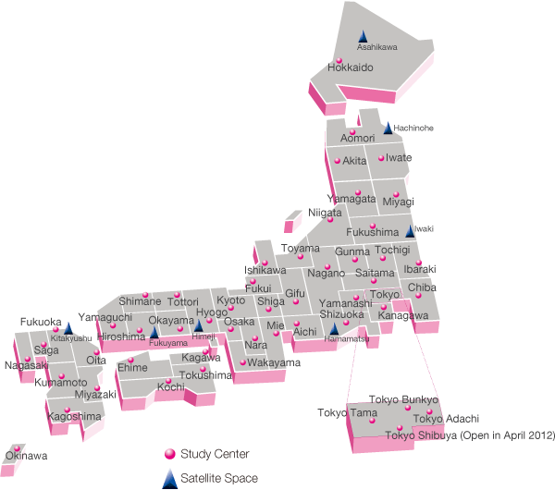
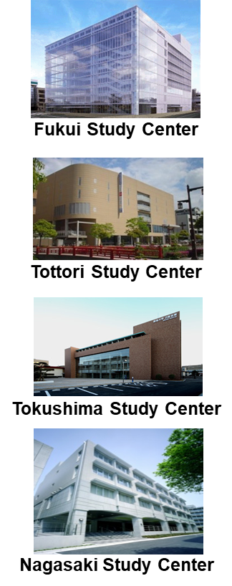
OUJ’s Study Center Network
50 Study Centers
at Nationwide

Slide 4
Functions of Study Centers
Various Student Services are provided.
Face-to-face courses
Final Examinations
Academic Consultation
Students’ Club Activities
Administrative Work

Slide 5
OUJ’s Examination Mechanism for Acquiring Credits
① Web/Post
② Sitting

Slide 6
Web Midterm Assignments for Broadcast Courses
 | Broadcast TV Courses | Broadcast Radio Courses | Total No. of Broadcast Courses | No. of Courses Accept Web Midterm Assignments | % of Courses Accept Web Midterm Assignments
Undergraduate | 160 | 126 | 286 | 254 | 88.8
Graduate | 5 | 53 | 58 | 36 | 62.1
Data of the 1st Semester of 2019

Slide 7
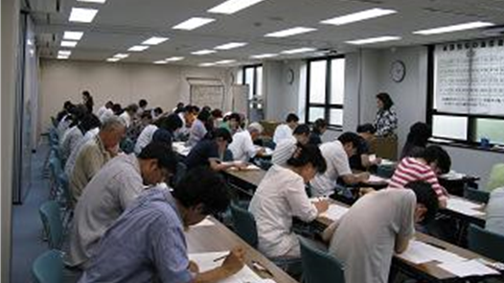
Final Exam for Broadcast Courses
15 Lectures for Broadcast Courses
1 ～ 8 Lectures → Mid Term Assignments
1 ～ 15 Lectures → Final Exam
Date and Time are Pre-Set.
Start Simultaneously at All SCs.
All Paper-Based Sitting Exams.

Slide 8
Issues on Current Examination Mechanism of OUJ
Pre-set Exam date may cause busy students’ dissatisfaction.
Learning opportunities are restricted.
Nationwide paper exam results in irrational working at SCs/SSs. Need to streamline work amount and services.
Expensive preparation & operation of paper exams.

Slide 9
Case 1: Athabasca University (AU) in Canada
AU exams must be taken with examination invigilators.
Students need to schedule own exams by course end (mostly 6 months).
Exams at AU locations (four campuses) requires no additional fees.
Many courses are designed with online exams (still require invigilation).
Ways to write online exams:
In AU Exam Centres (or other schools) with equipped pcs: Mostly no additional fees
By Invigilation Company at home: Must pay additional fees

Slide 10
Case 2: Sukhothai Thammathirat Open University (STOU) in Thailand
STOU HQ and exam centers conduct paper exams.
Organize “Walk-in Exam” according to readiness of individual students with set pcs.
Benefits students with enough knowledge and ability without waiting for final exam.
Held on weekends at nationwide in previous month of regular exam.
Need to pay 300 Thai Baht (around US$10) per course.
Temp result of multiple-choice question exams are announced immediately.

Slide 11
OUJ’s CBT for NEW Career Support Certification System
New curriculum “programming education in primary schools”
OUJ newly developed several courses for the teachers.
"Scratch Programming Instruction"
July 2019
First Practice in OUJ’s History
*CBT Operation by Private Company
*CBT Payment by Credit Card

Slide 12
Draft plan of CBT/IBT for Broadcast Courses
In Past, CBT/IBT have been developed as a part of online courses.
OUJ realizes they’re essential for broadcast courses to satisfy working students’ diversified needs.
They are expected as a trigger for solving other issues of OUJ.

Slide 13
OUJ’s Trials of CBT/IBT in 2018
A: CBT at Urban Study Center
B: CBT at Designated Rural Venue
C: IBT at Home of Students with Disabilities
9:15 - 10:05, 10:25 - 11:15 (23 - 24 Feb. 2019)
17 Students
Pcs set by the SC
9:30 - 10:20, 10:40 - 11:30 (3 Mar. 2019)
3 Students
Pcs prepared by OUJ (students’ own PCs allowed but no one wished)
9:15 – 10:30, 10:45 - 12:00 (23 - 24 Feb. 2019)
3 Students
Pcs prepared by students

Slide 14
OUJ’s Trials of CBT/IBT
Major Comments from the Survey
Writing task should be included.
Monitor text size should be enlarged for elderly.
IBT at home is beneficial and convenient for students.
Use of tablets should be considered.
Good to know the results immediately after Exams.
Monitor buttons were confusing.
Private information of front student pc could be seen.

Slide 15
Obstacles against Realizing OUJ’s Exam Digitalization
Ensure how to identify IBT candidates through webcam invigilation.
Cost of remote invigilation can be a burden of students.
Reform of existing learning system is harder than new establishment.
Roles of SCs/SSs need to be reconsidered in digital reform of exam mechanism.

Slide 16
Summary on OUJ’s future perspective
considers examination digitalization is a hopeful reformer.
May create another optional student service and burden university management.
Set lower tuition, widening learning opportunities or realizing inclusive education.
AU and STOU based on students’ active learning intention. OUJ may motivate it by examination digitalization and more attractive course.
Additional fees (Income) may improve services, but OUJ may seek other possible way to satisfy students.
Achievement of fairness by steady quality of examinations is essential, and it should be secured in reforms.

Slide 17
Thank you ありがとう

