Slide 1
Mobile Applications Development, A Novel Learning Experience for
University Foundation Course Students.

Slide 2

Hasnain Zafar Baloch*, James Walsh, Liow Chee Keong,
International Medical University, Malaysia
*hasnainzafar@imu.edu.my
Authors :

Slide 3

Introduction
Foundation in Science (FiS)
Computing Studies module
Four hours lectures
Ten hours of Computer Assisted Learning (CAL)
No prior knowledge of programing

Slide 4
MIT App Inventor
MIT App Inventor
Visual programing environment
coding skills
Problem solving skills
Develop apps

Slide 5
Group Project
Individual tasks for practice
develop a novel App as per defined rubrics.
Notes:
Pictures

Slide 6
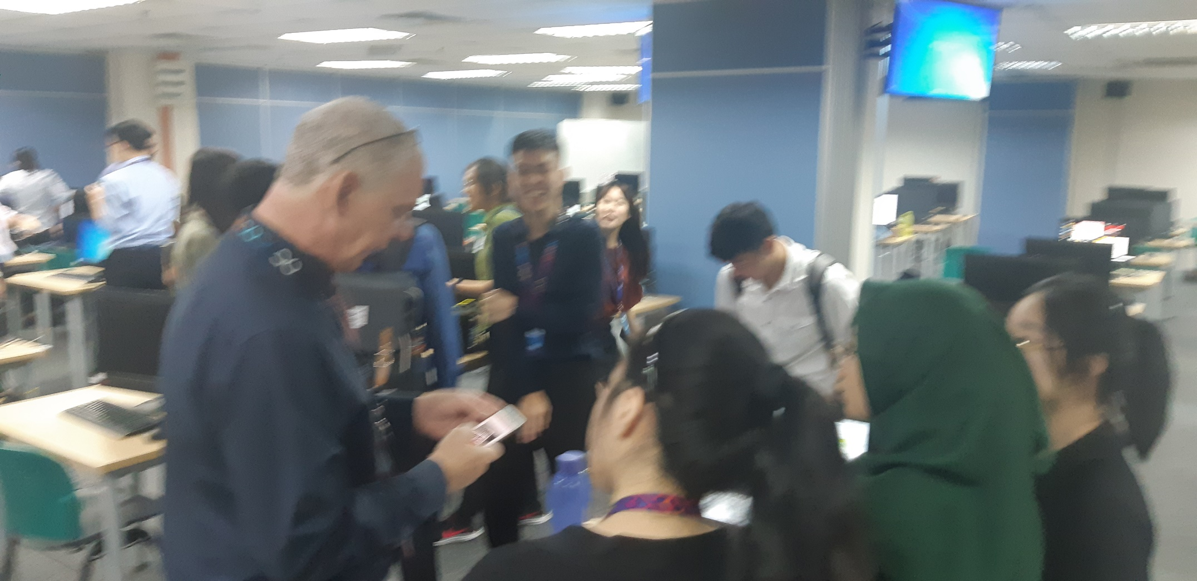
Group Project
Notes:
Pictures

Slide 7
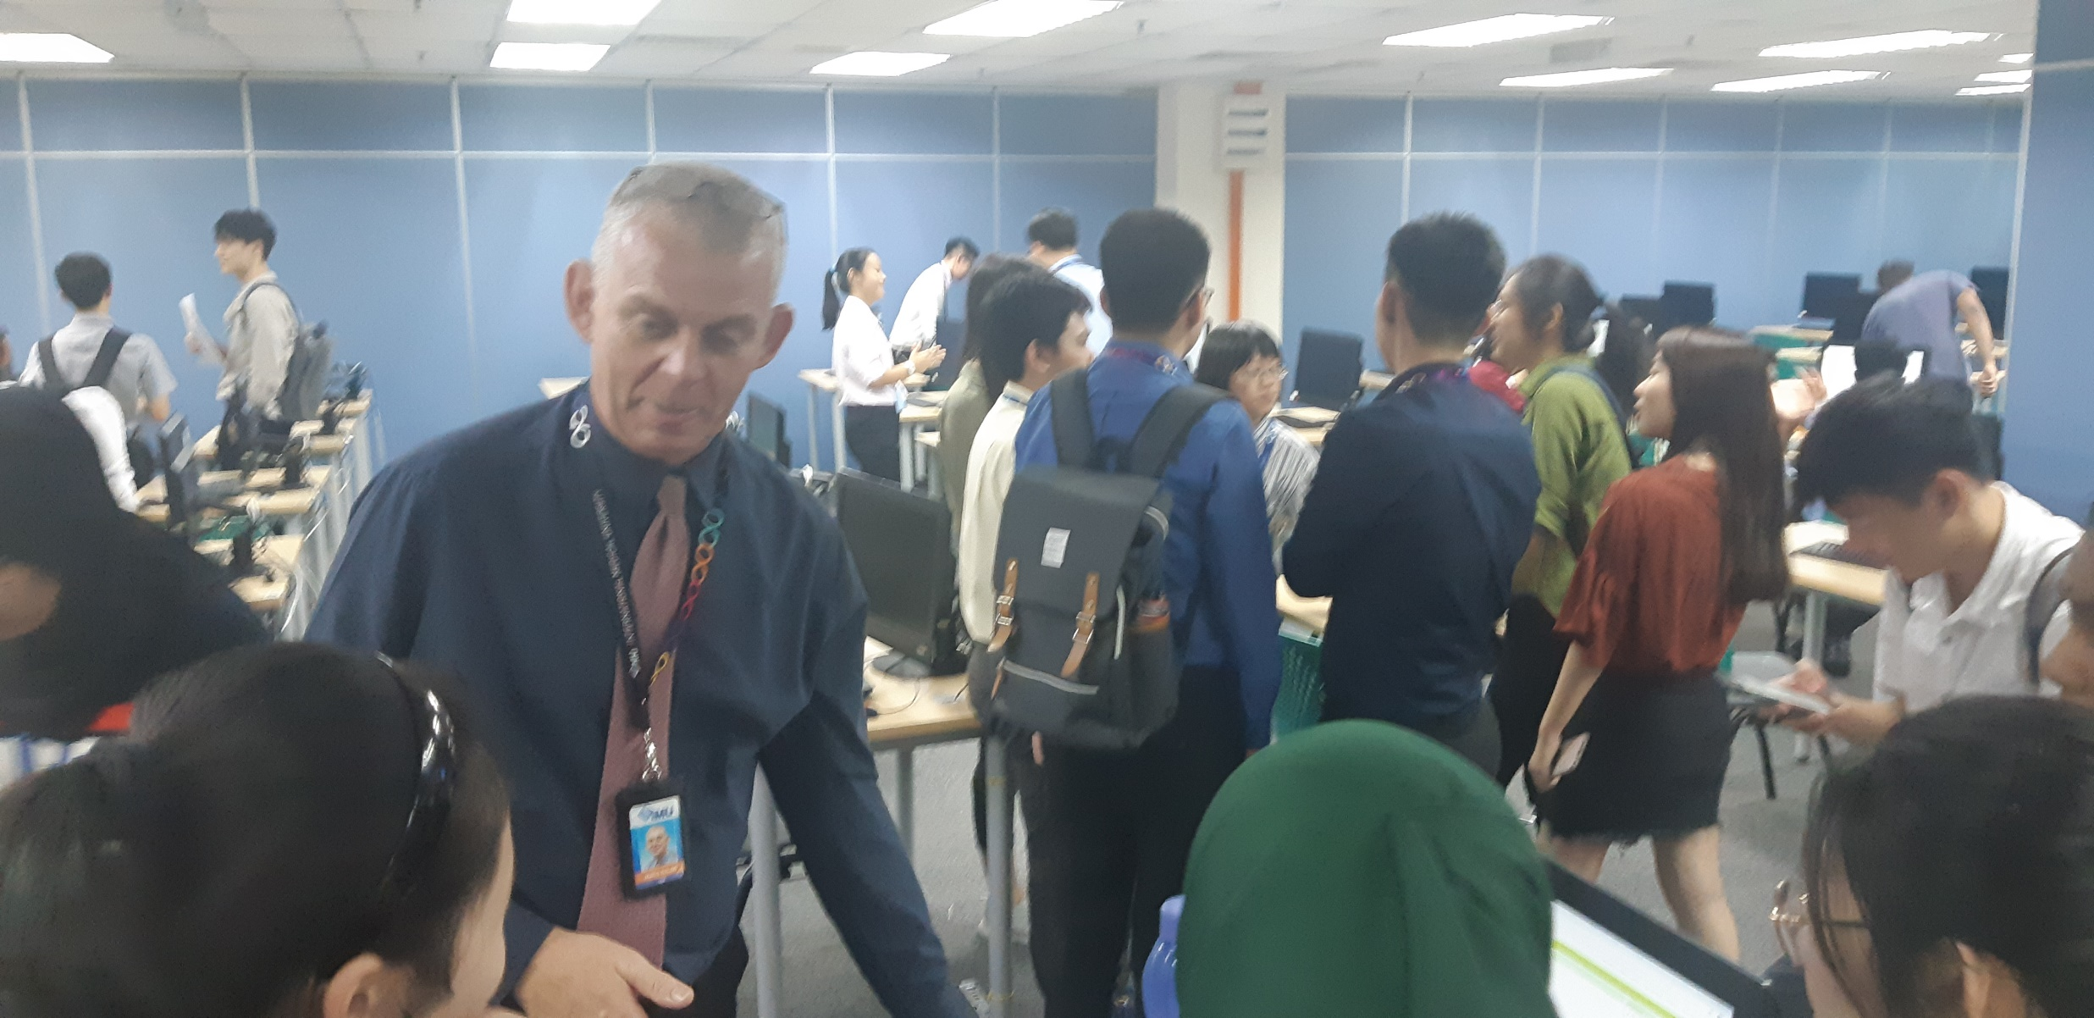
Group Project
Notes:
Pictures

Slide 8
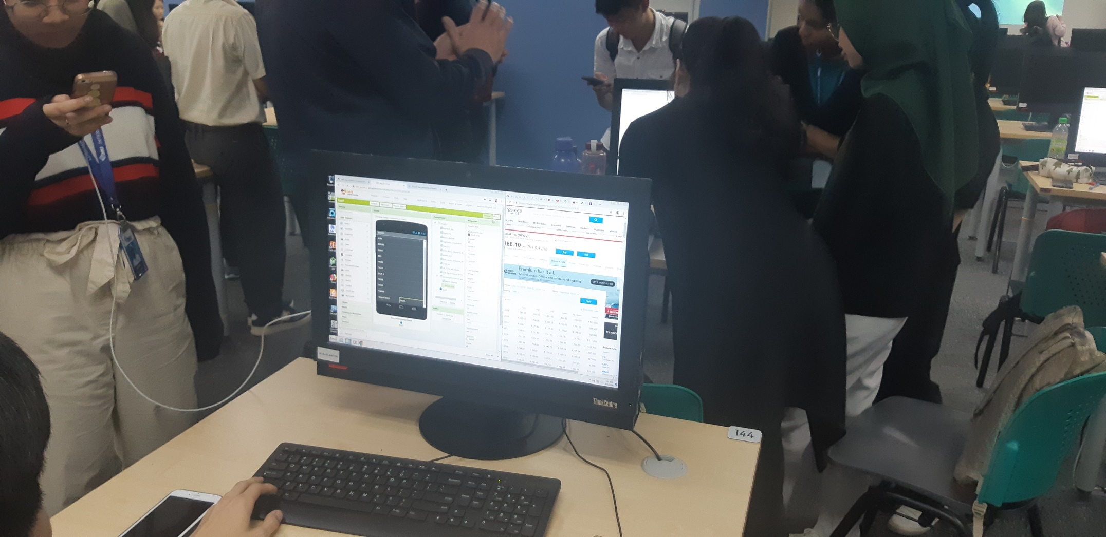
Group Project
Notes:
Pictures

Slide 9
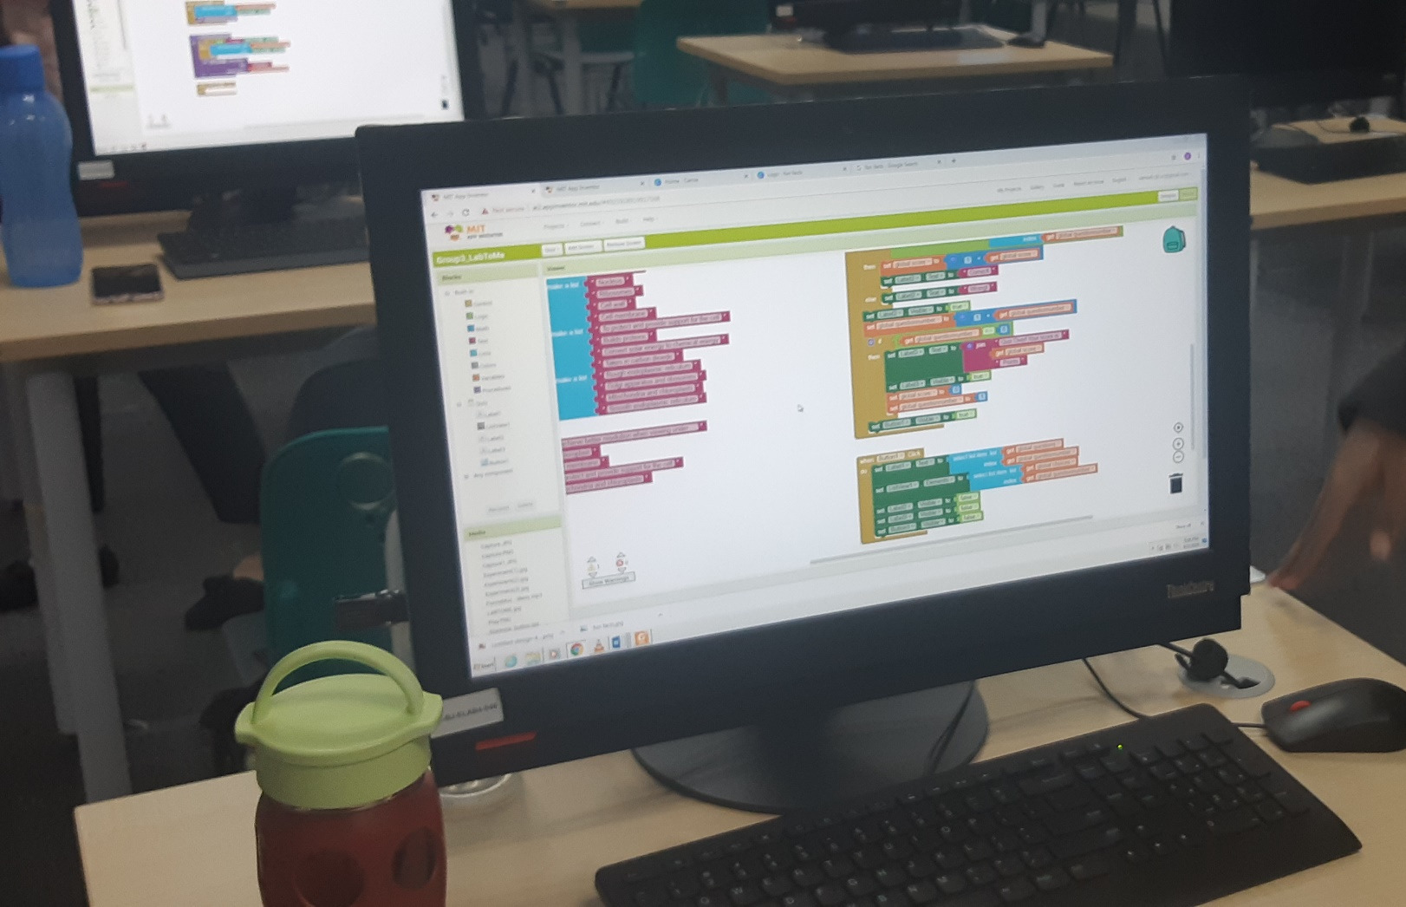
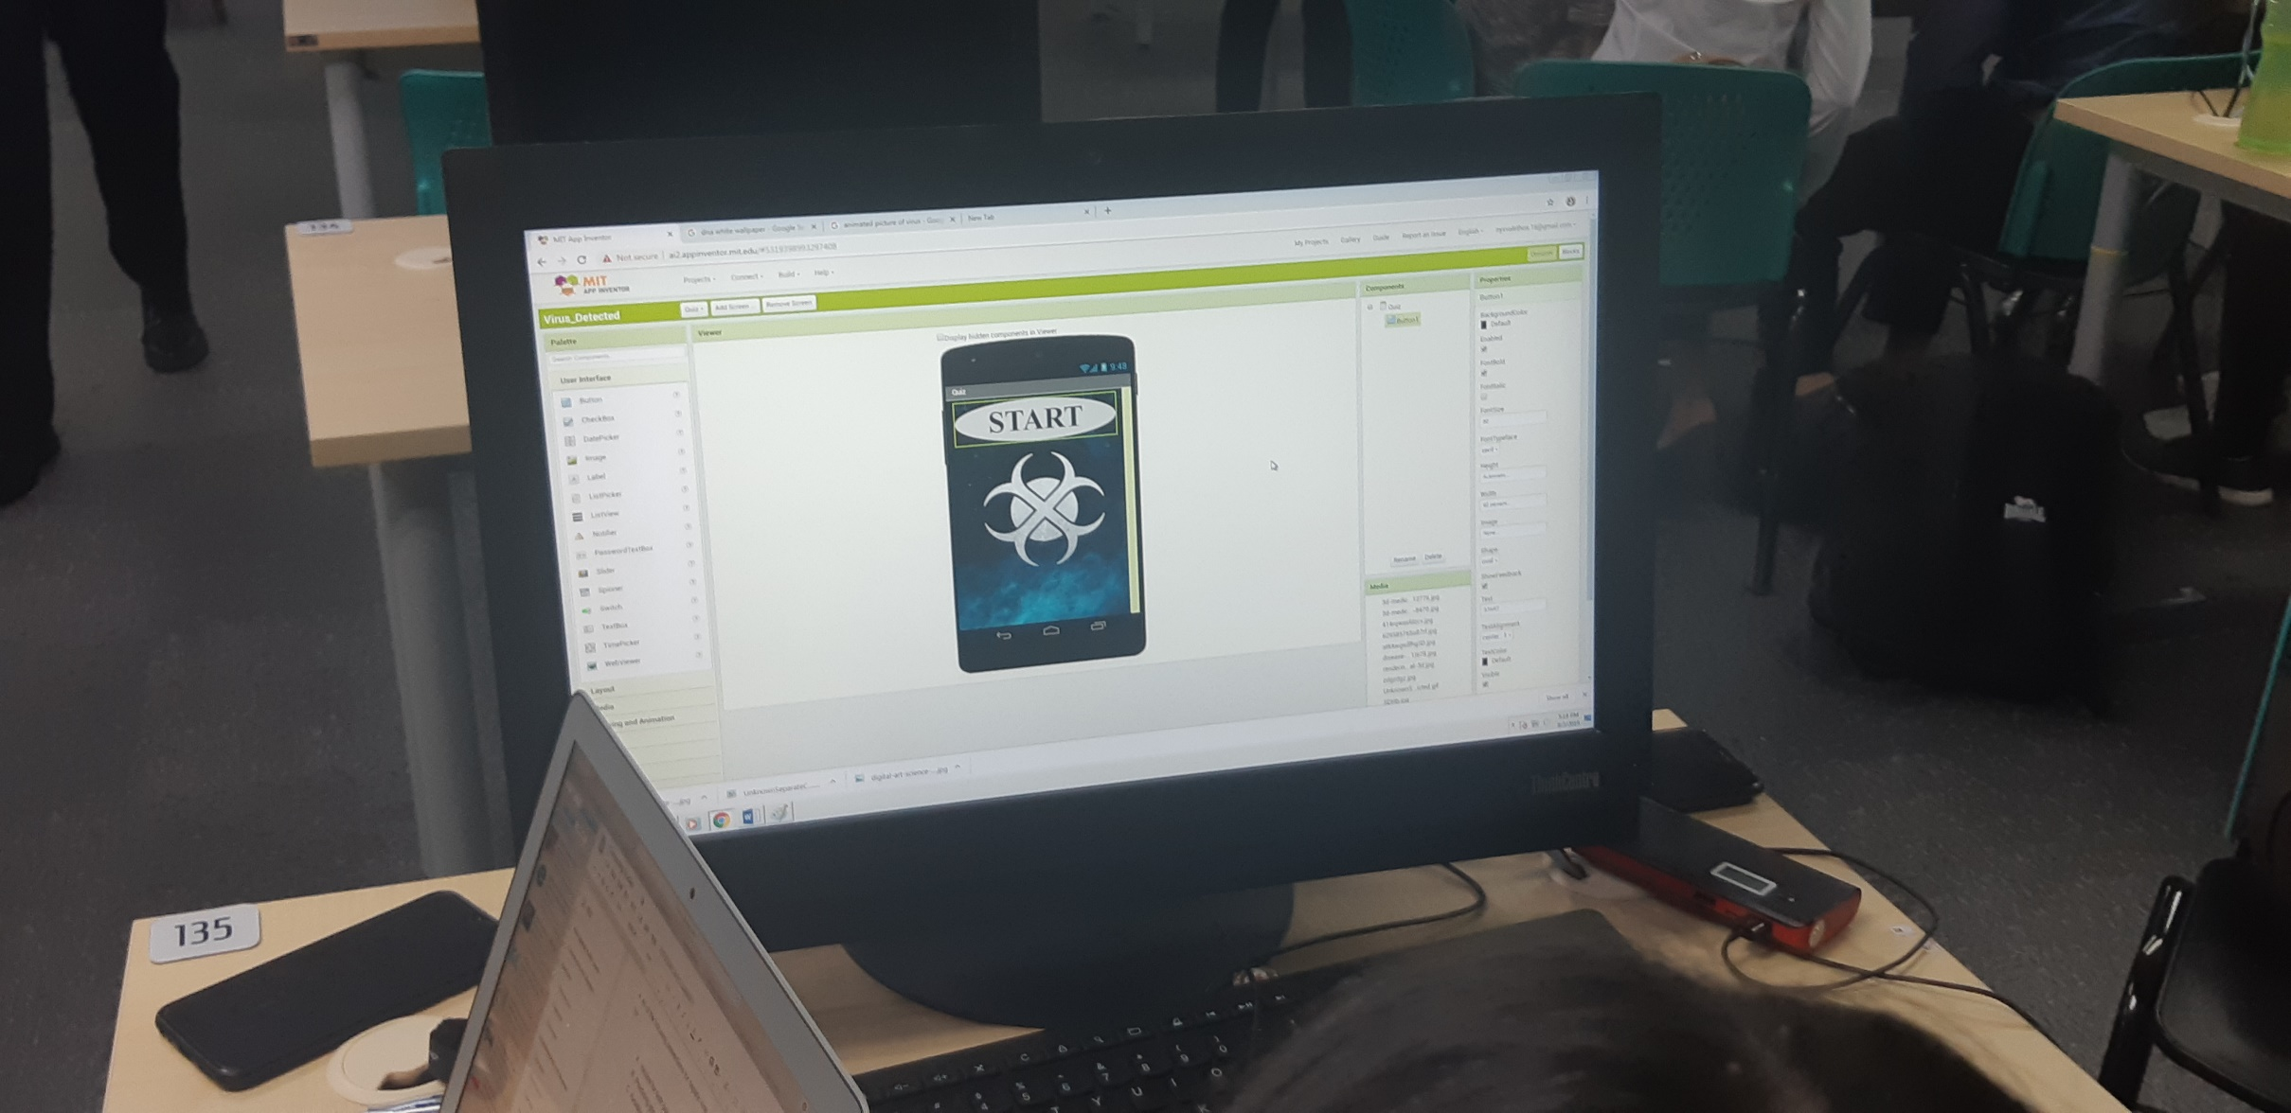
Group Project
Notes:
Pictures

Slide 10
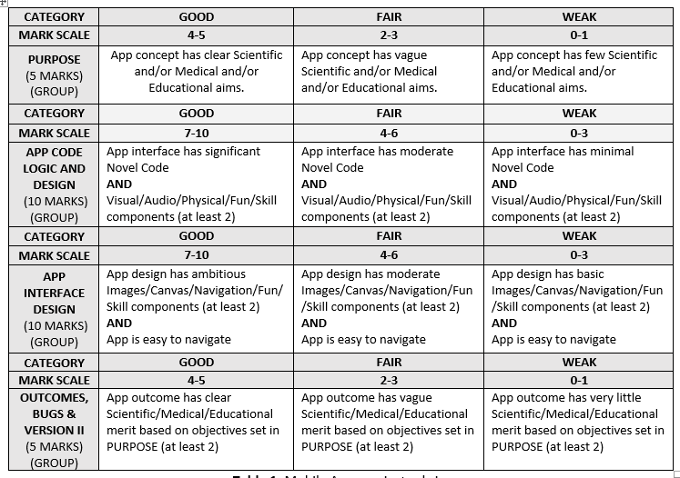

Slide 11
Evaluation comments

Slide 12
Evaluation comments -II

Slide 13
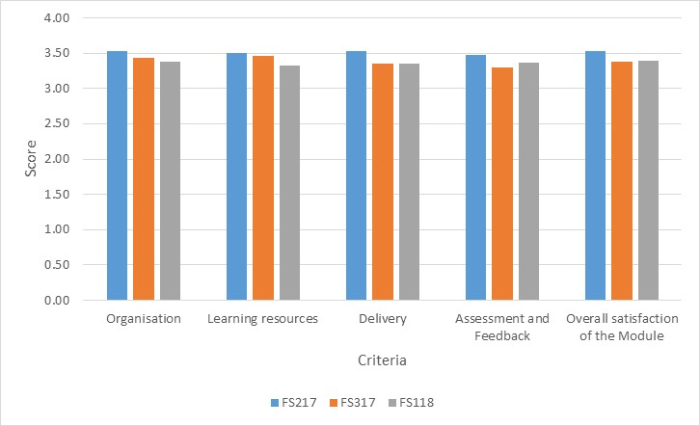
Evaluation scores three(3) FiS cohorts.

Slide 14

Q&A

Slide 15

Hasnain Zafar Baloch
E-Learning Manager
E-mail : hasnainzafar@gmail.com
Blog : https://hasnainzafar.wordpress.com/
Slides : http://www.slideshare.net/hasnainzafar
Twitter: http://twitter.com/hbaloch
IMU : http://imu.edu.my
DID : +603-2731 7171
Ext. : 3125

Slide 16

Thank you

