Slide 1
aaou 2019 awards ceremony

Slide 2
aaou 2019 young innovator award

Slide 3
Chair: prof. tsuneo yamada The open university of japan members: Dr. Daryono Daryono Universitas Terbuka Dr. Ria Mae Borromeo UNIVERSITY OF THE PHILIPPINES OPEN UNIVERSITY
YOUNG INNOVATOR AWARD
Adjudication committee

Slide 4
“Golden: Geospatial Model for Distance Education”
YOUNG INNOVATOR AWARD
silver medalist
Kamran Mir
Allama Iqbal Open University

Slide 5
aaou 2019 young innovator awardEE!
Congratulations

Slide 6
aaou 2019 BEST PRACTICE award

Slide 7
Chair: Dr. Jean Saludadez UNIVERSITY OF THE PHILIPPINES OPEN UNIVERSITY members: DR. Andy Liew Teik Koii WAWASAN OPEN UNIVERSITY Dr. Kunchon Jeotee Sukhothai Thammathirat Open University Dr. Zahid Majeed Allama Iqbal Open University
BEST PRACTICE AWARD
Adjudication committee

Slide 8
BEST PRACTICE AWARD FINALISTS

Slide 9
BEST PRACTICE AWARD
FINALISTS
“Cyber Security and Digital Forensics as a Preventive and Repressive Step to Overcome Cheating in Online Tutorials”
M JEFFRI ARLINANDES CHANDRA
PURWANINGDYAH MURTI WAHYUNI
HERRY NOVRIANDA
UNIVERSITAS TERBUKA

Slide 10
BEST PRACTICE AWARD
FINALISTS
“Computational Chemistry as Virtual Laboratory in Open and
Distance Learning”
TOMOKAZU YASUIKE
THE OPEN UNIVERSITY OF JAPAN

Slide 11
BEST PRACTICE AWARD
FINALISTS
“Development of online courses on a method of coding education for K12 teachers in Japan”
TATSUMI TAKEO
THE OPEN UNIVERSITY OF JAPAN

Slide 12
BEST PRACTICE AWARD
FINALISTS
“Research on the Application of Data Visualization and Analysis Technology in Online Education”
WEI FANGFANG & WEI SHUNPING
THE OPEN UNIVERSITY OF CHINA

Slide 13
BEST PRACTICE AWARD
FINALISTS
“Transforming Online Teaching & Learning in ODL Environment through Application of Artificial
Intelligence (AI)”
NANTHA KUMAR SUBRAMANIAM
OPEN UNIVERSITY OF MALAYSIA

Slide 14
BEST PRACTICE AWARD
FINALISTS
“Recruitment and Retention Practices of Hanoi Open University”
NGUYEN THI THUY HONG
HANOI OPEN UNIVERSITY

Slide 15
aaou 2019 BEST PRACTICE AWARD FINALISTS!
Congratulations

Slide 16
“Cyber Security and Digital Forensics as a Preventive and Repressive Step to Overcome Cheating in Online Tutorial”
BEST PRACTICE AWARD
silver medalist
M JEFFRI ARLINANDES CHANDRA,
PURWANINGDYAH MURTI WAHYUNI &
HERRY NOVRIANDA
UniversitAS TERBUKA

Slide 17
“Computational Chemistry as Virtual Laboratory in Open and Distance Learning”
BEST PRACTICE AWARD
silver medalist
TOMOKAZU YASUIKE
THE OPEN University OF JAPAN

Slide 18
aaou 2019 BEST PRACTICE AWARD SILVER MEDALISTS!
Congratulations

Slide 19
“Transforming Online Teaching & Learning in ODL Environment through Application of Artificial Intelligence (AI)”
BEST PRACTICE AWARD
GOLD medalist
NANTHA KUMAR SUBRAMANIAM
OPEN UNIVERSITY OF MALAYSIA

Slide 20
aaou 2019 BEST PRACTICE AWARD GOLD MEDALIST!
Congratulations!

Slide 21
aaou 2019 BEST PAPER award

Slide 22
Chair: Dr. Grace Javier Alfonso UNIVERSITY OF THE PHILIPPINES OPEN UNIVERSITY members: Dr. Li Kam-Cheong THE OPEN UNIVERSITY OF HONGKONG Dr. Alexander G. Flor UNIVERSITY OF THE PHILIPPINES OPEN UNIVERSITY Dr. Samuel Anbahan Ariadurai THE Open University OF SRI LANLA Dr. MELINDA F. LUMANTA UNIVERSITY OF THE PHILIPPINES OPEN UNIVERSITY
BEST PAPER AWARD
Adjudication committee

Slide 23
BEST PAPER
AWARD FINALISTS

Slide 24
BEST PAPER AWARD
FINALISTS
“Learning Material Development at Universitas Terbuka: Quality and Management Perspectives”
LIDWINA SRI ARDIASIH
LUDIVICA ENDANG SETIJORINI
TENGKU LUFIANA
UNIVERSITAS TERBUKA

Slide 25
BEST PAPER AWARD
FINALISTS
“The Perception and Expectation Quality Website Services of
Open University”
M. ARIFIN ZAIDIN
UNIVERSITAS TERBUKA

Slide 26
BEST PAPER AWARD
FINALISTS
“Perception Of Distance Learners On The Use Of Nanolearning Videos As An Educational Tool”
MICHELLE LOH WOON HAR
PHALACHANDRA BHANDIGADI
JASMINE SELVARANI EMMANUEL
WAWASAN OPEN UNIVERSITY

Slide 27
BEST PAPER AWARD
FINALISTS
“Issues and Challenges faced by Online Higher Education Teachers”
DARAKHSHAN MUSLIM
MUNAWAR SULTANA MIRZA
VIRTUAL UNIVERSITY OF PAKISTAN

Slide 28
BEST PAPER AWARD
FINALISTS
“Research Supervision in Distance Learning: Issues and Challenges”
MUHAMMAD ZAHEER
SABA MUNIR
VIRTUAL UNIVERSITY OF PAKISTAN

Slide 29
BEST PAPER AWARD
FINALISTS
“A Comparative Study of Knowledge and Use of Blooms’ Digital Taxonomy by Teachers and Students in Virtual and Conventional University”
HINA AMIN
MUNAWAR SULTANA MIRZA
VIRTUAL UNIVERSITY OF PAKISTAN

Slide 30
aaou 2019 BEST PAPER AWARD FINALISTS!
Congratulations

Slide 31
BEST PAPER AWARD
silver medalist
MUHAMMAD ZAHEER & SABA MUNIR
VIRTUAL UNIVERSITY OF PAKISTAN
“Research Supervision in Distance Learning: Issues and Challenges”

Slide 32
BEST PAPER AWARD
silver medalist
DARAKHSHAN MUSLIM & MUNAWAR SULTANA MIRZA
VIRTUAL UNIVERSITY OF PAKISTAN
“Issues and Challenges Faced by Online Higher Education Teachers”

Slide 33
aaou 2019 BEST PAPER AWARD SILVER MEDALISTS!
Congratulations

Slide 34
“A Comparative Study of Knowledge and Use of Blooms’ Digital Taxonomy by Teachers and Students in Virtual and Conventional University”
BEST PAPER AWARD
GOLD medalist
HINA AMIN & MUNAWAR SULTANA MIRZA
VIRTUAL University OF PAKISTAN

Slide 35
aaou 2019 BEST PAPER AWARD GOLD MEDALIST!
Congratulations

Slide 36
aaou 2019 MERITORIOUS SERVICE award

Slide 37
Chair: Prof. Asha Kanwar President & CEO, Commonwealth of Learning members: Prof. Tian Belawati Universitas Terbuka Dr. NAVEED MALIK THE VIRTUAL UNIVERSITY OF PAKISTAN Dr. GRACE ALFONSO THE UNIVERSITY OF THE PHILIPPINES OPEN UNIVERSITY
MERITORIOUS SERVICE AWARD Adjudication committee

Slide 38
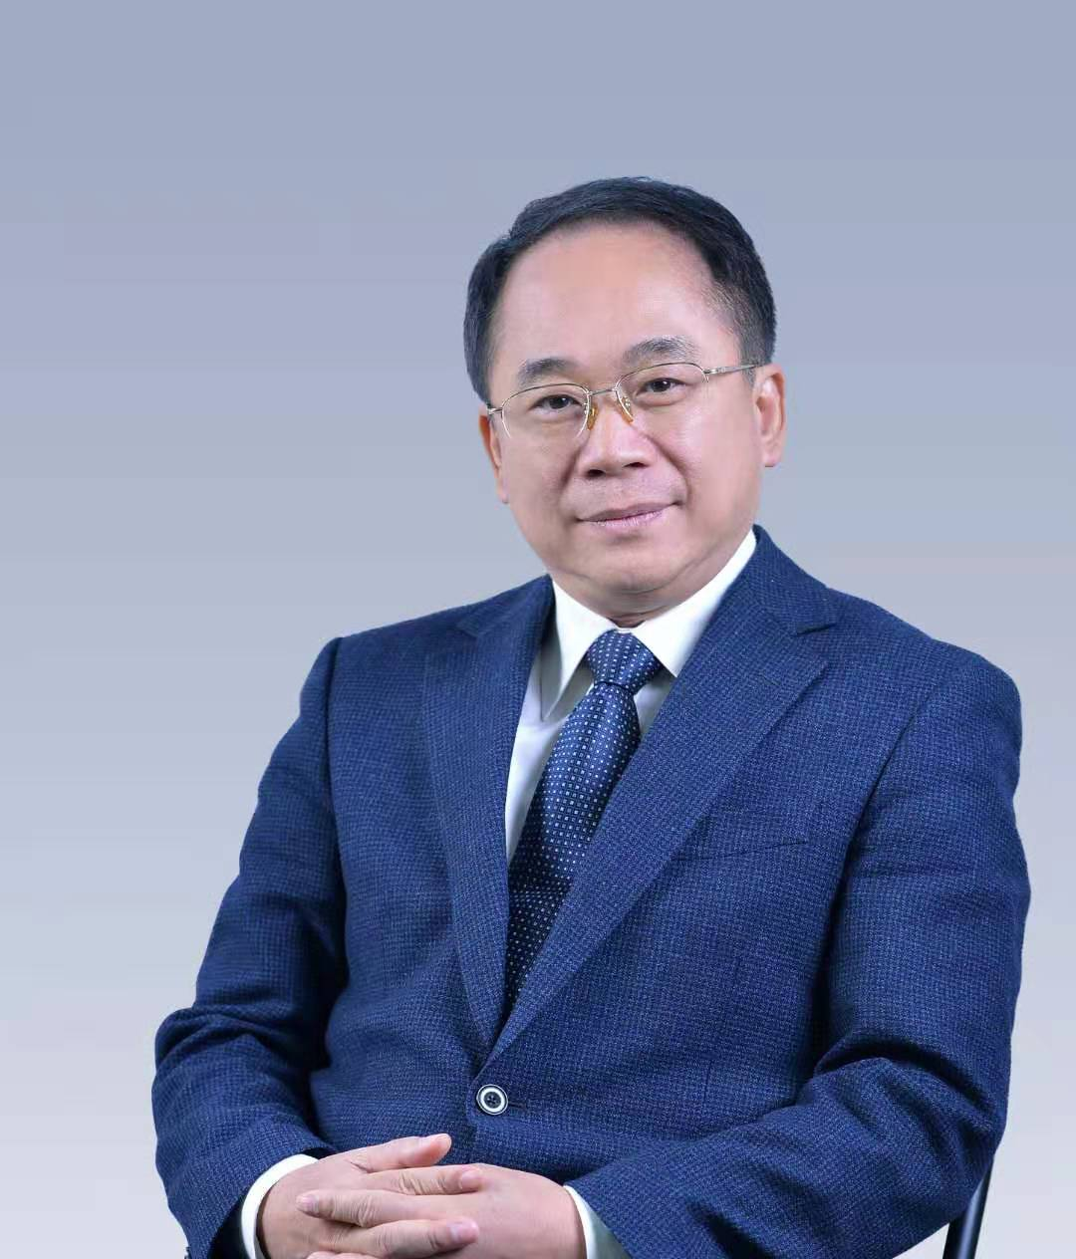
2019 AAOU MERITORIOUS
SERVICE AWARD
DR. YANG ZHIJIAN
FORMER PRESIDENT
THE OPEN University OF CHINA

Slide 39
2019 MERITORIOUS SERVICE AWARDEE DR. YANG ZHIJIAN!
Congratulations

Slide 40
Congratulations TO ALL AAOU 2019 AWARDEES!

Slide 41
aaou 2019 awards ceremony

