Slide 1
Relationship between Level of Interaction and Students’ Satisfaction in Online Learning: A Case of Virtual University of Pakistan
Saleha Ali
Tutor/Instructor (Education)
Dr. Munawar Sultana Mirza
Advisor, Department of Education
Virtual University of Pakistan

Slide 2
Introduction
Distance education, however, is a broad term, which is defined as a learning which is formal and happens when teacher and learner are geographically separated (Verduin & Clark, 1991).
This separation makes hindrances to correspondence (Sorensen & Baylen, 1999) as a number of non-verbal signs are missing (Sutton, 2001).

Slide 3
Cont..
Moore (1973) has introduced the theory of independent study which serves as a key foundation for distance/online learning.
“Effective teaching and learning at a distance depends upon the nature of an interaction and how interaction is facilitated through a technological medium (Moore & Kearsley, 2005)”.

Slide 4
Cont..
Level of interaction was measured according to the Moore’s types of interaction.
He noted three types of interactions:
Interaction between instructor and learner,
Interaction between learners, and
Interaction of learners with content.

Slide 5
Objectives of the study
Investigate students’ level of interaction with the teacher and among learners in online learning environment.
Explore the level of students’ satisfaction with online learning.
To find out correlation between the level of interaction and students’ satisfaction in online learning.

Slide 6
Research Questions
What is the level of interaction of learners with the instructors?
What is the level of interaction among learners?
What is the level of learners’ interaction with the content?
What is the students’ level of satisfaction with online learning?
What is the relationship between the levels of interaction and students’ satisfaction in online learning?

Slide 7
Literature Review
Joyner, Fuller, Holzweiss, Henderson and Young (2014) argues student-instructor interactions are very important in both conventional and e-learning settings.
Nir-Gal (2002) says online education involves a high level of interaction between tutor and a student.
Grandzol and Grandzol (2010) have suggested additional interaction in e-learning results in enlarged students’ satisfaction and improved learning outcomes.

Slide 8
Cont..
Sher (2009) found that learner-tutor and student-student interactions are notable contributors of learning and satisfaction.
Swan et al. (2000) found that within a class, interaction among students is very important. There should be activities in the class, this will result in increased level of learner satisfaction.
Hollenbeck, Mason, and Song (2011) investigated that respondents agree that they rely on learner to learner interaction because it reduced the perceived threat of poor performance.

Slide 9
Cont..
Payne and Hamzaee (2011) provide evidence that students’ satisfaction of course effectiveness can be influenced greatly by quality of assignments and reading, discussions and effectiveness of instructors.
Learner to content interaction was found as a strong predictor of students’ satisfaction in e-learning (Kuo 2013; Chejlyk, 2006).
A course which fails to meet learner’s desires and needs can exhibit low level of learner participation (Hall, 2001).

Slide 10
Cont..
Biner, Dean and Mellinger (1994) in the success of distance learning courses, students’ satisfaction plays a very important role.
Bolliger (2004) indicated that students’ satisfaction in on-line courses is influenced by three variables i.e. teacher variables, technical problems, and interactivity.
Croxton (2014) says interactivity is a vital element of students’ satisfaction for distance learners.

Slide 11
Cont..
Grandzol and Grandzol (2010) learner to learner interaction was significantly, correlated with completion of the course.
student to student interaction was correlated significantly with satisfaction (Arbaugh and Rau 2007).
Gunawardena, (2010), in a survey found that student-student interaction was correlated negatively with satisfaction.

Slide 12
Methodology of the Study
Research Approach: Quantitative
Instrument: Questionnaire
Population of the Study: 1049 students studying in Department of Education in various bachelors and master degree programs.

Slide 13
Cont..
Sampling technique and size: 731 students were using simple random sampling technique
Data Collection: Online survey link
Response rate: 85%

Slide 14
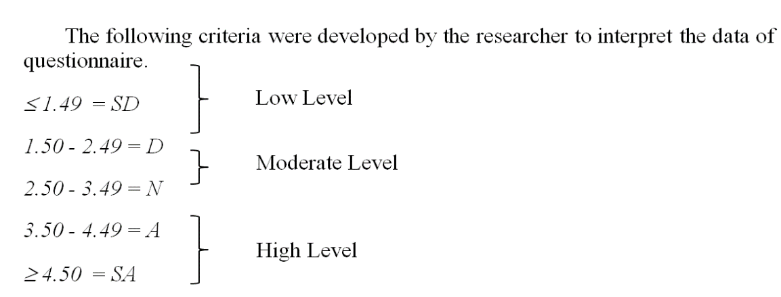
Data Analysis
Data were analyzed by using SPSS
The scale of the responses for students’ level of interaction and satisfaction ranged from “Strongly Disagree = 1” to “Strongly Agree =5”.

Slide 15
Cont..
Table 1 Level of interaction for learner-instructor interaction, learner-learner interaction, learner-content interaction.
Factor | N | Mean | S.D
learner-instructor interaction | 622 | 3.74 | 0.72
learner-learner interaction | 622 | 3.42 | 0.64
learner-content interaction | 622 | 3.79 | 0.61
Mean of Means | 622 | 3.65 | 0.57

Slide 16
Cont..
Table 5 Students’ level of satisfaction in online learning environment.
Factor | N | Mean | S.D
Students’ Satisfaction | 622 | 3.96 | 0.74

Slide 17
Cont..
Research Objective 3: Find out the relationship between students’ level of interaction and students’ satisfaction in online learning.
To find out the relationship, the guidelines given by Evans (1996) were adopted in the study. Evans’s guidelines were as follows:
.00 – 0.19 = Very weak
0.20 – 0.39 = Weak
0.40 – 0.59 = Moderate
0.60 – 0.79 = Strong
0.80 – 1.0 = Very Strong

Slide 18
Cont..
 |  | 1 | Satisfaction
Interaction | Pearson Correlation | -
 | Sig. (2-tailed)
 | N
Satisfaction | Pearson Correlation |  | .636*
 | Sig. (2-tailed) |  | .000
 | N | 622
**. Correlation is significant at the 0.05 level (2-tailed).

Slide 19
Results
learners experience higher level of interaction with instructors and course content but shows moderate level of interaction with other learners.
Furthermore, results of the study shows higher level of satisfaction among students studying in online learning environments.
There is significant positive relationship, between students’ level of interaction and students’ satisfaction for online learning. The strength of relationship between variables was strong.

Slide 20
Discussion
Research Question 1
What is the level of interaction of learners with the instructors?
Finding
There is a higher level of interaction between the learners and the tutors
Discussion
Joyner, Fuller, Holzweiss, Henderson and Young (2014)
Nir-Gal (2002)
Grandzol and Grandzol (2010)

Slide 21
Cont..
Research Question 2
What is the level of interaction between learners?
Finding
The present study showed moderate level of interaction between the learners.
Discussion
Swan et al. (2000)
Hollenbeck, Mason, and Song (2011)
Sher (2009)

Slide 22
Cont..
Research Question 3
What is the level of learners’ interaction with the content?
Finding
There is a higher level of interaction between the learners and the content.
Discussion
Payne and Hamzaee (2011)
Kuo 2013; Chejlyk, (2006)
Hall (2001)

Slide 23
Cont..
Research Question 4
What is the students’ level of satisfaction for online learning?
Finding
Participants showed higher level of satisfaction
Discussion
Biner, Dean and Mellinger (1994)
Bolliger (2004)
Croxton (2014)

Slide 24
Cont..
Research Question 5
What is the relationship between students’ level of satisfaction and interaction in online learning?
Finding
There is significant positive relationship, between students’ level of interaction and students’ satisfaction for online learning
Discussion
Grandzol and Grandzol (2010);
Arbaugh and Rau (2007).
Gunawardena, (2010)

Slide 25
Recommendations and Future Research
Institutes providing online education to students should be promoted because students studying in such online courses are highly satisfied with the studies.
Use of more software to interact with the students and instructor can be introduced.
Due to shortage of time, only one department of Virtual University of Pakistan was considered in this research. Future researches can consider other departments also.

Slide 26
Thank You

