Slide 1
EVALUATION OF UT’S ACADEMIC SERVICE SCHEMES
Enang Rusyana, Dina Thaib, Sugilar, Argadatta Sigit
Indonesia

Slide 2
Introduction
UNIVERSITAS TERBUKA INDONESIA
40 Region Centres, 292.465 students, 1.7 million alumni
Notes:
© Copyright PresentationGo.com – The free PowerPoint library

Slide 3
Introduction
UT Students in number
Age Group | ∑ | %
< 25 | 13.527 | 38,82
25-29 | 56.294 | 19,25
30-34 | 47.799 | 16.34
35-39 | 35,257 | 12,06
40-44 | 18.567 | 6,35
>44 | 21.021 | 7,19
Total | 292.465 | 100
Occupation | ∑ | %
Teacher | 162.670 | 55,62
Army/Police | 8.629 | 2,95
Gov. Employ. | 19.643 | 6,72
Private Emp. | 42.625 | 2,86
Entrepreneur | 8.353 | 2,86
Work with no desciption | 24.947 | 8,53
Do not Work | 25.598 | 8,75
Total | 292.465 | 100
Island | ∑ | %
Sumatera | 88.779 | 30,36
Jawa | 116.668 | 39,89
Kalimantan | 34.082 | 11,65
Bali | 5.192 | 1,78
Nusa Tengg | 14.647 | 5,01
Sulawesi | 21.441 | 7,33
Maluku | 3.779 | 1,29
Papua | 5.769 | 1.97
Abroad | 2.108 | 0,72
Total | 292.465 | 100
Sex | ∑ | %
Female | 196.556 | 67,21
Male | 95.909 | 32,79
Total | 292.465 | 100
Notes:
© Copyright PresentationGo.com – The free PowerPoint library

Slide 4
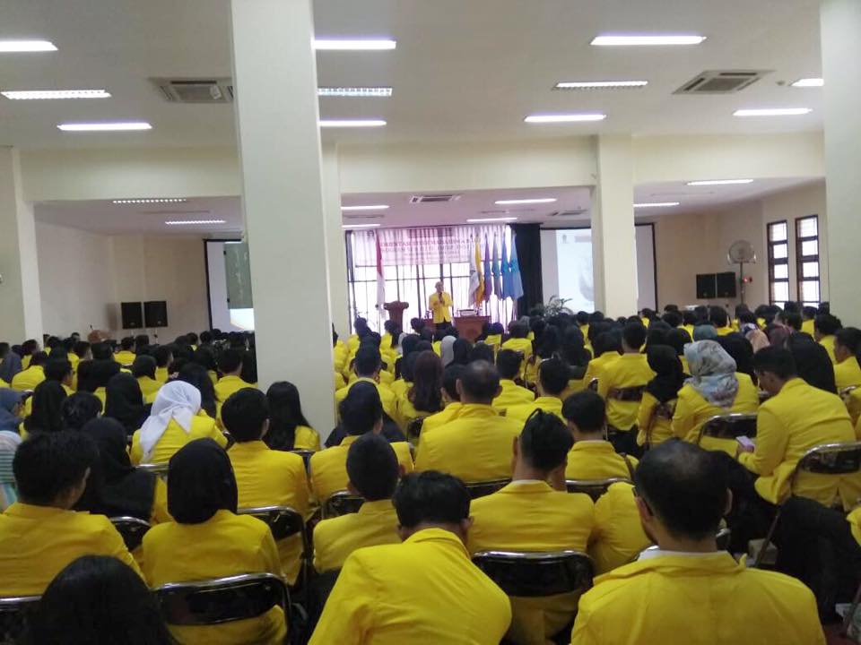
Introduction
Student expectations:
well served
graduated on time
good grade
Notes:
© Copyright PresentationGo.com – The free PowerPoint library

Slide 5
Introduction
UT provide 6 academic services schemes to fulfil the students expectation:
Academic services:
SPS Plus
Full SPS
SPS Semi
2.834
(2,22%)
SPS Non
FtF Tutorial
NonSPS
52
(0,04%)
7.138
(5.59%)
SPS Online
101.341
(79.37%)
16.322
(12,78%)
0
Notes:
© Copyright PresentationGo.com – The free PowerPoint library

Slide 6
Introduction
UT provides 6 academic service schemes to be selected:
1) SPS Plus (subject matter packages, printed learning material,
face to face tutorial, personal development training)
2) Full SPS (subject matter packages, printed learning material,
face to face tutorial)
3) SPS Semi (subject matter packages, printed learning material,
face to face tutorial in some subject matters)
4) SPS Non face to face tutoring (subject matterial packages,
printed learning material)
5) SPS Online (subject matter packages, digital learning material,
online tutoring)
6) Non SPS (no subject matter packages, no printed learning
material, no face to face tutorial)
Notes:
© Copyright PresentationGo.com – The free PowerPoint library

Slide 7
Question
The question:
Does the UT’s academic service schemes meet the student expectations?
There has been no research about these service before.
Notes:
© Copyright PresentationGo.com – The free PowerPoint library

Slide 8
Literature Review
AEIOU's approach to program evaluation, especially programs in distance education, was proposed by Fortune & Keith in 1992 and modified by Simonson in 2005. The components evaluated in this approach are (1) accountability, (2) effectiveness, (3 ) impact, (4) organizational context, and (5) unanticipated consequences. The AEIOU approach has proven effective for evaluating multi-year activities nationally at the Iowa Distance Education Alliance Star School Project. In addition, this approach has also been used by Simonson (2005) to evaluate major distance education initiatives in South Dakota, USA. From the several research approaches proposed above, the research uses the AEIOU approach because this approach accommodates formative and summative information needs, qualitative or quantitative.
Notes:
© Copyright PresentationGo.com – The free PowerPoint library

Slide 9
Methodology
Kind of rsch : Evaluative research by using
AEIOU Approach (Accountability,
Effectiveness, Impact,
Organizational context,
Unanticipated outcomes).Fortune & Keith, 1992 – Simmonson 2005
Place : 12 UT’s Regional Offices
Data : 2015 – 2019 academic year
Sample : 127.687 students/alumni
Instrument : quetionnaire and GPA data
(downloaded from UT’s Computer
Centre)
Data analysis: Data were analyzed using
quantitative analysis
Notes:
© Copyright PresentationGo.com – The free PowerPoint library

Slide 10
Result and Discussion
WHY THE SAME RESULT?
Result
SPS Plus: 3.19
SPS Full: 3.18
SPS Semi: 2.56
The Students GPA
Whereas, the students with SPS Semi attended face to face tutorial, while the students with SPS No FtF Tutorial were not.
SPS no Tutoring: 2.70
SPS Online: -
Non-SPS: 2.55
WHY THE SPS NO TUT BETTER THAN SPS SEMI?
Notes:
© Copyright PresentationGo.com – The free PowerPoint library

Slide 11
Result and Discussion
Component | SPS Plus (Scholar-ship Stdn) | Full SPS (Scholars-hip Stdn) | Semi SPS | SPS Non FtF Tutorial | SPS Online | Non-SPS
Printed Learning Material included | V | V | V | V | - | -
Face to Face Tutorial included | V | V | V/- | - | - | -
Personal development Training included | V | - | - | - | - | -
Gathering and interacting instensively | V | V | V/- | - | - | -
A
E
I O
U
?
Spirit of competition | V | V | V/- | - | - | -
GPA | 3.19 | 3.18 | 2.56 | 2.70 | 0.00 | 2.55
There is something do not work properly
Notes:
© Copyright PresentationGo.com – The free PowerPoint library

Slide 12
Discussion
The students in SPS Semi have good grade in some subject matters with face to face tutorial, but not good grade in subject matters with no face to face tutorial. UT has to improve it’s students skills learning, or UT suggest them to take face to face tutorial for all subject matters.
SPS’s students with no face to face tutorial have good grade, because of their good skills learning.
The students do not interested in SPS Online yet because of this service still newly offered or students do not too familiar with this kind of service.
Since Non SPS’s students have less good grade, UT has to remind students of time to: 1) registrating, 2) buying book (printed learning material), 3) involving online tutorial, 4) adopting the subject matter packages, etc.
Notes:
© Copyright PresentationGo.com – The free PowerPoint library

Slide 13
CONCLUSION
Based on the graduates' academic achievements, up to now the UT SPS Plus and SPS Full academic service schemes can be categorized as the best academic service scheme suitable for students. While other academic service schemes cannot yet be categorized as appropriate service schemes. However, considering that the study of UT's academic service schemes has not been done comprehensively including accountability, effectiveness, impact, organizational context, and unanticipated consequences, researchers have not been able to provide recommendations to UT.
Notes:
© Copyright PresentationGo.com – The free PowerPoint library

Slide 14
THANK YOU
Notes:
© Copyright PresentationGo.com – The free PowerPoint library

