Slide 1
Development and Validation of Media and Information Literacy Scale For Students in Blended Learning Programmes
Tooba Saleem
Nasir Mahmood
Allama Iqbal Open University, Pakistan.
October 15, 2019

Slide 2
Introduction
Media and Information Literacy is the composite of the ability to search, collect and process (create, organize, distinguish relevant from irrelevant, subjective from objective, real from virtual) electronic information, data and concepts and to use them in a systematic way. Applying a fundamental understanding of the ethical/legal issues surrounding the access and use of information though ICTs (National Research Council, 2010).
According to UNECO’s definition of media and information literacy (MIL) “set of competencies that empowers citizens to access, retrieve ,understand, evaluate and use to create as well as share information and media contents, in all formats using various tools, in a critical, ethical and effective way, in order to participate and engage in personal, professional and societal activities” (UNESCO, 2013).

Slide 3
Cont…
With the explosion of digital technologies, the awareness about media is acquiring crucial importance. Media and information literacy are the prevailing concepts that focus on a critical approach towards media messages. Media consumption is changing through user generated communication and the availability of digital products (European Commission, 2007).
In the developed world, media literacy is a well-researched concept and part of mainstream academic discourse. In Pakistan, however, the concept still seems pre mature. Though the electronic media landscape in the country has expanded and from one state-run television channel to more than eighty Pakistani satellite channels, including more than thirty-five news and current affairs channels are operating accessible at the moment (Alam, 2012).

Slide 4
Aim of the Study…
In this context our research attempts to:
develop and validate the Media and Information Literacy Scale(MILS) for Students in the Blended Learning Programmes

Slide 5
Construct Definition | Sub-Constructs
Media Literacy and Information Literacy Ability to search, collect and process (create, organize, distinguish relevant from irrelevant, subjective from objective, real from virtual) electronic information, data and concepts and to use them in a systematic way. Apply a fundamental understanding of the ethical/legal issues surrounding the access and use of information though ICTs. | 1.Ability to obtain information through ICT
 | 2.Ability to critically evaluate information and media contents
 | 3.Ethical Use of ICTs
Conceptual Framework
Media and Information Literacy Scale

Slide 6
Methodology
Research Design
Survey method was used to conduct the research. A total of 209 university students were taken as sample of the study. At the core of 21st century skills UNESCO’s framework (2013) was used for framing this research study.

Slide 7
Sample of the Study
We used stratified sampling technique to select the (N=209) undergraduate and postgraduate level students from Allama Iqbal Open University, Islamabad.
Table 1
Demographic Characteristics of Respondents (supervisees) Included in Sample
Sr. | Demographic characteristics | (N) % | Number of non-responsive cases
1. 2. | Marital Status Single Married Programme Undergraduate Master MPhil | 197 (94%) 11 (5%) 141 (67%) 52 (25%) 15 (7%) | 1 (%) 1 (.5%)
3. | Age 20-25 years 26-30 years | 196 (93%) 111 (5%) | 2(1%)
4. | Gender Female Male | 86 (42%) 119 (57%) | 4 (1%)

Slide 8
Instrumentation
A self-constructed survey questionnaire was used . The reliability (r=.803) of the instrument was measured The self-constructed Media and Information Literacy Scale (MILS) consisted of fourteen (14) items to be rated on six point scale for the three aspects given below.
# | Media and Information Literacy Sub-Scale | Items (N)
1 | Ability to obtain information through ICT | 8 | 1. It is difficult to find relevant information on internet although lot of material is available.
2 | Ability to critically evaluate information and media contents | 2 | 6. I remain confused about authentic information resources on internet
3 | Ethical Use of ICTs | 4 | 13. I have a fear of plagiarism while using different available sources on internet.
 | Total Items | 14

Slide 9
Validity and Reliability of MILS
Content validity of instruments was ensured through the:
Expert opinion
* Construct Validity
Exploratory Factor Analysis (EFA)
Reliability of instruments was ensured using:
Cronbach’s alpha (α) coefficient of reliability.
r (α) = .803

Slide 10
Procedure of Study
Data were collected personally by researchers. Respondents were asked to fill questionnaire after taking their consents of willingness to participate in research. Respondents were MPhil students of different blended learning programs at Allama Iqbal Open University. Data were collected during workshops.

Slide 11
Analysis and Findings
Descriptive statistics (mean, standard deviation, skewness and kurtosis) were conducted to ensure the normality of data.
Exploratory Factor Analysis were conducted to examine the appropriateness of MILS for assessing the Media and Information Literacy for students at Allama Iqbal open University, Islamabad.

Slide 12
Descriptive Analysis
Table 3
Preliminary Analysis of Students Level of Media and Information Literacy

Slide 13
Exploratory Factor Analysis (EFA)
Preliminary Analysis
Bartlette’s Test of sphericity (Bartlette, 1954) was used to test suitability of data for factor analysis was found significant at p< .05.
Kaiser-Meyer-Olkin (KMO)
index range from 0-1 min. value which is suggested good for factor analysis (Tabachnick & Fidell, 2007).
In our case the KMO value is .806 and Bartlett’s test is significant (p = .000), therefore factor analysis is appropriate.

Slide 14
Exploratory Factor Analysis (EFA)
Principal Component Analysis (PCA) with Oblimin Rotation method yielded into three subscales with 47. 85 % explained variance and established the construct validity of the scale.
Inter-factor correlation matrix confirmed the independence of factors and strong correlation values of subscales with scale.

Slide 15
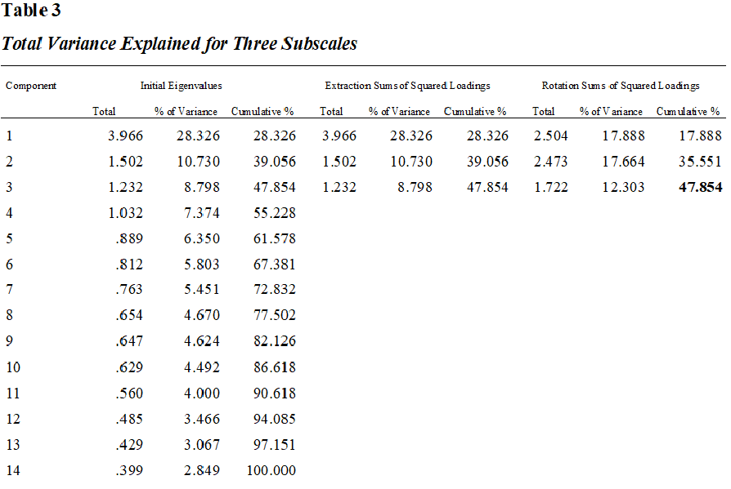
Principal Component Analysis

Slide 16
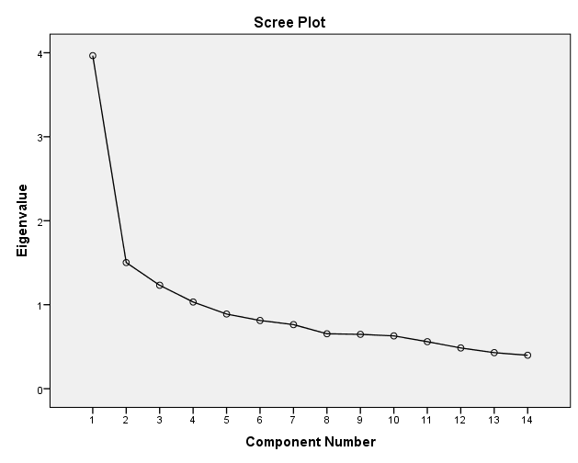
Scree Plot
Notes:
Often, using the Kaiser criterion, you will fi nd that too many components are extracted, so it is important to also look at the Screeplot. What you look for is a change (or elbow) in the shape of the plot. Only components above this point are retained.

Slide 17
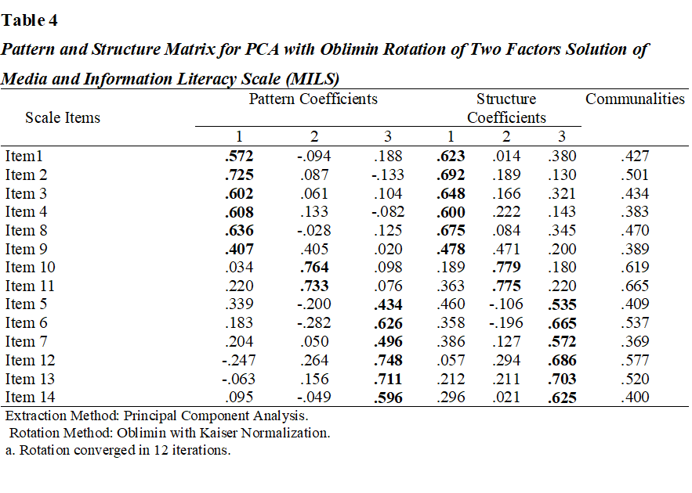
Notes:
The most commonly used oblique technique is Direct Oblimin.
Oblimin rotation provides two tables of loadings. The Pattern Matrix shows the factor loadings of each of the variables. Look for the highest loading items on each component to identify and label the component.
The Structure Matrix table, which is unique to the Oblimin output, provides information about the correlation between variables and factors.
Communalities is presented. This gives
information about how much of the variance in each item is explained. Low values (e.g. less than .3) could indicate that the item does not fi t well with the other items in
its component.

Slide 18
Inter-factor correlation matrix

Slide 19
Findings
The Kaiser- Meyer-Olkin value was .806, exceeding the recommended value of .6 (Kaiser 1970, 1974) and Bartlett’s Test of Sphericity (Bartlett 1954) reached statistical significance (p<.05) , supporting the factorability of the correlation matrix.
The correlation matrix revealed the presence of many coefficients of .3 and above.
Principal components analysis revealed the presence of 3 components with Eigen values exceeding 1
An inspection of the screeplot revealed a clear break after the third component. So it was decided to retain three components for further investigation. This was further supported by the results of

Slide 20
Cont…
The three-component solution explained a total of 47.6% of the variance, with Component 1 contributing 17.88%, Component 2 contributing 17.66% and Component 3 contributing 12.30%.
The rotated solution revealed the presence of simple structure (Thurstone 1947), with three components showing a number of strong loadings and all variables loading substantially on only one component

Slide 21
Conclusions
The findings of the study implicate the appropriateness of MILS to examine the students’ ability to search, collect and process the electronic information, data and concepts and to use them in a systematic way for blended and open learning environment.
The results of exploratory factor analysis support to use 1) Ability to obtain and analyze information through information and communication technology (ICT), 2) ability to critically evaluate information and media content and 3) ethical use of ICT as separate sub-scales for measuring Media and Information Literacy Skills (MILS) of students in blended learning programs.

Slide 22
Contact Tooba Saleem Secondary Teacher Education Department Allama Iqbal Open University, Pakistan
Email address:
tooba.saleem@aiou.edu.pk

