Slide 1
ADAPTATION OF THE URBAN AND REGIONAL PLANNING STUDY PROGRAM ALUMNI TO IMPLEMENT STUDIO COURSES AT THEIR WORK PLACE
Agus Susanto
Tina Ratnawati
Lina Warlina
Lahore , 14 – 15 October 2019
URBAN AND REGIONAL PLANNING STUDY PROGRAM UNIVERSITAS TERBUKA
INDONESIA

Slide 2
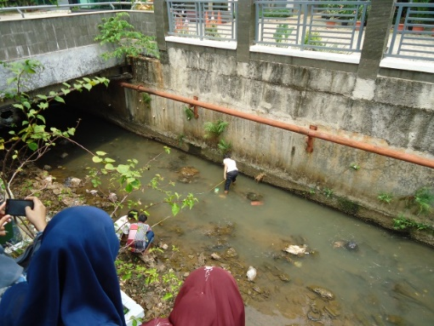
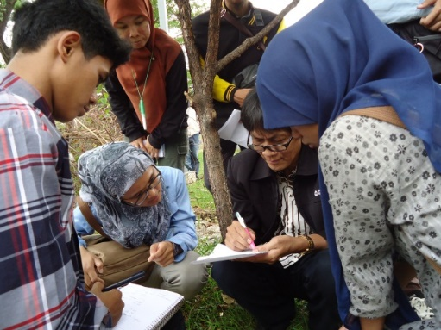
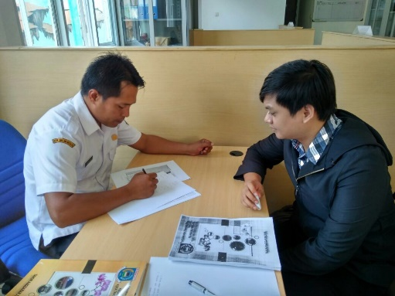
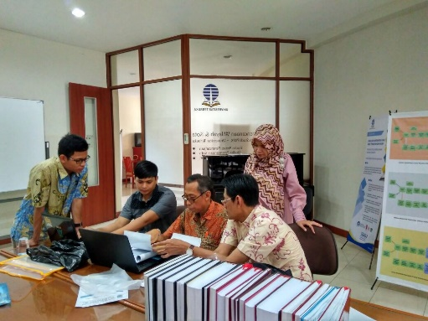
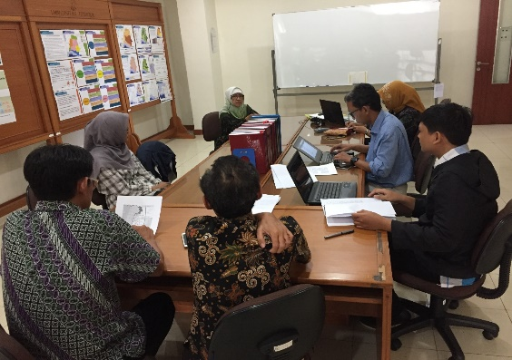
Background
Cor of urban and regional planning education is Studio
Studio courses are problem based learning that requires students to work in teams, play an active role in expressing opinions and arguments by considering feedback from the supervisor. In the studio students are trained to collaborate between disciplines, which is very important in every planning process
There is a difference Implementation of Studio Courses in Urban and regional Planning UT with those in other institution conventional
(UT = 8 weeks, coventional institution = 14 weeks)
residential studio implementation
Whether the alumni UT can apply studio courses in the work place

Slide 3
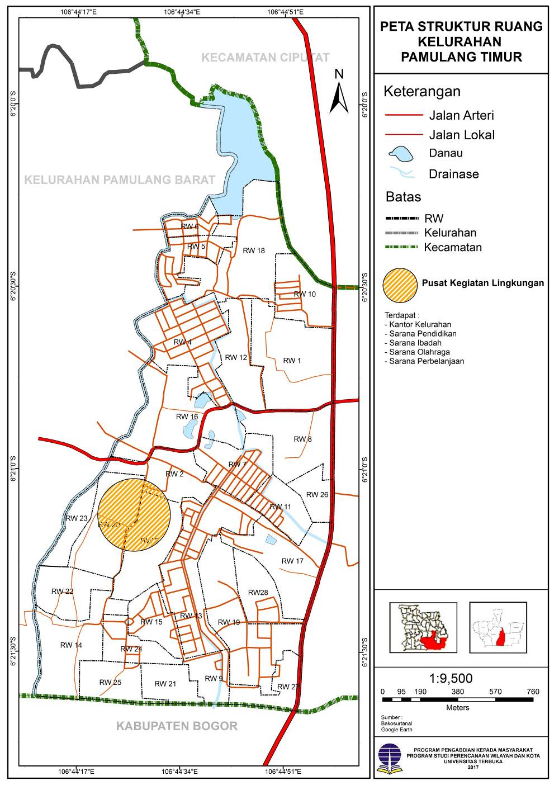
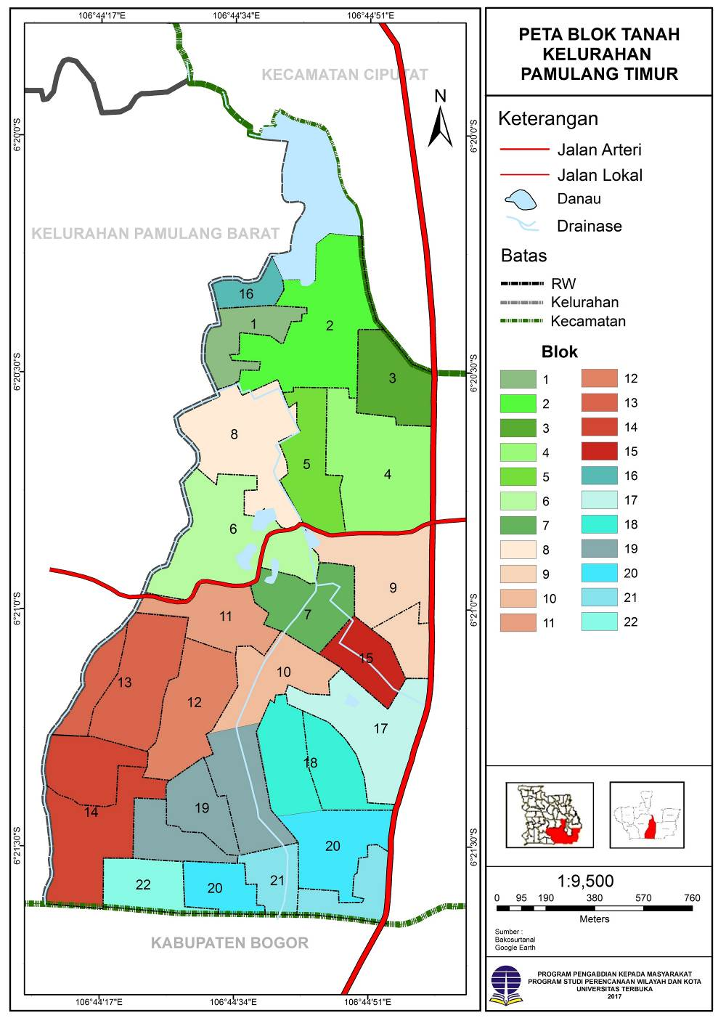
Studio Competent
Content of Studio
Planning Process Studios
Urban Planning Studios
Regional Planning Studios
Spatial Scale | Mikro- Village | Meso – District | Makro- Redion
Planning Style | Rasional Comprehensive | Rasional Comprehensive planning | Rasional Comprehensive planning
Main emphasis | - Discriptive, Scientific - Potential and problems | - Scientific approach - Physical environment management - Comprehensive plan - Blok plan | - Scientific approach - Physical environment management - Comprehensive plan - Strategic area
Methodes and Technoques | - Discriptive - Spatial recognitions | - Spatial analist - Zonasi - Bloc plan analist | - Spatial analist - Economic analist - Infrastructure analist
The Role of the planner | Analist | Expert – Analis | Expert - Inovator

Slide 4
Purpose
The purpose of this study:
Knowing profile of alumni Urban and regional planning study program in Universitas Terbuka
Analyze the extent to which the studio practices of the Urban and Regional Planning Study Program-UT alumni were applied at their place of work.

Slide 5
Methodology
Approach → Tracer Study
Tracer Study is a study of graduates of higher education providers. This study is able to provide a variety of information that is useful for the benefit of evaluating higher education outcomes and can then be used to improve and guarantee the quality of the higher education institutions concerned
Type → Quantitatif research
Quantitative research is carried out to explain, test the relationship between phenomena and determine causality of variables
Subyect → alumni of the Urban and Regional Planning Study Program-UT from 3 (three) graduates in 2016 to 2017
Instrument → Quetioner or questionnaires and interview
Analisis → quantitative descriptive.

Slide 6
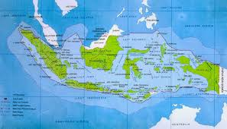
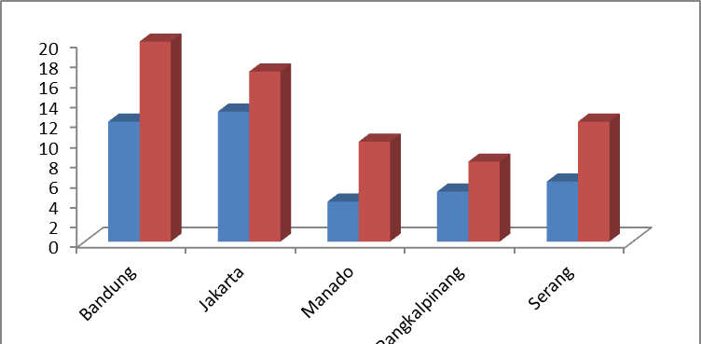
Methodology
Location
Location tracer study
UT Jakarta
UT Serang
UT Bandung
UT Pangkalpinang
UT Manado
Respondents answered
Number of Respondents

Slide 7
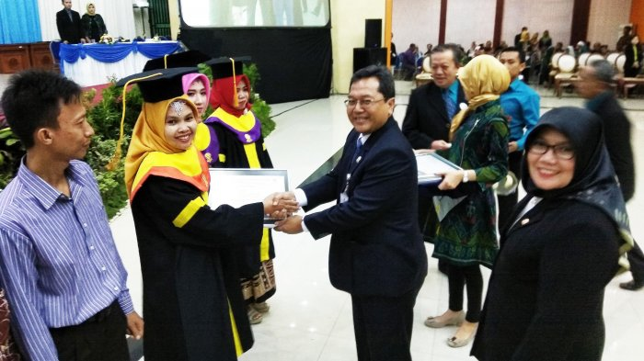
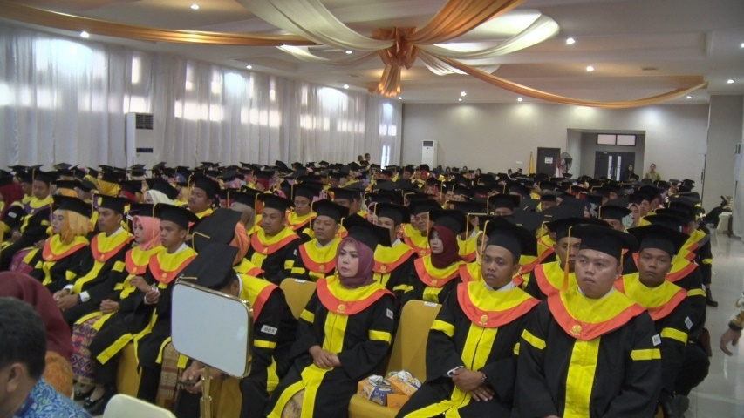
Alumni Profil
Distribution Alumni of Urban and regional planning study program

Slide 8
Alumni Profil
Alumni profile of Urban and regional planning Study program
No. | Caracteristic | Scale | Statistic
1. | ∑ Responden | N | 40 | %
2. | Age | Average |  | 24
 |  | Minimum |  | 22
 |  | Maximum |  | 39
3 | Gender | Male | 14 | 35
 |  | Female | 26 | 65
4. | Workplace | Government | 11 | 28
 |  | Private | 15 | 36
5. | Education before UT | High School | 38 | 95
 |  | Diploma | 2 | 5
6. | Start College | 2013 | 32 | 80
 |  | 2014 | 3 | 8
 |  | - | 5 | 13
7. | Graduate | 2017 | 25 | 63
 |  | 2016 | 9 | 23
 |  | - | 6 | 15
8 | GPA | Average |  | 2.92
 |  | Minimum |  | 2.50
 |  | Maximum |  | 3.95

Slide 9
Result & Discussion
Current potential of Urban and Regional Planning Study Program graduates
a. Mastery of the fields of study taken at UT
b. Knowledge of other fields of science
c. Analytical thinking
d. The ability to get new knowledge quickly
e. Ability to negotiate effectively
f. Good performance ability under pressure
g. Sensitivity to new opportunities
h. Ability to coordinate activities
i. Ability to manage time efficiently
j. The ability to work together productively with others
k. The ability to empower others
l. The ability to use a computer or the internet
m. Ability to solve problems
n. Have new ideas
o. The ability to judge one's own ideas or others
p. Ability to present ideas, results, or reports
q. Ability to write activity reports (research, projects, etc.)
r. The ability to write and speak in a foreign language

Slide 10
Result & Discussion
Competencies of Urban and Regional Planning graduates required
a. Mastery of the fields of study taken at UT
b. Knowledge of other fields of science
c. Analytical thinking
d. The ability to get new knowledge quickly
e. Ability to negotiate effectively
f. Good performance ability under pressure
g. Sensitivity to new opportunities
h. Ability to coordinate activities
i. Ability to manage time efficiently
j. The ability to work together productively with others
k. The ability to empower others
l. The ability to use a computer or the internet
m. Ability to solve problems
n. Have new ideas
o. The ability to judge one's own ideas or others
p. Ability to present ideas, results, or reports
q. Ability to write activity reports (research, projects, etc.)
r. The ability to write and speak in a foreign language

Slide 11
Result & Discussion
Impact of learning at UT for Urban and Regional Planning Study Program-UT alumni

Slide 12
Conclusion
Alumni profile of the Urban and Regional Planning Study Program-UT consist of: 27.5% working as civil servants, and others (72.5%) working in the private sector. For alumni who work in accordance with urban and regional planning fields, only 25%.
The quality of the Urban and Regional Planning Study Program-UT alumni is able to complete the study within 4 (four) years, with an average cumulative index (GPA) of 2.92, while the highest GPA is 3.95, and the lowest is 2.50. The average GPA is the GPA above the average GPA of the Faculty of Mathematics and Sciences.
For alumni who work in accordance with their fields, studio practices starting from the study of planning processes, urban planning studios, regional planning studios, have an impact on: independence, skills in utilizing media and technology, and better communication with peers, because studio practice is done in groups

Slide 13
Thank You

