Slide 1
Allama Iqbal Open University

Slide 2
AIOU

Slide 3
Universitas Terbuka

Slide 4
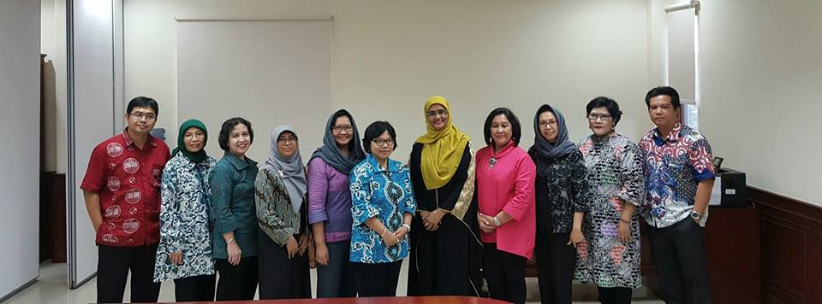
My First Day at UT ☺

Slide 5
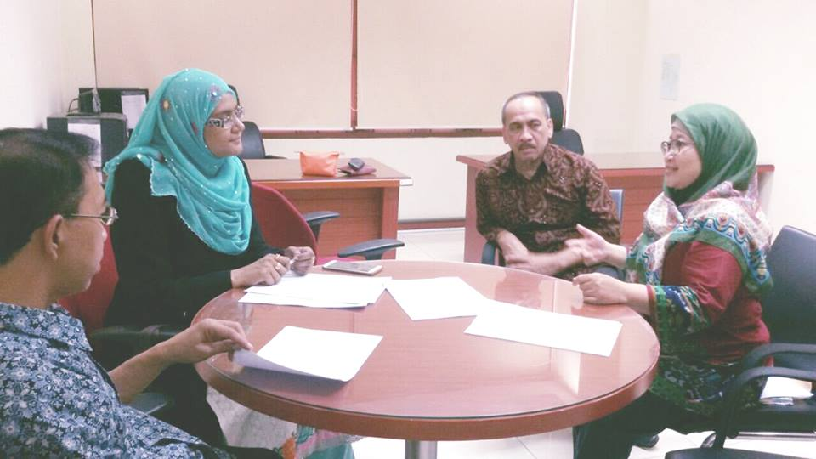
Discussions, Interviews

Slide 6
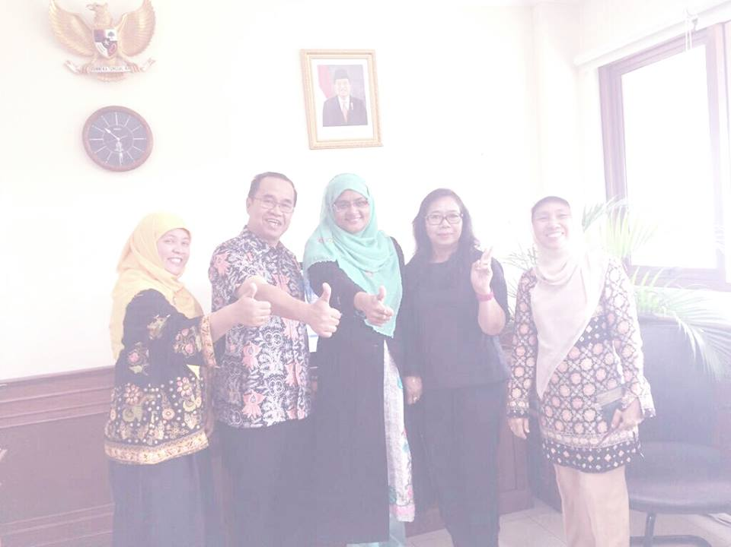
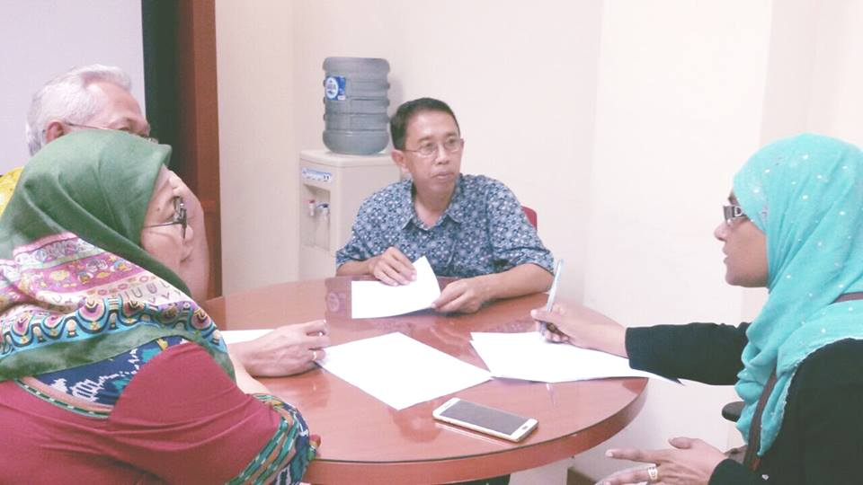

Slide 7
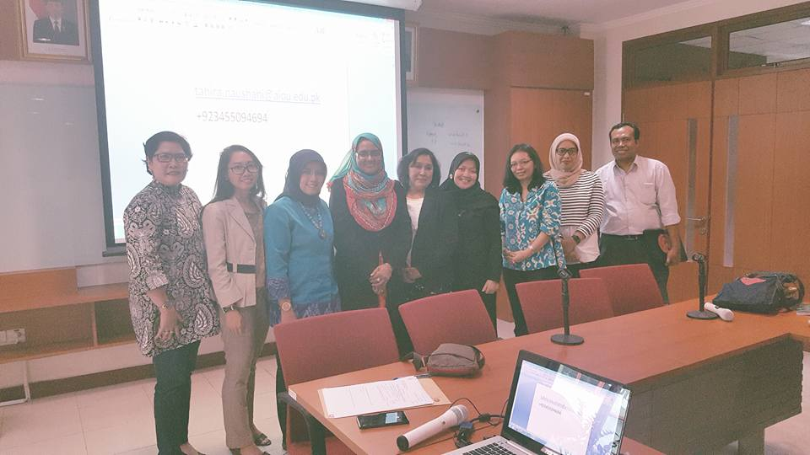
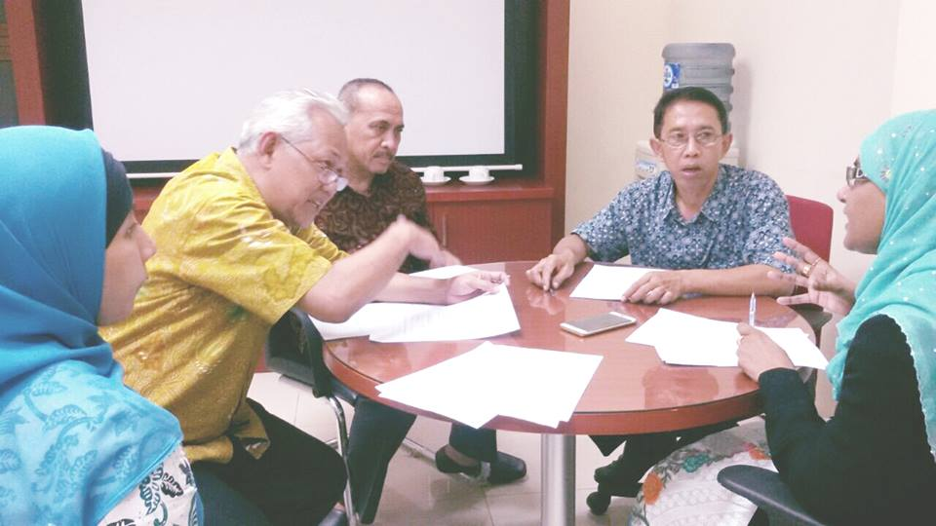

Slide 8
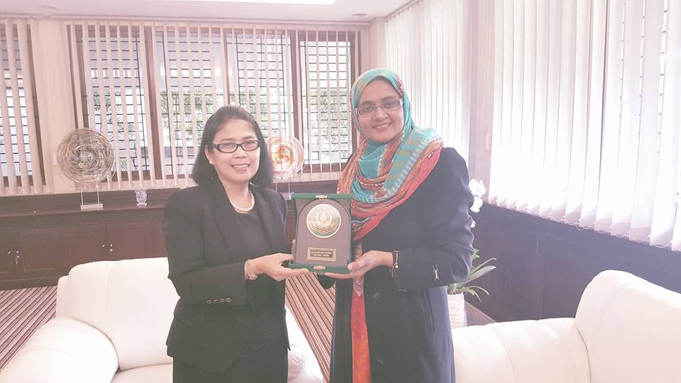

Slide 9
COMPARATIVE STUDY OF QUALITY ASSURANCE PRACTICES IN OPEN DISTANCE LEARNING (ODL) Universities
Ms. Tahira Bibi (PhD, EPM)
EPPSL Department
Allama Iqbal Open University Islamabad,Pakistan
tahira.naushahi@aiou.edu.pk

Slide 10
Quality Assurance in ODL
Traditional standards and measures of quality show that there are no principle standards for distance learning to achieve goals/objectives of quality assurance in Pakistan.

Slide 11
Framing of Issues
to compare and gain the knowledge about current practices and measurement standards in open distance learning (ODL) at international level between the ODL universities.
Threats and factors that are and will be affecting the quality of ODL and
strategies that will help Pakistan to meet the high quality as benchmark for ODL were also discussed and answered through this research project with comparative perspectives.

Slide 12
Quality Assurance in ODL
“Critics of ODL are only too ready to seize upon the
Lower or absence of entry standards,
The limited support for isolated learners,
The costs and effort involved in creating and maintaining the technological infrastructure and developing the courseware,
And the sometimes higher non-completion and failure rates.
ODL is perceived as “last-choice education.”
Slow and poor quality feedback and
Limited support for learners.
In other cases, the rise of private online providers more interested in profit than academic quality has helped give ODL a bad name. (COL, 2016)

Slide 13
Directorate of Quality Enhancement
The Quality Enhancement Cell (QEC) was established in the year 2007.
It has been actively involved in quality assurance, enhancement and to institutionalize a quality culture in the functioning of AIOU.
However, later in the year 2013, a Third Party Evaluation under “Commonwealth of Learning Review and Improvement Model (COL-RIM) Implication” was held.

Slide 14
Directorate of Quality Enhancement
DQE also has a deep concern for
The evaluation of programmes/courses,
Participation in national/international events and
Capacity building of the AIOU employees through
Trainings,
Workshops and Seminars.
Furthermore, the academic activities of AIOU are routed through DQE and are monitored by Quality Assurance Agency (QAA), HEC. (DQE,2016)

Slide 15
Directorate of Quality Enhancement
Presently, AIOU has membership of association with
Commonwealth of learning (COL),
International Council for Distance Education

Slide 16
Quality Assurance Unit of UT Indonesia
Universitas Terbuka has developed and implemented comprehensive Quality Assurance System , Sistem Jaminan Kualitas (SIMINTAS) since 2002.
This system was adopted from the Asian Association of Open Universities Quality Assurance Framework (AAOU QA Framework).
UT has accommodated the demand for improvement by integrating all requirements
BAN-PT,
ICDE and
Refinement of AAOU QA Framework into AAOU QA Statements of Best Practices into a new policy called
SIMINTAS UT 2012.

Slide 17
Accreditation and Certification
AIOU | UT
Accredited two programmes remaining are under process | Three Programs are under process remaining are accredited
Different Councils to accredited the programmes National Business Education Accreditation Council (NBEAC) National Accreditation Council for Teacher Education(NACTE) Pakistan Engineering Council(PEC) Pakistan Medical and Dental Council (PM&DC) Commonwealth of Learning (COL) | BAN-PT Higher Education National Accreditation Board ISO-9001;2008 Certified International Council for Distance Education (ICDE )

Slide 18
Quality Assurance Practices
AIOU | UT
HEC Quality Assurance Manual Internal Rules and Procedures constituted by the statutory bodies | Follow the Procedures for Quality Assurance System developed by the QAU, TU
No specific quality assurance procedures/ document available in Quality Assurance Department. | Well documented and organized procedural manuals available in Quality Assurance Department
Audit on demand by the external national or International organizations | Regular audit practices by the Internal and external auditors

Slide 19
Threats that Affect the Quality Assurance of the ODL
Internal Quality Assurance system is weak. Students get degree but week on subject.
Poor standers of technology
Inefficent management & monitoring system with in AIOU
Lack of concrete quality standards for quality assurance of ODL
Centeralization of system
Lack of coherent policy
Faculty of science is offering all its programmes on face to face teaching mode under the umbralla of ODL system.
Time management amongst the various components
Non serious behaviour of the ODL students
Quality assurance procedures and protocols

Slide 20
Threats that Affect the Quality Assurance of the ODL
11. No continuously monitoring and timely modificated procedures
12. Communication is the main problem due to unavailability of electricity
13. Lack of Proper implementation of Policies
14. Comparative environment in the presence of offering ODL programmes by the different / formal universities
15. Large number of students
16. Political influence
17. Recognition/ accreditation problems as compared to formal system
18. Inefficient feedback system
19. Assurance of ODL programmes on conventional standards
20. Constant change in technology

Slide 21
Threats that Affect the Quality Assurance of the ODL
21.Mind set of assurance agencies
22.Assessment system of the students
23.Increased enrolment
24.Stander procedures for different mode of ODL, online, blended, conventional ODL
25.Low trust on quality of students assignments
26. Less trust on activities going on at regional campuses

Slide 22
Threats that Affect the Quality Assurance of the ODL UT
Infrastructure
Online Learning
Data collection, auditing take lots of time for academician
Constant change in National Policy
Non supportive government policy of ODL
Less services to student supports
Less awareness about Quality Assurance
Internet access for student
Less human resource development
Tutor and Student Ratio

Slide 23
Threats that Affect the Quality Assurance of the ODL UT
Lack of Experties on ODL
Unique characteristics for each UT regional Campuses
Consistency in implementing the Quality Assurance of Programme
Less efficent monitoring system for student
Less support from the Indonesian Ministry of Research, Technology and Higher Education.
Less willingness of the staff to implement the procedure of Quality assurance
Government does not have the standards for ODL.
Reliabilty of Data for quality Assurance
Less implementation on feedback.

Slide 24
Proposed Strategies AIOU
Quality standards for ODL system
Quality Assurance Framework need to be developed
Quality in research work
Uniform policy, SOPs for Quality of all institutions of ODL
Establishment of ODL council at National Level
International standards and criterias should be focused but not be followed blindlly.

Slide 25
Proposed Strategies AIOU
7. Vigilant examination department/ e-assessment as alternative
8. Personnal training, awarness programmes about the quality education through ODL.
9. New e-Learning modes, access and development of Open Educational Resources
10. Blended learning approach
11. Well IT equipped regions
12. Right person for right job and justice objectively not subjectively
13. More collaboration from the ODL international institutions

Slide 26
Proposed Strategies UT
Revise the Learning Material
Support by the Indonesian Ministry of Research, Technology and Higher Education
Improvement about benefit by Remote Lab, Virtual Reality
Focus on the funding relevant to each unit
Discussion with Higher Education for more reliable standers for ODL.
Continuous training & Improvement
Increase the awareness on the importance of Quality Assurance for institutional survival in the long term.

Slide 27
Proposed Strategies UT
8. National and international networking and agreements with ODL stakeholders
9. Financinal support from government
10. Applicable policy for Unique UTS branches/ campuses
11. Internet sevice development
12. Monitoring and Control on implementation
13. Evaluation Researches

Slide 28
Summary/ Conclusion
The findings of the study indicated that:
The both universities AIOU and UT have QA departments namely Directorate of Quality Enhancement and Quality Assurance Unit.
Directorate of Quality Enhancement is struggling for Quality Assurance with the departments and Higher Education Commission.
AIOU and its departments are under the process of acreditation of the programmes from various recognizing bodies of HEC.
Where as in Universitas Terbuka (UT) have accreditation of its programmes from the
Higher Education National Accreditation Board,
Certified from the ISO 9001;2008 and
International Council of Distance Education.

Slide 29
Summary/Conclusion
6. UT has centralized, powerful, well organized and well documented quality assurance unit.
7. AIOU and UT need more efficient infrastructure, monitoring and controlling system for the e-learning and student support services at regional centers.

Slide 30
Recommendations
Collaboration in Research Projects/joint researches at faculty and students level for quality enhancement in research work.
Collaboration and exchange of designed instructions as well as exchange of quality standards.
Comparison of different systems and sub-systems of AIOU and UT i.e. Examination, Admission, Student Support Services for the exchange of strengths between universities to eliminate weaknesses of ODL system implementation
Faculty and administrative exchange programs for Quality Assurance Policies implementation.
Collaboration in monitoring and feedback systems and assessment systems
Globalized programs

Slide 31
References
Brennan, J. L. (1998). Quality assurance in higher education: A legislative review and needs analysis of developments in Central and Eastern Europe. London, UK: European Training Foundation/Quality Support Centre.
COL, (2016) Open and Distance Learning Quality Assurance in Commonwealth Universities. 4710 Kingsway,suite2500 Burnaby, British Columbia Canada VSH 4M2
DQE, (2016) Directorate of Quality Enhancement, Allama Iqbal Open University Islamabad Pakistan http://www.aiou.edu.pk/dqe/index.asp retrieved on 07-09-2016 at 12:30 pm
NACTE , (2016) National Accreditation Council for Teacher Education Pakistan (www.nacte.org.pk) retrieved on 06-09-2016 at 2:30 PM
HEC, (2016) Higher Education Commission of Pakistan.http://www.hec.gov.pk/english/Pages/Home.aspx retrieved on 06-09-2016 at 2:00 PM
NBEAC ,(2016) National Business Education Accreditation Council, Pakistan (http://www.nbeac.org.pk/) retrieved on 06-09-2016 at 2:00 PM
PEC , (2016)Pakistan Engineering Council http://psee.org.pk/site/) retrieved on 06-09-2016 at 2:35 PM
PM&DC, (2016) Pakistan Medical and Dental Council http://www.pmdc.org.pk) retrieved on 06-09-2016 at 2:35 PM
QAU, (2016) List of procedures for Quality Assurance System in Academic Management and Distance Learning Management, Universitas Terbuka Indonesia.
UT, (2012) Quality Assurance system Universitas Terbuka 2012 printed by Universitas Terbuka Indonesia

