Slide 1
THE USE OF ONLINE TUTORIALS HELPS INCREASE THE STUDENTS' UNDERSTANDING OF THE LEARNING CONTENT IN EARLY CHILDHOOD EDUCATION PROGRAMS
Siti Aisyah
Titi Chandrawati
Universitas Terbuka Indonesia

Slide 2
INTRODUCTION
The use of information and communication technology in open and distance learning is very important. Universitas Terbuka (UT) is very interested in improving the quality of services based on technology and communication (ICT). Academic services to students for various academic and administrative needs are carried out in stages using network-based applications.
.

Slide 3
The online tutorial (tuton) held by Universitas Terbuka (UT) is an application of e-learning offered to students to help the learning process.
Tuton provides benefits for students because learning is designed to be more communicative and interactive as well as providing learning assistance services optimally. As a learning aid to students, tuton has several advantages such as:
giving learning material/initiation
can be used to increase discussion activities (forums, chatting, etc.) and assigning assignments
At the end of the eight weeks learning activity, the online tutors will give scores and questionnaires about the quality of the online tutorials to students

Slide 4
TUTORIAL ONLINE SUCCESS FACTOR
Tutor
Student
Supporting facilities

Slide 5
PURPOSE
To investigate how far the online tutorial can help students’ understanding of the learning content

Slide 6
Jackson & Songer (2010: 462) states that technology in the teaching and learning process provides great benefits for students because various information and knowledge can be obtained quickly through the internet. The statement of the experts in line with the rapid change in technology. Today's technological developments have a major influence on the development of the education system so that the use of technology in education is a necessity in the teaching and learning process and the transfer of knowledge from the organizers of education to students.
LITERATURE REVIEW

Slide 7
METHODOLOGY
Data from 438 Early Chilhood Education students were processed using analyzed descriptively with SEM model.
1. SEM model testing as a whole, ie tests whether the model fits the overall SEM/fit of the data sample. This test is done by comparing the sample covariance matrix and the estimated covariance matrix of the SEM model.
2. Testing the measurement model using confirmatory factor analysis (CFA). After the measurement model is formed using CFA, the analysis of the relationship between latent variables and indicator variables is then carried out. In this testing process, including testing whether each indicator variable is able to measure its latent variables.
3. Structural model testing, which is testing the relationship between latent variables

Slide 8
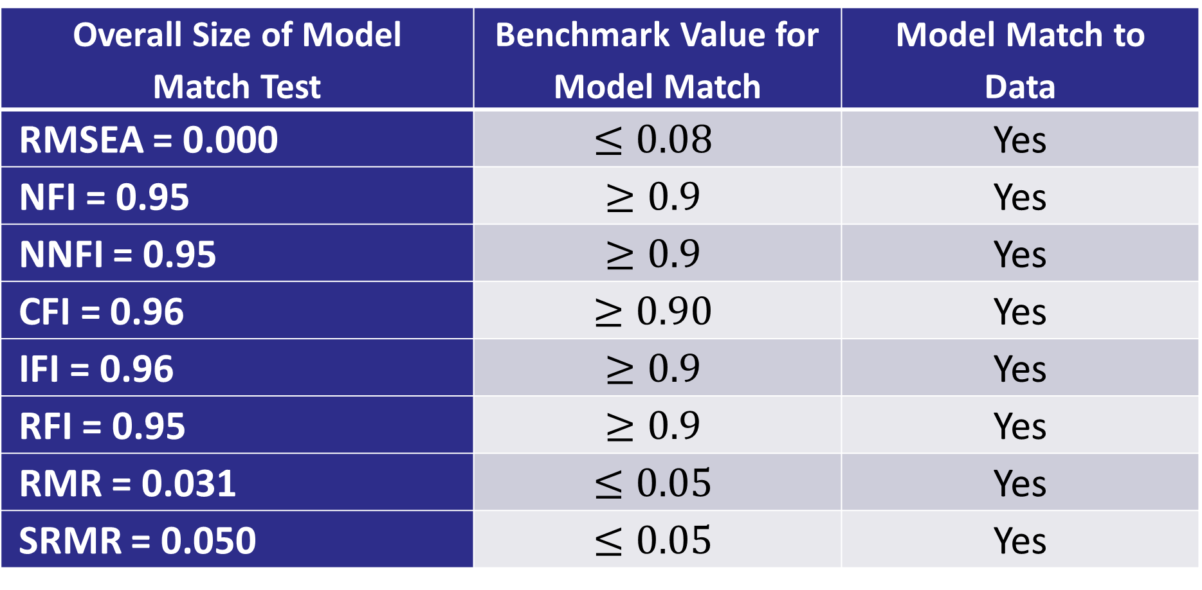
Overall SEM Model Testing
Overall Size of Model Match Test | Benchmark Value for Model Match | Model Match to Data
RMSEA = 0.000 | $$≤0.08$$ | Yes
NFI = 0.95 | $$≥0.9$$ | Yes
NNFI = 0.95 | $$≥0.9$$ | Yes
CFI = 0.96 | $$≥0.90$$ | Yes
IFI = 0.96 | $$≥0.9$$ | Yes
RFI = 0.95 | $$≥0.9$$ | Yes
RMR = 0.031 | $$≤0.05$$ | Yes
SRMR = 0.050 | $$≤0.05$$ | Yes

Slide 9
Overall SEM Model Testing
From testing the structural model as a whole most of the model fit test sizes are appropriate so that it can be concluded that the SEM model as a whole has good ability in terms of matching the sample data ( good fit ).

Slide 10
Evaluation of Indicator Validity
Indikator Variabel Eksogen | Loading Factor | Indikator Variabel Eksogen | Loading Factor
X11 | 0.72 | Y11 | 0.78
X12 | 0.71 | Y12 | 0.83
X13 | 0.73 | Y13 | 0.82
X14 | 0.72 | Y14 | 0.84
X15 | 0.77 | Y15 | 0.82
X16 | 0.80 | Y16 | 0.76
 |  | Y17 | 0.85
 |  | Y18 | 0.88
 |  | Y19 | 0.83

Slide 11
Evaluation of Indicator Validity
Evaluation of indicator validity is seen based on the value of Standardized Loading Factor (SLF). Evaluation of validity is said to be good if the SLF value is 0.5. (Hair, 2010: 679).
all question indicators in the Tutorial Online (X) and Understanding (Y) variables have SLF values> 0.5. This shows that these questions are valid in explaining the Online Tutorial (X) and Understanding (Y) variables.

Slide 12
Size of Average Variance Extracted
$$VE=\frac{\sum_{i=1}^{n}{SLF_{i}^{2}}}{n}$$
Table 3 Construct Reliability (CR) and Average Variance Extracted (AVE) values
Latent variable | CR | AVE | Information
Online Tutorial | 0.879 | 0.551 | Reliable
Understanding | 0.949 | 0.679 | Reliable
It shows that the CR value for each latent variable is 0.7 and the AVE value is 0.5, so it can be said that the question indicator used to explain the latent variable is reliable.

Slide 13
ANALYSIS AND RESULTS

Slide 14
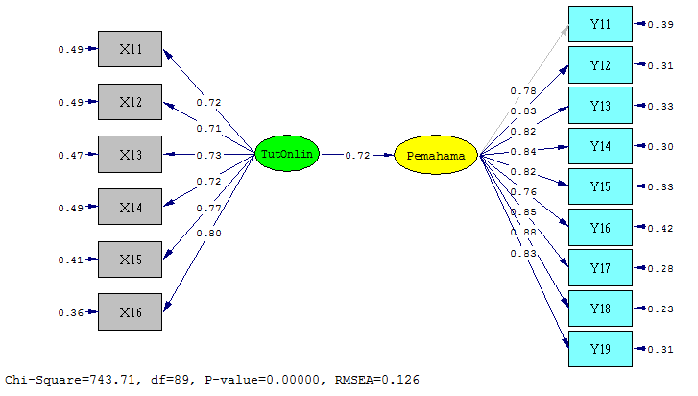
Figure 1 Path Chart of the Measurement Model

Slide 15
Notes:
X11: Initiation material in Tuton explains important concepts that students need to master
X12: The language used is easy to understand
X13: Initiation material is equipped with videos, audio, or relevant articles
X14: Supporting material in video, audio, or articles helps improve student learning understanding
X15: Discussion material triggers students to actively participate
X16: Discussion material helps improve student understanding of important concepts in initiation material
Y11: Tutors arouse student confidence or enthusiasm for learning
Y12: Tutors greet students via email or other media to be active in the tutorial
Y13: Tutors respond to student discussions
Y14: Tutor provides answers to questions and problems raised by students
Y15: Tutor encourages students to actively participate
Y16: Tutors encourage students to study independently
Y17: Tutors give examples of good communication methods and ethics
Y18: Tutors provide corrections, directives or input on how students communicate
Y19: Tutors provide feedback or responses to tutorial assignments undertaken by students

Slide 16
Structural Model Testing
Previously, we have tested the whole SEM model and tested the measurement model. The results of both tests showed good results. In testing the SEM model as a whole shows the results that the SEM model as a whole has been able to model the data properly. While the testing of the measurement model shows the results that the measurement model has good convergent validity and reliability. Next will be done by testing structural models.

Slide 17
CONCLUSION
The path coefficient of the Tutorial Online latent variable is 0.71. Positive path coefficient values indicate that the Online Tutorial latent variables have a positive effect on Understanding. In other words, the better the Online Tutorial learning given to students, the students will be more likely to understand the material from the tutorial.

Slide 18
CONCLUSION
The increasing number of tuton participants and the lectured subjects indicates that the tuton services have been used by students as one of the modes of learning and it is proven that participation in tuton can improve students' understanding of the learning material they have learned. Results of the test showed that the variables of latent Online Tutorials were able to explain the variable latency understanding by 48% while the remainder is explained by variables other outside the model. Other variables that influence the students’ understanding of the learning content can include students’ motivation, age, and others.

Slide 19
THANK YOU

