Slide 1
State Of Administration And Education At Public Sector Universities In Pakistan: Issues And Challenges
The 33rd Annual Conference of the
Asian Association of Open Universities
Dr. Sadia Mahmood Falki
Lahore College for Women University, Lahore
Salma Amjad
Virtual University of Pakistan, Lahore

Slide 2
Research Assumption
Pakistani public sector universities are primarily less influential to inculcate a feeling of Sense of Belonging and ownership amongst its students due to the structural and functional flaws.

Slide 3
Introduction
World View of Individual & Role of Education
Leads to Shape Quality of Human Capital
Universities: Architect of Competitive Knowledge Workforce and Social Change

Slide 4
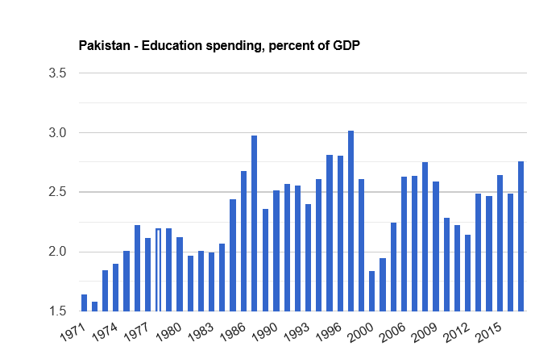
From 1971-2017, average public spending on education in Pakistan was confined only 2.34 percent Pakistan's public expenditure on education as a percentage to GDP is estimated at 2.4 percent in fiscal year 2018-19, which is the lowest in the region

Slide 5
Public spending on education, percent of GDP of South Asian Countries

Slide 6
Growth of Public Sector Universities
Year/Period | Public Sector Universities
1947 | Only one Public Sector University (University of the Punjab)
Till 1997 | Grew up to 24
1999-2000 | 31
Till 2006 (Under the ‘enlighten modernization’ approach) | 49
Within next few years | 51 Public Sector Universities in Pakistan (81 New universities were opened & several were upgraded from college to university.)

Slide 7
Research Objectives
To Identify the Issues and Challenges at Public sector Universities in Pakistan in General.
To Assess the Relationship Between Organizational and Structural flaws of Public Sector Universities and the Quality of education in Particular.
To Evaluate the Role of University Education for Inculcating the Sense of Ownership Among the Students Towards their Institutions, Society and State.
To Find Out the Role of University Education in Promoting Civic Sense Among Students Through ‘University Citizenship.

Slide 8
Methodology
‘Mixed Method Approach’ Qualitative and Quantitative techniques.
Primarily an Observational Study
Questionnaire was designed on 5 points Likert scale.
Basic information and 15 closed ended questions.
Population; Students from two Public Sector Universities;
Sample Size: 200 (Multi-stages stratified random sampling).
Descriptive and analytical research
Both primary and secondary sources
The 30 questionnaires were tested through pilot study to check reliability at Cronbach's Alpha.

Slide 9
Conception of Sense of Belonging & Ownership
Human Need of Group Identity
Enables the Ability To See the Value in Life To Cope Challenges
Community Behind "US"
Makes US Receptive, Motivated & Persisted
Individual-Institution-Organizational Identity : Awareness of Membership & A Sense of Involvement With The Group
University Citizenship: Having A Voice & Being Involved
Core to Academic Success

Slide 10
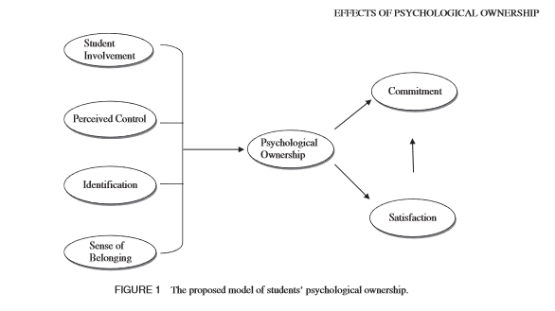
Psychological Ownership Theory

Slide 11
Results & Analysis of Data
Demographic Information
Age Group | 18-26 | 27-35 | 36 and above
 | Row N % | Row N % | Row N %
Percentage | 72.0% | 20.0% | 8.0%
Qualification | BS/Masters | M. Phil/MS | Ph.D
 | Row N % | Row N % | Row N %
Percentage | 67.0% | 26.0% | 7.0%
Affiliation with the University | LCWU, Lahore | GCU, Lahore
 | Row N % | Row N %
Percentage | 50.0% | 50.0%

Slide 12
Responses of Students collected through Survey
Responses | Strongly Agree | Agree | Neutral | Disagree | Strongly Disagree | Accumulative Result
 | Row N % | Row N % | Row N % | Row N % | Row N % | %
Clarity of rules at the Time of Admission. | 33.0% | 42.0% | 9.0% | 15.0% | 1.0% | 75
Rules and its implementation mechanism help to make a working relationship between you and your university. | 19.0% | 51.0% | 12.0% | 16.0% | 2.0% | 70
University administration listens to students’ concerns seriously. | 24.0% | 35.0% | 12.0% | 11.0% | 18.0% | 59
Easy access to concern administration officers | 21.0% | 30.0% | 11.0% | 12.0% | 26.0% | 51
University administration owns you by addressing or sharing concerns to the general problems of students. | 13.0% | 38.0% | 12.0% | 15.0% | 22.0% | 51
University provides a suitable environment for the students to speak up for their academic well being. | 17.0% | 25.0% | 13.0% | 17.0% | 28.0% | 42
University has any mechanism for career orientation. | 8.0% | 32.0% | 27.0% | 26.0% | 7.0% | 40
University intends to give /create a conducive environment for check and balance for both teacher and student through shared learning process. | 7.0% | 34.0% | 37.0% | 18.0% | 4.0% | 41

Slide 13
Responses of Students collected through Survey
Responses | Strongly Agree | Agree | Neutral | Disagree | Strongly Disagree | Accumulative Result
 | Row N % | Row N % | Row N % | Row N % | Row N % | %
At other places, you feel proud to associate yourself with your University. | 30.0% | 40.0% | 15.0% | 10.0% | 5.0% | 70
Your identity with the university determines your status in academic circles. | 34.0% | 48.0% | 10.0% | 5.0% | 3.0% | 82
Your degree program is effective to develop a sense of ownership in you with your university. | 20.0% | 21.0% | 17.0% | 31.0% | 11.0% | 41
Your degree program is enabling you to play your role as an active citizen in a better way. | 25.0% | 29.0% | 14.0% | 17.0% | 15.0% | 54
University degree has potential to facilitate you to get a reasonable job. | 23.0% | 40.0% | 12.0% | 11.0% | 14.0% | 63
University academic environment plays a significant role to inculcate civic sense in you. | 20.0% | 33.0% | 17.0% | 14.0% | 16.0% | 43
University provides counseling services to the students to initiate the good citizenry | 11.0% | 27.0% | 23.0% | 18.0% | 21.0% | 38

Slide 14
Problems & Challenges At Public Sector Universities
Students Are Not The Final Product While Lacking Progressive Thinking.
Clientlist Relationship between the Institution and its Students.
Bureaucratic Decision Making Model
Lack of Infrastructure & Trends of Adhocism
Quality of Teaching At Universities
Stakes are Low.

Slide 15
Recommendations
To ensure the transparent recruitment process at public sector universities
Visiting or Deputation should be the Rare practices under Definite and Strict conditions to Avoid Nepotism and Favoritism.
Compulsory “Review Mechanism” for the research and professional performance of the university teachers through interval or yearly assessment and “Professional Growth Check” after every five or ten years
There is also need to apply some scrutiny measures on the admission to the research base higher degree programs.
Need to Enhance the Professional Identities
The students should involve into some sort of decision making process so they may develop an association or stake in the university and also learn to lead and coup challenges by bringing problem solving approaches.

Slide 16
Recommendations
The sense of ownership among the students can be established by offering them choices, listening carefully to their concerns and helping them to polish their leadership skills.
The curriculum irrespective of disciplines should be designed on the bases of two fundamental principles;
‘Shared Learning’ both by students and teachers
and ‘Identified relevance
The Active Citizenship Program (ACP) would be the dynamic step of inculcating a strong sense of associations among the students with less privileged communities and Pakistani society primarily advancing the responsible citizenship.
This model should be extended to all public sector universities in Pakistan by including this as compulsory 3 credit hour course into their BS programs of all disciplines.

Slide 17
References
Dawn, (2016) Retrieved August 21, 2019 from https://www.dawn.com/news/1254909
Economic Survey: Government spending on education less than 3 per cent of GDP. (2018, January 31). The Indian Express. Retrieved from https://indianexpress.com/article/education/economic-survey-government-spending-on-education-less-than-3-per-cent-of-gdp-5045498/
Government of Pakistan (2002). Pakistan Madrasa Board: First Annual Report, Islamabad
Govt Redefines Literacy for Count, (2019, Augst 25). The Express Tribune
Hoodbhoy, P. (2009). Pakistan’s Higher Education System- What Went Wrong and How to Fix It. The Pakistan Development Review, 48(4). part II, 581-594.
Hoodbhoy, P. (n.d.). Education Reform In Pakistan- Challenges and prospects, 1-31. Retrieved from http://eacpe.org/content/uploads/2014/02/Pakistan-Education-Challenges-and-Prospects
Javed, M. A., & Ali, A. (2017). Educational Development in Pakistan: A Critical Appraisal of Muhammad Pervez Musharraf Presidency (1999-2008). International Journal of Scientific and Research Publications, 7(3) 277-282. Retrieved from www.ijsrp.org
Khan, Z. (2019). Major Structural Issues in Pakistan’s Higher Education system. Daily Times. Retrieved August 7, 2019, from http://dailytimes.com.pk/339939/major-structural-issues-inpakistanis-higher-education-system
Pakistan: Education spending, percent of GDP. The Global Economy. Retrieved August 15, 2019, from https://www.theglobaleconomy.com/Pakistan/Education_spending/
Pakistan’s Literary Rate Stands as 58 PC. Retrieved August 13, from https://www.thenews.com.pk/print/309542-pakistan-s-literacy-rate-stands-at-58pc
Riazul Haq, (2019). 21 Public Sector Varsities Operating Without VCs. The Express Tribune. Retrieved August 11, 2019 from https://tribune.com.pk
Tarar, N.O. (2006). Globalization and Higher Education in Pakistan. Economic and Political Weekly 41(49), 5080-5085.
The constitution of Islamic republic of Pakistan. (2012) National Assembly of Pakistan. Retrieved August 15, 2019, from http://www.na.gov.pk/uploads/documents/1333523681_951.pdf
Tilak, J. B. G, (2015). Higher Education in South Asia: Crisis and Challenges. Social Scientist, 43(½), 43-59. Retrieved from https://www.jstor .org
Zaidi, A. (2002). The Dismissal State of the Social Sciences in Pakistan. Islamabad: Council of Social Science.

Slide 18
Thank You

