Slide 1
Sustainable Democracy and Crisis of Governance in Pakistan
Ruqia Kalsoom
P. hD Scholar and Instructor in the department of Pak-Studies, Virtual University of Pakistan .
Javaria Nizam Instructor in the department of Pak-Studies, Virtual University of Pakistan

Slide 2
Introduction
In the contemporary era, Democracy and governance have been incorporated across the world by developed as well as by the developing nations.
Democracy and governance are sin qua non for each other.
Both support and strengthen each other in a certain political system.
Democracy cannot be sustained in the absence of good governance and the presence of governance can be established with the continuity of democracy.
An embryonic and sustainable democracy can develop some suitable strategies to bring viable governance to the nation in a more progressive manner.
Pakistan has been facing a number of challenges in its search for good governance, national development and struggling to establish a sustainable democracy.
No leadership except the founding father has chosen the path of providing good governance and gaining the sustainable democracy.
The country remained subject to a persistent democratic and governance crisis.

Slide 3
Objectives of the Study
This study is an attempt to explore the concepts of democracy and governance in terms of their compatibility and collaboration.
To investigate the crisis of democracy and governance in the context of Pakistan with a view that the sustainable democracy and viable good governance are pre-requisites for the socio-cultural, economic and political stability and for the national progress and development of Pakistan.
To accentuate that the crises of democracy and good governance have become the most alarming challenge which has potential to deprecate the very survival of the country.

Slide 4
Research Methodology
The intensive challenges and issues of democracy in Pakistan urged an acute need of governance has been informed in this research.
The descriptive and deductive content analysis has been adopted with the use of primary and secondary sources for data collection.
The study is divided into four parts with introduction, objectives and research questions are the first part of the study.
The second part is the conceptual explanation of the analysis where key concepts of democracy, governance and good governance are clarified.
The examination of the real scenario of democracy and good governance and their compatibility in Pakistan is the thrust of the third part.
The fourth and last part of the study is devoted to conclusion and various remedial measures to strengthen the democracy and develop the good governance in Pakistan.

Slide 5
Democracy: A Conceptual Discourse
“a system of government in which everyone in the country can vote to elect its members, a country that has a government which has been elected by the people of the country, a situation or system in which everyone is equal and has the right to vote, make decisions etc”. (Longman Dictionary of Contemporary English)
“a system of government by all the people of a country, usually through representatives whom they elect, thought as allowing freedom of speech, religion and political opinion”. (Oxford Advanced Dictionary)
It is a process by which harmony emerges out of discord, melody out of the cacophony. It works with and for a consensus, not with and for despotism.

Slide 6
Democracy - Sustainable Democracy
Key relationship: Citizens → Government
Key principle: popular control as political equals
Spheres: regime rules, office-holders, public policy
Tools: technology, institutional capacity, impartial institutions, elections, rights and freedoms, rule of law, development
Sustainable democracy- not merely based on electoral procedures or political stability.
Key Principles: political power resides in the common people- Equality in the political process, assurance of government for equitable justice, guarantee domestic tranquility, general prosperity, provision of the required security and liberty of the common person.
Tools - reliable structures, strong institutions and balanced stated powers, which can lead to the national development

Slide 7
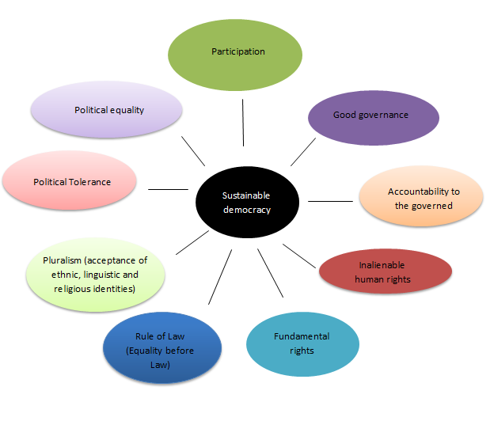
Elements of Sustainable democracy

Slide 8
Governance – Good Governance
Governance-- a method to lead /direct the society and state towards the achievement of collective goals and a process of making and implementing the decisions.
“The exercise of economic, political and administrative authority to manage a country’s affairs at all levels. It comprises the mechanism, process and institutions through which citizens and groups articulate their interests.
The phenomenon of good and viable governance logically derives and flows from the concept of governance.
Good governance is relatively a wider concept which is aimed at providing the material conditions and collective self –actualization to the individuals.
Notes:
Fukuyama, F. (2013). What is governance? Governance, 26(3).
The United Nations Development Programme (1997, UNDP (1997) Human Development and Governance Report. United Nation; New York)

Slide 9
Elements of Good Governance
Accountability
Transparency
Rule of Law
Responsiveness
Equal participation
Equitable and comprehensive
Efficient and Effective

Slide 10
Democracy and Good Governance: The Synergy
Good governance- an important indicator of national development + an established standard for the sustainable democracy.
Both are related to each other, as their aims and objectives are same.
Some political ethos and principles of governance such as free and fair elections, political regulation and representation, plural politics and freedom of expression are similarly the prominent values of democracy.
Notes:
Rhodes, Roderick Arthur William. "The new governance: governing without government." Political
1996, p.6252

Slide 11
Democracy
Good Governance
People
Government
Policy
Common tools
Support
Support

Slide 12
Governance ↔Democracy
Shared tools: technology, institutional capacity
Good Governance supports Democracy (impartial institutions, elections, rights and freedoms, rule of law, development)
Democracy supports Good Governance (public leadership, social support, accountability mechanisms).
Good governance can be operationalized when it includes all the procedural indicators, variables and particular qualities of democracy.
On the other end, the certain indicators and variables which are used as parameters for good governance are also used to determine the strength of democracy.
Notes:
Morlino. L. (2010). “Qualities of democracy: How to analyse them”, paper presented at the workshop.

Slide 13
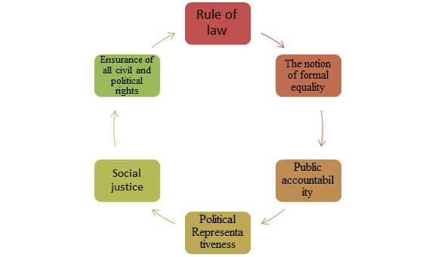
Common Features and Values of Democracy and Governance

Slide 14
Democracy and Good Governance in Pakistan
Pakistan has the potential and vivacity to adopt democratic system and has urged for good governance.
A persistent feature of Pakistani socio- cultural, historical and political basis has always been an inspiration for democracy.
The democratic journey was started with doubts and skepticism.
No serious attention has been given to make democracy strong and viable.
Right from the outset, Pakistan has displayed a stellar performance, despite the significance of democracy and good governance for the survival and integrity.
It is still struggling to move ahead on the road to sustainable democracy and good governance.
The political traditions have been abridged, the political institutions have been truncated and destabilized and other non- political elements have attained more space and superior position for themselves due to which the destiny of a viable and sustainable democracy and good governance have been frequently flawed.
Notes:
Rose, L. E., & Evans, D. H. (1997). Pakistan's enduring experiment. Journal of Democracy, 8(1).
Shafqat, S. (1995). Contemporary issues in Pakistan studies. Gautam publishers. 51.

Slide 15
In 2018, Pakistan was declared as hybrid regime and ranked just above the Myanmar’s authoritarian regime according to the Democracy Index. Pakistan’s global rank is 112 and regional rank is 21. On the other hand, out of 149 states on the Legatum Prosperity Index, Pakistan has been ranked as 13th least prosperous country. And it saved second last position (23rd) out of 24 countries in Asia-Pacific region.
The unstable democracy and poor governance have given rise to constant patterns of acute confrontation among the political powers, conflicting relations between military and civic forces which have ultimately paved the way to collapse of the political system and the consistent cycles of instability.
Due to these crises, Pakistan is still in the vicious circle of the following challenges:
Political instability
Social and religious division
Economic uncertainty
Factionalism and parochialism
Notes:
Kamran, Tahir. (2008). Democracy and Governance in Pakistan, South Asia Partnership-Pakistan.

Slide 16
Conclusion
A “true” democracy, along with its structures and basic principles can provide plentiful space for the nourishment of good governance.
A real democratic rule that integrates good governance will categorically achieve tremendous national development over time.
Pakistan’s democracy is relatively an “infant” one and if it has to leap with faith to greater height.
Democracy can be a suitable remedy for all the governance ailments of Pakistan.
A democracy that is particular about delivering the gains of democracy must embrace good governance, which will in turn bring about the national development of that democracy and her people.

Slide 17
The prevalence of democracy in Pakistan no matter who governs how governs, but one should have by now, began bringing the blessings of democracy which is embedded in good governance.
The democracy can be sustained in Pakistan and governance crisis can be managed if democratic governments fulfill the needs and demands of people by making sure, that it essentially replicates positively on the quality life.
The issues of democracy and governance can be addressed by making the political system more effective, responsible and pro-active.
On the other hand, only the democratic suitability is not enough for development, rather the guarantee of the viable and good governance is also required.

Slide 18
Recommendations
Issues of governance should be understood and resolved under the framework and lineage of democracy in the country.
people oriented policies to address the problems of common man.
A true democratic culture to develop the good governance.
Democracy must gain the appreciable degree of good governance.
A systematic effort from all the stakeholders
A culture of research should be encouraged to strengthen the democratic institutions.
This research should cover democratic issues and problems that are taking place at the level of the society. The more the institutions would be knowledgeable about the society, the more realistic their policies would become.

Slide 19
Appropriate reforms should be introduced for all the political, social and economic institutions to make them effective and viable in the functioning of parliament and increasing its effectiveness.
Democracy and good governance should begin synonymously to entrench a fearless, free, safe and secured life.
Judging by this yardstick, a genuine democracy and good governance would not remain an elusive dream as far as Pakistan is concerned.

