Slide 1
New Generation Learners Impacting Present and Future Design, Development and Delivery of Open Distance Learning
Prof. Dr. John Arul Phillips
Dean
School of Education & Cognitive Science
Asia e University
Malaysia
john.arul@aeu.edu.my
http://www.aeu.edu.my
The 33rd AAOU Annual Conference ‘Open Distance Learning: 2020 and Beyond’
on 14-16 October, 2019, Lahore, Pakistan

Slide 2
1. Changing Profile of Learners
4. Skills Development and
Employability
2. Learner Support
5. Assessment of Competencies
3. Harnessing Technology
6. Staff Development
Roundtable of Vice Chancellors of Commonwealth Open Universities in Asia and Africa, 23-24 April 2019, New Delhi, India
7. Quality Assurance

Slide 3
Increased Internet penetration
Faster Internet
More affordable
LEARNING REVOLUTION
Internet
Devices
Communication Tools
Digital Content
Billions of text files, videos, podcasts, simulations, images
Affordable devices
Laptops, tablets &
smartphone
Social networking
Audio & video conferencing

Slide 4
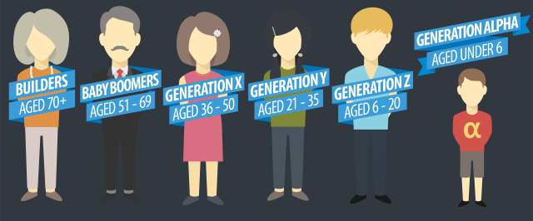
ODL Learners Spanning GENERATIONS

Slide 5
New Generation Learners
FASCINATED WITH TECHNOLOGIES - constantly discovering, curating, giving and receiving feedback and sharing
AUTHENTIC GOALS –
Meaningful and Engaging
SOCIAL LEARNERS - rely on online sources and others to make decisions
APPLICATION to real world situations – WHY not just the WHAT
ACCUSTOMED TO MULTI-TASKING

Slide 6
Changing Profile of Learners
PREFER VIDEOS & AUDIO CLIPS - the ‘YouTube generation’
PANCAKE GENERATION
- Short attention span
VIDEOGRAPHERS
SHORT BURSTS OF INFORMATION
STRUCTURE Clear and definitive outcomes Time Constraints

Slide 7
Changing Profile of Learners
LESS FORMAL LEARNING ENVIRONMENT – ‘Laid back’ setting
COURSES TO LEVERAGE ON THEIR EXPERIENCES
LOWER PROFICIENCY IN ENGLISH
Include students – with DISABILITIES, UNDERREPRESENTED & DISADVANTAGED
Generation ‘C’ -
CONNECT, CONSUME, CREATE & CURATE

Slide 8
Dare You to Predict !!!

Slide 9
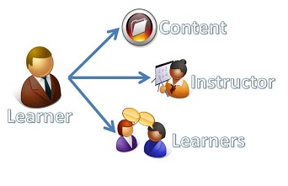
AeU Pedagogical Framework
Moodle Tools & Plugins
Technology Design
Learning Activities &
Social Learning Technological Tools
Assessment Design
Learning
Outcomes
Content Design
Principles of SIM Design

Slide 10
Technology Design
Potential of
Organisation
Topics
Lesson
Delivery
Assignment
Workshops
Collaboration
Glossary
Wikis
Assessment
Choice
Quiz
Survey
Feedback
Communication
Big Blue Button
Forums
News
H5P
Interactive videos
Gamification
Game-based learning
HotPot
Socialwall Format
Moodle Analytics
Offline Quiz
Zoom Meeting
Chatbots
Exabis Games

Slide 11
Content Design
for the New Generation Learners
Content Made ‘Simple but
Not Simpler’
Emphasise Collaborative & Cooperative Learning
Video-Based Learning
Immediate & Continual Feedback
Work-Based Assignments
Courses - Performance-Based
Open Education Resources
- OER

Slide 12
Content Design
for the New Generation Learners
Clear Pathways
Social Learning
Personalisation
Content Curation
Responsive Mobile Learning
Clear Expectations of Course & Assignments
Variety of Assessment Methods
Micro-learning – Snackable & Stackable

Slide 13
CLOs
Table of Contents
Word
Documents
Websites
Pdf
documents
SELF-INSTRUCTIONAL MODULE AS PDF
10 Topics
Learning Outcomes
Video
Clips
PPT Slides
Model 1
SIM
Audio Clips
Digital Library
Case
Study
Online Test
Simulators

Slide 14
CLOs
Table of Contents
Word
Documents
Websites
Pdf
documents
LIST OF READINGS
10 Topics
Learning Outcomes
Video
Clips
PPT Slides
Model 2
Readings
Audio Clips
Digital Library
Case
Study
Online Test
Simulators

Slide 15
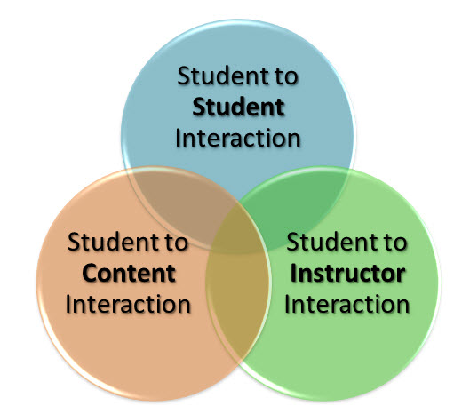
Interaction Design
Big Blue Button

Slide 16
Assessment Design
Work-based – assignments
Video assignments
Audio assignment
Competency-based
Digital portfolios
Mini-projects
Online assessment
Take-home exams
Open-book exams

Slide 17
Harnessing Technology to ……..
DOING …..

Slide 18
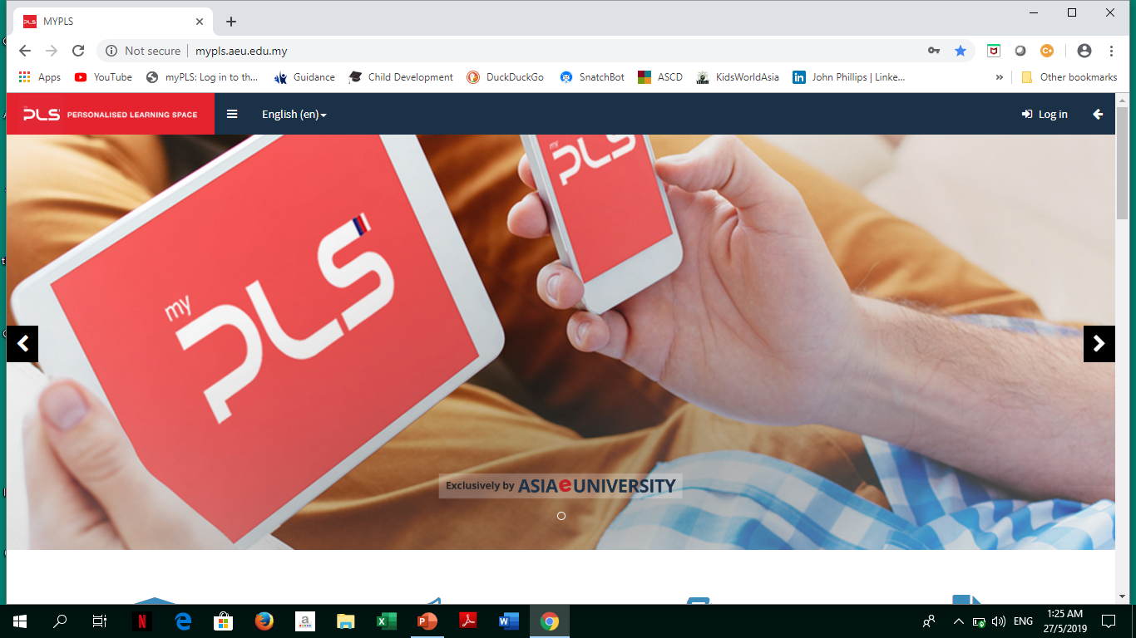
Doctoral Programmes
Valmikiacademy.com
COMPULSORY
Online Research
Methodology Modules
1. Quantitative Research Methods
2. Qualitative Research Methods
3. Doing a Research Proposal
4. Writing the Thesis or Project Paper
5. Thesis Defence
Practice Tests Online
Take Test Online
Awarded

Slide 19
The Future of Education?

Slide 20
Meeting the
needs …..

Slide 21
Performance-Based
Competency-Based
Available on Demand
Verifiable
Portable
Job Embedded
Affordable
Personalised
Bite-Size
Stackable
Learning by Doing
Flexible
Demonstration of Skills

Slide 22
Digital Badges
Certified Professional
Free-Standing Courses / MOOC
400 Courses
With SIMs
Areas:
Education
Management
Business
Information Technology
Creative Multimedia
Social Science
Research Methodology
Islamic Studies
Nano-Degree
Micro-Master
Micro-Certification
Specialisation
Micro-courses /
Microlearning

Slide 23
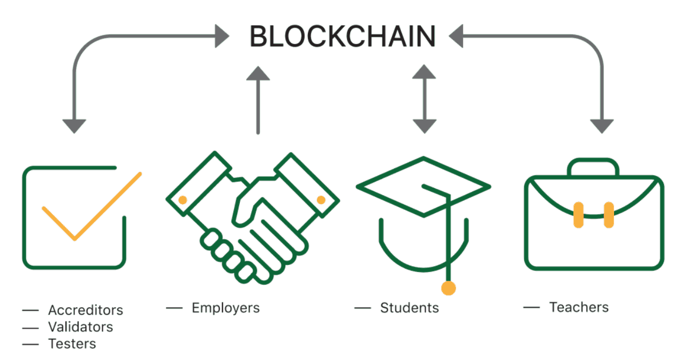
Distributed Ledger
Reduce data breach
e-Portfolio
Privacy
Transparency
Links Students with Employers
Verification of competencies
Student
Records
Badges – Specific competencies
AF
Records
Validate
Student Assignment & Attendance
Smart
Learning
Contracts
Credit Transfer
APEL
Share
Credentials

