Slide 1




The 33rd Annual Conference of the Asian Association of Open Universities

Slide 2
Introduction
Architecture (ICT)
Production Facility
Courses/Trainers
Enrollments and Demographics
Trainee Support Services

Slide 3
Future of Work
Knowledge workers offering skills/services online using ICT
Online outsourcing business expected to generate revenue between $15 – 25 Billons by 2020.
Major share of this business is taken over by individuals working as Freelancers
Pakistan is 4th largest provider of skilled freelancers globally
Estimated revenue/foreign exchange generated is $500 million to $1.3 Billion

Slide 4
Introduction to DSTP
To seize the opportunities available in online international job market places
To equip our youth, freelancers, students, professionals, etc.
  with the knowledge, skills, tools & techniques necessary to seize the opportunities available in online job market places
  to earn a living or to supplement their income.
To realize the untapped potential of our educated youth, women and others.
Individuals and their community may reap the benefits
Ultimately the growth will be represented in a flourishing national economy as foreign exchange earnings are realized.

Slide 5
Aims of DSTP
Impart One million trainings
Increase the number of
  Individuals working as freelancers in the country, specially youth and women
  Household incomes
  IT exports
  Experts in specialized skills
  The scope/ range of skills possessed by the Pakistani HR
  Improve contemporary skills possessed by the Pakistani HR

Slide 6

Target Trainees
Existing Freelancers
Vocational Trainees
Students (matric onwards)
Housewives
Journalists
Graduates
Employed
Self employed
Unemployed

Slide 7
DSTP Structure
DigiSkills Training Project
DigiSkills Outreach Project
DigiSkills Monitoring & Evaluation (M&E) Project

Slide 8
Scope of DigiSkills Training Project
High quality & engaging online video content designed, developed and delivered by VU
Non-Captive audience
Development of Web Portal & Learning Management System (LMS)
Setting up IT infrastructure for hosting LMS and Web portal
Making content accessible online to trainees
Overarching trainee support services with a comprehensive team of qualified Coaches
Helping and guiding trainees for enhanced training experience and course completion
Managing complete project and operations of online training
MIS generation of key data and reports for data analysis, monitoring & evaluation
Operations & maintenance for 24/7 availability of the web portal & LMS, etc.
Collaboration and coordination with other two elements of the program for outreach and M&E

Slide 9
ICT Highlights
Responsive, elegant and easy to use Web Portal
“Skilly AI Chatbot”
Robust and secure LMS
Scheduled/Self-paced learning facility
Topics videos with week-wise study plan
Moderated discussions forum
Online quizzes & hand’s on Exercises

Slide 10
Architecture (ICT)
Showcasing of Success Stories
Trainees progress timeline
Personalized/Customized themes for LMS
Online support system
DigiSkills.pk Mobile App
Realtime Reporting & Analytics

Slide 11
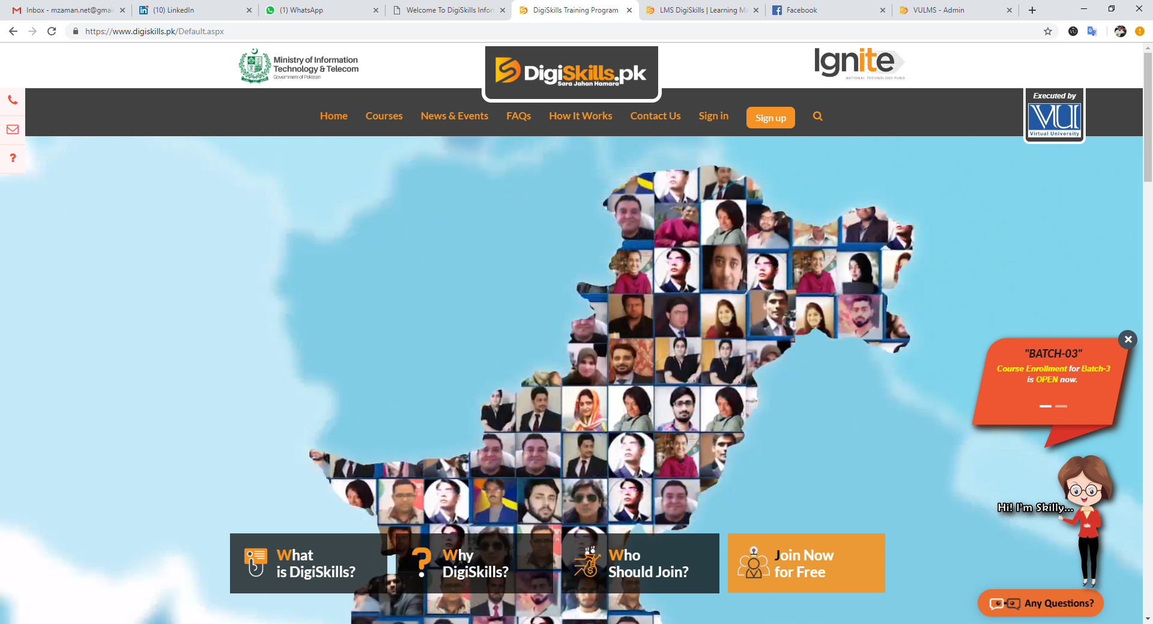
Responsive, elegant and easy to use Web Portal

Slide 12

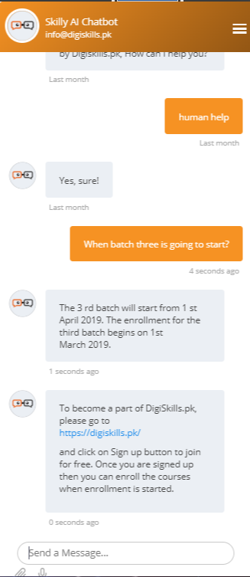
“Skilly” AI Chatbot

Slide 13
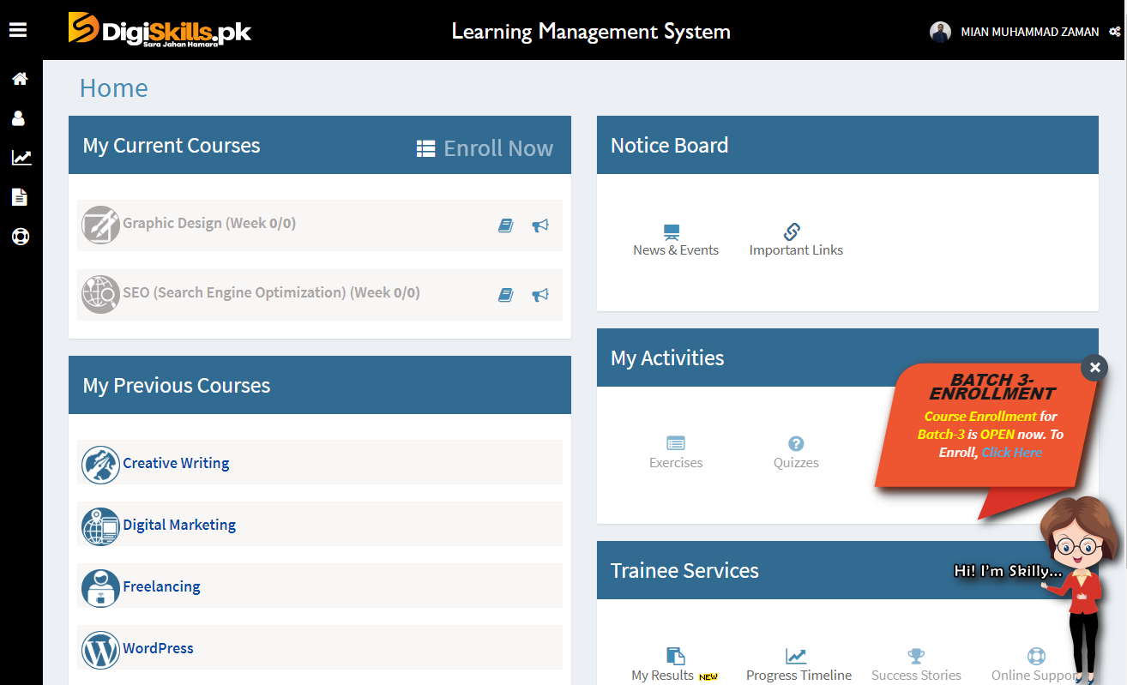
Robust and secure LMS

Slide 14
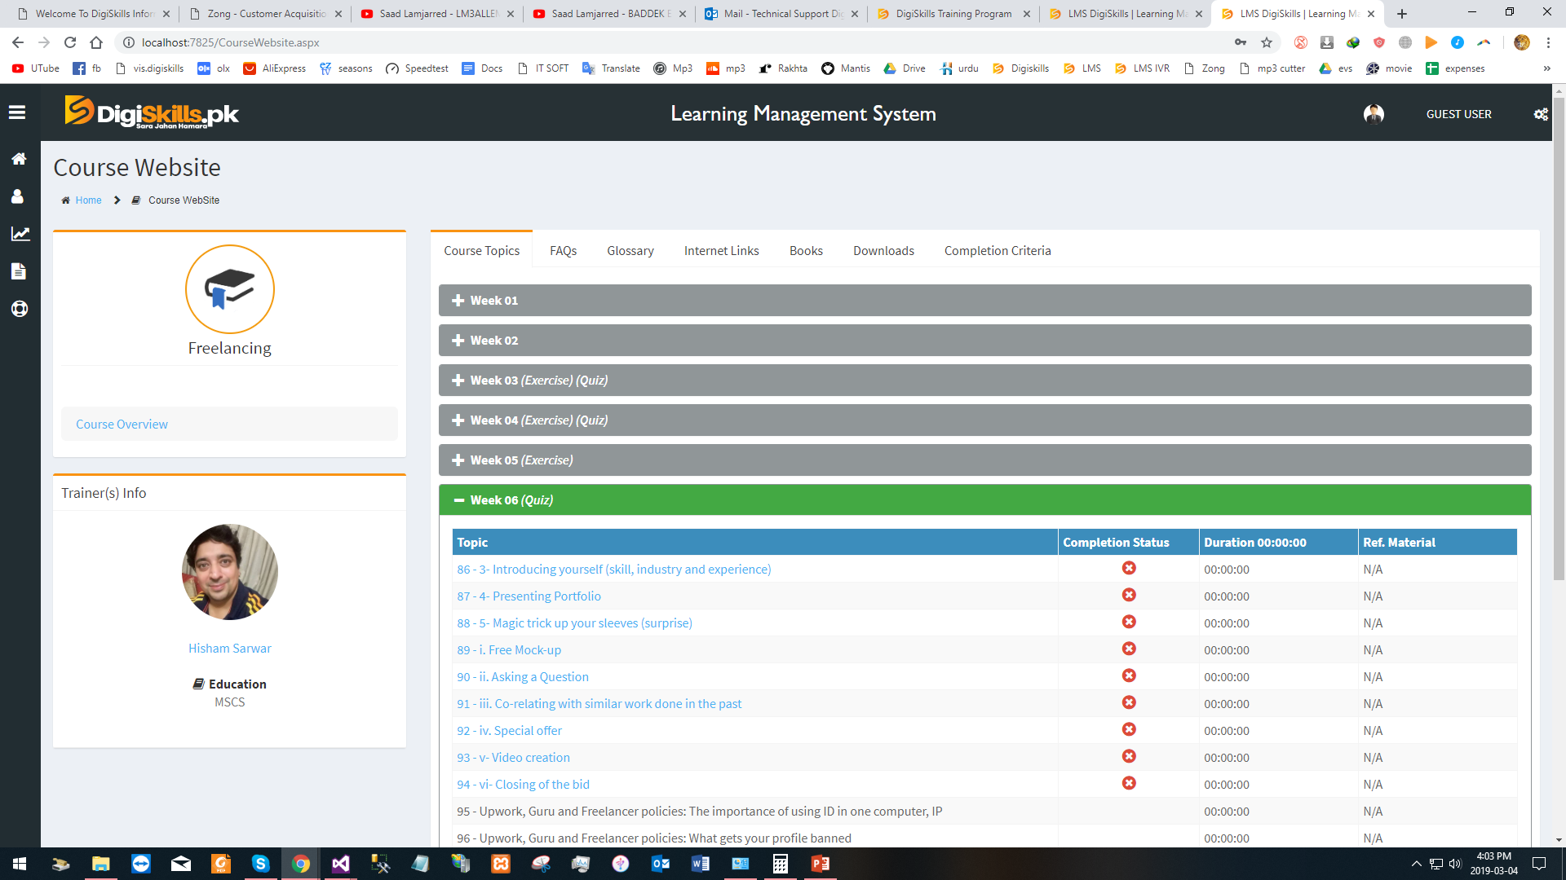
Scheduled/Self-paced learning facility

Slide 15
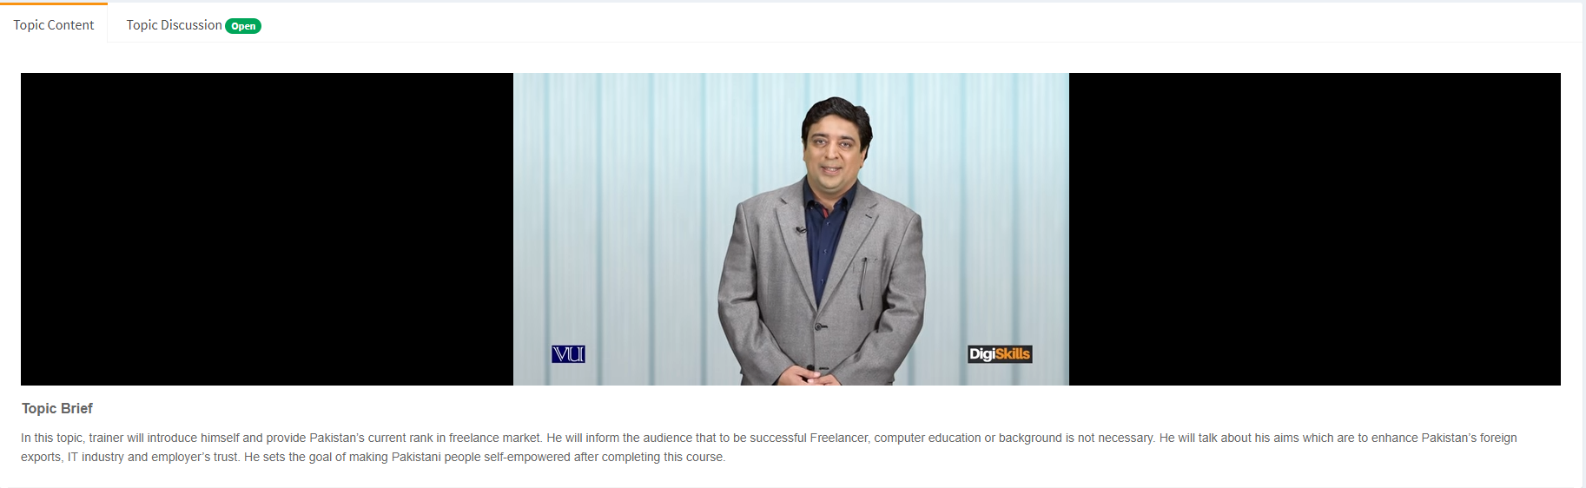
Topics videos with week-wise study plan

Slide 16
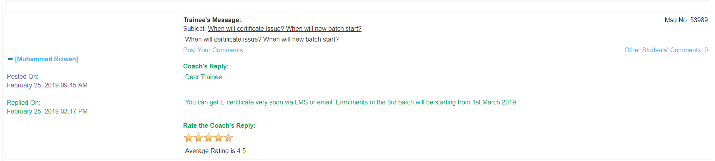
Moderated discussions forum

Slide 17
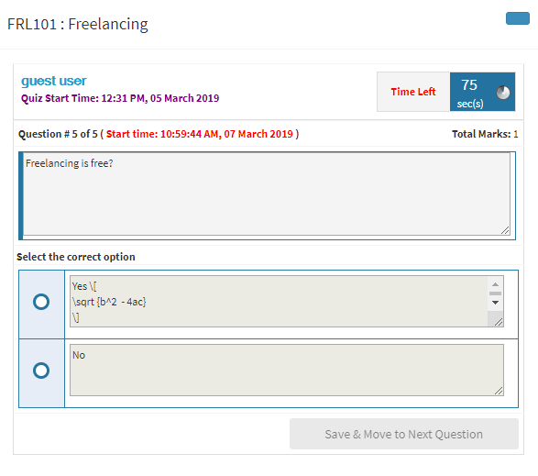
Online quizzes & hand’s on Exercises

Slide 18
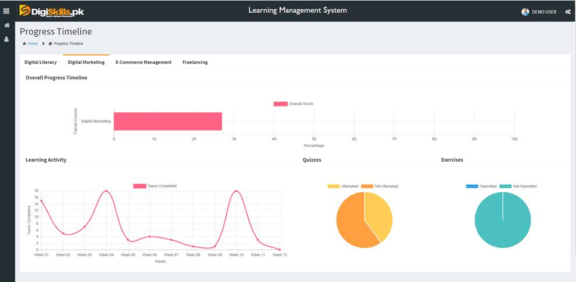
Trainees progress timeline

Slide 19
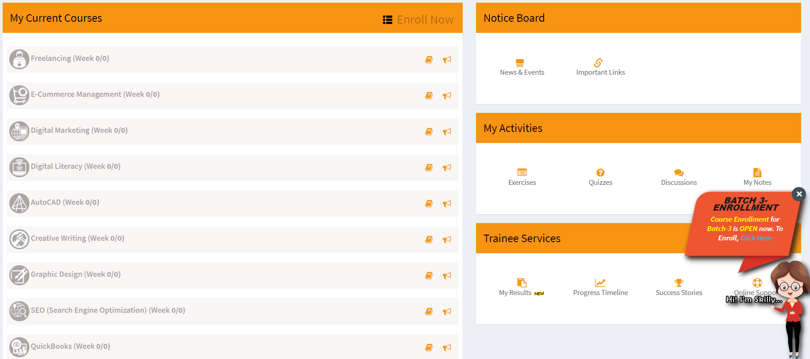
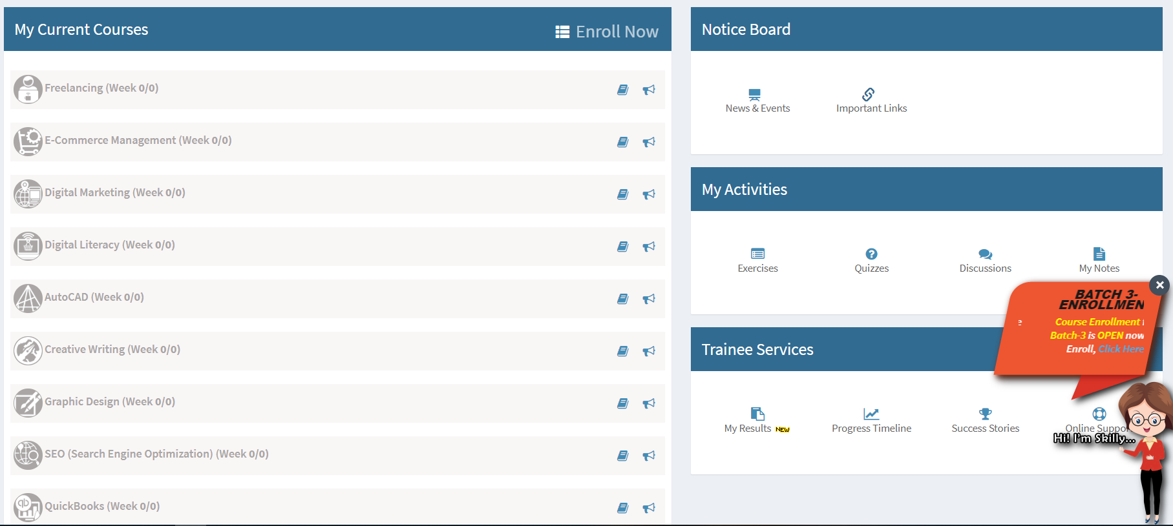
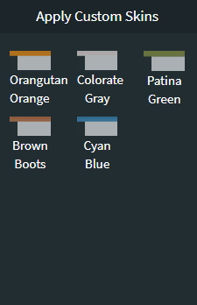
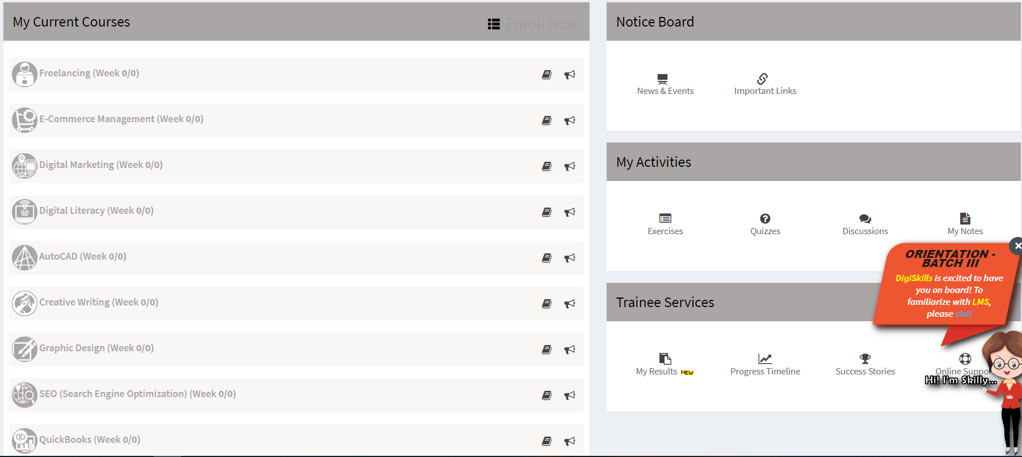
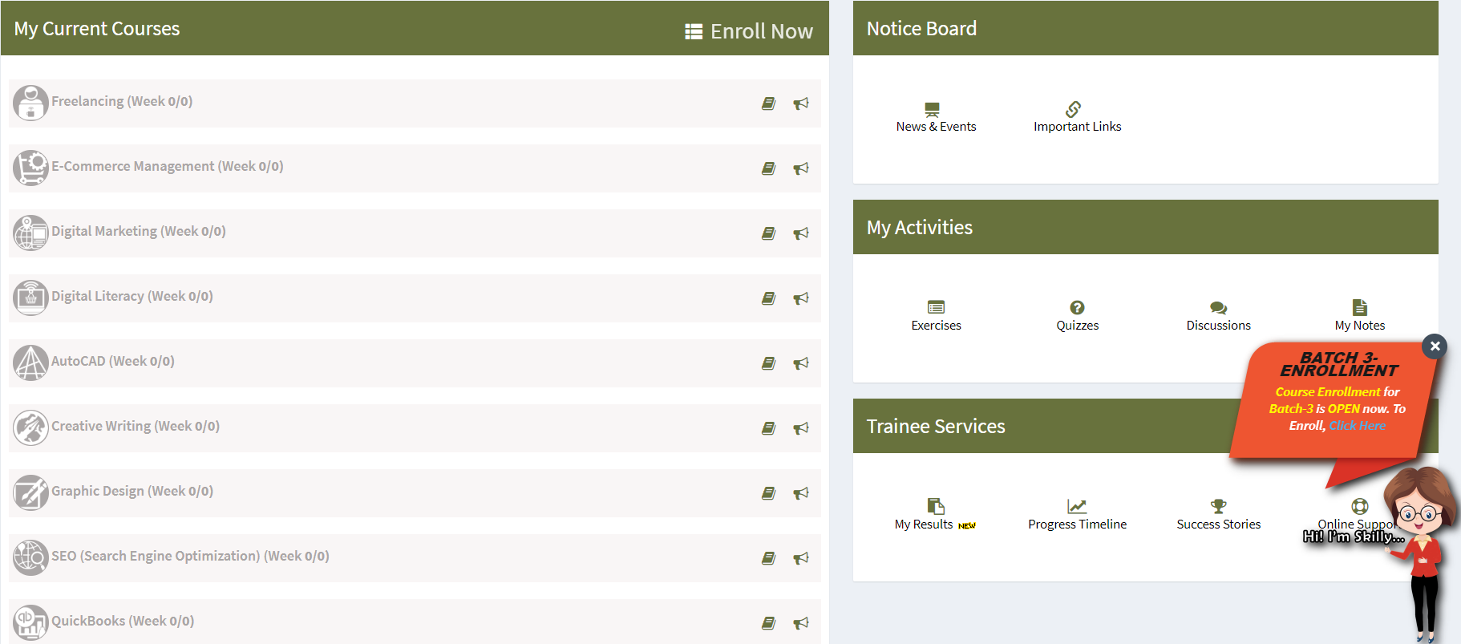
Personalized/Customized themes for LMS

Slide 20
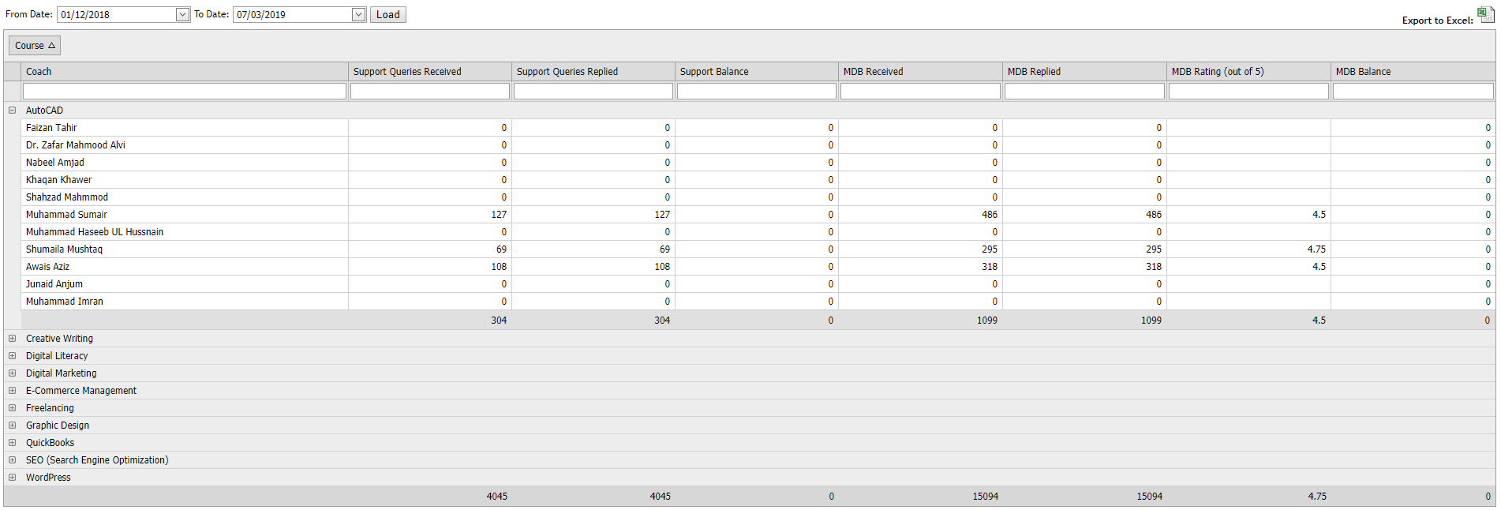
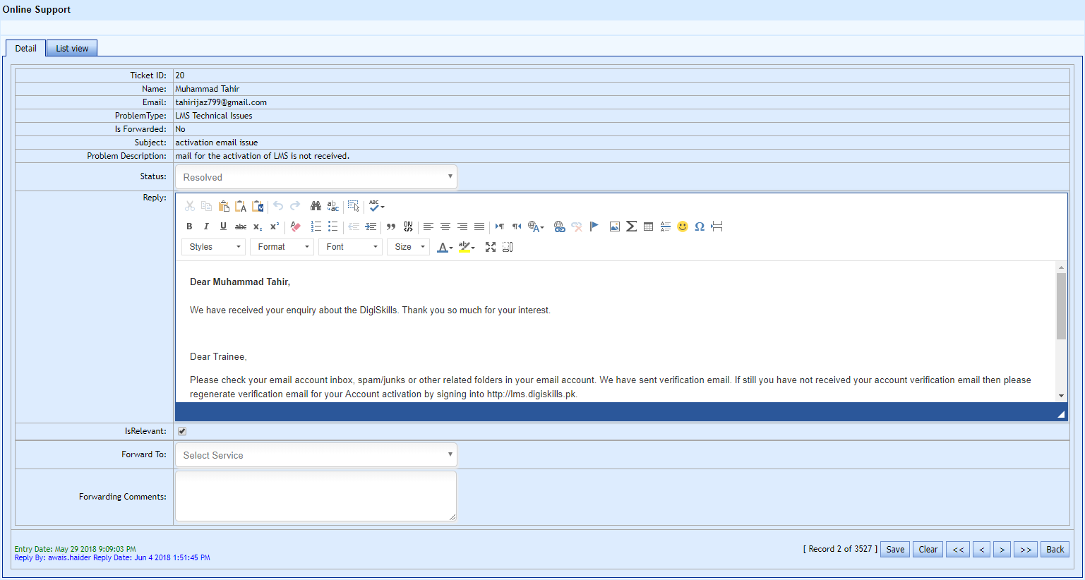
Online support system

Slide 21

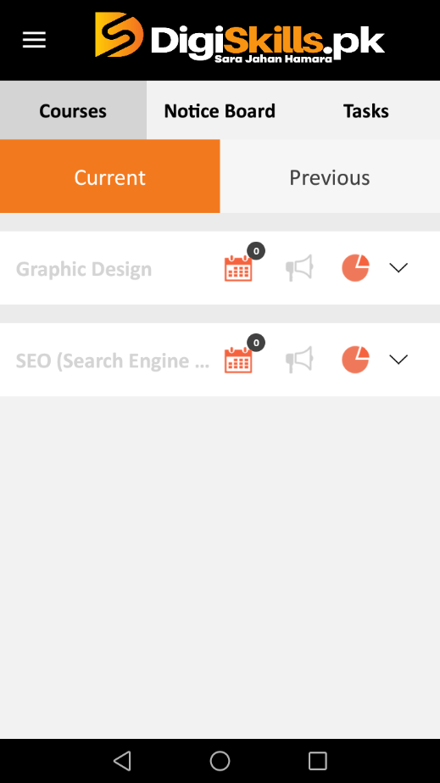
DigiSkills.pk Mobile App

Slide 22
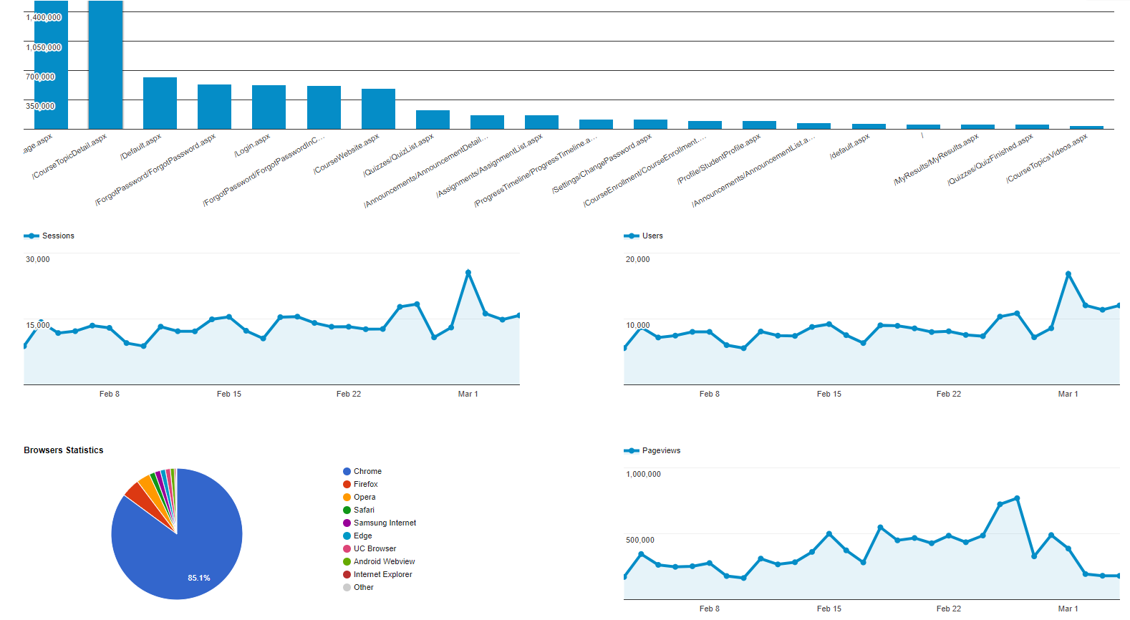
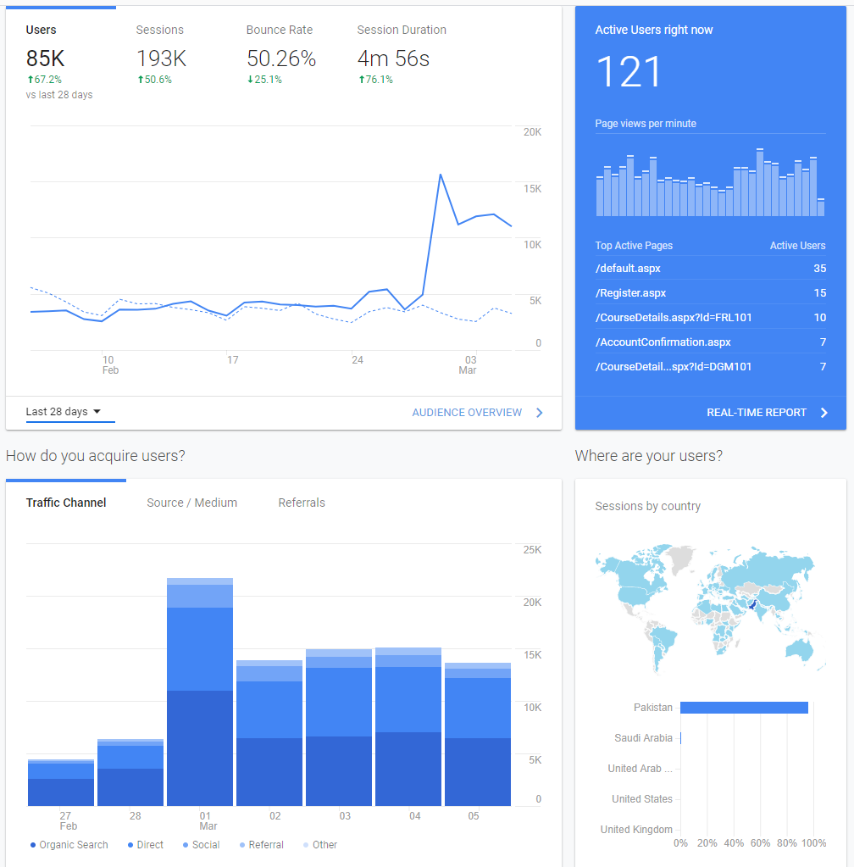
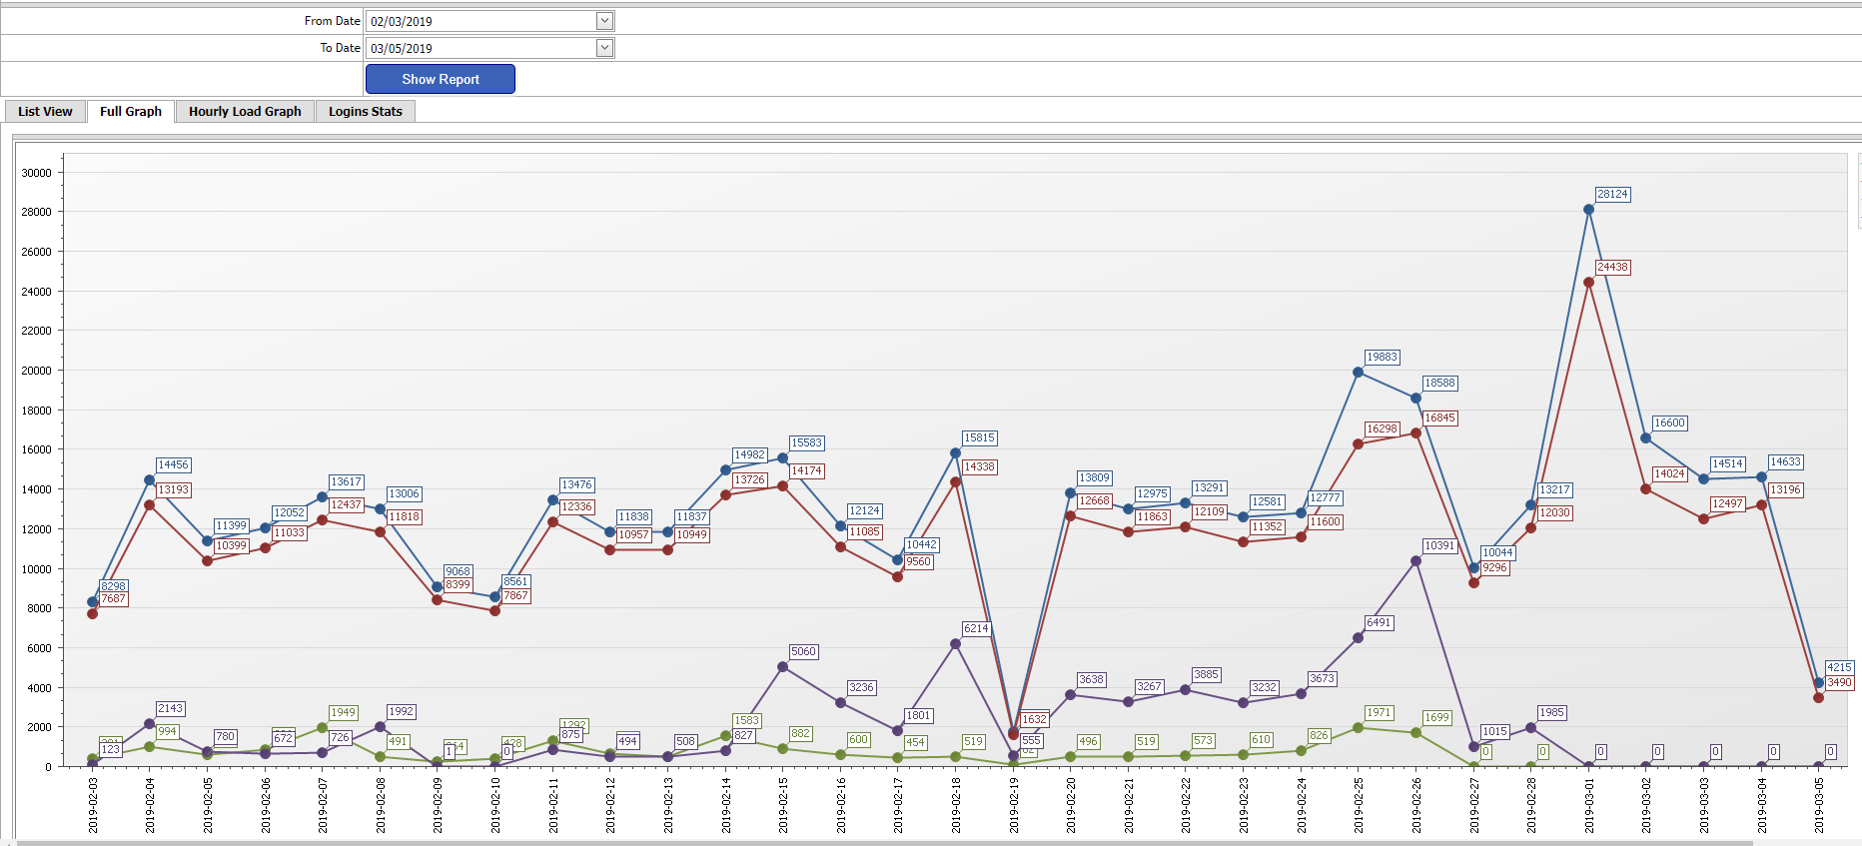
Real-time Reporting & Analytics

Slide 23
Production

Slide 24


Slide 25
DigiSkills.pk
Hisham Sarwar (Freelancing)
Dr. Yasir Rashid (Digital Marketing)
Saad Hamid (WordPress)
Usman Latif (SEO)
Syed Hassan Adnan (QuickBooks)
Yasir Javed Dogar (Graphic Design)
Syed Arif Hussain (AutoCAD)
Sheraz Pervaiz (E-Commerce)
Amena Kamal & Ayesha Fazlur Rahman (Creative Writing)
Trainers

Slide 26
Enrollments
Batch | Enrollments
Batch-01 | 30,924
Batch-02 | 81,119
Batch-03 | 200,331
Batch-04 | 220,000

Slide 27
Enrollments
Batch 1 Enrollments
  Male 23,883
  Female 7,045
  Total 30,932
Batch 2 Enrollments
  Male 64,069
  Female 17,052
  Total 81,121
Batch 3 Enrollments
  Male 1,56,818
  Female 43,513
  Total 2,00,331
Batch 4 Enrollments
  Male 1,63,203
  Female 56,797
  Total 2,20,000

Slide 28
Qualification Wise Summary
Graduation 11,940
Intermediate 6,600
Masters 8,233
Matric 1,260
MS/Mphil 1,580
PhD 24
Post-Doc 12

Slide 29
Province Wise Sign-ups
AZAD KASHMIR 4,222
BALOCHISTAN 3,962
CAPITAL 24,662
KHYBER PAKHTUNKHWA 31,721
Punjab 2,37,330
SINDH 93,904
Other 1,24,941

Slide 30
Trainee Support Services
Training material
  Videos
  Handouts
  PPTs
  Hands on Exercises
  Quizzes

Slide 31
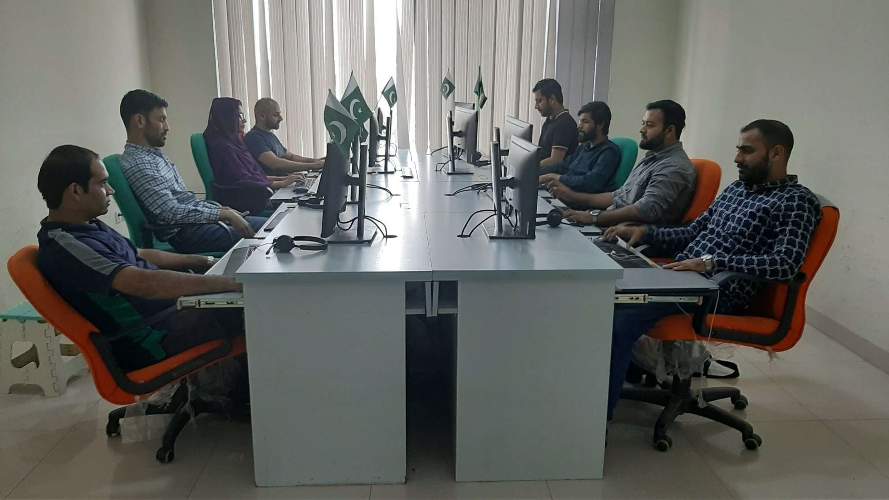
Trainee Support Services

Slide 32
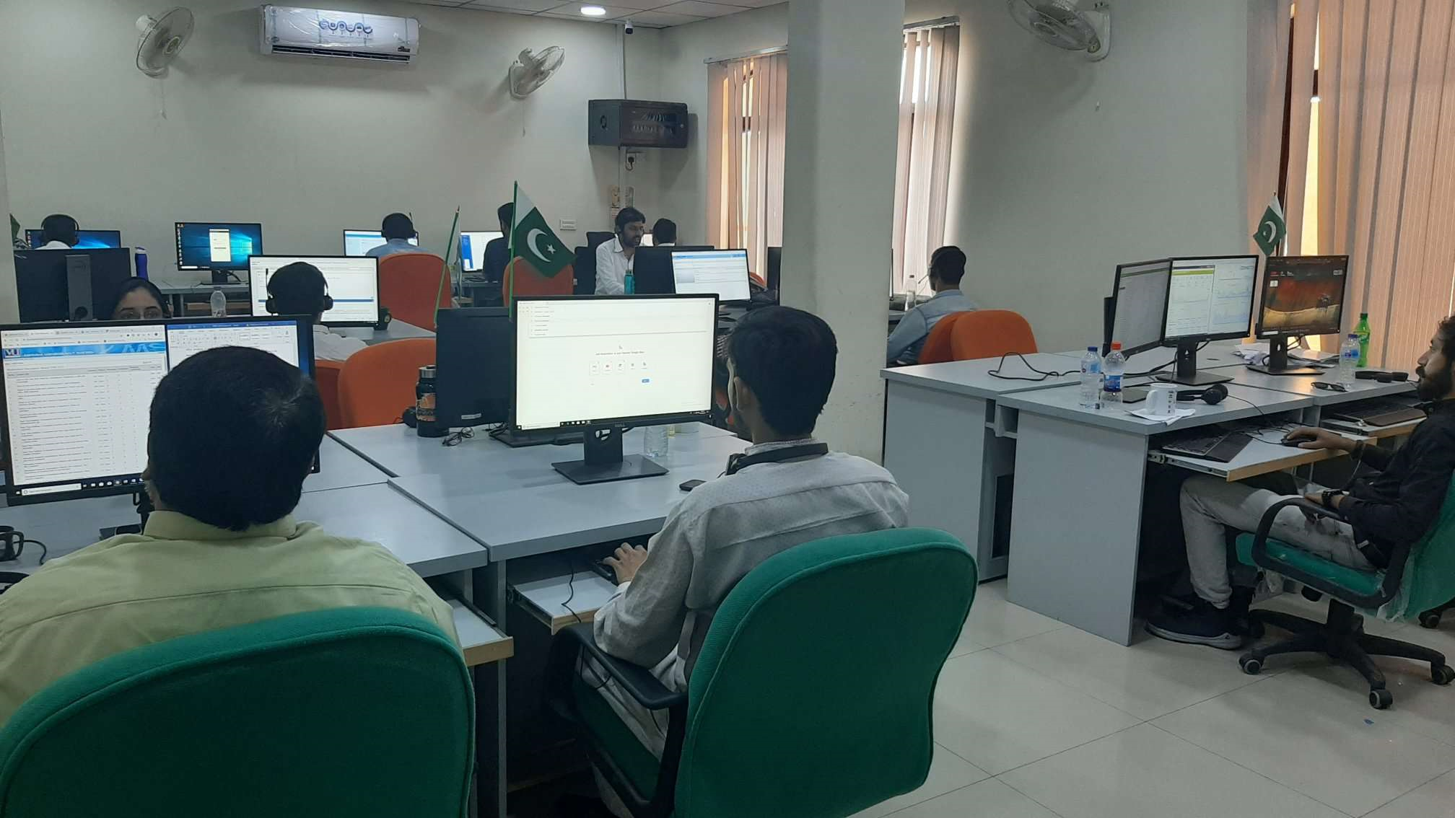
Trainee Support Services

Slide 33
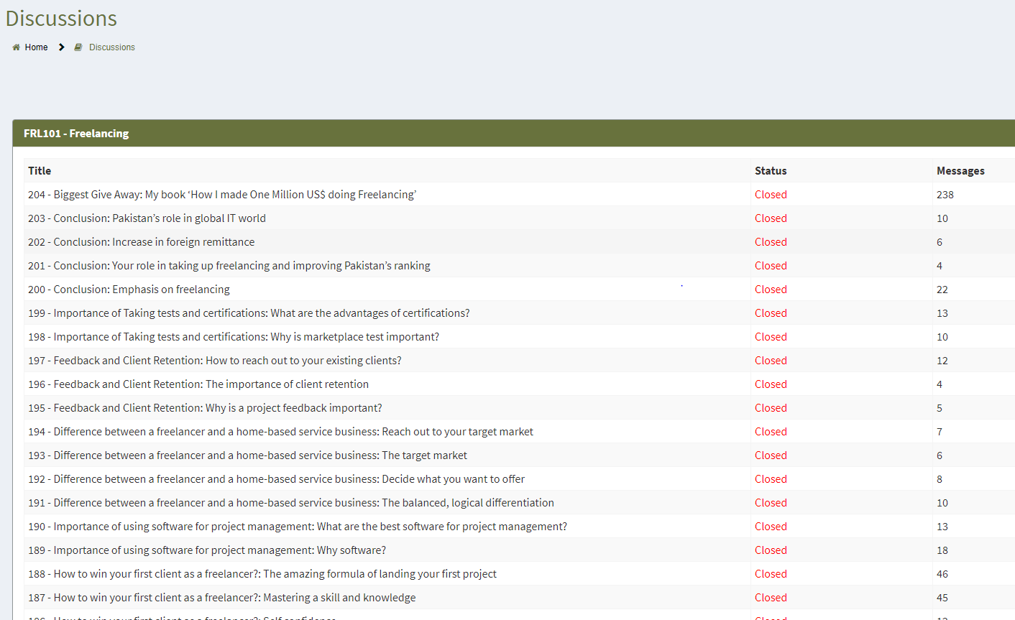
Trainee Support Services
MDB (Moderate Discussion Board)
  Discussion board is available for
  each topic to ask topic related
  queries
  Trainees can initiate and
  participate in discussion
  Queries on MDB are responded
  on priority basis
  Trainees can rate the responses

Slide 34
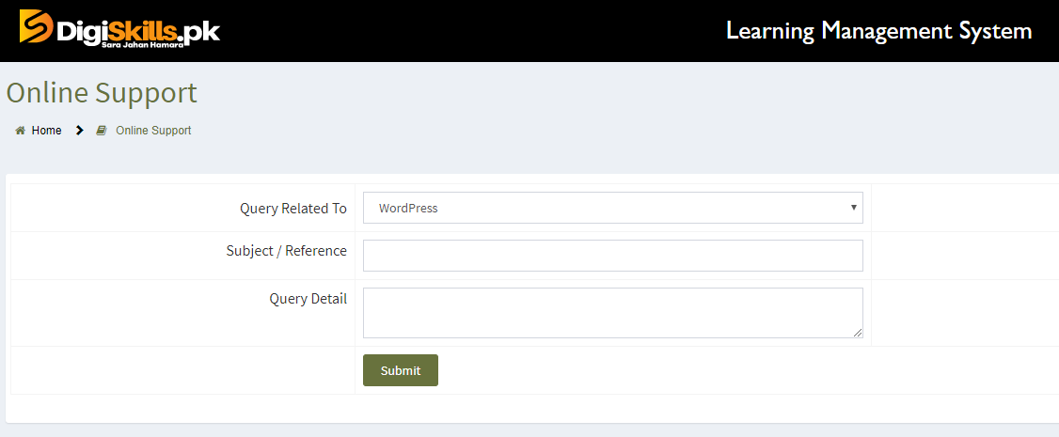
Trainee Support Services
Queries via Web Portal
  Queries web portal is available
  for general queries
  Project level queries
  Technical queries
  Trainees can ask questions
  individually

Slide 35
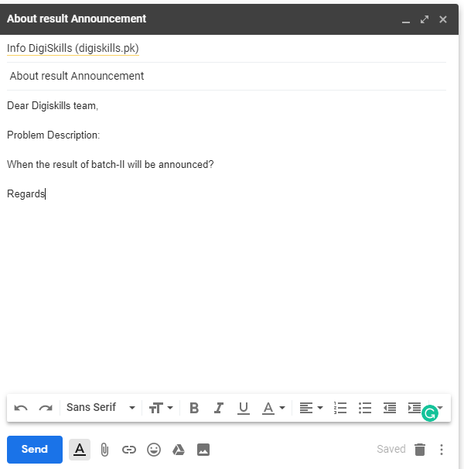
Trainee Support Services
Emails
  Trainees can email us at
  info@digiskills.pk to ask queries

Slide 36
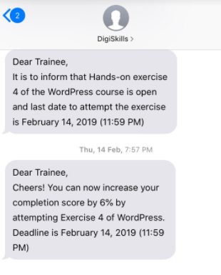
Trainee Support Services
SMS
  Reminder SMS to trainees about
    important events (Quiz submission etc.)
  Motivational SMS
Phone calls
  Trainees can call us at 0311-111-3444
  Types of calls
    Inbound (Trainees can ask queries on call)
    Outbound (Motivation calls to complete the training)

Slide 37
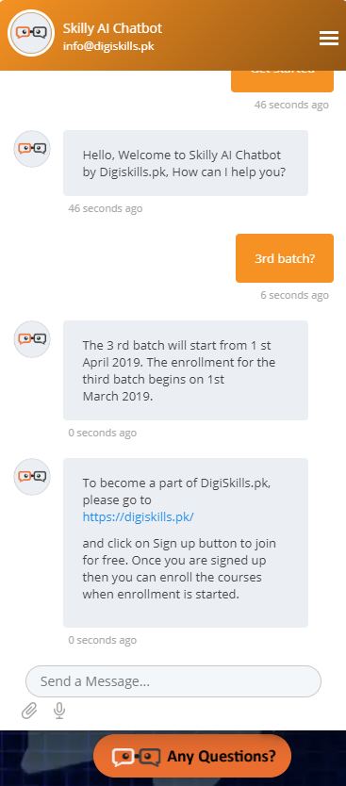
Trainee Support Services
Website: Chat Bot
  Skilly AI Chatbot at DigiSkills.pk
  Automated response, quick assistance
  General queries
  Human Agents to reply un-replied quires

Slide 38
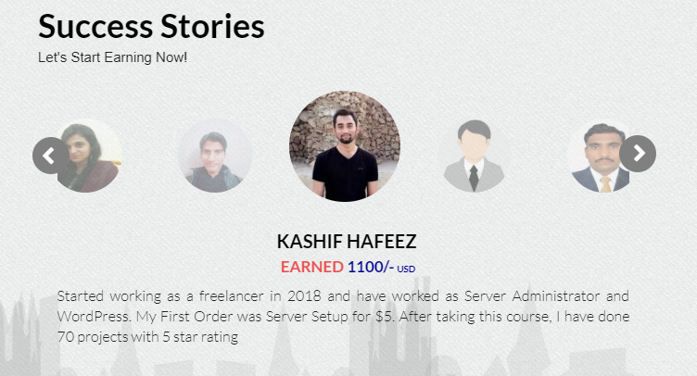
Success Stories
Trainees are encouraged to share
their success stories in Freelancing.
Can be added in Trainee’s Services
section of LMS Home
Approved stories are shared on the
Digiskills.pk website

Slide 39
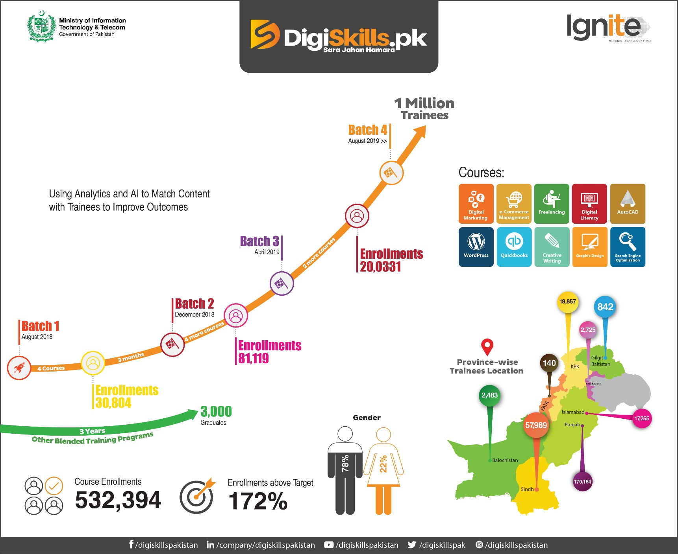
Success
Stories

Slide 40
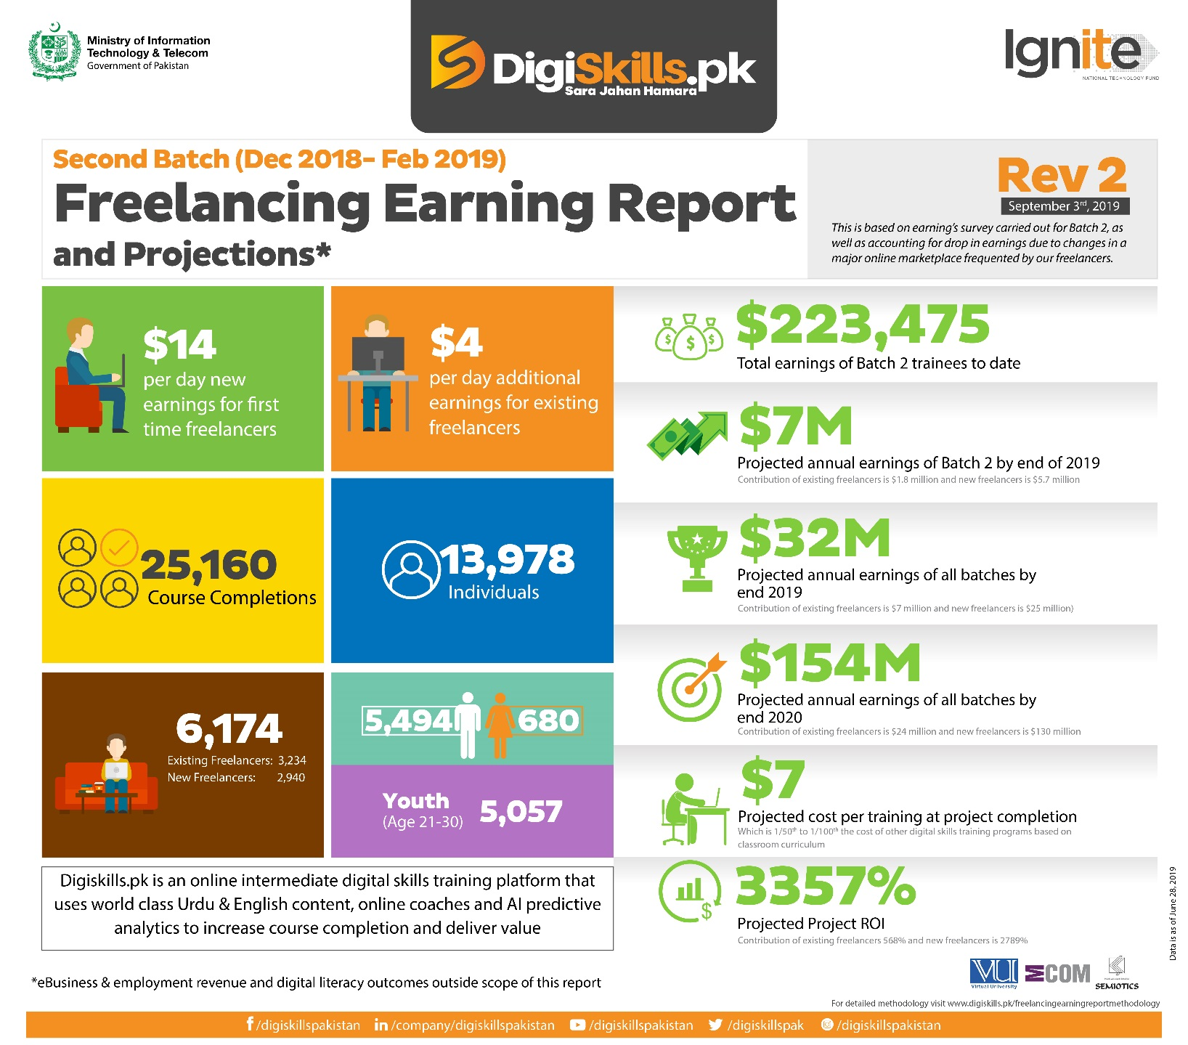
Success
Stories

Slide 41


Slide 42
Q&A

