Slide 1
Application of information technology in managing the foreign language training centers to meet the requirements of fundamental and comprehensive innovation of Vietnamese education
HANOI OPEN UNIVERSITY
Presenter: Dr. Dinh Tuan Long

Slide 2
TABLE OF CONTENTS
02
01
INTRODUCTION
APPLYING ICT IN MANAGEMENT OF FOREIGN LANGUAGE CENTER
Information gathering (online)
Statistics and reports (for state management)
Self-assessment (according to the set of criteria)
Storing learning results (blockchain)
Publicizing information with society
Proposing implementation plan
03
CONCLUSION

Slide 3
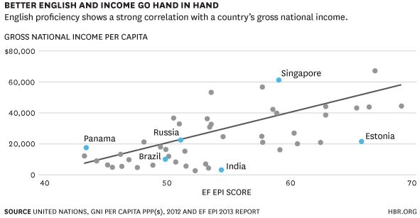
INTRODUCTION
01
Figure 1: Better English has better live (United Nations Report)
Notes:
According to the statistics of researchers who are good at using foreign languages, English can be successful in many fields and can advance in their careers. Especially in the era of the ongoing 4.0 revolution, English in particular and other popular languages ​​such as Japanese, Chinese and French ... play an important role in life.

Slide 4
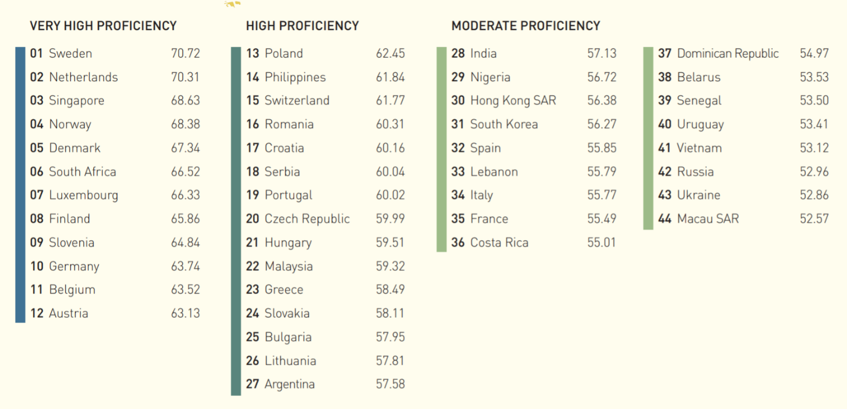
01
INTRODUCTION
Figure 2 - English Proficiency Index Ranking 2018 (EF Reports)
Notes:
Also according to EF's report in 2018, the level of Vietnamese proficiency in English is ranked at 41 out of 88 countries, belonging to the average proficiency level (EF EPI 2018). The results of this report are based on a survey of 1.3 million people, of which 92% are under 40 and the average age is 26, of which 60% are female and 40% are male. The test takes 15, 50 minutes or 2 hours, and only has two reading and listening skills.

Slide 5
Only about 20-30% of students can study English at university.
The official education system does not have enough investment to teach practical language skills.
English Training Centers in Vietnam were born and contributed a great deal of effort in improving the foreign language level of the people
Current situations of Vietnamese students in learning English
Notes:
We cannot deny the role of foreign languages, especially English in modern life, so the Vietnamese government also offers many policies to encourage English training for people. However, looking at the reality of foreign languages ​​of education in Vietnam in recent years shows many challenges posed to this problem. The application of English teaching materials at all educational levels in recent years has brought about ineffective results, making parents and society not really satisfied.
In fact, in Vietnam, students official learn English from grade 3 to grade 12 in school but most of them nearly cannot listen, reading and writing. Most of the levels only stop at the simple words, greetings, introduction of names and common social sentences, but cannot tell a short story in English about 100 words. According to information from universities (in 2012), the ability of students to use English is still weak, only about 20-30% of students can study English at university, the rest must learn classes preparatory before entering the official English class. According to information from enterprises, the English proficiency level of graduates has not met the demands of the job well; mainly reading comprehension materials, but communication, writing, and presentation skills are very weak.
The cause of such ineffective English learning partly because the official education system does not have enough investment to teach practical language skills such as listening, speaking and writing. The teachers who teach English only to take the examinations are the main target, so they don't invest in other skills, especially listening and speaking. Large class sizes and lack of assistive technology make it difficult to teach effective language practice skills. The motivation to study English of students and students is mainly to learn to pass the exam but not to practice practical language skills. Because of that reason, English Training Centers in Vietnam were born and contributed a great deal of effort in improving the foreign language level of the people. Foreign Language Centers (mainly English) are open nationwide, helping to socialize education, bringing benefits to people in need.

Slide 6
How to manage language centers effectively ?
Current situations of Vietnamese language centers
4,000
FOREIGN LANGUAGE TRAINING CENTERS
Focus on big cities
Hard to control the quality of language centers
Many teachers haven’t got any degree or pedagogy skill
The establishment of a language center is quite difficult with many complicated procedures
Notes:
According to the statistics of 2017 of the Continuing Education Department - Ministry of Education and Training, Vietnam, there are currently more than 4,000 foreign language training centers nationwide with a variety of investors and enterprises. However, ensuring the quality of language centers is an urgent issue, with a large number of people, the quality and efficiency of training are hard to recognize. Many centers do not have formal training programs but are still ready to issue certificates when students need it
The statistical survey results on the location show that: Up to 76% of the language centers in big cities; 14% of the centers in urban areas; 7% of the centers in areas with favourable conditions. Only 3% are taught throughout the remote areas. A large number of foreign language centers in big cities are privately opened, which are all majestic, advertised as top quality, exclusive of the most modern English teaching methods. However, when it comes to learning many people are disillusioned because the teachers are said to be carefully selected but in fact native teachers are temporary working persons who do not have any degree or pedagogy skill. Vietnamese teachers are mostly young teachers and even last year students in language universities, they are enthusiastic, but their qualifications are limited. Many people teach English but pronounce incorrectly, there is no proper teaching method, not to mention there are also centers that arbitrarily display their names with reputable organizations or famous lecturers to deceive learners. That not means in Vietnam there are all low-quality foreign language centers, but there are still many reliable English language learning addresses, high standard textbooks, qualified teachers and teachers. High expertise, quality is assessed by the fact from the results of each student when completed and applied in practice

Slide 7
02
Applying ICT in management of foreign language center
Information gathering (online)
Statistics and reports (for state management)
Self-assessment (according to the set of criteria)
Storing learning results (blockchain)
Publicizing information with society
Proposing implementation plan
Notes:
The statistical survey results on the location show that: Up to 76% of the language centers in big cities; 14% of the centers in urban areas; 7% of the centers in areas with favourable conditions. Only 3% are taught throughout the remote areas. A large number of foreign language centers in big cities are privately opened, which are all majestic, advertised as top quality, exclusive of the most modern English teaching methods

Slide 8
Information gathering (online)
There are many methods of online information collection that have been used on many different subjects and fields. Almost are used questionnaires with many answers.
A new direction: Combining online questionnaires and long-term cumulative database systems
Notes:
A large number of Foreign language centers across the country with specific characteristics of training management and unit operations. There are many foreign language centers operating their own management software systems that are not homogeneous. Besides, most of these units perform manual management in combination with calculation and reporting tools. This situation leads to difficulties in data synthesis according to the analysis of state management objectives.
There are many methods of online information collection that have been used on many different subjects and fields. Most of the methods used are questionnaires with many answers and have brought certain results as well as proven to be suitable for the needs of information synthesis. However, for the problem of this study, if only the method of using online questionnaires is applied, there will be no accumulation and analysis of change over the years. A new direction in implementing online data collection should be introduced. So the best methodology is combining online questionnaires and long-term cumulative database systems for foreign language centers. This method both ensures convenience when declaring to units as well as ensuring data inheritance and concentration

Slide 9
Statistics and reports (for state management)
For statistical activities, previous reports were done manually and through many levels of adjustment, additional information leading to many delays and lack of accuracy.
Proposed solutions: Providing online statistics and reporting systems tightly integrated with the survey system of foreign language centers,
Notes:
For statistical activities, previous reports were done manually and through many levels of adjustment, additional information leading to many delays and lack of accuracy. According to the Government's general roadmap for implementing e-Government development for line ministries, the national reporting information system is one of the very important components - where the information gathered from local to central level in all areas of national activities.
In order to work towards a common roadmap for data integration and sharing in statistical reporting, appropriate orientation of data is needed. This statistical module should be closely associated with the online information collection system. By providing online statistics and reporting systems tightly integrated with the survey system of foreign language centers, the research team wants to bring the most useful tools for state management agencies to have The data can be monitored quickly, providing consistent information to serve the purpose of managing and making decisions about the operational policies of language centers across the country

Slide 10
Self-assessment (according to the set of criteria)
The inspection and evaluation of educational institutions so far have been carried out completely manually and need several times.
If applying the automatic grading according to the set of criteria in the collection of online bring many advantage
Automatically score and rate the standard
Automatic classification according to the set of evaluation criteriainformation will
Notes:
The inspection and evaluation of educational institutions so far have been carried out completely manually and need several times to collect enough data to classify an educational institution according to the set of criteria. Based on the set of criteria for evaluating and ranking foreign language centers of this research topic, the team found that if applying the automatic grading according to the set of criteria in the collection of online information will bring many advantages. For a foreign language center, when making information on the online management system, the system can automatically score and rate the standard. The automatic classification according to the set of evaluation criteria will greatly support the ministries and agencies when implementing the quality accreditation of Foreign language centers across the country.

Slide 11
Storing learning results (blockchain)
The situation of granting foreign language certificates across the country:
The allocation is done manually
No system of national concentration on the grassroots level
Using illegal certificates
BLOCKCHAIN
Notes:
The situation of granting foreign language certificates across the country is generating many problems: the allocation is done manually, there is no system of national concentration on the grassroots level. certificate data, there are some cases of using illegal certificates, etc.
Following the trend of the 4.0 revolution, the blockchain and its applications are being widely adopted. Advantages of blockchain: distributed storage, preventing illegal changes, ensuring the correctness of data stored in the blockchain. Implementing a blockchain system for managing foreign language certificate data will help improve existing shortcomings.

Slide 12
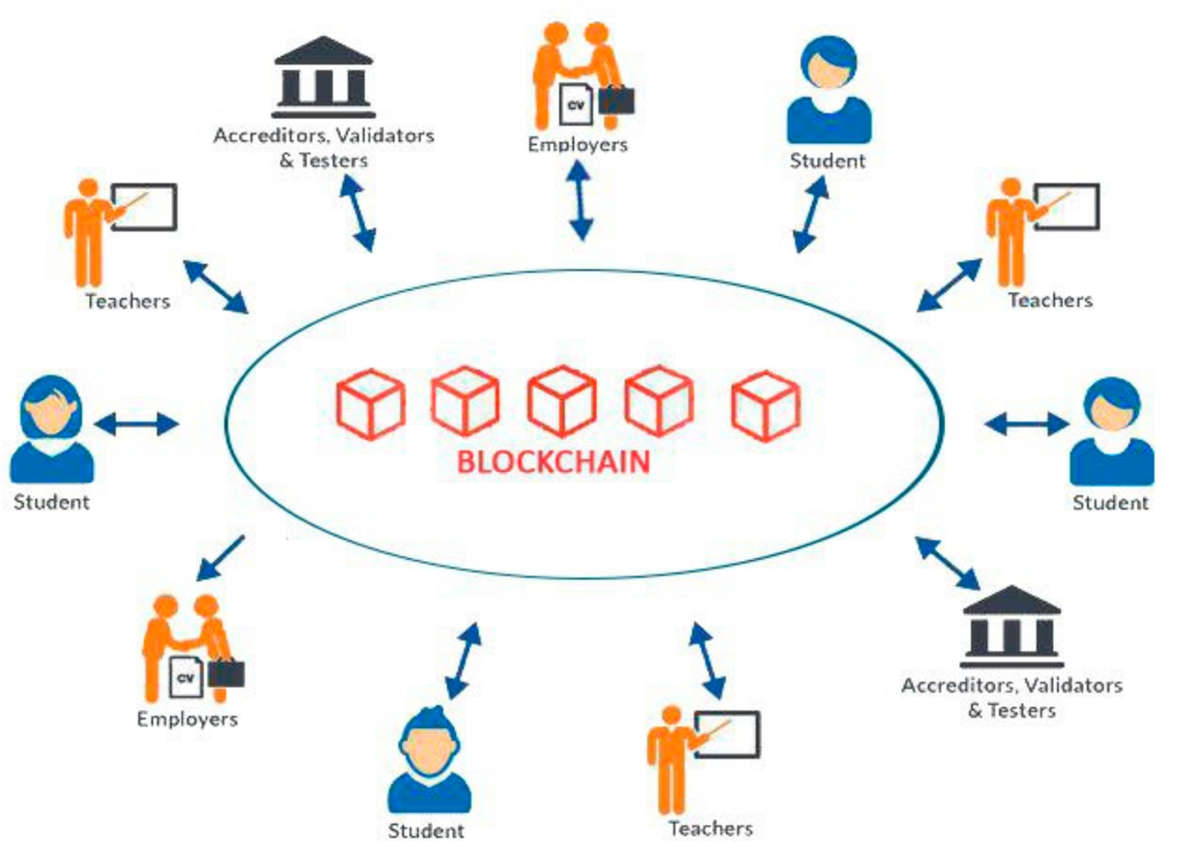
Storing learning results (blockchain)
BLOCKCHAIN
Learners' learning results at authentic centers will be stored and shared via blockchain technology.
The results is verified, long lasting, can be changed and will be used when learners start at a new learning center or use when applying for a job.
Notes:
The situation of granting foreign language certificates across the country is generating many problems: the allocation is done manually, there is no system of national concentration on the grassroots level. certificate data, there are some cases of using illegal certificates, etc.
Following the trend of the 4.0 revolution, the blockchain and its applications are being widely adopted. Advantages of blockchain: distributed storage, preventing illegal changes, ensuring the correctness of data stored in the blockchain. Implementing a blockchain system for managing foreign language certificate data will help improve existing shortcomings.
In our study, learners' learning results at authentic centers will be stored and shared via blockchain technology. These results is verified, long lasting, can be changed and will be used when learners start at a new learning center or use when applying for a job. Learners don’t need any external credential to prove that they already get some training process.
However, this need to have a long roadmap to implement, within the scope of this study only refer to as a new deployment direction

Slide 13
Publicizing information with society
Publicizing information about foreign language centers brings many benefits:
Prividing many informations to learner.
Quality assurance of a language center.
Supporting to supervise the activities of the language center
Notes:
Publicizing information about foreign language centers brings many benefits to learners and is the clearest proof for the legitimacy and quality assurance of a language center. . Information disclosure allows residents to supervise together with state management agencies on the operation of foreign language centers across the country. Disclosure of information helps learners to easily select reputable and quality training units, avoiding the risks of participating in illegal or poor quality units

Slide 14
Proposing implementation plan
Developing a system of criteria to assess the status and quality of a language center
01
03
02
Completing a set of evaluation standards for foreign language centers
Building information collection system of foreign language centers across the country
Notes:
Through this study, our team would like to propose a step-by-step roadmap for the application of information technology to the management of foreign language centers across the country
One of the most basic steps is to soon complete a set of evaluation standards for foreign language centers, which is the basis for all the next steps.
Based on those sets of standards, a system of criteria for assessing the status and quality of a language center should be developed. This set of criteria will be very helpful for quality accreditation of these centers.
Building information collection system of foreign language centers across the country, supporting the separation of surveys in each period.

Slide 15
Proposing implementation plan
Provide online reporting system and online monitoring in parallel with the survey process
04
06
05
Applying a set of evaluation criteria to automatically classify, record rankings and recommendations for state management agencies
Deploying to localities, promoting propaganda for foreign language centers and people about the effectiveness of the project
Notes:
Applying a set of evaluation criteria to automatically classify, record rankings and recommendations for state management agencies before carrying out procedures for accrediting foreign language centers.
Provide online reporting system and online monitoring in parallel with the survey process.
Simultaneously deploying to localities, promoting propaganda for foreign language centers and people about the effectiveness of the project.

Slide 16
SUMMARY
Foreign language centers in Vietnam play an important role in the process of training human resources for the country
There are many difficulties for quality management
The effective application of ICT in managing language center is imperative
Notes:
Foreign language centers in Vietnam play an important role in the process of training human resources for the country. However, due to the large number of centers, it has caused many difficulties for quality management. The effective application of ICT in managing language centers will help management agencies to minimize their effort and can quickly grasp the situation, enabling centers to understand themselves and know how to change to higher level, learners also know the quality of the centers to make choices that suit their learning needs.

Slide 17
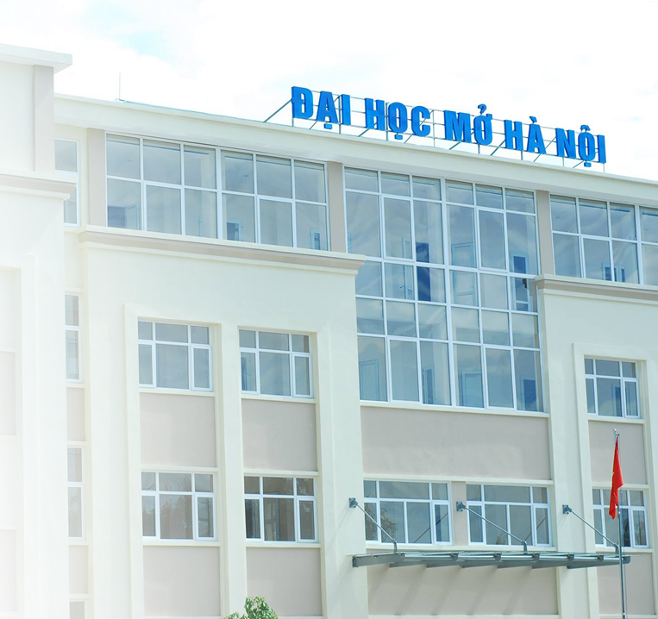
THANKS
http://www.hou.edu.vn
mhn@hou.edu.vn
(024) 38682321

