Slide 1
Contribution of Authentic Assessment Tasks in Developing Critical and Innovative Thinking Skills in Open and Distance Learning Environment
Nasir Mahmood
Tooba Saleem
Allama Iqbal Open University, Pakistan.
October 15, 2019

Slide 2
Introduction
In 21st century, the development and assessment of critical and innovative thinking skills is at the core of higher education level programs. For academic institutions, charged with equipping graduates to compete in today’s knowledge economy with growing recognition that individuals need a wide array of skills in order to meet the needs of the modern workplace.

Slide 3
Cont…
In this context, our existing assessment procedures are unable for developing and measuring the critical and innovative thinking skills and traits with traditional assessment procedures. In this context, a panel survey study was designed to examine the development of critical and innovative thinking skills through an intervention of authentic assessment tasks using learning management system (LMS).

Slide 4
Cont…
Critical thinking is purposeful, reasoned, and goal-directed. It is the kind of thinking involved in solving problems, formulating inferences, calculating likelihoods, and making decisions” (Halpern, 1998, pp. 450-451).

Slide 5
Authentic Assessment and critical thinking Skills

Slide 6
Aim of the Study…
In this context our research attempts to:
examine the development of critical and innovative thinking skills through an intervention of authentic assessment tasks using learning management system (LMS).

Slide 7
Construct Definition | Sub-Constructs
Reason effectively, use systems thinking and evaluate evidence . Understand systems and strategies for tackling unfamiliar problems .Understand the importance of evidence in belief formation Reevaluate beliefs when presented with conflicting evidence Solve problems and Identify gaps in knowledge . Ask significant questions that clarify various points of view and lead to better solutions | 1.Look for evidence
 | 2. Draw conclusions
 | 3. Decision making
 | 4. Implementing new ideas
Conceptual Framework
Critical and Innovative Thinking Scale (CITS)

Slide 8
Methodology
Research Design
The study was quantitative in nature. A panel survey study was designed to examine the development of critical and innovative thinking skills through an intervention of authentic assessment tasks using learning management system (LMS). A cohort of MPhil students (N=38) was pretested and went through an intervention of two semesters in which ten authentic assessment tasks were given to students for developing critical and innovative thinking skills.

Slide 9
At the end of course assessment tasks were evaluated against a rubric to find the evidence of critical and innovative thinking skills in completing tasks and a post-test of skills was taken. Internal validity threats were controlled during intervention and reliability of scale was ensured (α=.965).
Notes:
The CTS were assessed through a self reported survey questionnaire.

Slide 10
Instrumentation
A self-constructed Critical and Innovative Thinking Skills Scale was used . The reliability (r=.96) of the instrument was measured The scale was consisted of 66 items to be rated on six point scale for the three aspects given below.
# | Subscales | Items (N) | Sample Item
1 | Look for Evidence | 9 | I use facts while talking about any issue
2 | Draw Conclusion | 23 | I put forth my argument with reason
3 | Decision Making | 15 | I consider all possible solutions before drawing conclusion
4. | Implementing New Ideas | 19 | I am open to new ideas to have clear understanding of the concept
 | Total Items | 66

Slide 11
Validity and Reliability: Critical and Innovative Thinking Scale (CITS)
Content validity of instruments was ensured through the:
Expert opinion
Reliability

Slide 12
Analysis and Findings
Descriptive Analysis
Descriptive analyses were used (i.e. mean, standard deviation, skewness and kurtosis) to check the normality of data.

Slide 13
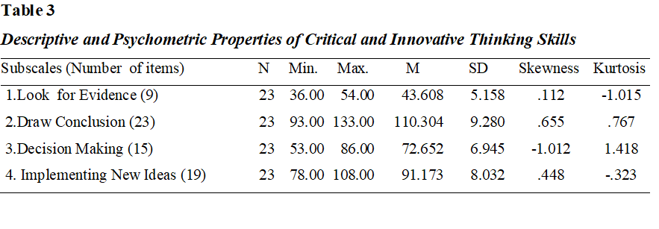
Descriptive Analysis

Slide 14
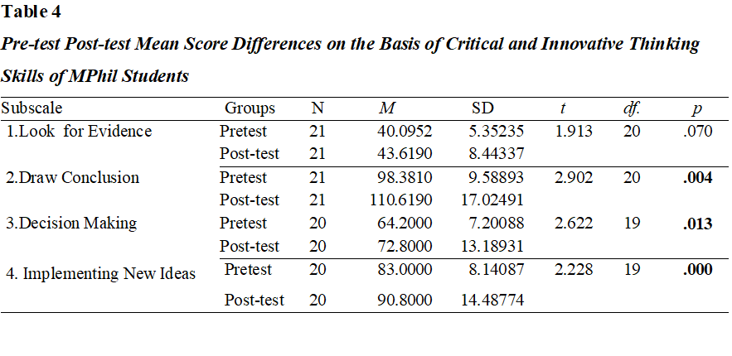
Pre-test post-test comparison

Slide 15
Major Findings
The findings of the study highlighted a significant positive change in the development of students ability to draw conclusions (p= .004), decision making (p=.013) and Implementing new ideas (p=.000).
The space for creativity and implementing new ideas in given assignment tasks helped students to enhance critical and innovative thinking skills using learning management system at Allama Iqbal Open University.

Slide 16
Conclusions
It can be concluded from the results that authentic assessment tasks helps the students to improve their critical and creative thinking skills. Learning management system provides the space to use 21st century tools to gather and interpret information and use it in more creative way. But Sometimes the lack of having appropriate ICT skills create hindrance to exhibit critical and creative abilities while working on learning management system or working online.

Slide 17
Contact: Prof. Dr. Nasir Mahmood Tooba Saleem Allama Iqbal Open University, Pakistan
Email address:
nasir.mahmood@aiou.edu.pk
tooba.saleem@aiou.edu.pk

