Slide 1
Potential Risk Factors of School Bullying in Secondary Schools
AAOU-2019(Lahore)
By
Dr Nargis Abbas
Dr. Uzma Ashiq
Ms. Ayesha Saddiqa
Notes:
Presented in International Conference AAOU 2019 conducted by Virtual University in Lahore.

Slide 2
Points of Discussion
Background of the Study
Theoretical Framework
Operational Definitions
Research Methodology
Key Findings/Results
Conclusion
Suggestions

Slide 3
Background of the Study
Bullying around the world, among school students declared as a prevailing issue with alarming impacts. Thus bullying and other behavior issues are major concerns for teacher and parents as those students who experience bullying victimization get socially segregated, isolated, and peers humiliating rejection (Abbas et al., 2019).
There are a number of risk factors which can increase the probability that a student will be a victim of bullying in school. Bullying has short term effects like truancy and absenteeism from schools as well as long term effects like poor academic achievements, complex personality disorders and above all suicide attempts.
Notes:
done

Slide 4
Cont…
Siblings have a significant place in one’s life as friends, educators, and parental figures through their relationship and their communications with each other. Research demonstrates a relationship between kin bullying and school bullying, like half of the kids who dealt kin exploitation equally experienced exploitation at school.
Notes:
done

Slide 5
Theoretical Framework
Incidents of bullying and victimization do not happen solely between a bully and a bullied. Indeed, bullying incidents are complex social interaction between individuals, their peers and wide social environment around them. The Risk factors of bullying can be best explained through key theory the “Social Ecological Model”.
The Social Ecological Model (EM) outlines behavior as the function of an individual’s interactions with environment. There are four levels of the EM, which are conceptualized as concentric circles beginning with the center and working outward.
Notes:
Done

Slide 6
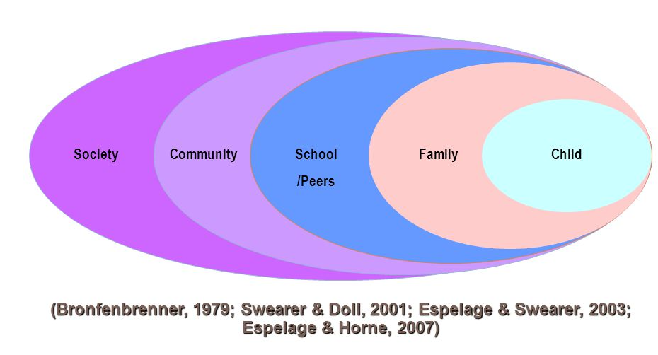
Each level of the model has impact on the next. The center of the framework encompasses the individual. Individual factors that may influence a child’s behavior. The next level is relationship; family and others living in the home. The next level is the community level, which includes schools, peers, community members and neighborhoods. The outer level of the EM is society, which encompasses broad societal factors that include social and cultural norms, policies and laws.
Notes:
done

Slide 7
Research Questions
This research study consists of three potential risk factors i.e,
Academic failure
Delinquent sibling
Sexual harassment
Thus this study aimed at investigating that how risk factors are affecting the students with regard to gender, grade and age in schools or home?
Notes:
Done

Slide 8
Operational Definitions
For the current study,
Academic failure is assumed as the performance that is not up to the mark or below the standardized criteria of being passed.
Delinquent siblings show hostile behaviour on the base of individual difference like age, size and mental growth, which leads them to severe situations like humiliation, aggression and social boycott.
Sexual harassment is forceful sexual behaviour, which affects your life through gender harassment, seductive behaviour, and sexual coercion.
Notes:
Done

Slide 9
Research Methodology

Slide 10
A Quantitative Survey research design was used to conduct this study in public sector secondary schools of Sargodha.
In this study, influence of three variables as potential risk factors were investigated on school bullying incident, these were; Delinquent Siblings, Academic failure, and sexual harassement.
Notes:
Done

Slide 11
Research Instrument
After reviewing the relevant literature, a questionnaire was developed. The questionnaire was divided into two sections; demographic information and scales measuring risk factors. Three potential risk factors were measured on 7-points Likert scale. Further, to measure school bullying, “Bullying Participant Behaviors Questionnaire (BPBQ)” by Demaray et al, (2016) was adopted.
Research Instrument was developed.
Factors were explored through EFA technique.

Slide 12
Population and Sampling
Stratified sampling technique was adopted to draw the sample.
At first stage, 15% of secondary schools of Sargodha Tehsil were selected through random sampling. Thus, total thirty (30) schools were selected among them twenty (20) were public and remaining ten (10) were private schools.
At this stage, half of the schools were girls secondary schools and half were boys secondary schools (15 each).
At Next stage, 25% of the 10th grade students from each school were selected through systematic sampling. Total 555 students of secondary schools of Sargodha tehsil was the sample of this study.
Notes:
Done

Slide 13
Results and Findings

Slide 14
Table 1: Respondents’ demographic
Variables | Frequency | Percentage
Gender
Male | 264 | 47.6%
Female | 291 | 52.4%
Grades
Ninth | 281 | 50.6%
Tenth | 274 | 49.4%
Area
Rural | 335 | 60.4%
Urban | 220 | 39.6%
Sector
Public | 387 | 69.7%
Private | 168 | 30.3%
Notes:
done

Slide 15
Gender Differences
 | Gender | Descriptive Statistics |  |  | t-value
 |  | N | Mean | SD
Academic Failure | Male | 264 | 78.47 | 14.730 | 3.855***
 | Female | 291 | 73.16 | 17.679
Delinquent Sibling | Male | 264 | 62.56 | 9.186 | 1.434
 | Female | 291 | 61.32 | 11.186
Sexual Harassment | Male | 264 | 62.55 | 15.067 | 4.080***
 | Female | 291 | 57.02 | 16.832
School Bullying | Male | 264 | 67.83 | 10.131 | 1.719
 | Female | 291 | 66.34 | 10.291
***p<0.001.
Notes:
done

Slide 16
Prediction of School Bullying
Multiple regression is an extension of simple linear regression. It is used when we want to predict the value of a variable based on the value of two or more other variables. Following regression model was adopted for the current study.
Y= a+b₁x₁+ b₂x₂+ b₃x₃
Where;
Y = School bullying x₁ = Academic failure
a= constant x₂ = Delinquent sibling
b= regression coefficient x₃ = Sexual harassment

Slide 17
Model Summary
Model Summary
Model | R | R² | Adjusted R Square | Std. Error of the Estimate
1 | .426ª | .181 | .172 | 9.311
The "R" value is the multiple correlation coefficients, represents the measure of the quality of the prediction of the dependent variable. For the current model, it was found 0.426 which is a good level of prediction. The R²=0.181 explains that the potential risk factor in this study explain the 18% of the variation in School bullying.

Slide 18
Significance of the Regression Model
Further, in order to investigate whether the suggested model is significantly exist with the combination of the potential risk factors or not, ANOVA results were studied. The F-ratio was found significant, that is, the regression model significantly predicts the dependent variable ‘School bullying’, that is, the regression model is a good fit of the data
{ F(6, 548) =20.200, p < .0001 }.
Notes:
done

Slide 19
Table 3. Model summary of four regression models
Coefficientsª
Model |  | Unstandardized Coefficients |  | Standardized Coefficients | t-value | Sig.
 |  | B | Std. Error | Beta
 | (Constant) | 44.327 | 2.773 |  |  | .000
 | Academic Failure | .206 | .029 | .333 | 7.125 | .000
 | Delinquent Sibling | .021 | .044 | .021 | .032 | .974
 | Sexual Harassment | .064 | .030 | .101 | 2.097 | .036
Notes:
done

Slide 20
Findings
The unstandardized coefficient, B, for ‘academic failure’ is equal to .206 which means that for one unit increase in academic failure, there is an increase in .206 units in school bullying.
The unstandardized coefficient, B, for ‘delinquent sibling’ is equal to .021, which means that for one unit increase in delinquent sibling, there is a increase of .021 units in school bullying.
The unstandardized coefficient, B, for sexual harassment is equal to .064 which means that for one unit increase in sexual harassment, there is an increase of .064 units in school bullying.
Further, t-values shows that most significant potential risk factors that can significantly predict the school bullying among secondary school students were ‘academic failure’ and ‘sexual harassment’.
Notes:
done

Slide 21
Conclusion & Discussion

Slide 22
Conclusion & Discussion
Researches found that particular demographics of students can also impact school bullying, for example, higher grades and increase in age of a student result in decline in the school bulling.
The findings of current research show non significant difference with respect to grade which support the findings of previous researches that higher grades reduce the school bullying.
In addition, it is found in literature review that boys experience more bullying than girls. The findings of present research with respect to gender difference support the previous researches that boys get more victimized of bullying than girls.

Slide 23
Cont…..
Moreover, it was found that ‘academic failure’ and ‘sexual harassment’ are the potential predictors of the school bullying. Considering the major findings of study it is suggested that bullying victimization can be controlled through training sessions.
Awareness programs should be arranged in schools in the presence of parents to reduce the intensity of school bullying.
Further in depth studies would be pertinent to explore more prospect risk factors that can define the school bullying phenomenon.

Slide 24
Any Question please!

