Slide 1
DESIGN OF “TABLE OF SPECIFICATION” AS AN
ASSESSMENT GUIDE IN OUTCOME-BASED
EDUCATION
(OBE) FOR ODL
Nantha Kumar Subramaniam

Slide 2
Introduction
In Malaysia, Outcome-based Education (OBE) is being implemented in all institutions of higher level since 2009
All programs must comply to the OBE requirements
2

Slide 3
OVERVIEW: Outcome-based Education
Outcome-Based Education (OBE) is an educational system that put emphasis on what the students are expected to be able to do within the specified period of learning
This requires having a clear set of essential knowledge and skills that students are expected to have learnt at the end of their learning experience
3

Slide 4
WHY OBE?
This is to ensure the academic programmes, delivery system and the assessment methods will produce graduates equipped with high quality knowledge and skills
4

Slide 5
Main pillars of OBE
PEO – Programme Educational Objectives
PLO – Programme Learning Outcomes
CLO – Course Learning Outcomes
5

Slide 6
PEO – Programme Educational Objectives
PEO are the broad statements that describe the career and professional accomplishments that the programme is preparing graduates to achieve after they graduated
6

Slide 7
PLO – Programme Learning Outcomes
PLO are the statements that describe the specific and general knowledge, skills, attitude and abilities that the programme graduates should demonstrate upon graduation
7

Slide 8
CLO – Course Learning Outcomes
CLO is the statements on what a student should know, understand and can do upon the completion of a period of study for the course.
CLOs are mapped to their respective PLOs.
8

Slide 9
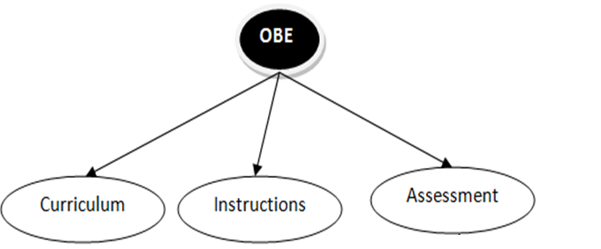
--OBE FOCUS AREA--
Assessment component in OBE boils down to the course level and attempts to answer the following:
What is to be assessed?
How to assess?
Is the course effective?
To what degree are students learning?
PLO
CLO
CLO
CLO
9

Slide 10
OBJECTIVE
To propose and implement a holistic and OBE-compliant Table-of-Specification (TOS)
This TOS will allow the instructor to achieve balance in the test and to identify the achievement domains being measured and to ensure that a fair and representative sample of questions appear on the both coursework and examination
10

Slide 11
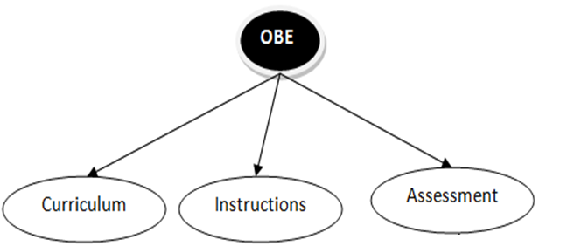
OBE FOCUS AREA
CLO
CLO Achievement Report
11

Slide 12
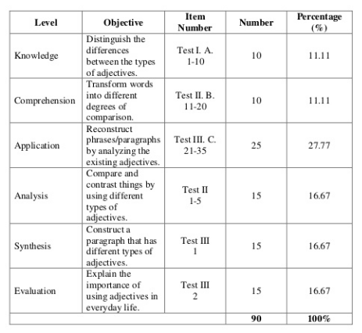
WHAT IS TOS?
TOS is a two-way chart which describes the topics to be covered by a test and the number of items or points which will be associated with each topic
12

Slide 13
DESIGN OF OBE-COMPLIANT TOS
13

Slide 14
SECTION 1: COURSE PARTICULARS
14

Slide 15
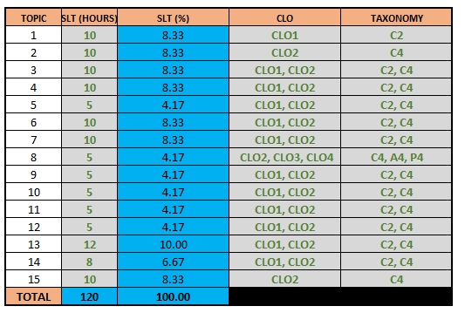
SECTION 2: MAPPING OF TOPICS TO SLT AND LEARNING
TAXONOMY
15

Slide 16
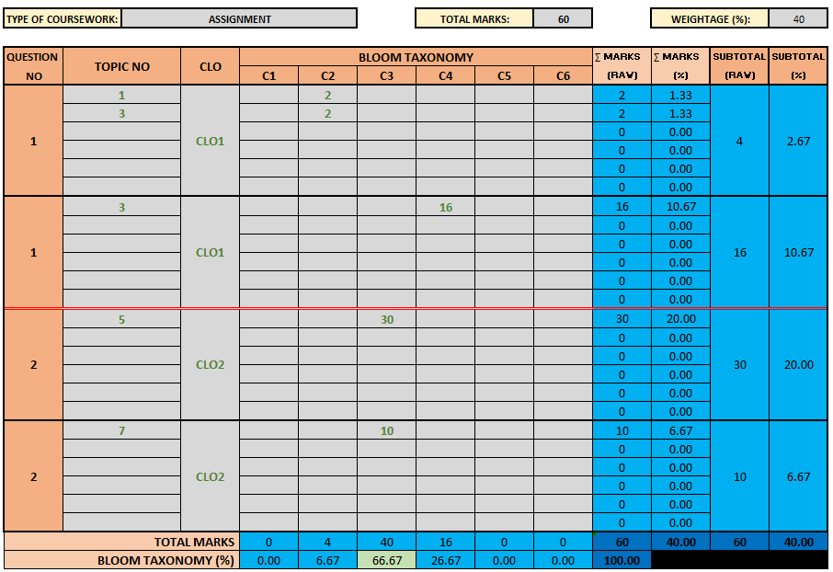
SECTION 3: CAPTURING COURSEWORK INFORMATION
(COGNITIVE)
16
Figure 8: Capturing the coursework (psychomotor) information

Slide 17
SECTION 3: CAPTURING COURSEWORK INFORMATION
(AFFECTIVE)
17
Figure 8: Capturing the coursework (psychomotor) information

Slide 18
SECTION 3: CAPTURING COURSEWORK INFORMATION
(PSYCHOMOTOR)
18
Figure 8: Capturing the coursework (psychomotor) information

Slide 19
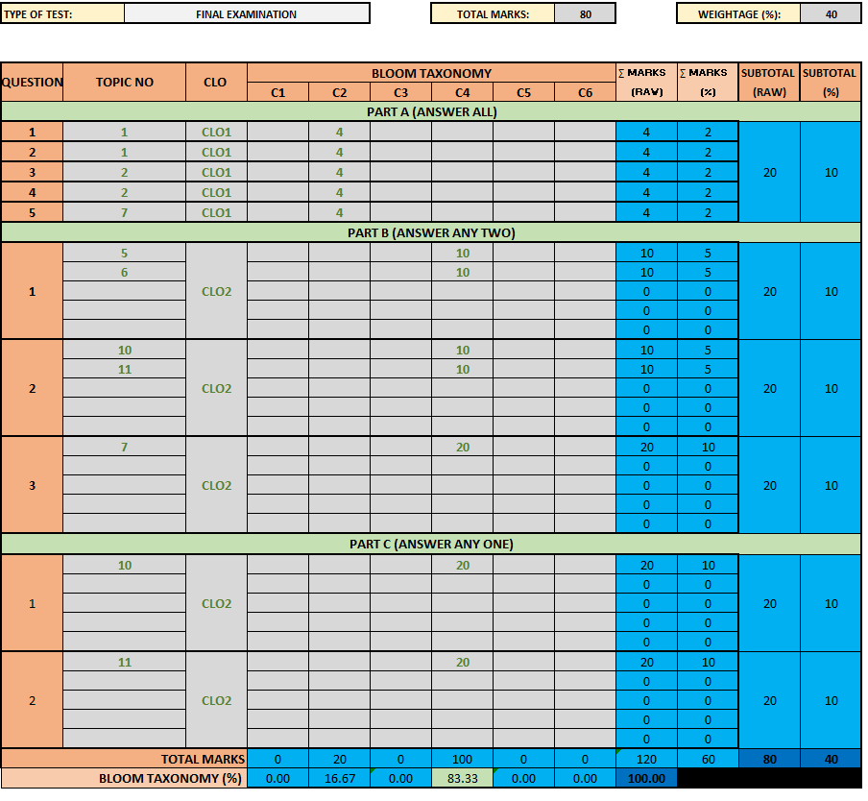
SECTION 4: CAPTURING SUMMATIVE INFORMATION
19
Figure 8: Capturing the coursework (psychomotor) information

Slide 20
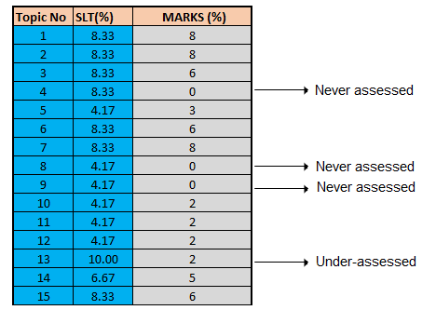
SECTION 5: SUMMARY
20
Figure 8: Capturing the coursework (psychomotor) information

Slide 21
CALCULATING THE ACHIEVEMENT OF CLOs
21
Figure 8: Capturing the coursework (psychomotor) information

Slide 22
OBE FOCUS AREA
CLO
CLO Achievement Report
22

Slide 23
COMPUTER GENERATED ASSESSMENT PERFORMANCE REPORT
23
Figure 8: Capturing the coursework (psychomotor) information

Slide 24
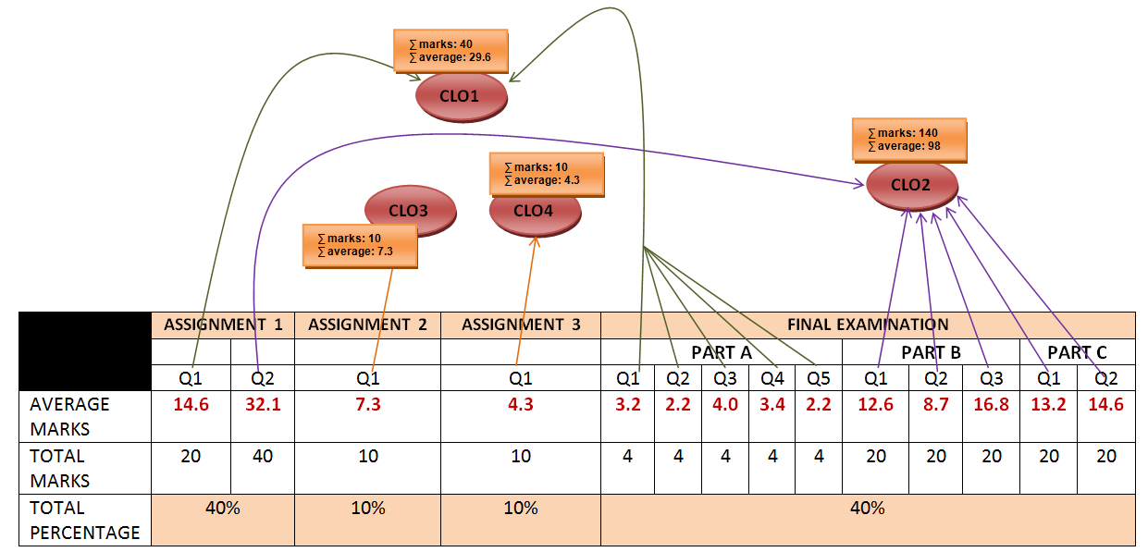
24
Figure 8: Capturing the coursework (psychomotor) information

Slide 25
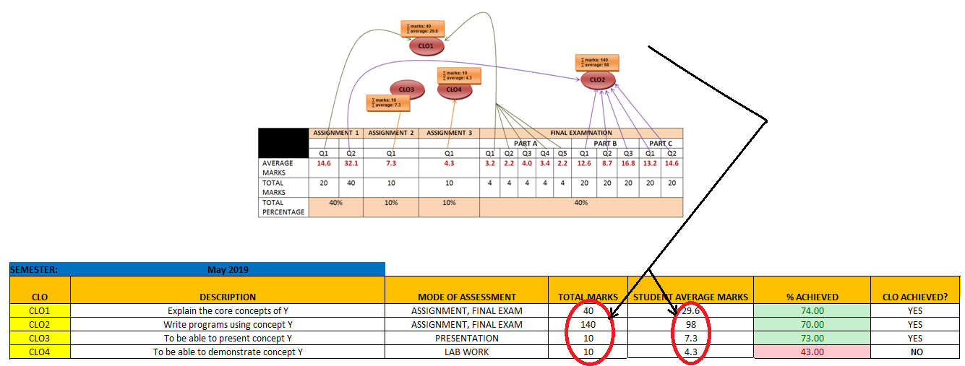
25
Figure 8: Capturing the coursework (psychomotor) information

Slide 26
Way Forward: E-TOS in the Question Bank
26
Figure 8: Capturing the coursework (psychomotor) information

Slide 27
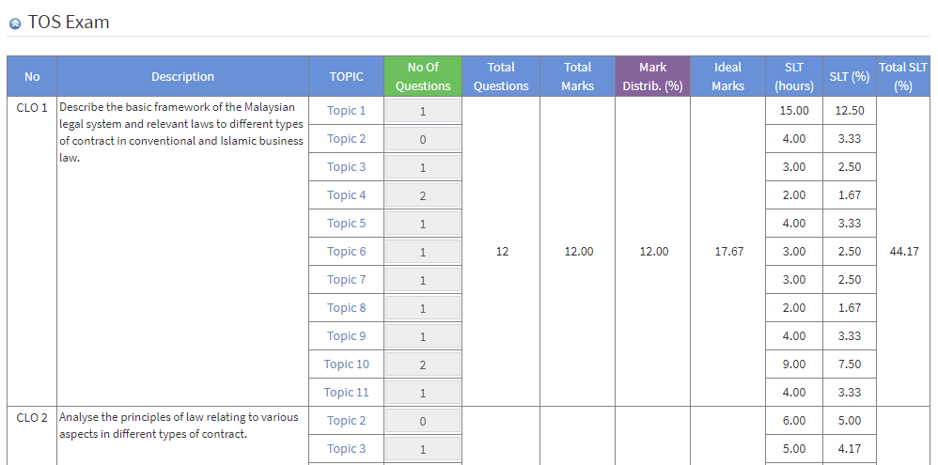
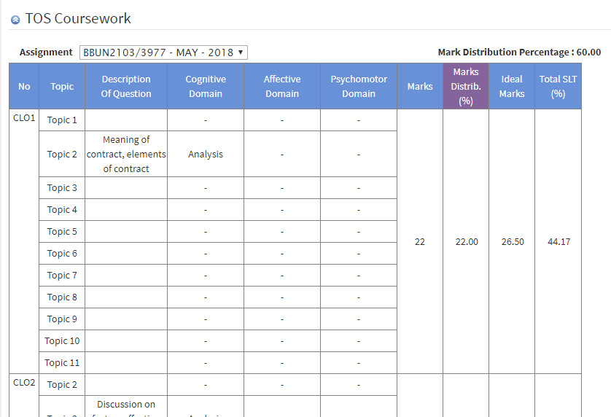
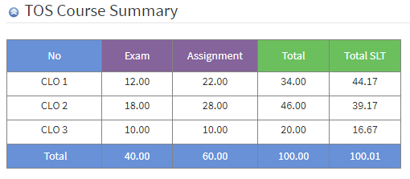
E-TOS in the Question Bank System
27
Figure 8: Capturing the coursework (psychomotor) information

Slide 28
Conclusion

Slide 29
Assessment is very much abstract in nature and a complicated process
The TOS proposed in this paper is able to guide the instructors in preparing the test items in a more holistic and systematic manners
The TOS is very flexible as it allows the instructor to fill-up the TOS in an incremental and iterative manner in order to achieve the desired result in a shorter time
29
Figure 8: Capturing the coursework (psychomotor) information

Slide 30
Thank you..

Slide 32
FEEDBACK FROM THE ACADEMICS
Complicated process had been made easy;
It helps me to understand the assessment better;
It gives the bird-view of the assessment;
It helps me to enhance my course;
I am now confident with my test items.
32
Figure 8: Capturing the coursework (psychomotor) information

