Slide 1
Comparison of Bio-science Degree Programs Offered in Distance Learning Mode :A Success Story of Virtual University of Pakistan Dr. Muhammad Tariq Pervez Associate Professor Virtual University of Pakistan

Slide 2
Agenda
Overview of distance learning mode for bio-science degree programs offered by various educational institutions.
Virtual University Platform for bio-science degree programs

Slide 3
Countries Offering Education in Distance Learning Mode
France Germany Italy Malaysia Nigeria South Africa United Kingdom China Sudan Japan | United States Russia Netherlands Spain India Bangladesh Pakistan Canada Australia

Slide 4
Country Wise Institutions
Country | Institutions | Link
India | 35 | http://www.indiaeducation.net/online-education/articles/top-distance-learning-universities.aspx
Pakistan | 02 | https://en.wikipedia.org/wiki/Category:Distance_education_institutions_based_in_Pakistan
France | 3 | https://en.wikipedia.org/wiki/Category:Distance_education_institutions_based_in_France
Germany | 2 | https://en.wikipedia.org/wiki/Category:Distance_education_institutions_based_in_Germany
Italy | 10 | https://en.wikipedia.org/wiki/Category:Distance_education_institutions_based_in_Italy
Malaysia | 4 | https://en.wikipedia.org/wiki/Category:Distance_education_institutions_based_in_Malaysia
Nigeria | 1 | https://en.wikipedia.org/wiki/Category:Distance_education_institutions_based_in_Nigeria
South Africa | 13 | https://en.wikipedia.org/wiki/Category:Distance_education_institutions_based_in_South_Africa
UK | 22 | https://en.wikipedia.org/wiki/Category:Distance_education_institutions_based_in_the_United_Kingdom
US | 78 | https://en.wikipedia.org/wiki/Category:Distance_education_institutions_based_in_the_United_States
Total | 170

Slide 5
Continent Wise Open Universities
Continent | Countries | Population (Billion) | No. of Open Universities
Asia | 50 | 4.6 | 42
Africa | 54 | 1.3 | 9
Australia | 14 | 0.042 | 01
Europe | 51 | 0.747 | 10
North America | 23 | 0.588 | 5
South America | 12 | 0.428 | 2
Total | 204 | 7.705 | 69
https://en.wikipedia.org/wiki/List_of_open_universities
https://www.countries-ofthe-world.com/continents-of-the-world.html

Slide 6
Open Universities Offering Bioscience Programs
University | Country | Mode
National Open University of Nigeria | Nigeria | Blended
Hellenic Open University | Greece | Blended
Intercultural Open University Foundation | Spain | Blended
The Open University | Uk | Blended
Yashwantrao Chavan Maharashtra Open University | India | Blended
Vardhaman Mahaveer Open University | India | Blended
Uttarakhand Open University | India | Blended
Madhya Pradesh Bhoj Open University | India | Blended
Universitas Terbuka | Indonesia | Blended
Polytechnic University of the Philippine | Philippines | Blended
Open University of Sri Lanka | Sri Lanka | Blended
Allama Iqbal Open University | Pakistan | Blended

Slide 7
Other Universities Offering Bioscience Programs
University | Country | Mode
University of Nottingham | UK | Blended
NYU Tandon School of Engineering | USA | Blended
University of Westminster | UK | Blended
University of Stutgar | Garmani | Blended
Atlantic International University | USA | Blended
Worcester Polytechnic Institute (WPI) | USA | Blended
University of Maryland | USA | Blended
University of Nebraska | USA | Blended
University of Saint Joseph | USA | Blended
University of Florida | USA | Blended

Slide 8
Problem
VUP students are spread all over the country including the remote areas
Students face difficulties like accommodation, travelling and pausing their routine activities to reach nearby physical lab.

Slide 9
Solution
Lab on Wheels
Smart Lab
Objective
To provide equal wet lab facilities to all VUP students at their door steps

Slide 10
Virtual University of Pakistan
Total Enrollment: 297512
Active students: 65223
Total Bioscience: 6000

Slide 11
Virtual University of Pakistan
Programs
BS Bioinformatics, Biotechnology, Zoology, Microbiology
M.Sc. Zoology
Ph.D Biotechnology
Mode: Blended
Labs: 6 Physical labs
One Mobile Lab
Two smart labs

Slide 12
Lab on Wheels
In advanced countries, the concept of mobile labs is not new

Slide 13
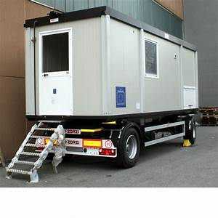
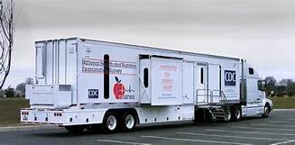
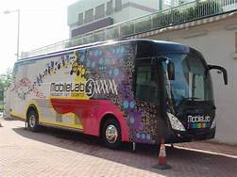
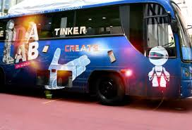
Lab on Wheels

Slide 14
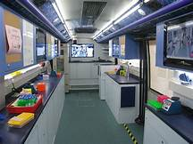
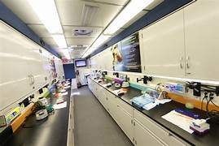
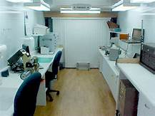
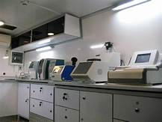
Lab on Wheels

Slide 21
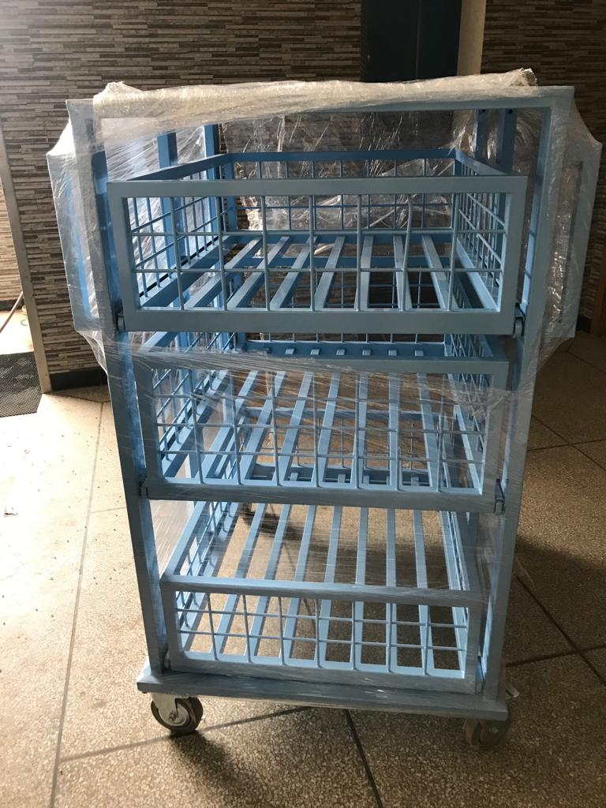
Smart Lab

Slide 22
Smart Lab
Various difficulties faced during practical sessions in ML such as
Space for mounting ML,
Electricity and water supply,
limited sitting space for the students and especially The students feedback i.e. ML is best suited for conducting practical sessions of Zoology students, VUP felt to establish Smart Lab.

Slide 23
The Idea of Smart Lab
The idea was that a mini truck/ mazda will be used for carrying and moving bio-lab equipment and consumables, packed in trollies to the designated VUP campuses.
After that, the equipment is moved to the next VUP campus for conducting practical sessions arranged using the same equipment and consumables and so on.

Slide 24
The Idea of Smart Lab
To prevent from damaging the equipment during travel, high quality foam was placed all around the equipment in the trolley/ vehicle.

Slide 25
Thank you very much

