Slide 1
Flexibility or fragmentation:
Implications of Unbundled Online and Distance education
Keynote presentation AAOU2019
14-16 October 2019, Lahore, Pakistan Sukaina Walji,
Centre for Innovation in Learning & Teaching
University of Cape Town
Notes:
It is a great honor for me to be here today. Thank you for the kind invitation and introduction

Slide 2
This Photo by Unknown Author is licensed under CC BY-ND
Notes:
Here’s a picture of the university of Cape Town. I have come a long way to be here, Cape Town is on the southernmost tip of Africa but I feel very much at home. Thank you to the organisers for the hospitality and welcome. I’ve very much enjoyed the sessions yesterday today and many of the keynotes have touched on common issues regarding how higher education provision is changing catalyzed by digital technologies.
Today, I am going to talk about some of these developments and draw on research I have been involved based at the University of Cape Town and the University of Leeds.

Slide 3
Researching the Unbundled University
The Unbundled University
researching emerging teaching and learning models in unequal landscapes
How unbundling/rebundling is playing out from the point of view of key stakeholders in HE in terms of emergent forms of teaching and learning provision
at the intersection of digitisation and marketisation
in contexts of austerity and inequalities
The relationships between universities and private companies
Notes:
We have been researching the idea of the Unbundled University . Unbundling is a useful lens through which to see how higher education globally is changing and what new models of teaching and learning provision are emerging. I’ve noticed that two of yesterday’s keynotes mentioned unbundling and it seems that this is a concept that is being applied to higher education. Given the theme of this conference is open and distance learning 2020 and beyond, I hope that sharing some thoughts on the Unbundled University may be of interest.

Slide 4
Exploring emergent models of teaching and learning
The Unbundling University
Unbundling is the process of disaggregating educational provision into its component parts likely for delivery by multiple stakeholders, often using digital approaches and which can result in rebundling
Project website: https://unbundleduni.com
Notes:
In our research project, we use a particular definition of unbundling - that it is a process of disaggregating educational provision into its component parts likely for delivery by multiple stakeholders, often using digital approaches and which can result in rebundling. This is a specific definition we developed, and the research is to investigate what extent and how unbundling is happening in universities and what are its implications. Our two sites for data collection were South Africa and England

Slide 5
Focus: Emergent models of teaching and learning
Marketisation
Digitisation
Inequality
Unbundling
Notes:
Conceptually, unbundling as a process is situated at two intersections. First unbundling intersects with marketisation in higher education and secondly unbundling intersects with digitization – the affordances enabled by the growing availability of digital technologies. The intersection of these – the meeting in the middle – is what is particularly interesting. The outer circle in which these forces exist is inequality and a reminder of the various inequalities that exist in higher education systems globally and within national systems. How is the process of unbundling influencing inequalities?

Slide 6
Forces shaping teaching and learning provision
Massification
Growth in students entering Higher Education
Austerity
Worldwide universities and companies are under pressure to cut costs
Digitisation
Digital technologies, Internet and web tools offer new opportunities for teaching and learning
Marketization
Introduction of market forces into educational practices and processes including edtech companies and education focussed venture capitalists.
Unbundling
Process of disaggregating educational provision into its component parts likely for delivery by multiple stakeholders
Notes:
I’m now going to talk a bit more about some of the global trends and factors that have and are influencing higher education and leading to new unbundled models of provision. Of course, none of these factors is new and they have been happening over many decades, but it is the coming together of these factors at this time – massification and austerity along with marketization and digitization that is enabling unbundling of higher education.

Slide 7
Massification
Increased access – from elite to mass to universal
Democratising access for non traditional students
New models of universities incl ODL
Perceptions of decreased quality
Stratified systems - elite, mass, universal
Reduction in public spending
Notes:
– massification – which is the increasing number of students entering higher education has been happening over many decades leading to higher education changing from an elite to a mass model of access. Open and distance universities have enabled greater access to large numbers of people while experiments with digital delivery in residential universities over the years has also enabled larger numbers of students to access higher education. However massification has led to other types of consequences – perceptions about quality and higher drop-outs, stratification inside national systems and among universities. A major consequence has been the reduction in public or government spending under the guise of austerity initiatives.

Slide 8
Austerity
Shift from public/government funding to students and parents through fees
Mechanisms such as student loans and focus on means tested financial aid
Notion of education as a private good part of discourse
Notes:
This gradual shifting over decades and exacerbated by the global financial crash in 2007/2008 has meant that governments in many jurisdictions have reduced the amount of funding available to public higher education. While this varies country to country, the overall shift of reduced public spending has led to a number of responses. First the responsibility for funding higher education has either shifted entirely or partially to students and families. New mechanisms to assist students and families have emerged include student loans arrangements.
A social and cultural impact has been to question the notion of education as a public good with indications that since individuals are paying for it represents a private good. Austerity has also led universities to look at ways of either reducing costs or finding new ways of generating revenue – which is sometimes called third stream income. Often such new initiatives involve taking advantage of the affordances of digital technologies

Slide 9
Digital Technology
Dramatic growth of online education since the introduction of MOOCs
Education through use of digital technology and the Internet
Online education and digital technology for:
continuing professional development,
accredited learning
lifelong learning,
widening access,
enhancing the quality of teaching,
Responding to massification and austerity
Ed Tech Industry: estimated to be worth over £120 billion
Supported by universities (partnerships)
Notes:
The use of digital technologies to support education provision is not new. Many forms and experiments have been happening over many decades with initiatives in radio, television, and digital storage materials. The availability of networked digital connectivity and the Internet has of course made it much easier to enable distance education where students have access to connectivity, although we do not have mass Internet penetration to make this feasible on a global basis yet. However developments in cellphone technology and increasing networked, digital and Internet access, means that many conventional and distance education universities depending on their contexts are using digitization more for a range of educational offerings.

Slide 10
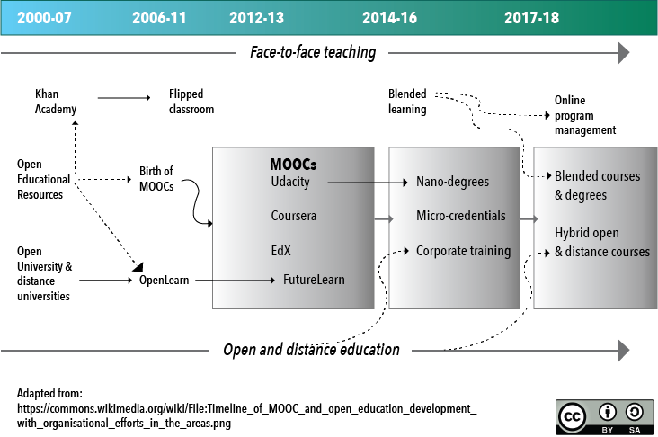
Emergence of online education provision over time
https://twitter.com/sharplm/status/1034562474064924682
Notes:
If we go to a time-line showing the emergence of education provision over time, we can see how increased digitization is leading to new models. This diagram is an adaptation of one originally created by Yuan and Powell and adapted by others. What’s very useful about it is that it tracks some key moments of developments for both open and distance educational institutions along the bottom and face to face universities along the top.

Slide 11
Emergence of online education provision over time
https://twitter.com/sharplm/status/1034562474064924682
Notes:
These are both highlighted in yellow. Digital technologies have come to support, catalyse and enable news forms of higher educational provision for all types of universities. You can see that the UK Open university made a play for the MOOCs space with the setting up and investment of FutureLearn. For some conventional universities, such as at my university, there is a growing move into blended and online modes of teaching and learning, and this is certainly a worldwide trend.

Slide 12
Emergence of online education provision over time
https://twitter.com/sharplm/status/1034562474064924682
Notes:
Indeed it’s the stuff in the middle highlighted here that is really interesting and where we are seeing forms of unbundling happening. So MOOCs have emerged in this space as well as the variants of MOOCs. I think much of this is informed by market forces and market players as it is in the middle that we are seeing new players and entrants in higher education. Both residential universities and open and distance universities are operating in this middle space and what is happening is that more modular online credentials and more hybrid online and blended degrees are more prevalent.
And right at the end of that timeline you can see Online Program Management, and that leads me on to talk about marketization.

Slide 13
Marketisation
Generate third stream revenue
Principles of the market in education
Build or Buy
Competition
Reputation
Rankings
England – fees are £9,250 per year
SA - Fees increased 9% per year in the period 2010-2017
Notes:
So marketization is a broad all-encompassing word. It’s also nothing new that the private sector operates in the higher education space. While shifting fees to students is a form of marketization, it’s not the only way in which universities are becoming more marketized. The drive for third stream income is another impetus.
.

Slide 14
Marketisation and market making
Endogenous (bringing the language and practices of the market into public education)
-language of business pervading institutions including measurements, metrics, tracking
-considering students as consumers ‘buying’ a product
Exogenous (using the market for public education needs)
-public education is opened up to private sector participation on a for-profit basis
-private sector is invited to deliver some parts of public education
Ball & Youdell, (2007) Hidden Privatisation in Public Education https://pages.ei-ie.org/quadrennialreport/2007/upload/content_trsl_images/630/Hidden_privatisation-EN.pdf
Notes:
Ball and Youdell distinguish between two types of marketization. They talk about exogenous and endogenous privatization. The endogenous type is about bringing market-type practices into universities deploying the language and practices of business and corporate culture. This might mean a focus on increased metrics and measurement or in the way students are talked about. When we talk of students as consumers or customers, this is a form of endogenous marketisation.
Exogenous marketization on the other hand is about the participation of private companies to deliver parts of higher education. Now I am not talking about private universities or the use of private companies for non -teaching and learning functions such as catering or maintenance. What I am talking about is how public education is opened up to the private sector on a for-profit basis and where the private sector is invited to deliver parts of educational provision.

Slide 15
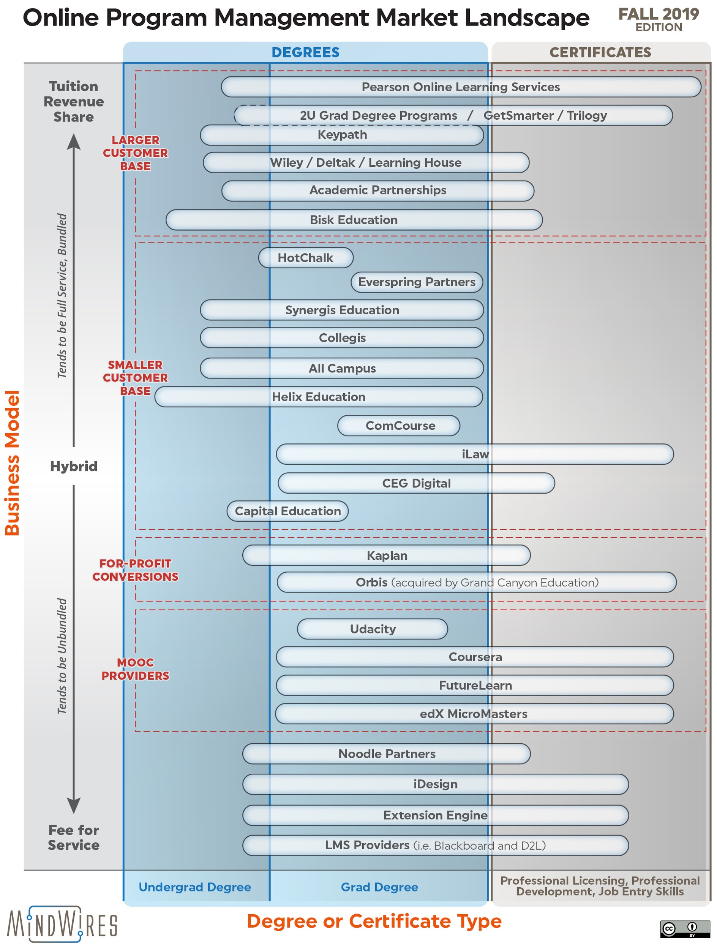
Education as a business
Investments in Edtech
In 2018 the global investment in Edtech was $4.46 billion (source: http://funding.hackeducation.com/investments.html)
Emergence of new companies- Online Programme Management (OPMs)
https://philonedtech.com/opm-updated-2019-market-landscape/
Notes:
You may be familiar with the term Online Program Management company or OPM. Other terms include edu-businesses or enabler companies. Again if we think along the timeline of the development of online and open education, what is happening is that as more universities are starting to deliver fully online degrees, there has been an increase in the number of private companies who act as Online Program Managers or sometimes Online Program Enablers. This graph by the educational consultant Phil Hill categories these types of companies. Let’s take a closer look.

Slide 16
Emergence of OPMs
Traditional OPMs as full service revenues share:
Degrees and certificates
https://philonedtech.com/opm-updated-2019-market-landscape/
Notes:
At the top of the graph are the most well known companies and you may recognize some of them – they include 2U, Academic Partnerships, Pearson, Wiley. These companies effectively invest or go into a joint venture with universities to offer certain particularly marketable degrees or qualification in return for revenue share. These are often called full service OPMs. These types of companies are now also moving into non-degree spaces such as short learning programmes or certificate programs.

Slide 17
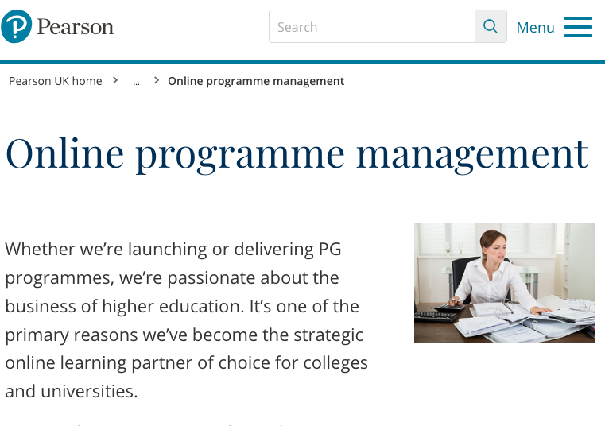
Notes:
Pearson’s Online Program Management website page is an illustration of the marketing and services offered.

Slide 18
Emergence of OPMs
New OPM models
“For-profit”conversions
MOOC providers
“Fees for service”
Notes:
The second half of the graph shows a different group of companies. One group comprises the MOOC providers – Coursera and FutureLearn who are moving into the OPM space by offering universities more than MOOCs. Their business models have evolved from free MOOCs to different types of paid for online credentials – such as Specialisations, MicroMasters.
Also in this group are companies that offer enabling services to universities but unlike the first group of OPMs, they do not offer a joint venture or investment in return for profit share but offer specific services on what we call a ‘fees for services’ model.
These different models point to the dizzying increase in the type of companies who are now offering services to universities.

Slide 19
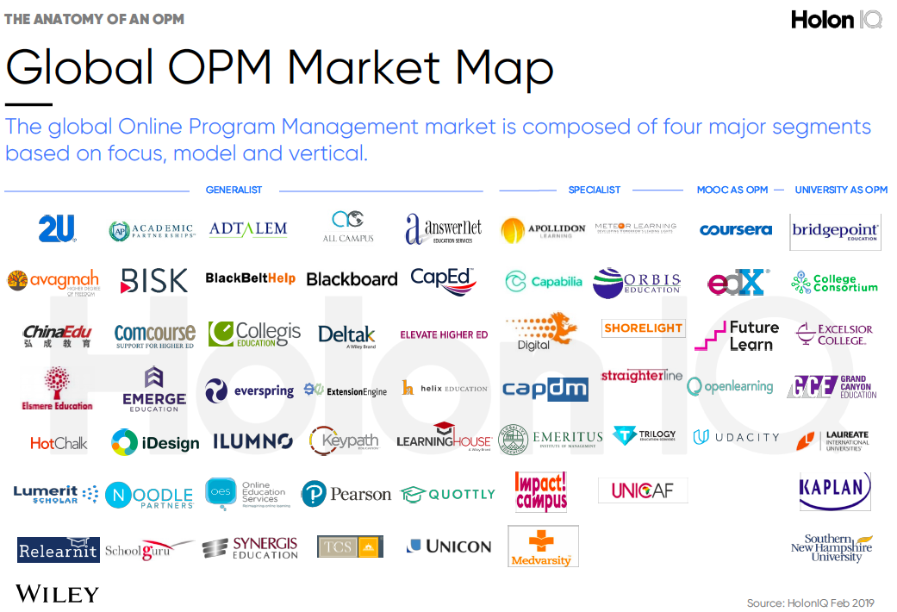
The shape of OPM market
4 types of OPM:
General
Specialist
MOOC-as-OPM
University-as-OPM
Notes:
This is another graphic produced by a consulting firm that offers categorization of OPMs – you may recognize some of these logos. In any case you can see that Higher Education and its outputs are seen as business opportunities for venture capitalists, investors and consultancies. This is what I mean by market making and it is both an outcome of the confluence of marketization and the opportunities afforded by digital technologies.

Slide 20
What does unbundling look like?
Notes:
So I described some of the factors influencing and changing global higher education and focused on the rise of more blended and online programs – whether they are degrees or short courses.
So where does unbundling come into this?

Slide 21
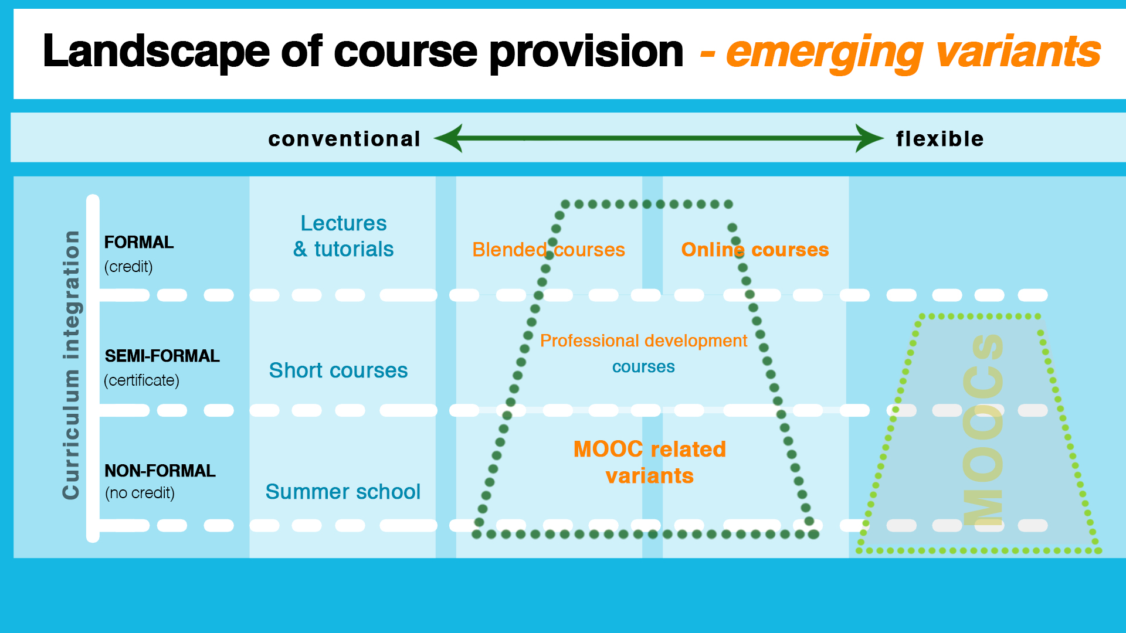
Emerging business models of online learning
Formation of business relationships to design, deliver T&L
Notes:
Let’s look at a university’s provision map. Conventional higher education institutions offer formal, credit-bearing curricula with lectures, tutorials, and seminars. They also offer semi-formal forms of delivery such as short courses as well as non-formal offerings such as summer school or public lectures. Recently there has been expansion into that non-formal space, especially with massive open online courses (MOOCs).
Five years ago, MOOCs were completely in the non-formal space, but this has changed. What's particularly interesting now is the intersection between non-formal, semi-formal, and formal.
Sometimes these intersections enable a rebundling towards a degree where discrete learning elements such as courses or microcredentials can either standalone or can be stacked up and make up a degree.

Slide 22
MOOC providers and microcredentials
MOOC providers have been at forefront of imaging new credentials as the MOOC business model search for sustainability and profitability:
Add something from Class Central
Coursera
3200 courses
300 specialisations
10 MasterTrack or Prof Certifcate
14 degrees
This works as a system and a pathway.
“Stackability is not a marketing strategy, stackability is a learning strategy”
https://www.classcentral.com/report/moocs-microcredentials-analysis-2018/
Notes:
This foray into unbundled bite-sized university courses sometimes credit bearing and sometimes not has led to increased interest in micro-credentials or alternative credentials offered online. Again, the idea is not new and universities over many decades have been offering short learning programmes as part of continuing education.
But the entry of private companies and the affordances of internet technology is leading to interesting experiments with an array of of micro-credentials products. Some of these are in response to employer and industry needs and are often in conjunction with companies who would hire successful completers of those credentials. Google’s IT certification with MOOC providers is an example of this.
Microcredentials and their stacking up potential is a form of unbundling and rebundling. However getting this right in way that works for all the stakeholders is challenging. For many years the degree has provided a signaling mechanism to potential employers. However the extent to which microcredentials can be recognized or where offered for credit and mapped to appropriate qualifications frameworks is the work that is yet to be done

Slide 23
Trends on acceptance of microcredentials
New Zealand has a nationally agreed system for accreditation of microcredentials
India’s SWAYAM platform allows students to study MOOCs for university credit
In the UK, some universities are accepting standalone credit-bearing courses as accredited prior learning (‘MOOC to degree’), but not widespread and locally owned. There are discussions about introducing national microcredential standards
Some universities in Europe have ‘virtual exchange’ programmes where students study MOOCs for credit from other universities
The OER university is a consortium of universities offering alternative models for stackable credentials e.g. pay for assessment only (https://oeru.org/)
Notes:
Offering microcredentials is one thing but they also need to be accepted. There are some promising signs about the acceptance of microcredentials as some of these examples illustrate. Developments in New Zealand and India suggest government steering is giving the impetus.

Slide 24
How is unbundling happening?
Notes:
Having looked at the macro view of unbundling, I’m going to bring it down to the level of a degree or qualification. How is unbundling practically happening?
Let’s look at it from a university’s perspective and how and why they might choose to unbundle.

Slide 25
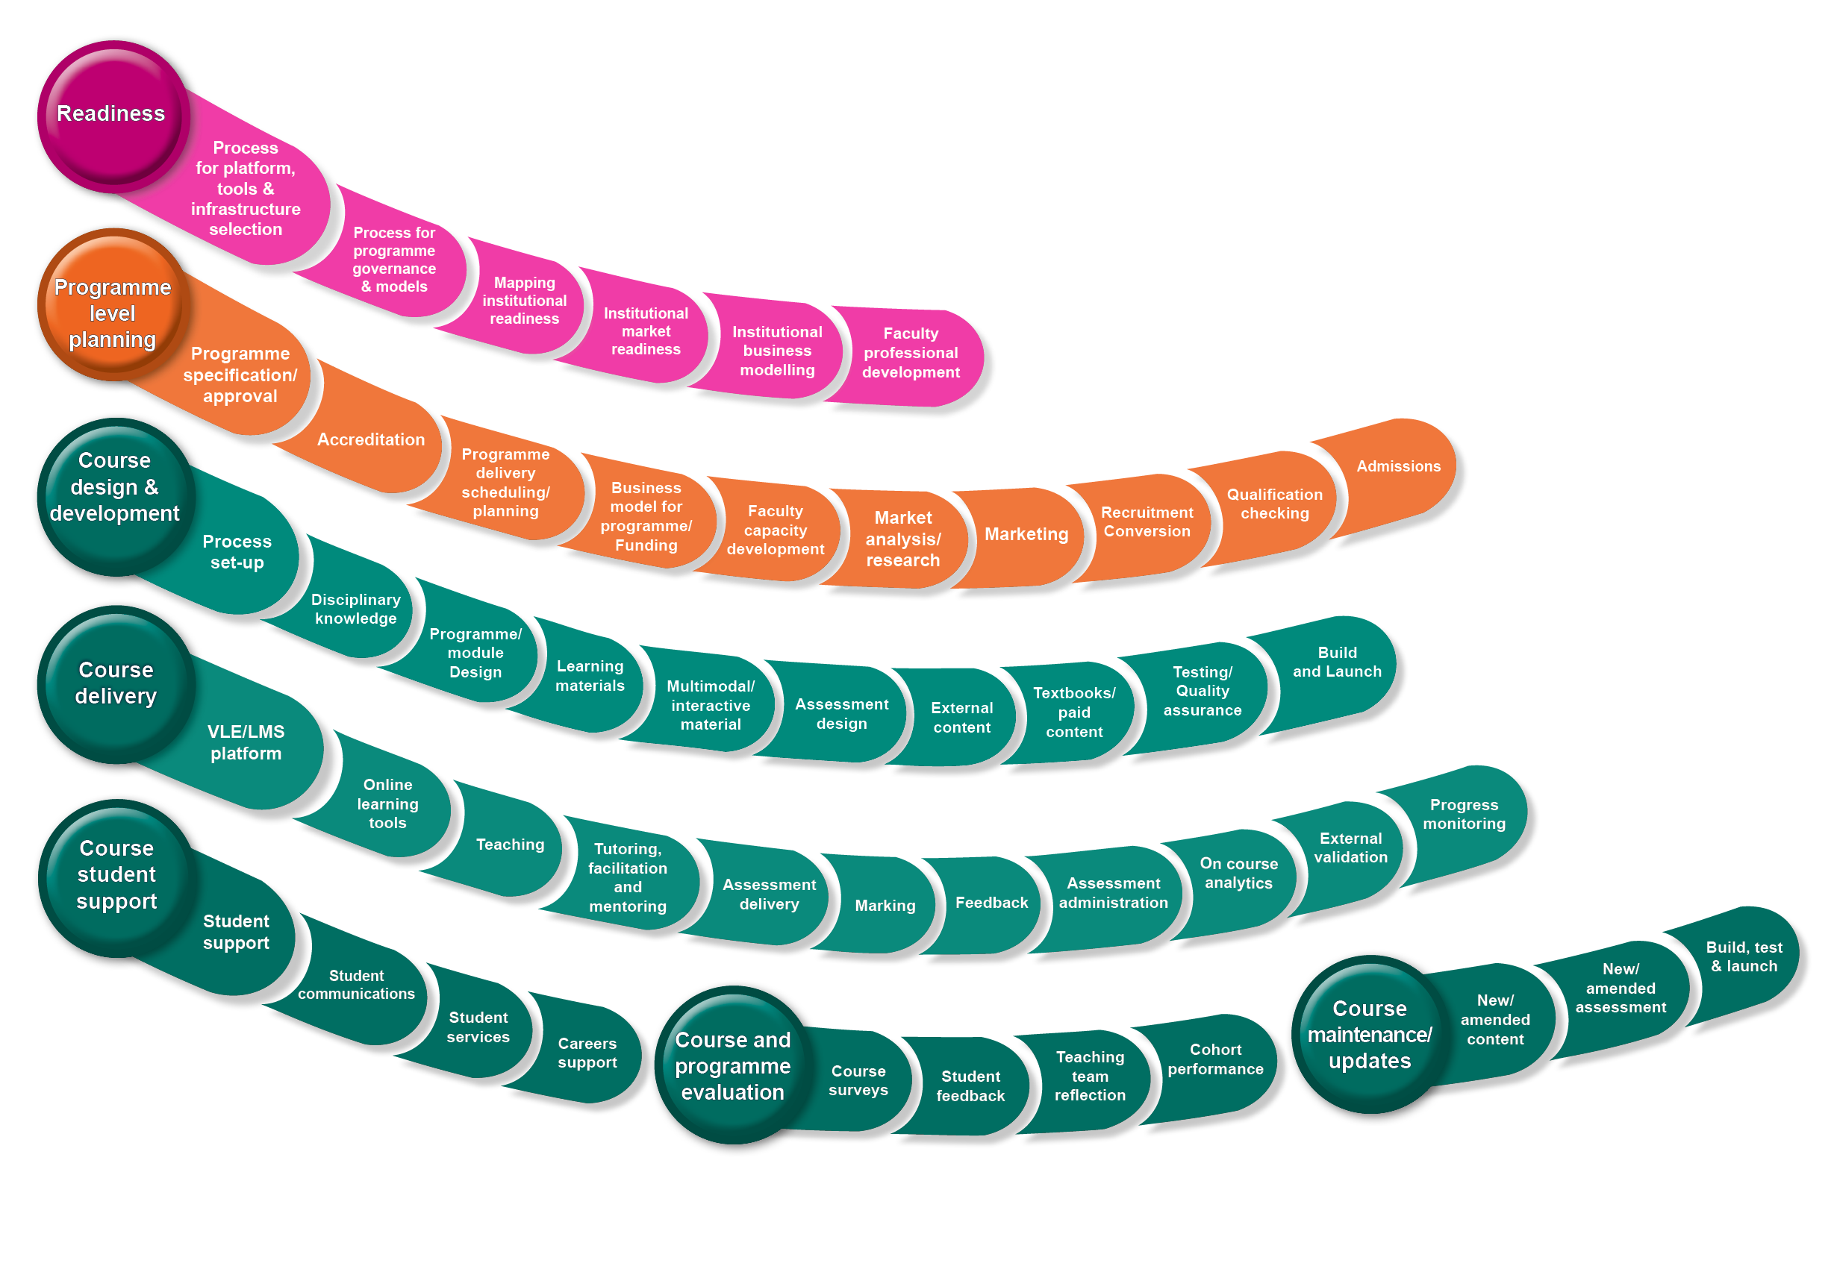
Online Education Programme and Course Unbundled Services
Walji, Morris & Czerniewicz, 2017
Notes:
As many more institutions are producing online degrees and qualifications, the processes and steps needed to achieve this are becoming better understood. When an institution moves to offer qualifications in an online mode, it has to look at existing processes and ways of working and look at what resources and services need to be provided. Sometimes this means developing new skills and expertise.
This diagram is an overview of an online qualification development process. We have mapped the various stages a university might need to go through and point to what could and is being unbundled and rebundled

Slide 26
Business models and market scan
Systems and technology
Governance and accreditation
Walji, Morris & Czerniewicz, 2017
Notes:
Starting with an assumption that a university is not currently offering online provision it needs to get to a stage of readiness. These are the kinds of activities the university might have to go through to achieve readiness, such as establishing a suitable learning technology platforms and reviewing current processes for governance. Other activities include the readiness of faculty to engage with the new type of offering.
What could be unbundled here? Well, we are seeing companies coming into the market that are helping universities get ready for online learning. This might involve setting up tools and learning technology infrastructure and embarking on faculty training.

Slide 27
Selection of programmes & courses
Market research and marketing the specific program,
Marketing the specific program, admissions
Walji, Morris & Czerniewicz, 2017
Notes:
The next stage after readiness is programme level planning. The activities here are to do with establishing the viability of a particular degree. So to establish the viability of a new online degree, an institution might go through a series of steps, such as getting the requisite approvals and accreditation from an external body.
It's also common for market research and marketing activities to take place, and also planning for admissions to be included in this process. Some of these activities, especially marketing and online admissions, are not the kinds of activities a traditional conventional university has been involved in. Therefore, these activities are increasingly being unbundled and offered by private companies as discrete services.

Slide 28
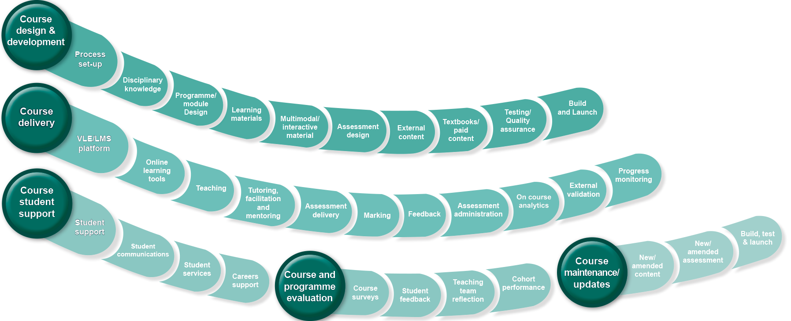
Course design stages
Course delivery and online teaching
Student support/helpdesk
Walji, Morris & Czerniewicz, 2017
Notes:
Having established readiness and programme level planning, the next phase of activities centre on the course level design, development, delivery. Along with producing and delivering a course online, other activities such as student support, evaluation and maintenance are also strands of activities that happen at the course level. So let's look more closely at what could be unbundled here. The production of learning materials and multimedia, such as video, is commonly outsourced often due to capacity and constraints. A private company might work with a subject matter expert and take over all the production activities, including building the course itself.
Student support is another area in which private companies operate. They may provide help desks or more intensive online coaching and mentoring directly to students. These are tasks and job roles that universities may not be geared up to do or don't want to do and are often unbundled. Depending on the context of the institution, more or less can be unbundled.
The rebundling is performed through the relationships that form when a university and a private company provide a distributed online degree or multiple microcredential experience. This may be more or less invisible to the student.

Slide 29
How prevalent is unbundling?
Notes:
How prevalent is this form of unbundling? In our research we mapped using publicly available data the relationships between private companies in England and in South Africa. So where a university has a relationship with a MOOC provider or an Online Program Manager, we mapped this.

Slide 30
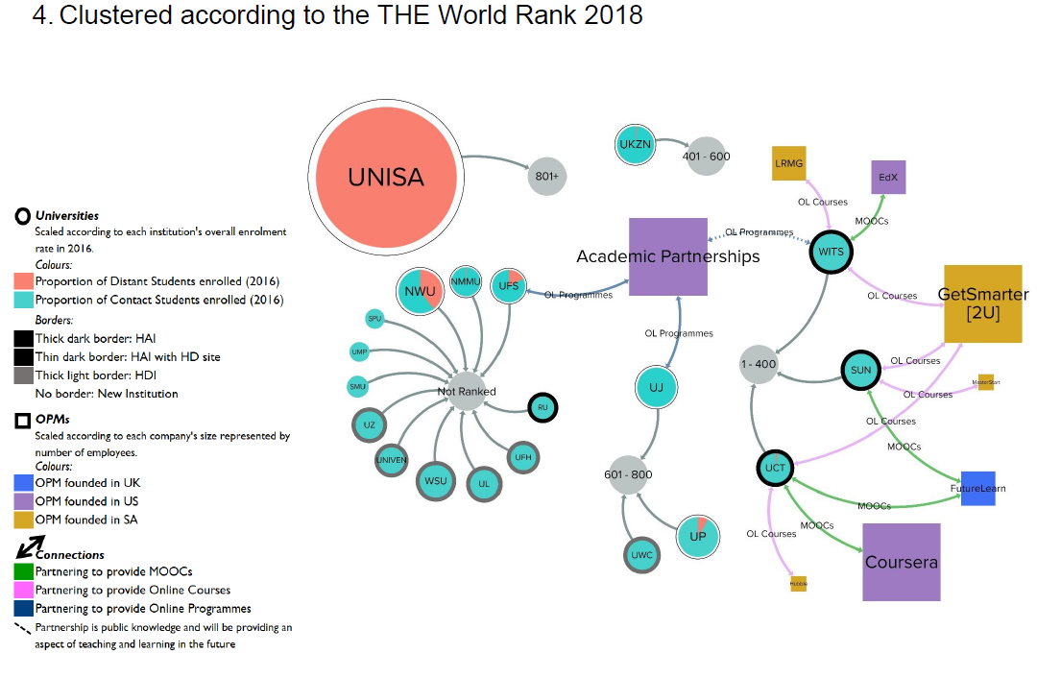
Swinnerton et al 2018
Notes:
This is a diagram showing relationships between private companies including MOOCs and universities in South Africa. What our data showed was that it tends to be the higher ranked companies that are engaging in relationships and partnership arrangements.

Slide 31
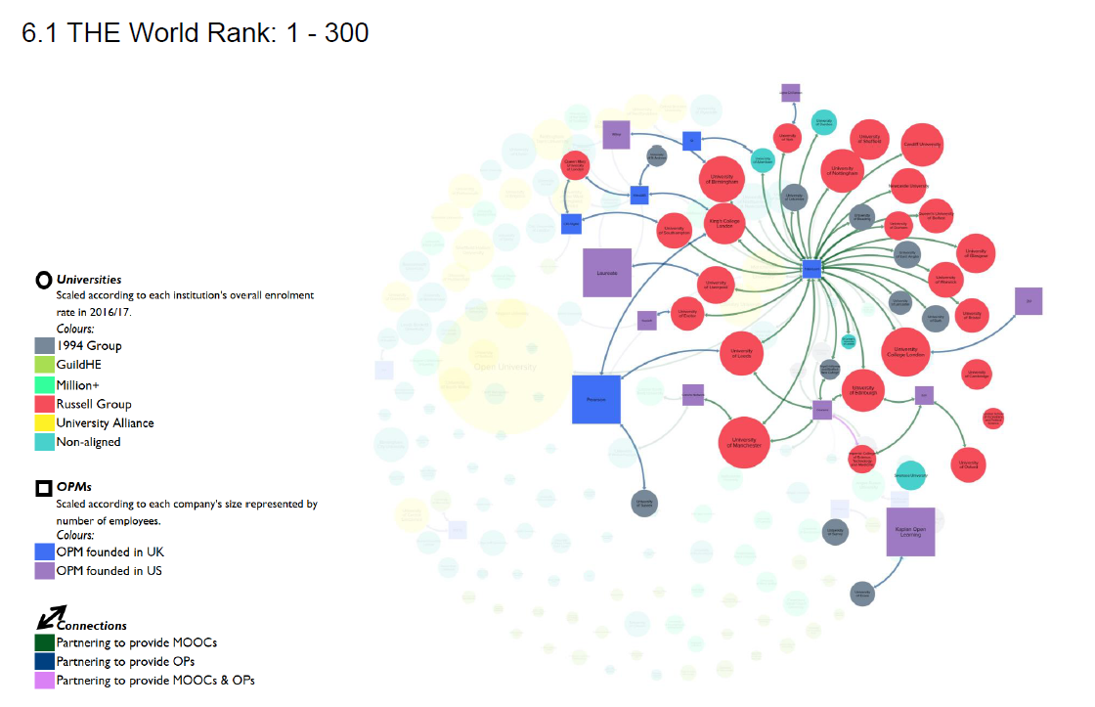
Swinnerton et al 2018
Notes:
In England there are many more universities and many more arrangements and partnerships but the patterns are similar in that the highly ranked universities according to global metrics are those with partnerships.
Over time this may be changing but it’s worth noting that these sorts of developments point to the university’s brand and its attractiveness to a market. Our interviews with private company executives suggest that brand is important is companies plan to invest into a program or a university.

Slide 32
Flexibility through unbundling (and rebundling)
Students
Choice
Academics
Reuse and modularity
Institutions
Cost reductions
Agility
Stackability
Innovation
Industry partnerships
Shared teaching functions
Employers
Relevant credentials
Opportunity to create credentials
Speed and time to market
Notes:
So what are the implications of this unbundling environment. The promise of flexibility for the various stakeholders is certainly there.
As Prof Belawati mentioned yesterday, students may have more choices and the opportunity to personalize their learning. Flexibility also means the stackability, and the opportunity for cost reducts. Flexibility for academics and institutions especially where savings and efficiencies might be achieved.

Slide 33
Fragmentation though unbundling (and rebundling)
Students
Overwhelming choice
Academics
Identity
Institutions
Navigate multiple systems
Sense of belonging
Market forces steering
Cultural changes required
Agency of academics
Employers
Reputation and confusion
Issues about Recognition
Narrow education
Requires technical infrastructure
Value of degree questioned
Notes:
However unbundled educational provision has the potential for fragmentation – for students as well as other stakeholders across the system. Students may be overwhelmed by choice and the burden to creating personalized pathways may disadvantage particular students. For institutions unbundling the degree and rebundling raises questions of what is the value proposition of the holistic degree, while a market led approach may mean a focus on degrees that are attractive to a market rather then for other public good processes. For teachers and academics, a more disaggregated teaching experience may result in the loss of agency.

Slide 34
Final thoughts
The future for digitally mediated learning is likely to be
Unbundled and rebundled
Enable flexibility and result in fragmentation
Current trends in many jurisdictions appear to show a market-led unbundled and rebundled future but there could also be
Unbundled and rebundled partnerships between universities or university systems
Online and blended learning offer great opportunities for increasing access and reducing costs but market making might have unintended consequences
THANK YOU – contact Sukaina.Walji@uct.ac.za Twitter: @sukainaw
Notes:
So to conclude, unbundled educational provision is an emerging trend in many universities but it is being driven as much outside of institutions as within. MOOC providers and Online Program Managers are giving universities many new options. This is a complicated and sometimes confusing space which university governance structures are often not ready to grapple with.
The future for digitally mediated learning is likely to be
Unbundled and rebundled
Enable flexibility and result in fragmentation
Needing technology solutions to enable rebundling – blockchain may assist students in mitigating the effects of fragmentation.
Current trends in many jurisdictions appear to show a market-led unbundled and rebundled future but there could also be
Unbundled and rebundled partnerships between universities or university systems
Online and blended learning offer great opportunities for increasing access and reducing costs but market making might also have unintended consequence

Slide 35
Acknowledgements
University of Cape Town: Laura Czerniewicz, Alan Cliff, Rada Mogliacci
University of Leeds: Neil Morris, Bronwen Swinnerton, Mariya Ivancheva, Taryn Coop
Contact: Sukaina Walji, University of Cape Town
sukaina.walji@uct.ac.za
@sukainaw

