Slide 1
The Open University of China
Mode exploration and mechanism innovation
of network teaching team model in mixed learning environment
Hu zhengwei
2019-10-15

Slide 2
lecture outline
the foundation and background
the path and practice
the prospect of the future

Slide 3
the foundation and background
Presiding teacher
Chief editor, chief lecturer
Executive Teachers
Tutors
Chief editor
Chief lecturer
Presiding teacher
Executive Teachers
Tutors

Slide 4
the foundation and background
teaching team
Chief editor
Chief lecturer
Presiding teacher
Presiding teacher
Executive Teachers
Executive Teachers
Tutors
Core team
Implementation team

Slide 5
the path and practice
Core team members
(Course title : Applied writing/Team building time : 2017)
 | name | organization | role
1 | Hu zhengwei | Headquarters of OUC | Presiding teacher
2 | Ren ying | Headquarters of OUC | Chief editor, chief lecturer
3 | Wen zhihui | Hunan branch | Executive Teacher
4 | Liu xiangdong | Jiangxi branch | Executive Teacher
5 | Su wei | Shanxi branch | Executive Teacher
6 | Han cuiling | Gansu branch | Executive Teacher
7 | Xiang shuxi | Chongqing branch | Executive Teacher
8 | Wang shuling | Hebei branch | Executive Teacher/Tutor
 | name | organization | role
1 | 文智辉 | 湖南分部
2 | 刘向东 | 江西分部
 | 苏 炜 | 山西分部
 | 韩翠玲 | 甘肃分部
 | 向曙曦 | 重庆分部
 | 王淑玲 | 河北分部

Slide 6
the path and practice
Core team work
(Course title : Applied writing/Team building time : 2017)
 | Main work | remark
1 | Define learning goals and design learning programs
2 | Build the course, such as the digital textbook and online course | see image below
3 | Determine the assessment method and content
4 | Carry out experimental teaching and give feedback
5 | Instruct the implementation team to conduct teaching work on a larger scale

Slide 7
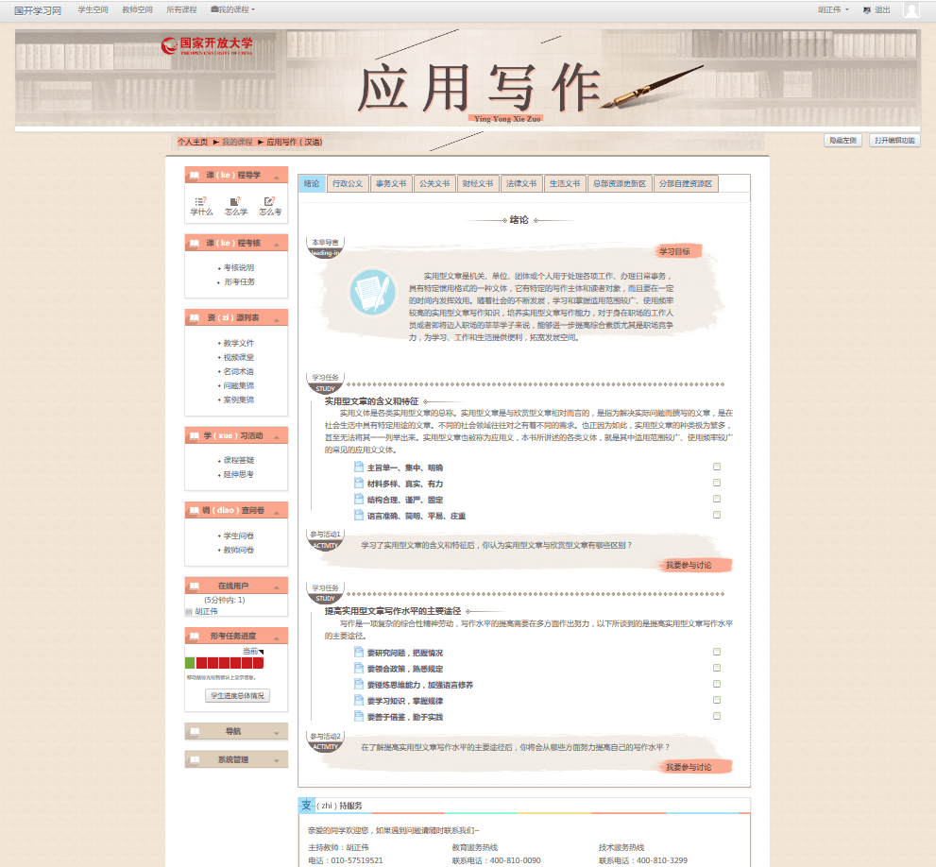
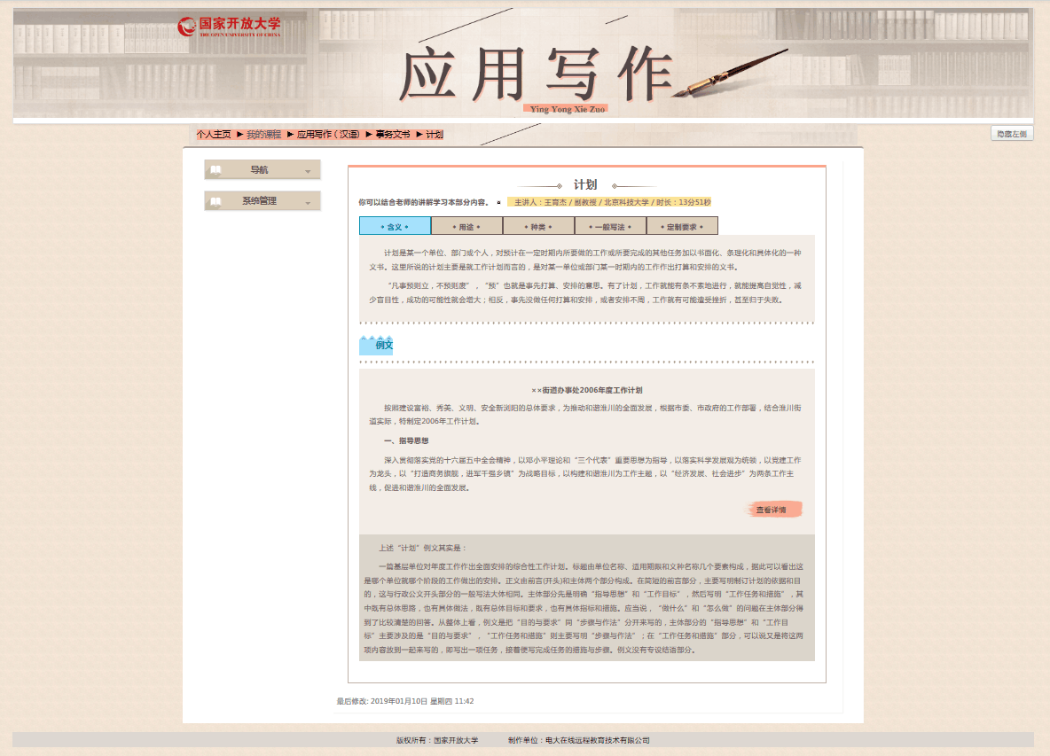
the path and practice
Examples of core team work results : Online course
(Course title : Applied writing/Course building time : 2018)

Slide 8
the path and practice
Examples of core team work results : Online tutoring
(Course title : Applied writing/Online tutoring time: 2018)

Slide 9
the path and practice
Implementation team work
(Course title : Applied writing/Team building time : 2017)
 | Main work |  | remark
1 | Adapt to mixed learning environment and promote learning behavior | To understand the characteristics and learning needs of students
 |  | Carry out online teaching and guidance
 |  | According to the actual situation and needs, carry out face-to-face teaching or activities
2 | According to the learning objectives, organize different forms of assessment | Formative assessment
 |  | Summative assessment
 |  | Performance evaluation of learning behavior in both online and face-to-face environments
3 | Give the feedback of teaching | Get in touch with the core team members, offer advice and provide some students' learning results | Necessary, indispensable

Slide 10
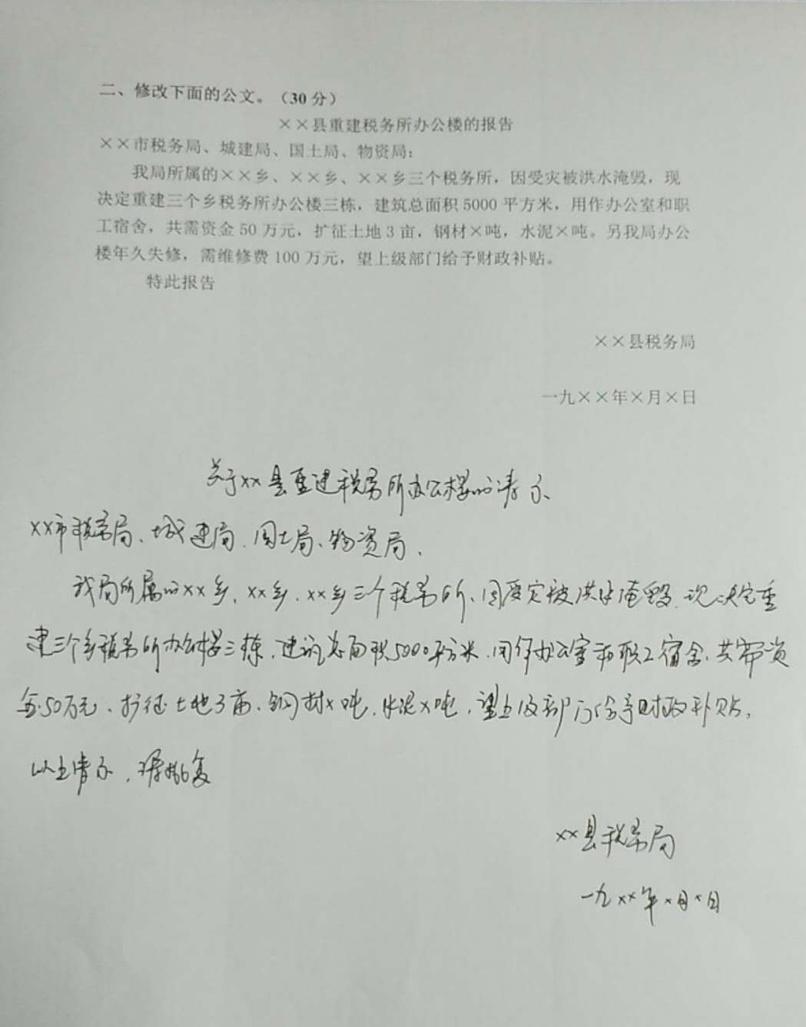
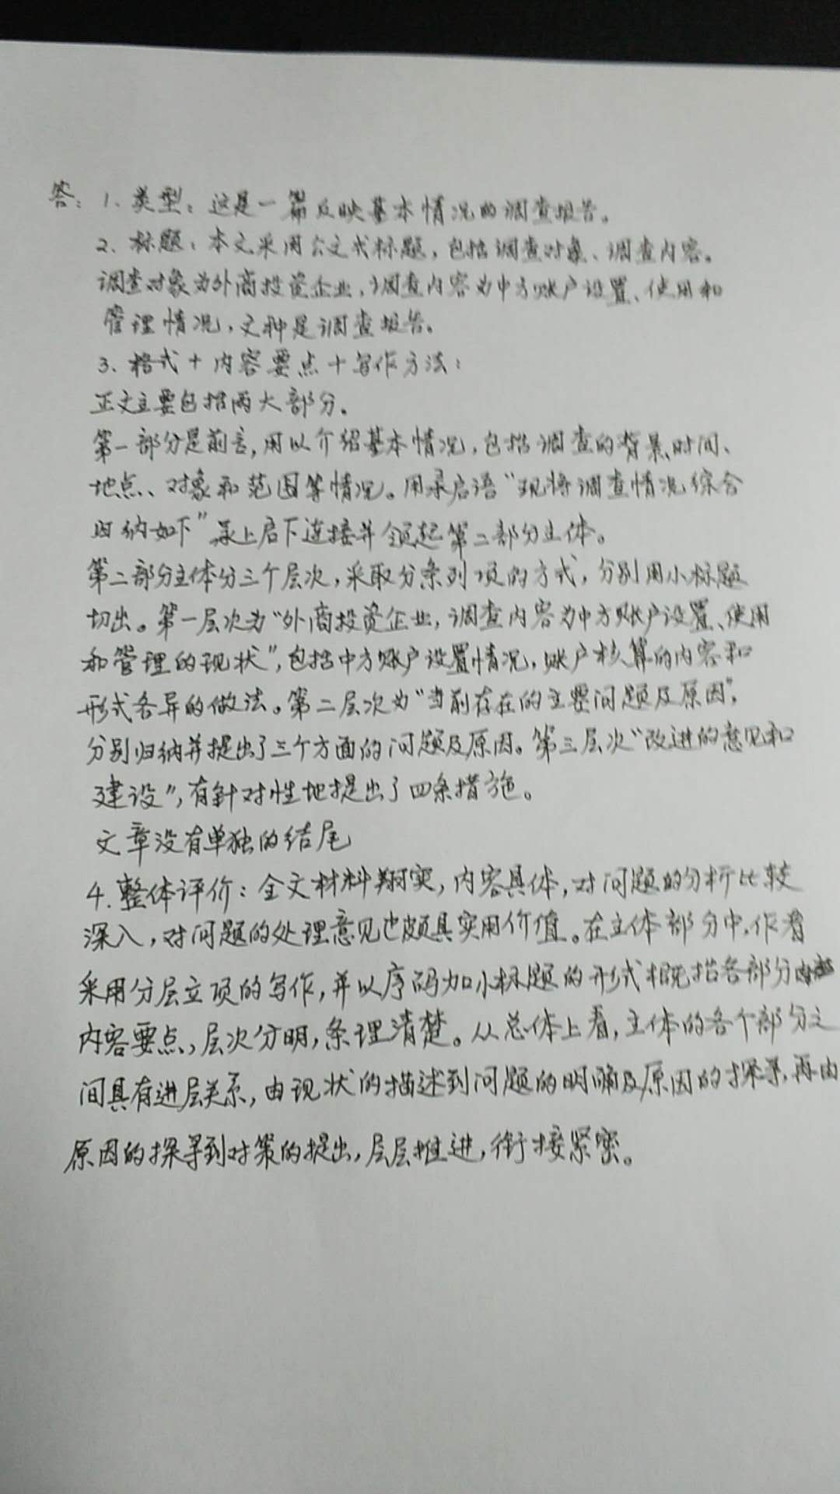
the path and practice
Implementation team work
(Course title : Applied writing/Team building time : 2017)

Slide 11
the path and practice
Network teaching team work effect
(Course title : Applied writing/Data acquisition time: 2019)
In the spring semester of 2019, 61,734 learners received the guidance of the online teaching team of applied writing course.
Students' online learning behavior
Teachers' online teaching behavior
Total number of student behaviors | Per capita behavior hours | Total per capita behavior
61055 | 112.08 | 111.94
Total number of student behaviors | Per capita behavior hours | Total per capita behavior
1454 | 165.60 | 1155.91

Slide 12
the prospect of the future
Facing the future and adapting to the mixed teaching environment, the network teaching team needs to do the following work:
Further clarify the role division, optimize the team structure
Strengthen teachers' self-identity and enhance their moral realm
Summarize team work, turn experience into theory, and improve the scientific nature of team work

Slide 13
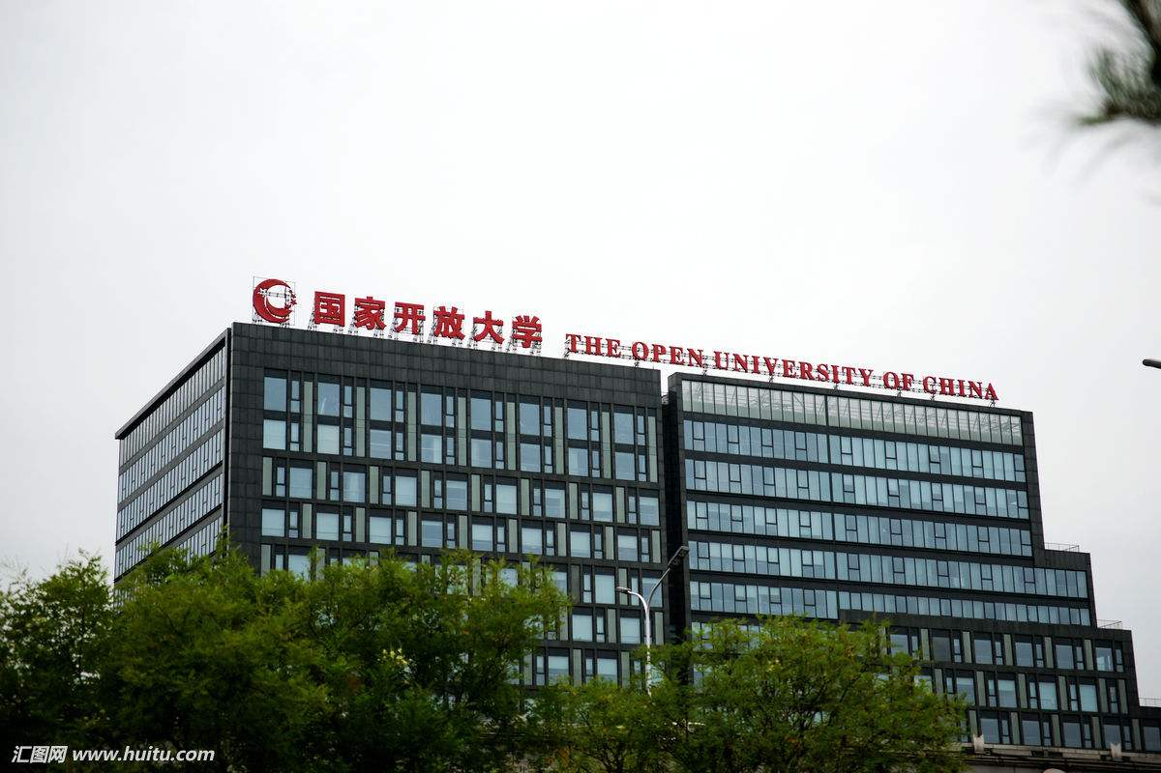
Welcome to China
Welcome to the Open University of China
email : huzhw@ouchn.edu.cn

