Slide 1
EMPLOYERS’ PERCEPTION OF AND ATTITUDE TOWARDS OPEN AND DISTANCE eLEARNING (ODeL) AND HIRING PRACTICES OF PHILIPPINE INDUSTRIES
MELINDA LUMANTA, Vice Chancellor for Academic Affairs, UP Open University
MICHAEL LAGAYA, Human Resources Development Officer, UP Open University
LOUISE ANTONETTE VILLANUEVA, Research Assistant, UP Open University
IVY ROSEMARIE ORTIGUERO, Research Assistant, UP Open University

Slide 2
INTRODUCTION
CHALLENGE: Employability of ODL students and graduates
Quality of education
Negative perceptions
Dearth in literature on ODL as perceived by industry
Least explored in the Philippines
Notes:
While open and distance learning are gaining popularity due to increasing enrolment, it is still faced with many challenges such as the employability of its students and graduates. Skepticism on the quality of education provided by ODL institutions as well as negative perceptions of employers about online degrees were noted to be the contributing factors as these are reflected in the hiring practices of the employers. In the Philippines, the employability of ODL graduates is the least explored research hence, this study.

Slide 3
OBJECTIVES
To determine employers’ knowledge of and attitude towards ODeL institutions and how these affect their hiring practices;
To determine employers’ perceptions of ODeL graduates in terms of desired attributes in the workplace; and
To determine employers’ willingness to hire graduates of ODeL institutions and to recommend their employees to take ODeL courses.
Notes:
The objectives of the study are the following : [enumerate objectives]

Slide 4
RESEARCH FRAMEWORK
Knowledge
Awareness about ODL institution
Familiarity and usage of online learning platforms
Attitude
Affect and belief towards ODL, ODeL, and its graduates
Intention to hire ODL graduates
Practice
Recruitment and hiring criteria
Presence of ODL-graduate employees in the company
Industry/Individual Profile
Type of organization
Type of industry
01
Text Title
Place your own text here
EMPLOYERS’ PERCEPTION OF AND ATTITUDE TOWARDS OPEN AND DISTANCE eLEARNING (ODeL)
Willingness
Willingness to hire ODL graduates
Willingness to recommend employees to study/take courses at ODL institutions
04
Text Title
Place your own tet here
Figure 1. Conceptual framework used in the Employer’s Perception Survey towards ODeL
Notes:
[Copied from the full paper] This study was guided by a conceptual framework that posits that an employer’s willingness to hire an ODeL graduate and/or willingness to allow current employees to enroll in an ODL institution is influenced by (1) level of knowledge about ODeL and (2) attitude towards ODeL graduates. In this research, the employer’s perception towards online and distance e-learning (ODeL) is expected to be affected by two general factors – organization characteristics and employer’s knowledge, attitude, and practices (KAP) factors.
As shown in the framework, the employer’s perception is influenced by what they know, believe, or done with regards to ODeL. Employer’s knowledge was gauge based on their understanding and awareness regarding ODeL, ODeL institutions, and online learning platforms. The attitude of the respondents was examined through asking their opinion on ODeL graduates and quality of education. Recruitment or hiring criteria and the number of ODeL graduate-employees were the basis for the evaluation of the practices of the employer. These three components of KAP are assumed to be interrelated. It is hypothesized that the KAP factors had an effect on the willingness of the employer to hire ODeL graduates and recommend employees to take courses/study at ODeL institutions.

Slide 5
DESCRIPTIVE ANALYSIS
METHODOLOGY
Graphs, Tables, Percentages, Frequencies, Means
Human resources managers and practitioners of BPO/IT-enabled services, eco-mining, medical tourism, health and wellness, agribusiness, electronics, and value-chain materials and manufacturing
Survey questionnaire and key informant interview
KAP ANALYSIS
Knowledge on ODL, awareness about ODL institutions and online learning platforms
Attitude towards ODL and its graduates and hiring practices via five-point Likert scale
ASSOCIATION AND CORRELATION ANALYSIS
Pearson’s chi-square
Spearman’s rho
Notes:
Human resources managers and practitioners from sunrise industries which are rapidly growing companies characterized by global competitiveness (NEDA, 2013) in 2007-2016 were selected as respondents. Majority of the 91 respondents were from the National Capital Region and Region IV-A (CALABARZON) since the main offices of the companies are located in these areas.
[Copied from the full paper] To achieve the objectives of the research a survey was conducted among employers of different industries in the country to determine their perceptions of open and distance elearning and graduates of this mode of education. In addition to obtaining profiles of the industries surveyed, data were obtained on the knowledge, attitude and practice of the respondents using a five-point Likert scale. To validate results of the survey instrument, key informant interviews were also conducted.
[Copied from the full paper] To corroborate findings of the survey two approaches were included in the study. First, graduates of an ODeL institution were tracked using crowd-sourcing as sampling method. Those who opted to participate in the research were requested to fill in a self-completed closed format questionnaire (Appendix ). Second, semi-structured interviews were scheduled to gain in-depth insights about the key parameters of investigation. Specifically, the designed questions for the interview sought to answer a number of questions which had arisen from prior data analyses such as the knowledge, attitude and practices of HR practitioners towards ODeL graduates.
The result of the study were analysed using descriptive statistics, KAP analysis, and correlation and chi-square analysis.

Slide 6
PROFILE OF THE RESPONDENTS
(n=91)
Figure 2. Distribution of respondents by industry
Notes:
The 91 respondents were mostly from value chain materials/manufacturing, BPO/IT-enabled, and health and wellness. Majority of the industries are classified as local. Moreover, 44% of the companies have more than 500 employees.

Slide 7
KNOWLEDGE, AWARENESS, AND USAGE
Table 1. Employers’ awareness and usage of OLP
ONLINE LEARNING PLATFORMS | AWARENESS* | USAGE*
 | in percent, n=91
UPOU Model | 24.5 | 7.7
Coursera | 13.8 | 19.2
edX | 6.4 | 15.4
Udacity | 1.1 | 0.0
Udemy | 13.8 | 23.1
NovoEd | 2.1 | 0.0
Future Learn | 3.2 | 0.0
OpenUpEd | 23.4 | 15.4
Iversity | 3.2 | 3.8
Open2Study | 8.5 | 13.8
Note: * Multiple Responses
Notes:
Notions of Open Learning, Distance Education, and e-Learning as described by the respondents includes: 1) online delivery or education administered primarily via the internet, 2) on-traditional or learning outside the physical classroom, 3) Flexible, accessible, convenient, and 4) Independent learning, blended learning, modular learning, massive open online courses.
On the other hand, majority of the respondents have knowledge in terms of ODL institutions in the Philippines. They also reported awareness of UPOU ModeL, Coursera, Udemy, and OpenUpEd as online learning platforms. Lastly, majority of the respondents (comprising of 69%) had not used online learning platforms.

Slide 8
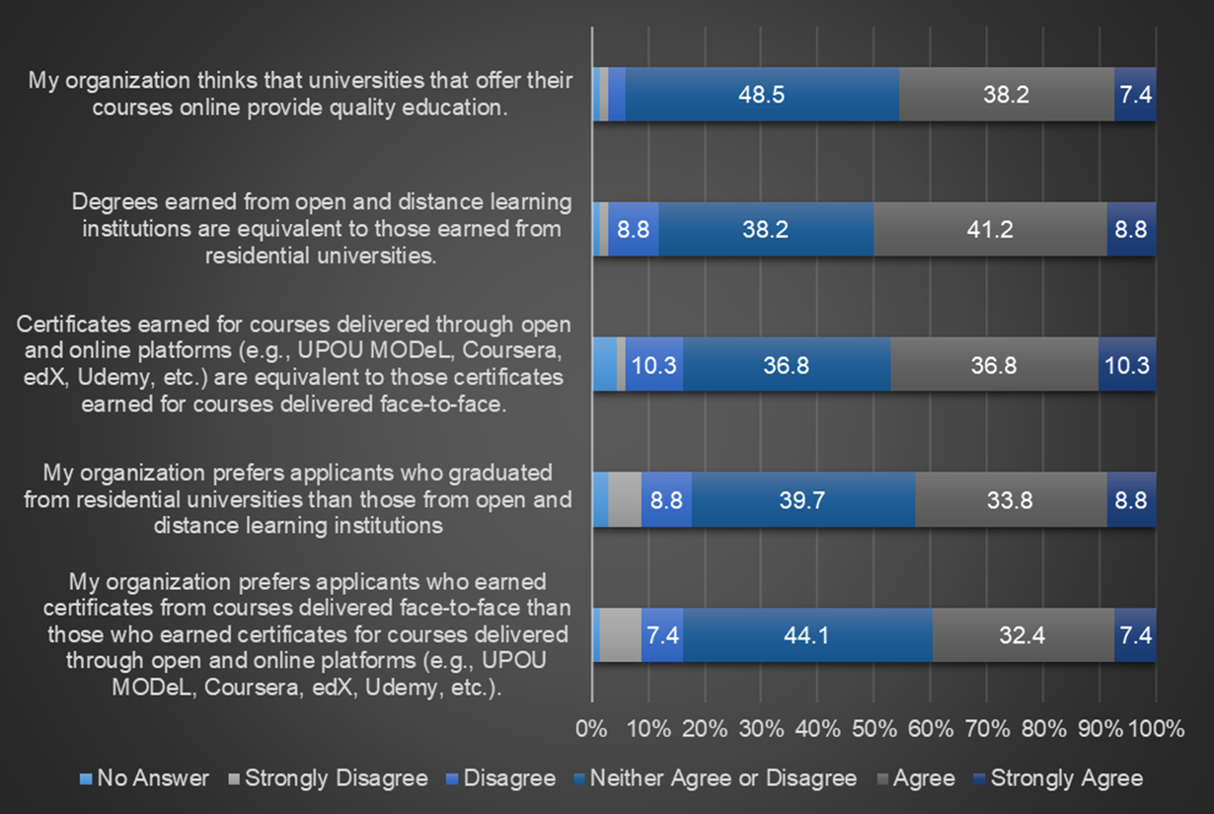
EMPLOYER’S ATTITUDE
Figure 3. Attitude of respondents towards ODL
Notes:
Through the use of the likert scale, the attitude of respondents towards ODL was measured. The respondents were neither favorable nor unfavorable about open and distance learning institutions and its graduates. In addition, an apparent agreement can be observed about the equivalence of certificates earned via online platforms to those earned via face-to-face delivery.

Slide 9
EMPLOYER’S PRACTICE
Importance of Applicant’s Attributes, Skills, and Competencies
Current employment of ODL graduates
Table 2. Employer’s importance scale on applicant’s attributes, skills, and competencies
DESCRIPTION | MEAN
Foundation Skills | 4.02
Professional Competencies | 4.26
Personal Attributes | 4.62
Organization Skills | 4.42
Technical/Domain Specific Knowledge | 4.37
Notes:
Among the five categories, only the foundation skills was labeled as “very important” while the other attributes were marked as extremely important. The personal attribute was rated to be highest and perceived by employers as the most important attribute of an applicant while foundation skill was ranked the lowest. Examining individual items, it was observed that English language comprehension for foundation skills , critical thinking and problem solving for professional competencies, integrity for personal attribute, productivity for organizational skills ,and capacity to use knowledge and skills in workplace content for technical knowledge were deemed by the respondents as the most significant. On the one hand, the subcategories that have recorded the lowest mean making them the least important are numerical skills for foundation skills, conceptual skills for professional competencies, cross-cultural skills for personal attributes, entrepreneurial skills for organization skills, and knowledge of international standards and related bodies for technical knowledge.
In terms of the current employment of the ODL graduates, the following were observed: 1) More than half of the respondents do not employ ODL graduates; 2) ODL graduates in the institutions were already in the company when they enrolled in ODL or they met and passed the required skills and competencies for the positions; and Lack of employees from ODL institutions was attributed to the absence of applicants.
Practice Analysis - lack/absence of ODL graduate-applicants
employers do not have a basis on the quality of education since there is a lack/absence of ODL graduate-applicants
cannot verify what are the competencies and skills of an ODL graduate

Slide 10
Table 3. Employer’s willingness to hire ODL graduates and recommend current employees to take courses/study at ODL institutions
EMPLOYER’S WILLINGNESS
RESPONSE | WILLINGNESS TO HIRE | WILLINGNESS TO RECOMMEND
 | in percent, n=91
Yes | 47.3 | 72.5
No | 1.1 | 3.3
Maybe | 22.0 | 24.2
No Response | 29.7 | -
Willing to hire and recommend but emphasized that they neither agree nor disagree in terms of preference towards ODL graduate over residential university-graduate
Recommended programs
Certificate courses (65.9%)
Short courses (63.7%)
Master’s degree (58.2%)
Notes:
The uncertainties of the respondents in their willingness to hire ODL graduates (20%) and willingness to recommend employees to study/take courses in ODL institutions (23%) suggests that there is a parameter/circumstance to be considered by the employers in hiring ODL graduates and recommending them to take ODL courses.

Slide 11
PEARSON’S CHI-SQUARE & SPEARMAN’S RHO
Generally, there is an association between the KAP factors and employer’s willingness
Degree of association ranges from very weak to weak
Duplicates the initial assumption on the conceptual framework that KAP factors affect the employer’s willingness

Slide 12
REFERENCES
[1] Poulin, R., & Straut, T. (2016).WCET Distance Education Enrollment Report 2016. Retrieved from http://wcet.wiche.edu/initiatives/research/WCET-Distance-Education-Enrollment-Report-2016
[2] Class Central. (2017). By the numbers: MOOCs in 2017. Retrieved from https://www.class-central.com/report/mooc-stats-2017/
[3] Macon, S. C. (2012). Is my online degree worth anything? the lived experiences of learners choosing online education despite opposition (Order No. 3546681). Available from ProQuest Dissertations & Theses Global. (1267128747). Retrieved from https://search.proquest.com/docview/1267128747?accountid=47253
[4] Columbaro, N.L., & Monaghan, C.H. (2008). "Employer Perceptions of Online Degrees: A Literature Review," Adult Education Research Conference, 14. http://newprairiepress.org/aerc/2008/papers/14
[5] Silva, A.P., Lourtie, P., & Aires, L. (2013). Employability in online higher education: A case study. The International Review of Research in Open and Distributed Learning, 14(1). Retrieved from http://www.irrodl.org/index.php/irrodl/article/view/1262/2426
01
Text Title
Place your own text here
02
03
Text Title
Place your own text here
04
Text Title
Place your own tet here

Slide 13
REFERENCES
[6] Partnership for 21st Century Learning. N.d. Framework for 21st Century Learning. Retrieved from http://www.p21.org/about-us/p21-framework
[7] Alfonso, G.J. (2014). Creating spaces and possibilities through Open and Distance e-Learning (ODeL): A Worldview. In G.J. Alfonso and P.G. Garcia (Ed.), Open and Distance e-Learning: Shaping the future of teaching and learning (pp. 3-14). Laguna, Philippines: UP Open University and Philippine Society for Distance Learning.
[8] Official Gazette. (2014). Republic Act No. 10650. Retrieved from http://www.officialgazette.gov.ph/2014/12/09/republic-act-no-10650/
[9] National Economic and Development Authority. (2013). Competitive Industry and Service Sectors. Retrieved from http://www.neda.gov.ph/wpcontent/uploads/2013/09/CHAPTER-3.pdf
[10] Rav-Marathe, K., Wan, T.T.H., & Marathe, S. (2016). A systematic review of the KAP-O framework for diabetes education and research. Medical Research Archive, 4(1). Retrieved from http://journals.ke-i.org/images/sidebar/pdf/483-1710-1-PB.pdf
01
Text Title
Place your own text here
02
03
Text Title
Place your own text here
04
Text Title
Place your own tet here

Slide 14
REFERENCES
[11] Delameter, J.D., & Myer, D.J. (2011). Social Psychology. Belmont, CA: Wadsworth Cengage Learning
[12] World Economic Forum. (2017). The Travel & Tourism Competitiveness Report 2017. Retrieved from http://www3.weforum.org/docs/WEF_TTCR_2017_web_0401.pdf
[13] Crouch, L. (2017). Measuring Functional Literacy and Numeracy for Lifelong Learning. Retrieved from http://uis.unesco.org/en/blog/measuring-functional-literacy-and-numeracy-lifelong-learning
[14] Magno, C. (2011). Analysis of the Basic Education of the Philippines: Implications for the K to 12 Education Program. Retrieved from https://www.academia.edu/3814475/Analysis_of_the_Basic_ Education_of_the_Philippines_
[15] Education First. (2016). EF English Proficiency Index. Retrieved from https://www.theewf.org/uploads/pdf/ef-epi-2016-english.pdf
01
Text Title
Place your own text here
02
03
Text Title
Place your own text here
04
Text Title
Place your own tet here

Slide 15
THANK YOU FOR LISTENING!
University of the Philippines Open University Tel. no. (049) 536-6001 www.upou.edu.ph

