Slide 1
Evaluating the Impact of Final Year Project in Mass Communication on Professional Development of Students: A Study of Virtual University of Pakistan
Masroor Ahmed¹, Prof. Dr. Najma Najam², Asim Razzaq³, Kausar Parveen⁴ & Muhammad Abrar⁵
¹Lecturer, Mass Communication, Virtual university of Pakistan
²Advisor Academics, Virtual University of Pakistan
³Instructor, Mass Communication, Virtual university of Pakistan
⁴Instructor, Mass Communication, Virtual university of Pakistan
⁵Instructor, Mass Communication, Virtual university of Pakistan

Slide 2
Introduction
Final Year Project provides students an opportunity to explore their area of interest considering the contemporary media trends and build their professional skills in respective fields.
Final Year Project establishes student’s familiarity with the overall process of conducting research and the prevailing issues in Mass media
The study has evaluated the impact of the Final Year Project of mass communication department students and the benefits they are acquiring from it in practical life.

Slide 3
Research objectives
The main objectives of this research are;
To highlight the impact of the final year project in mass communication on the professional development of students.
To analyze the impact of final year project in mass communication on professional development of students considering their Degree program, Gender and Nature of Profession (Media and Non Media professions).
To suggest ways that how to improve the project for the students of mass communication at VUP based on students opinion.

Slide 4
Research Design
Research technique applied in this study is Survey method. It is a quantitative method of research.
A closed ended questionnaire with 13 items has been used to collect responses at a 5 point likert scale.
The researcher has selected the purposive sampling technique for the data collection in survey.
The Questionnaire was sent to 71 students, out of which 41 responded.

Slide 5
Data Treatment
Data has been analyzed using SPSS through applying the non-parametric tests.
The non-parametric test was applied due to the fact that the data violated the assumption of normality.
A Mann Withney u test is an alternate test to independent sample t test while Kruskal-Wallis test is a possible alternative to the one-way ANOVA in the case of more than two independent samples.

Slide 6
Reliability Statistics

Slide 7
Descriptive data of respondent’s gender, degree level and nature of profession
Data Analysis

Slide 8
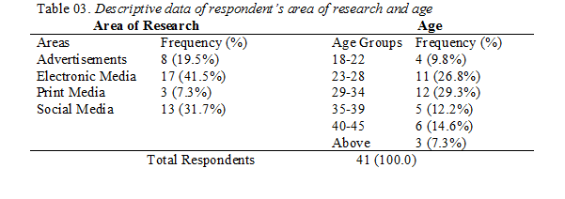

Slide 9
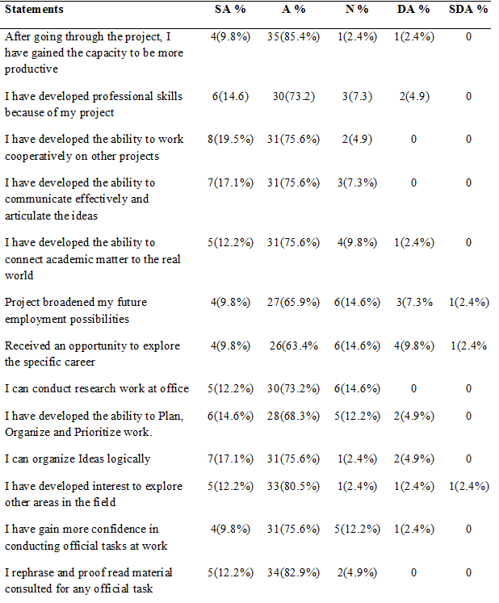
Descriptive statistics of student’s responses on Items
Scale (1=strongly agree, 5=strongly disagree)

Slide 10
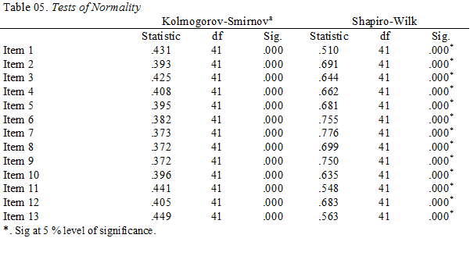
Tests of Normality
To check the normality of the data, the tests of normality have been applied, namely the Kolmogorov-Smirnov Test and the Shapiro-Wilk Test.
The result of the test shows that the data gathered through the thirteen items is not normally distributed i.e. Sig. Value is less than .05, which is the main and very basic assumption of parametric tests.
Therefore, data has been analyzed using non-parametric tests.

Slide 11
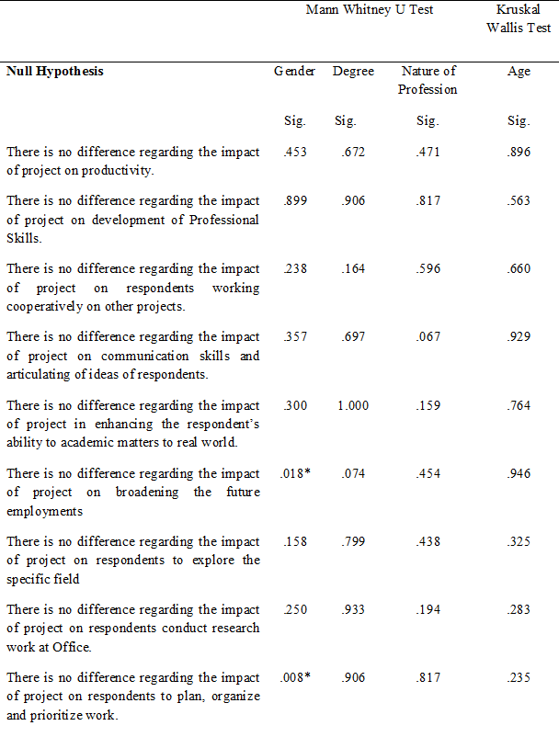
Hypothesis Testing
*Sig at 5 % level of significance.

Slide 12
Interpretation
The results indicates that the null hypothesis have been retained where the value of (Sig. is greater than .05 while the null hypothesis have been rejected where the Sig. value is less than .05.
The null hypothesis has been rejected considering the gender wise impact of final year project on broadening the future employment of respondents, to plan, organize and prioritize work and organize ideas logically.
The rest of the hypothesis considering the gender, degree level, nature of profession and age has been retained.

Slide 13
Conclusion
The results indicates that the respondents don’t differ regarding the impact of final year projects on their professional development considering the Degree (BS & MSc), nature of profession (Media & Non-Media) and Age (18-22=1, 23-28=2, 29-34=3, 35-39=4, 40-45=5, above=6).
Consider, the gender, the respondents differ in terms of the final year project impact on broadening the future employment of respondents, to plan, organize and prioritize work and organize ideas logically.
Respondents showed a strong agreement regarding the impact of the project of their professional development.
They showed strong agreement that through the final year project they have gained the capacity to be more productive (85.4%), developed the ability to work cooperatively on other projects (75.6%), influenced their ability to communicate effectively and articulate the ideas (75.6%), developed the ability to connect academic matter to the real world (75.6%), broadened my future employment possibilities (65.9%), received an opportunity to explore the specific career (63.4%), can conduct research work at office (73.2%), have developed the ability to Plan, Organize and Prioritize work (68.3%), organize Ideas logically (75.6%), have developed interest to explore other areas in the field (80.5%), gained more confidence in conducting official tasks at work (75.6%) and they rephrase and proof read material consulted for any official task (82.9%).
This study concludes that, the final year project has a positive impact on the professional development of the students.
Students suggested that these projects can give more productive results if campus based faculty is available to help them conduct their research or to accomplished their final projects. Moreover, live sessions should be conducted to provide them guidance. University should provide students access to the journals databases to frame their research or projects.

Slide 14
End
Q/A

