Slide 1
“Analisis Penyelenggaraan Tutorial Tatap Muka Mata Kuliah Berpraktek
Pada Program Studi Pendidikan Anak Usia Dini”
“Analisis Penyelenggaraan Tutorial Tatap Muka Mata Kuliah Berpraktek
Pada Program Studi Pendidikan Anak Usia Dini”
Online Training To Enable Online Tutors:
Experience of Universitas Terbuka - Indonesia
Marisa & Mira Aryani
Universitas Terbuka - Indonesia
2019

Slide 2
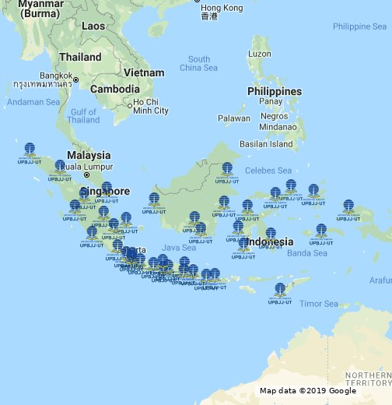
Background
Indonesia
Pendahuluan
A country with > 17.000 islands
UT with 40 regional Offices

Slide 3
Background
Pendahuluan

Slide 4
Background
Pendahuluan

Slide 5
Problems
Pendahuluan
Needs more online tutors
UT’s Lecturers & tutor = 632 & 4.076
Serving 210.765 online students
1 Lecturer for 51 classes
More classes - Less tutor

Slide 6
Problems
Pendahuluan
Train Tutors: from Face to Face Instructor
Online Tutors

Slide 7
Theory
Pendahuluan
Role of Tutors In Distance Education System:
Salmon (2004), Gerrard (2002), Collison et al. (2000), Marjanovic, 1999; Berge, (1992), Jimenez, et.al. (2017), Berge (1995), Bawane and Spector (2001)
Denis, et al (2004)

Slide 8
Methodology
Survey
Involved 51 training participants
Online Training’s Logbook & Questionaires
Descriptive data analysis

Slide 9
UT’s Online Training for Online Tutors
Pendahuluan
Asynchronous Online Training -
Completion criteria:
1. Assess discussion
2. Give discussion responses
3. Grading Assignments
4. Provide feedback for students
5. Uploading enrichment material
6. Join e-Seminar (Webinar)

Slide 10
Discussion
Data from Participants Logbook
Number of Tutors | Range of Access (1 week training) | Range of Access (8 weeks real class)
10 | 100 - 200 | 801 - 900
10 | 201 - 400 | 901 - 1000
14 | 401 - 600 | 1001 - 2000
11 | 601 - 1000 | 2001 - 3000
6 | 1001 - 5000 | 3001 - 4000
51*
*Sample is 51 trainees meet the training criteria

Slide 11
Discussion
Tutors’ Perception
of Their Skills
in Online Tutoring
Aspect | Result
Administrative | Very good
Learning Design | Good
Facilitation | Very Good
Evaluation | Very Good
Technical | Good

Slide 12
Conclusion
Online training has a good influence on the ability of tutors to carry out their online classes.
Liu, et al (2014): tutors who were trained with work readiness material as tutors showed satisfactory results when serving as tutors, despite psychological unpreparedness. Sharing seminars on tutorial experience, helped tutors when on duty
Sulcic & Sulcic (2010):well-trained tutors would be able to meet student expectations.
Amara & Atia (2016) Online training → efficiency and effectiveness in HRD
Lack of time in training will result in under performance of tutors (Nemati, 2008)

Slide 13
Conclusion
Tutors' abilities from 5 functions that have met the expectations:
provide a clear learning path
encourage student participation in discussions
develop student’ assignments
Webinar sessions in online training also had a good impact on tutors' ability to manage classes.
Even so, capabilities that still need to be improved:
plan student learning activities
provide applicative examples of the concepts discussed
prepare criteria for discussion and assignment
Technical difficulties using various LMS Moodle features.

Slide 14
Shukriya

