Slide 1
Assessment Practices For Open And Distance Learning: Format And Challenges
By:
PROF. DATO' DR. MANSOR BIN FADZIL
DR. THIRUMENI T SUBRAMANIAM
PROF .DR. WIDAD OTHMAN
NUR AMALINA DIYANA SUHAIMI

Slide 2
OUTLINE
Introduction
Literature Review
Research Methodology
Findings
Conclusion

Slide 3
Introduction
Open and Distance Learning (ODL) institutions are driven towards promoting assessment systems for learning and for the purpose of quality assurance.
Research Objectives
Document current practices of the assessment system at OUM
Identify challenges of the assessment systems at OUM
Research Questions
What are the current practices of the assessment system at OUM?
What are the challenges of the assessment system at OUM?

Slide 4
Literature Review
Definition
Assessment refers to a wide variety of methods or tools used to determine: Academic readiness, Learning progress, Knowledge and skill acquisitions, or any other targeted educational needs
Purpose
To create opportunity for learning
Important needs
Strategies used in both instruction and assessment in higher education institutions & ODL institution should promote self-directed learning
In addition, there are different emphases within the ODL framework such as to offer flexibility that is afforded by the technology enhanced online learning environment. Flexibility is also observed by the widening of the entry requirements using recognitions of prior learning. Other purposes may include placement, screening and high-stakes (such as the national examinations)
To ascertain the quality of its graduates

Slide 5
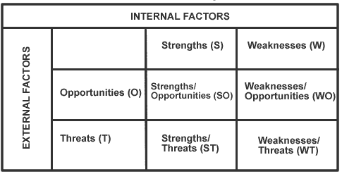
Research Methodology
Full-time academic staff
Qualitative method using open-ended questions based on :
Population
Learners
Administrative staff
Respondent: 568 learners from the three clusters (Education and Social Science, Applied Sciences, and Business Management)
Valid responses: 187 (32.9%)
Note:
Few administrative staff were involved in the identification of implementation challenges. Responses from selected academic were merely used a guide and not analysed in this paper.

Slide 6
Findings 1: Challenges
Operational
Quality of
Assessment
Feedback from operation staff highlighted several challenges including:
The manner how changes (format of assessment) are managed require improvement
The movement of papers between academic and administrative staff require management intervention to ensure smooth transfer and improved work culture
Improve the management of late submissions
Limitation of expertise in some areas must be resolved
There many dimensions to the question of quality form from obvious typos to failure to measure the targeted learning outcomes. While there are processes for moderation of question papers and answer scripts in place, there is a need to improve the process further.
There is the issue of interpretation of answer scheme that is almost unavoidable in written scripts. In some cases, the considerable differences in marks between e-graders pose a serious problem. This problem must be investigated further.
Quality of
feedback
Time
To learner is one of the key concerns at OUM. There are complains that the feedback given are too general. This issue must be investigated further by sourcing feedback from other stakeholders.
The whole task of preparing the assessment papers and answer scripts, moderation process, marking and submission of assessment marks is time consuming.
All these takes up about 40% of the academic working hours, almost equal hours spent on teaching and learning, leaving little time for other scholarly pursues.

Slide 7
Findings 2: Example SWOT Analysis
STRENGHT
MCQ
WEAKNESS
The difficulties for learner to answer it correctly (tricky questions), prompt many to merely guess without thinking (n = 79)
Limited time (n = 15)
Single opportunity. A wrong answer gain zero mark with no opportunity to provide rationale
(n = 13)
Easy and convenient form of assessment as there are options (n = 102)
Can be challenging and require one to think carefully (n = 37)
OPPORTUNITY
THREAT
The opportunity to choose the right answer and get perfect score (n = 67)
Good coverage to the topics (n = 10)
Afford good time management (n = 9)
Largely test memory and this pose a problem for learners (n = 1)
Limitation in the evaluation of individual critical analysis and creativity (n = 1)
Problem with the System (n = 1)
***Note: Top 3 findings

Slide 8
SEQ
STRENGHT
WEAKNESS
Helps learners understand the subject better and prepare them for the exams (n = 39)
Learners are able to express their opinions freely
(n = 35)
Questions are straightforward and easy to answer (n = 33)
Learners will too focused on memorizing and will not generate any ideas on their own
(n = 24)
Insufficient time (n = 23)
Hard on learners who are weak in the English Language (n = 16)
OPPORTUNITY
THREAT
Able to get marks and pass easily (n = 32)
Give learners the opportunity to express themselves (n = 27)
Learners are able to elaborate on their answers
(n = 7)
Learners get easily confused and stray from the question (n = 5)
Insufficient time for learners (n = 3)
Answer must follow the module (n = 2)

Slide 9
ESSAY
STRENGHT
WEAKNESS
Able to generate ideas from own knowledge and experience (n = 34)
Help learners understand a subject better
(n = 24)
Train learners on writing essays and familiarizing themselves with the format (n = 21)
Too many words required (n = 25)
Learners tend to stray from the topic given
(n = 7)
Lack of proofreading (n = 7)
OPPORTUNITY
THREAT
Able to get higher marks (n = 23)
Gives learners points/keywords to elaborate on
(n = 16)
Practice for improving grammar (n = 15)
Learners tend to stray from the topic given (n = 7)
Waste of time (n = 6)
Lack of proofreading (n = 2)

Slide 10
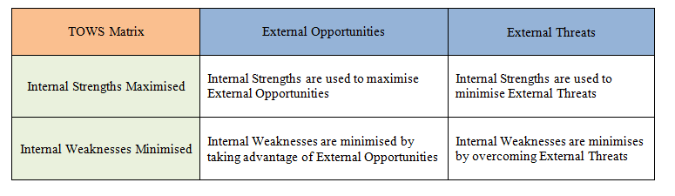
Findings 3: TOWS Matrix
Example: MCQ
One of the strengths is its convenience in terms of format, it can be maximised by using the strategy of developing numerous practice tests to improve learner’s time management. This also increases learning opportunities for the learners.
The strength can also be used to minimise the threat of questions that merely test memory.
Meanwhile, the MCQ weakness of having tricky questions can be minimised to create a more positive learning experience and to prevent students from merely guessing the answer.
In general, there is a need to balance the benefits of timely feedback and level of thinking tested in accordance to the level of the programme and course offered.
*Note: TOWS Matrix is the reverse of the SWOT Analysis model
T: Threats, O: Opportunities, W: Weaknesses, S: Strengths

Slide 11
Conclusion
This paper describes the current effort at OUM to review its assessment practices.
Apart from gathering information based on documents, qualitative responses were obtained to identify benefits and challenges using open-ended questions and SWOT instrument.
Findings discovered help the identification of perceived strengths, weaknesses, opportunities, and threats. In general, there is a need to balance the benefits of timely feedback and level of thinking tested.
A further analysis of the current findings can help the university to improve the quality of assessment, and create a more engaging learning environment.
This study necessitates further exploration through a thorough analysis and focus group interviews towards creating an assessment system that is an effective integral part of the 21st century learning.

