Slide 1
PERCEIVED INFORMATION QUALITY OF OPEN LEARNING RESOURCE WEBSITE OF UNIVERSITAS TERBUKA (SUAKA-UT) AT UPBJJ-UT MAKASSAR Presenter M. Arifin Zaidin Faculty of Teacher Training and Education Unit of distance learning program for open university Makassar-Indonesia

Slide 2
I. INTRODUCTION
Open Educational Resources (OER) broadly represents any materials offered freely and openly for educational purposes.
OER has become the crux of educational materials in higher education. Open University is the only open distance education in Indonesia that embraces OER throughout its educational practices
Open University embraces OER and integrates it into students’ learning management systems through a web-based information system
High information quality enhances the use of information system.

Slide 3
LITERATURE REVIEW
History of SUAKA-UT
Open University (OU) extends its learning initiatives through SUAKA-UT as a commitment to provide free-access learning materials for broad communities
The key tenets of OER OU build on (1) freely accessible learning components, (2) learning management that fits all levels of education, (3) modular learning, (4) reused and repurposed materials, and (5) online platforms.
In general, OER is outlined into four categories within higher education, i.e., open textbooks, open computer, open online learning and open-source license for softwares and tools that permits the free use to sustain teaching-learning activities
Thailand initiates OER movement with aim of providing high-quality teaching and learning resources for students and teachers while breaking down barriers to time, geographical space, affordability and accessibility.

Slide 4
Evaluation of Information Quality
Throughout diverse bodies of literature, information quality is often perceived as information that adheres to the fitness for use of the information provided, thus conforming to the specifications that meet user expectation
The study delves into the analysis of information quality and identifies as well as formulating 20 dimensions commonly used to highlight areas concerning information quality
Perception
Perception is a process to find out or recognize events that aim to involve the five senses, the environment, culture, education, and experience

Slide 5
Common Dimensions of Information Quality (Knight & Burn, 2005; Kandari, 2010)
Dimension |  | Definition
1 | Accuracy | Information presented is accurate, reliable and error-free.
2 | Consistency | Information is presented in the same formatting style compatible with previous information.
3 | Security | Access to information is limited to maintain and assure its security.
4 | Recency | Information is measured by how up-to-date it is.
5 | Completeness | Information is presented in a complete, extensive and in-depth manner.
6 | Conciseness | Information is presented without an excessive amount of detail.
7 | Reliability | Information is correct and reliable.
8 | Accessibility | Information is easily accessible.
9 | Availability | Information is physically accessible.
10 | Objectivity | Information is unbiased, impartial and unprejudiced.

Slide 6
Continued
11 | Relevance | Information fits user need.
12 | Usability | Information is clear with an ease-of-use concept.
13 | Comprehensibility | Information is clearly defined, unambiguous and easily understood.
14 | Number of Data | The quantity of information fits the needs of its intended users.
15 | Trustworthiness | Information is accountable and reliable.
16 | Navigation | Information is easily organized and navigable.
17 | Reputation | The source and content of information are reputable.
18 | Usefulness | Information is advantageous and functional.
19 | Efficiency | Information is obtained with the least waste of time and effort.
20 | Added-value | Information has an advantage and positive characteristic for all users.

Slide 7
RESEARCH METHODOLOGY
A. Type of Research
Quantitative descriptive study
B. Population and Sample of the Study
The Population of this research were 6,090 students.
The sample of this research were 85 students (14% of the population).
C. Data Collection Technique
The data collection techniques is used a questionnaire. The questionnaire contained 54 questions divided into 18 dimensions of information quality measurement adopted from the dimension of information quality assessment
D. Data Analysis Technique
This study uses data analysis categorization measurement techniques
Keterangan:
M = Mean
SD = standar deviasi

Slide 8
RESEARCH RESULT
Validity and Reliability Test
a. Validity Test
The result shows that, among 54 indicators, one indicator is found invalid and, therefore, is excluded from the question list prior to reliability test.
b. Reliability Test
Cronbach "s alpha (a) value is obtained 0.916, it can be concluded that the reliability results are declared reliable.
Descriptive Analysis
With 85 respondents at hand, the maxium obtainable score is 425.
The classification, accordingly, fits into these categories:
(1) Low category: 0 - 212
(2) Moderate category: 213 - 319
(3) High category: 320 – 425
The total scores are calculated to fit into a category of each indicator for the dimensions of information quality as Figure I illustrates below.
,
Cronbach's Alpha | N of Items
.916 | 53

Slide 9
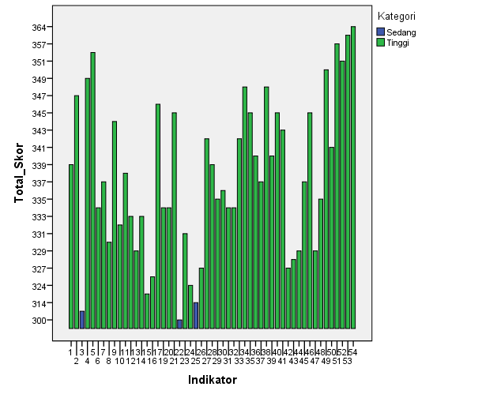
.

Slide 10
CONCLUSION
Statistical findings show that the overall information quality of SUAKA-UT fits into a high category which scores 94.44%, with only three indicators lining up in a moderate category, i.e., accuracy, conciseness and ease of use ranging at 5,55%. From these insights, the information quality of SUAKA-UT at UPBJJ-UT Makassar in general is of high quality.
This, in turn, leads to the embodiment of the core principles of SUAKA-UT that serves as Open Educational Resources alongside the importance of strengthening its capacity to design, implement and monitor coherent and integrated efforts for sustainable development that facilitates the satisfaction of its students and the general public.

Slide 11
Thank You and That’s All
See you next time

