Slide 1

Research on Resource Service Mechanism of M-Learning in Heterogeneous Wireless Networks
Speaker: Li Feng
15-Oct-19 Lahore Pakistan

Slide 2
Presentation Outline
Ⅰ.Introduction
Ⅱ. Related Works
    （ Ⅱ. 1 M-learning in HWNs; Ⅱ. 2 System model and architecture）
Ⅲ. Methods
    （ Ⅲ. 1 Handoff in HWNs; Ⅲ. 2 Reinforcement Learning）
Ⅳ. Results and Discussion
Ⅴ. Conclusion

Slide 3
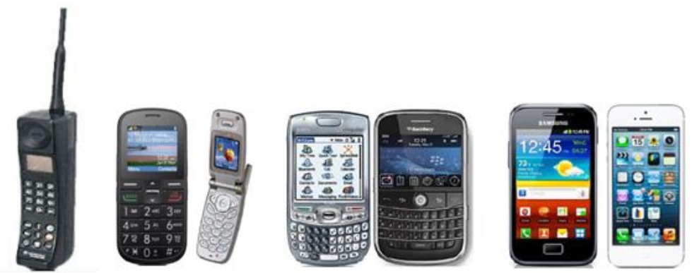
Ⅰ.Introduction
Mobile devices, especially smartphones, are the most frequently used technological devices in daily routines. They have been used for more than three decades since their invention.
·First Stage ·Second Stage ·Third Stage

Slide 4

Ⅰ.Introduction
  M-learning that presents new and powerful opportunities for effective teaching and learning makes it possible for students to access to multiple information sources.

Slide 5
Ⅰ.Introduction
HWNs (Heterogeneous Wireless Networks )
  The development of wireless communication technology presents a prosperous scene, but it is foreseeable that any technology has its own advantages and disadvantages.
  One hand, new wireless access technologies will not completely replace the existing technology, and will be in the pan with heterogeneous coexistence for a long time.
  Another hand, M-learning in HWNs and traditional single access mode has remarkable differences in transmission characteristics. If the past research methods are completely applied in HWNs causes many unsuitable problems.

Slide 6
Ⅱ. Related Works
M-Learning experience in actual wireless environment

Slide 7
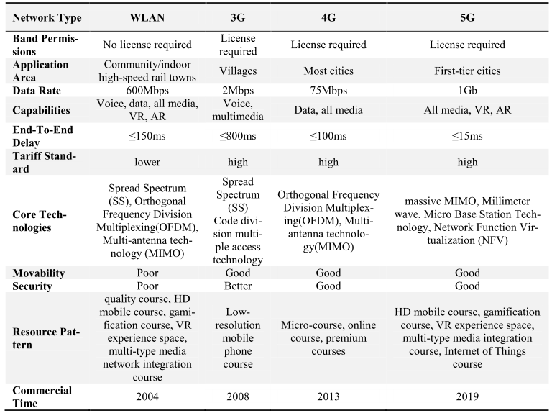
Ⅱ. Related Works
Parameters comparison between WLAN and cellular communication

Slide 8
Ⅲ. Methods-M-learning in HWNs
  System model and architecture

Slide 9
Ⅲ. Methods—Handoff in HWNs
As discussion above, we know that varying wireless technologies are driving today’s wireless networks to become heterogeneous, i.e., the network comprised of two or more different access network technologies. Heterogeneous networks have created many challenges such as mobility management, handoff, resource management, location management, providing quality of service, security and pricing.

Slide 10
  Ⅲ. Methods—Reinforcement Learning
Reinforcement learning system consists of two important parts: Environment and Agent.

Slide 11
Ⅳ. Results and discussion
an off-the-shelf WiFi access point;
a centralized controller hosted on;
multiple wireless stations (Windows/Linux/Android supported).

Slide 12
Ⅵ. Conclusion
This paper investigates the actual occurrence process of M-Learning in HWNs, and realizes the analysis of the elements of M-Learning.
On this basis, we present a resource service framework in M-Learning using comprehensively information technology such as network handoff technology, cloud service, streaming media and reinforcement learning technology.
Furthermore, the detailed analysis of M-Learning resources, services and terminal level technology to ensure the reliability of learning, and thus improve learning experience and quality.

Slide 13
Thank you!
Connect me:
School of Engineering&Technology, Sichuan Open University (SOU)
Room EH-S208, No. 3, West Three Section, Ring One Road, Chengdu, Sichuan, China
Off: +86 028-87762961 Mob: +86 136 8840 8236 (WeChat)
Fax: +86 028-87762251 Zip: 610073
Mail: feng_fengli@163.com Web: gcjsxy.scrtvu.net

