Slide 1

A Knowledge Engineering Approach for Technology Enhanced Learning (TeL)
Prof Dr Zia Ul Qayyum
Vice Chancellor
Allama Iqbal Open University Islamabad - Pakistan

Slide 2

Agenda
    ODL: Information Transmission to Knowledge Construction
    E-Governance and Revamping structure of ODL through Knowledge Engineering Techniques
    Strategic integration of ODL and Managed Learning Eco-System (MLE)
    Research Initiatives for Improvising ODL effectiveness
    ODL: Initiatives for “Tomorrow”

Slide 3
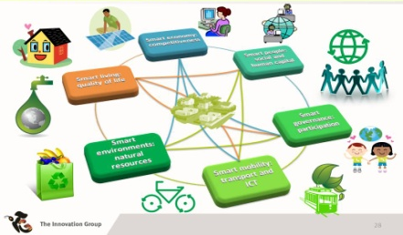


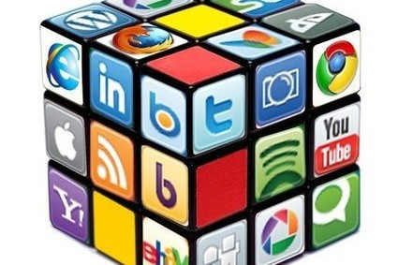
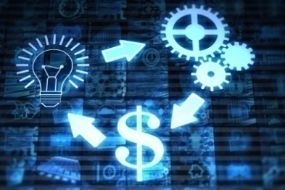

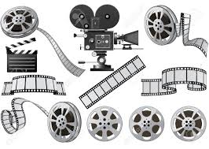
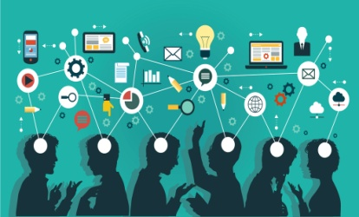
E-Governance
E-Governance is transforming every dimension of human life
IoT
Communication
Health & Medicine
Socialisation
E-Economy
E-Business
E-ShowBiz
E- Education
E-Education Leveraged through Managed Learning Eco-System (MLE)
Notes:
Education: a great medium to learn new things at school level, source of knowledge repositories at university level, MOOCs (e.g. course era) have transformed the physical academics to virtual institutions by minimizing cost and time barriers. Teachers, with e-learning models, have liberty to change their learning style and fully involve students in learning activities. Digital Libraries and reputed journals are great source for innovative research activities.
Communication: A step in realization of the concept of Globalization. Millions of domestic and world wide users of internet can share information by communicating promptly. This communication includes sending/receiving emails. Interacting in chat rooms or VoIP base software like Skype or video conferencing.
Health and Medicine: internet has potential to educate and empower the health conscious users due to features of anonymity, convenience and volume of information. Telemedicine education, genomic database for scientists. Mobile apps used for disease detection and curation (telepathology) e.g. malaria. Patient records maintained electronically across the globe in a standardized way improves quality and impact of health services e.g. HL 7.
Socilization: Internet has improved awareness across the globe hence improved the quality of life towards facilitating the humans. social media has taken over as mind changer. Online connectedness is taking over the social life centered more towards smart devices. Different forums like facebook, twitter, linkedIn and blogs can make a difference positive/negative in life; may be professional and political
Economy: World wide Industrial and technological linkage through R&D are ensured through internet. Establishing Offshore offices, outsourcing projects and freelancing forums are making a difference in economies that is possible through internet. Share of economy has moved from merchandiser to service orientation.
Business: Internet has introduced a global competitive market with benefits for common man in every chunk of society. It has reduced the communication cost and devised easier ways to marketing and sales while keeping track of customers. This helps in mass marketing, product recommendations and helps to predict customer behavior. Amazon.com, buyvip.com,
ShowBiz: it has enabled fans to keep the track of movies, seasons and celebrities. User specific ratings and recommendations of movies is also a major advantage. Youtube, netflix.com, imdb.com
IoT: Today’s talk of town in research is IoT; Thanks to Internet.

Slide 4
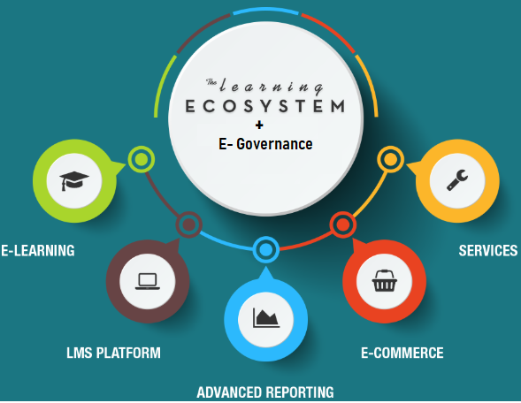
Managed Learning Eco-System - MLE
Cohesive and consistent policies\processes for EL governance
Measuring Extent and Effectiveness of Learning…
People Capability Maturity Model
  (P-CMM) is a maturity framework that focuses on continuously improving the management and development of the human assets of an organization. It describes an evolutionary improvement path from ad hoc, inconsistently performed practices, to a mature, disciplined, and continuously improving development of the knowledge, skills, and motivation of the workforce that enhances strategic performance.
Learning needs analysis (Human-In-The-Loop)
    Procedural Skills
    Knowledge Transfer
    Communication Skills
    Colossal Thinking
    Psycho-motor Skills
    Attitude Learning
    Physiological Stresses
Moving Towards Experience Management
Notes:
People Capability Maturity Model (P-CMM) is a maturity framework that focuses on continuously improving the management and development of the human assets of an organization. It describes an evolutionary improvement path from ad hoc, inconsistently performed practices, to a mature, disciplined, and continuously improving development of the knowledge, skills, and motivation of the workforce that enhances strategic performance.
Human-In-The-Loop: Human-in-the-loop or HITL is defined as a model that requires human interaction. HITL is associated with modeling and simulation (M&S) in the live, virtual, and constructive taxonomy. HITL models may conform to human factors requirements as in the case of a mockup.
Psychomotor learning is the relationship between cognitive functions and physical movement. Psychomotor learning is demonstrated by physical skills such as movement, coordination, manipulation, dexterity, grace, strength, speed—actions which demonstrate the fine or gross motor skills, such as use of precision instruments or tools, and walking.

Slide 5

MLE - Our Contribution
Learning Management System (Aagahi)
  Baseline Repository for Adaptive Content Recommenders
  Quantitative performance measurement for learners
Campus Management System
  Automation of Academic/Administrative Processes
Research, Innovation & Commercialization System
Performance Management System (CPS)
Enterprise Resource Planning System

Slide 6
Managed Learning Ecosystem -MLE
MLE
Operations
Learning Management System
Campus Management System
Governance
ORIC
Performance Management Systems
Enterprise Resource Planning
Admin
Documenting
Tracking
Reporting
Resource Management
Faculty- Student Assistance
Human Capital Planning
Capacity Planning
Research Cluster Managements
Collaboration Management
KPI based Evaluation

Slide 7
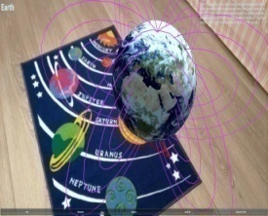
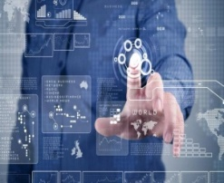
Research Initiatives - I
Augmented Reality
  Intelligence Amplification (IA) to simulate virtual actions for education
    A mixed reality continuum in which virtual data whether it may be images, videos, and three dimensional objects/characters or sound that is merged with the real view to create an ubiquitous reality. A survey of the field defines augmented reality “AR supplements reality, rather than completely replacing it. Ideally, it would appear to the user that the virtual and real objects are coexisting the same space.”
  Co-existence of virtual and real objects through sensory inputs
  Provision of e-learning and m-learning solution for next generation teaching pedagogies
    Combine the cutting edge tools of mobile technologies with new teaching methodologies using augmented reality
  Partnered with QUALCOMM, EBMACS and Pure Push (Pvt. Ltd.)
Notes:
Augmented reality is very useful visualization technique in the field of computer vision and lies between physical model and computer generated model i.e. virtual reality which deals with the combination of real-world and computer generated data. It can be described in terms of mixed reality continuum in which virtual data whether it may be images, videos, and three dimensional objects/characters or sound that is merged with the real view to create an ubiquitous reality. Azuma [2], in a survey of the field defines augmented reality states that “AR supplements reality, rather than completely replacing it. Ideally, it would appear to the user that the virtual and real objects are coexisting the same space.”
AR can also make the user interact with virtual data generated by any AR capable device. Characteristically data which is generated is overlaid in the user’s field of view giving him an extra understanding and information of the ubiquitous environment or specifically helping him for accomplishing a task.

Slide 8
Research Initiatives -II
Learner Centric research
  Learner categorization for prolific delivery of learning contents
  Implicit as well as explicit characteristics of learners to have learners’ perspectives
    Demographics, Academics, Inclinations and Behaviours
  Machine learning based dynamic and adaptive techniques on a labelled data set for learner categorization in distance learning
  Novelty of techniques signified through
    Preprocessing of feature attributes
    Quality of data
    Training of machine learning model on more relevant data
    Adaptivity

Slide 9
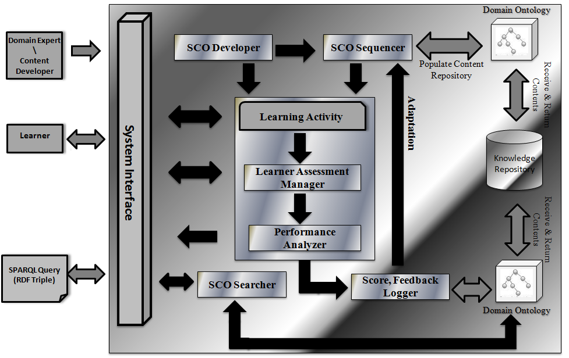
Personalized E-Learning Framework
Notes:
SCO : Shareable Content Objects

Slide 10
Learner Profiling and Categorization
Personal Details (Name, Age, Degree)
Learner Ontology
Aptitude Details
(Learning Style, IQ, Ability)
Academic Details
(SGPA, CGPA, Pre-Req GPA)
Retain Learner’s Category
Retain Learner’s Category
CBR
ANN
FL
LCHAIT
Novice
Easy
Proficient
Expert
Learner
Catagory
CBR: Case Base Reasoning
ANN: Artificial Neural Nets
FL: Fuzzy Logic

Slide 11

Research Initiatives -III
  Educational recommenders for effective learning
    Collaborative, Content , Hybrid, Knowledge base recommenders
    Recommendation of learning contents for better learning of the learners.
      Rule base Recommender for Personalized recommendations
      Learning Cycle: Learning, Evaluation and Adaptation
      Contents are modeled through ontology
    A step towards Web 3.0 compliant educational systems

Slide 12



Adaptive Educational Recommender
Implícit
Parameter
SCORM
Compliance
Knowledge based Recommender
Explicit
Parameters
Domain
Experts (I)
Learner Model
Ontology Alignment
Learning Content
Model
Explicit
Parameters
Rule Based Mapping
Domain
Experts (A)
Explicit
Parameters
Feature Based Mapping
Domain
Experts (A)
Implícit
Parameter
LO Recommended
IMS
Compliance
LO Repository

Slide 13
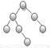
Adaptive E-Learning Recommender (KASER)
Learner Attributes- Implicit
System Interface
Learner Attributes - Explicit
LearnerProfile Preprocessor
Learner Attribute Profiler
LearnerProfile Categorizer
Learning Content Model
Personalized Recommender
Learning Cycle
Adaptive Recommendations
Learning Cycle
Personalized/Improved Learning
Notes:
Knowledge based Adaptive Semantic e-Learning Recommender

Slide 14
Our Contributions – In Practice
Different metrics to measure the viability of MLE solutions
  Adoption of MLE components (esp Aagahi) by Pakistani Academia
  Learner Performance measurement and improvement
    ML based Learner Categorization integrated with Aagahi (Pilot Project)
    Learner performance measurement over the years
  Deployment of CPS & ORIC Systems
  Customized CMS and ERP Solutions …

Slide 15
MLE Adoption - Aagahi Enrollment

Slide 16
Aagahi Training at HEIs

Slide 17
Evaluation and Results – Learner Categorization

Slide 18
Results - Recommender’s Impact on Learner’s Performance
Notes:
Personalised Adaptive e-Learning System

Slide 19
Evaluation and Results-Adaptive Learning
With new group of students, learner categorization based content recommendation was made and subsequently results were recorded

Slide 20



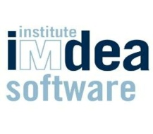



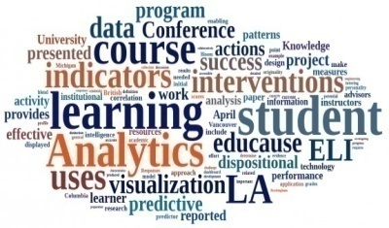
Our Collaborating Peers
Research Collaboration with world leading research groups….

Slide 21
Research Way Forward
LMS has enriched data repositories that can be used for:
  Improving the learning experience and productivity
  Modeling the learner data for “Need Analysis” of market
  ODL frameworks harnessing the power od Social media and knowledge engineering approaches …
  Performing Impact analysis of Learner vs MOOCS using Data Analytics Techniques
Individual students’ needs and advances in learning analytics
  Enabling quicker feedback on students’ performance

Slide 22
Thank you!

Slide 23
References
Role of science and technology for future development. http://unu.edu
BROWN, DAVID G. 2000. "The Jury Is In!" In Teaching with Technology,
David G. Brown. Bolton, MA: Anker. CONNICK, GEORGE P. 1997. "Issues and Trends to Take Us into the Twenty-First Century." In Teaching and Learning at a Distance,
Thomas E. Cyrs. San Francisco: Jossey-Bass. Innovations and new technology - what is the role of research?Implications for public policy, vinnova ANA LYSis VA 2014:05
Walker, W. (2000) “Entrapment in Large Technology Systems: Institutional Commitments and Power Relations”, Research Policy, Vol. 29, Nos 7-8, pp. 833-846
VINNOVA (2011) “Utveckling av Sveriges kunskapsintensiva innovationssystem – Bilagor.
Underlag till forsknings- & innovationsproposition” VINNOVA Policy VP 2011:05
Whitehead, A.N. (1925) “Science and the Modern World.” New York, Cambridge University
Press
Teece, David J.; Pisano, Gary 1994: “The dynamic capabilities of Firms: an Introduction”,
Oxford: Industrial and Corporate Change, Volume 3, Issue 3, Pp. 537-556

Slide 24
References
Sörlin, S. and Vessuri, H. (eds) (2007) Knowledge Society vs. Knowledge Economy: Knowledge, Power, and Politics. Knowledge, International Association of Universities/New York: Palgrave Macmillan.
Ravetz, J. (2006) When communication fails: a study of failures of global systems.
Guimarães Pereira, A., Guedes Vas, S. and Tognetti, S. (eds) Interfaces between Science and Society.
“Technology and National Security: Risks and Responsibilities” By William J. Perry Stanford University
Science, technology, and economic growth ARIEL PAKES* AND KENNETH L. SOKOLOFF
Science, Technology, and the Federal Government: National Goals for a New Era, Committee on Science, Engineering, and Public Policy, http://www.nap.edu/9481
High Level Group on the Modernization of Higher Education, New modes of learning and
teaching in higher education

Slide 25
References
Murray, Kristine; Rhonda Waller (May–June 2007). "Social Networking Goes Abroad"(PDF). Education Abroad. 16 (3): 56–59.
Shiao, Dennis. "Why Virtual Classrooms Are Excellent Learning Venues". INXPO. Retrieved 18 May 2013.
Tremblay, Eric (2010). "Educating the Mobile Generation – using personal cell phones as audience response systems in post-secondary science teaching.". Journal of Computers in Mathematics and Science Teaching. 29 (2): 217–227. Retrieved 2010-11-05.
Murray, Kristine; Rhonda Waller (May–June 2007). "Social Networking Goes Abroad". Education
Baker, Celia. "Blended learning: Teachers plus computers equal success". Desert News. Retrieved 30 January 2014.

