Slide 2
“A STUDY ON CHALLENGES AND OPPORTUNITIES FOR DIGITAL IMMIGRANT TEACHERS RELATED TO ICT APPLICATIONS IN THEIR CURRENT PEDAGOGY”
Dr. Safia Urooj Rubina Usman Dr. Wahaj Muhammad Khan
University of Karachi

Slide 3
Objectives of this Research
This study aims to examine the relationship between challenges and opportunities related to ICT applications in their current teaching pedagogy in Sindh, Pakistan.

Slide 4
Purpose of this study
This study helps digital immigrants to identify and solve the barriers during the integration of technology. This study promotes the need of capacity building, collaboration and critical thinking.

Slide 5
Review of literature
Khokhar (2017) highlighted the differences amongst teachers and students about what technology to be used in classroom and for what purposes. Khokhar discovered two opposite views. On the one hand teachers believe they use ICT effectively while on the other hand students disagree with their teacher’s idea of ICT integration in classroom.
Khokhar, Ashar & Gulab, Fozia & Javaid, Sharoon. (2017). Information Communication Technology Integration: Trained Secondary School Teachers' Dilemma. Journal of Research in Social Sciences -JRSS. 5. 94-102.

Slide 6
Review of literature
5. Gul (2015) identified the factors which affected the use of ICT tools and intended to explore the perceptions of university teachers about ICT. For this, “Information and Communication Technology Usage Survey” scale was administered to university teachers of the Punjab. The results also indicated a positive relationship between self-efficacy belief and perceived expertise level for using computers.
\

Slide 7
Review of literature
4. Tunio (2014) determined the effects of ICT (Information and Communication Technology) on the upcoming generation of urban and suburban communities. Tunio found that if proper management of ICT tools are put in place, the students exhibits more tendencies towards the understanding and application of ICT tools.
Tunio, Muhammad Nawaz (2014) Evaluation of ICT Education in Private Secondary Schools: A Case Study of Hyderabad, Sindh Mehran University Research Journal of Engineering & Technology, Volume 33, No. 1, January, 2014 [ISSN 0254-7821]

Slide 8
Review of literature
3. Hassan (2013) investigated the barriers to the integration of Information and Communication Technologies (ICTs) at secondary level learning in Pakistan, with special emphasis on Punjab province. Exploring major barriers to the integration of ICTs at the school level, teacher level and student level and possible enablers to these barriers is the major focus of study. Hassan found and oserved from the findings that most of the participants have positive perceptions about integration of ICTs into their teaching and learning. Many of these barriers are verified by the teachers and students.
\

Slide 9
Theoretical framework
TAM (technology acceptance model) and its versions have been used as the theoretical framework for many empirical studies predicting students’ performance with the use of technology.

Slide 10
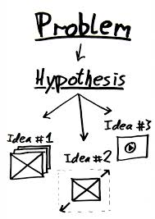
Hypothesis
H1: There is a statistically significant and strong relationship between challenges and opportunities and ICT Integration.
HO: There is a no statistically significant and strong relationship between challenges and opportunities and ICT Integration.

Slide 11
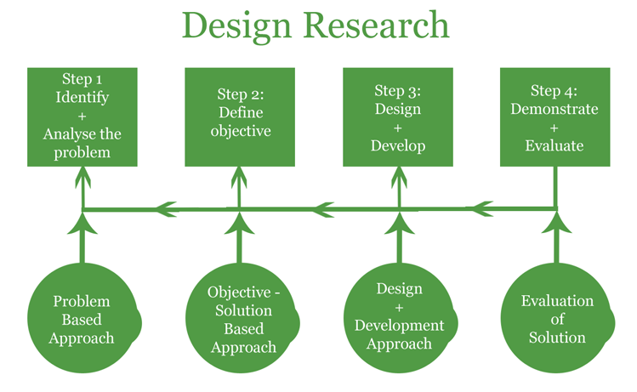
Research Design
This is an applied quantitative correlational descriptive study which describe the relationship of independent variables with dependent variable.

Slide 12
Methodology
In this research study purposive random sampling was used because in this research all the schools have computer lab and all the teachers are ICT trained.
Pakistan government Schools are the population of this study. 48 Government schools (2 from each district) from Sindh province will sample for this study. 10 teachers (80% of staff) from one school will select randomly on the basis of subjects, so 480 subject teachers will select as a target sample

Slide 13
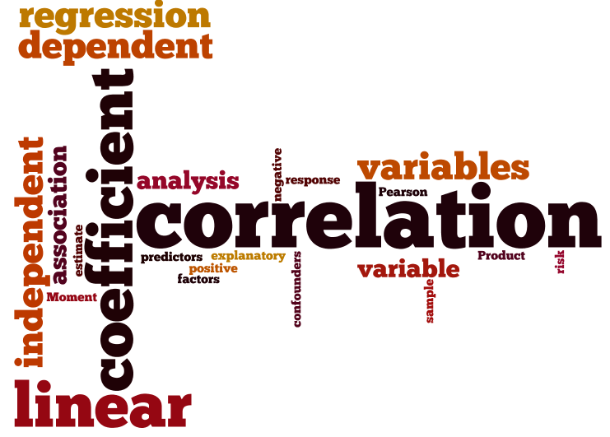
Data analysis
The data analysis process of this study included two stages. The first stages included a descriptive analysis to describe the distribution of the data. The second stage included hypothesis testing with ANOVA. Using one-way analysis of variance (ANOVA), this study aims to examine the relationship between challenges and opportunities related to ICT applications in their current pedagogy.

Slide 14
Finding
the overall test was significant, a post-hoc test using Dunnett’s C test was conducted to compare the mean of the two groups. The results indicated that teachers with high opportunities score had significantly higher ICT integration score than teachers with low opportunity score had significantly lower ICT integration score.
The results of the ANOVA allowed to rejecting the null hypothesis H0 and supporting the conclusion that there is a statistically significant and strong relationship between challenges and opportunities score and ICT Integration.

Slide 15
Recommendation
Now is the right time to respond to a simple but a critically important question, “what should be done to fully exploit valuable resources for better education in the future?” It would be to use all resources in a smart way to maximize their potentials to meet the different perspectives on ICT from stake holders: teachers, students, and academic institutions.

