Slide 1
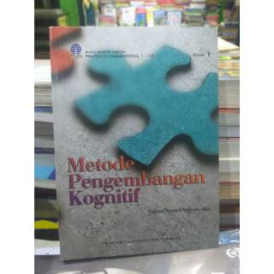
AAOU 2019
Use of Learning Materials Cognitive Development Method Course
By Early Childhood Education Students at Universitas Terbuka
Mukti Amini Universitas Terbuka,
Indonesia

Slide 2
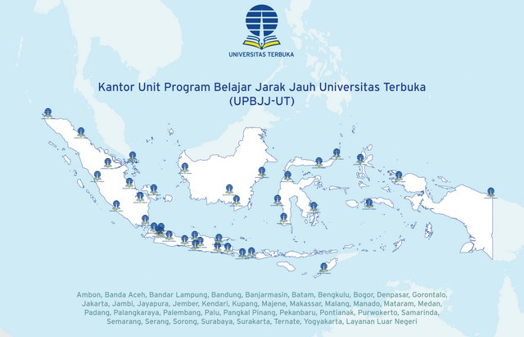
Context of Universitas Terbuka (UT), Indonesia
UT is the only open university in Indonesia that uses open systems and distance learning.
UT has 40 regional learning services units throughout Indonesia & abroad
UT has 4 faculties, one of them is the faculty Faculty of Teacher Training and Education
Faculty students who has registered in this semester → 181.565

Slide 3
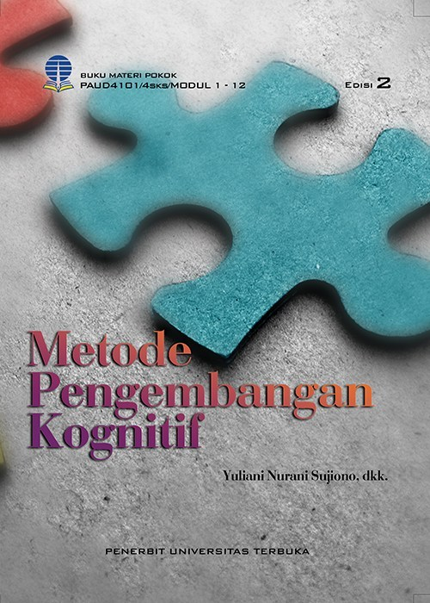
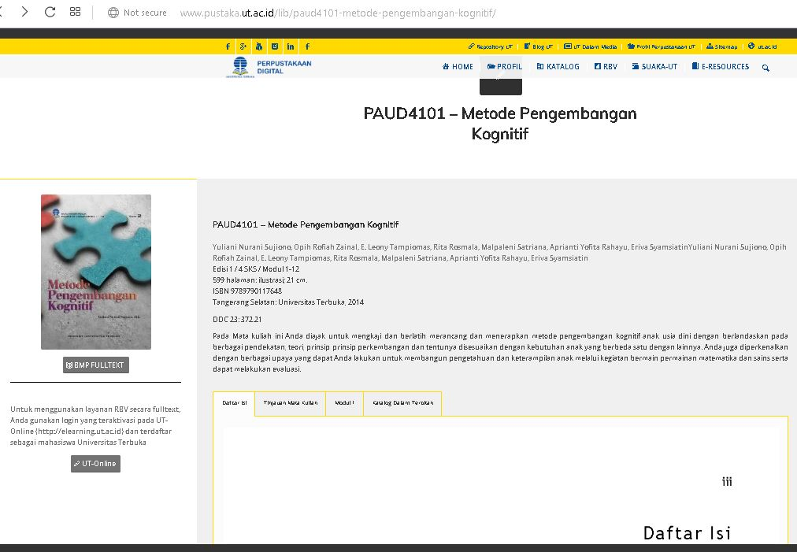
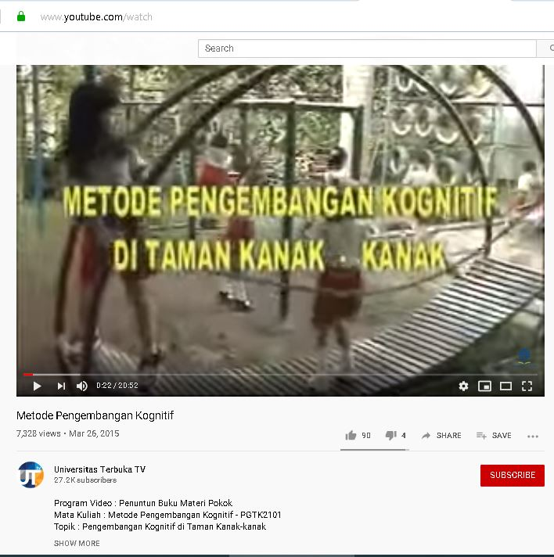
Learning Material for CDM Course
 | Printed | Non Printed
Offline | Book | Video Compact Disc
Online | Virtual Reading Room (RBV) | Youtube by UT TV
Book
RBV
Video by UT TV

Slide 4
The Research Question
How about the use of CDM learning materials by ECE-UT students?

Slide 5
Method of The Research 1
Method → Descriptive, with survey
Instrument → Questionnaires & Interview
Aspects of Instruments:
Object → 65 ECE-UT students who had taken CDM courses in the previous semester, in 3 regional office of UT (Jakarta, Semarang, Serang)
Condition of CDM Learning Materials
Efforts of students if the learning material is difficult to understand
The study was conducted from July to September 2018.

Slide 6
Result 1: Condition of CDM Books
No | Aspect | Yes Answer (in %)
1. | Ease of getting CDM book teaching materials | 98.5%
2. | The physical appearance of CDM books
 | a. Good because the cover is trendy | 39.7%
 | b. Good because in the form of a booklet | 13.2%
 | c. Good because it's not like the UT module in the past | 23.5%
 | d. Not good because it's too thick | 10.3%
 | e. Drab because of minimal images or other graphic forms | 16.2%
 | f. Not good because of the case example only from the culture in Java | 1.5%
3. | Content in CDM book material easy to be understand | 77.9%

Slide 7
Discussion Result 1
Morgan's (2014) → textbooks with good design have the potential to make learning more enjoyable, long-lasting, meaningful and perhaps more involving student cognition in various ways, for example through visual processing mechanisms, analytical thinking, submitting questions, testing hypothesis, and verbal reasoning.
The Indonesian government → the development of learning materials needed to fulfill the characteristics: self-instructional, self-contained, stand-alone, adaptive, and user-friendly

Slide 8
Result 2: Efforts of students if the book material is difficult to understand
No | Aspect | Yes Answer
 |  | n | %
1. | Asking experts | 9 | 13.2%
2. | Looking for learning resources from the internet | 13 | 19.1%
3. | Discussions with friends and tutors | 23 | 33.8%
Dispini & Romadoni (2014) → the reasons students rarely ask questions, including shame, fear of being asked back, reluctance, fear of cutting others off, lack of confidence, not knowing what to ask, and being lazy to ask questions.
Bunga (2016) → the factors that encourage discussion with friends are 3, namely: attention, feelings, and motives.

Slide 9
Interview About
Condition of CDM Learning Materials,
Learning materials still need to be added with many illustrations and images that support the explanation
The appearance of the book are expected to be like a book for high school students, attractive designs and many color illustrations to facilitate understanding
Image illustration too small, unclear and only black and white so it is not attractive
It is expected that the book is not too thick, by dividing it into several volumes so that it is easy to carry
Many formative test answer keys are still wrong
The summary at the end of the topic is less comprehensive and sometimes not related to the material of the previous discussion.
Video Compact Disc (VCD) is less effective. Some of the VCDs turned out to be damaged and cannot be played. Content is also less interesting

Slide 10
Conclusion
teaching materials still need to add many illustrations and images for support the explanation
book summaries improved to match the previous explanation
The formative test answer keys must match the question
The material content in VCD needs to be revised
books are considered too thick, better divided into several volumes

Slide 11
Suggestion
Preliminary research on the use of CDM learning materials need to be continued by developing CDM learning materials to revise existing media

Slide 12
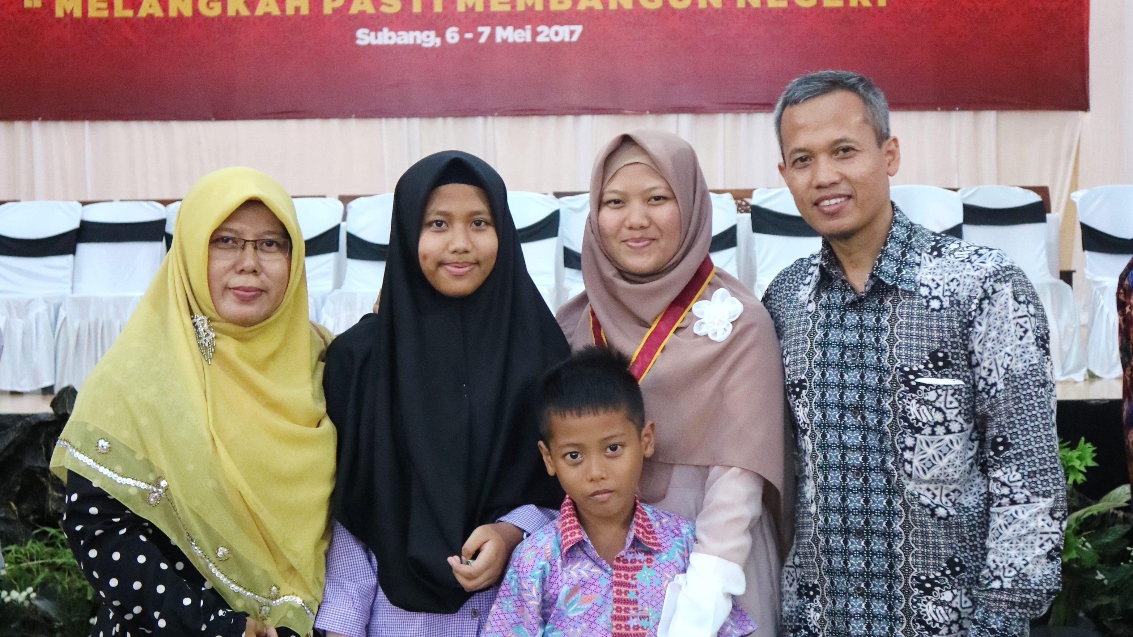
TERIMA KASIH
Than k You

