Slide 1
AAOU International Accreditation System for
Quality Assurance of
Technology Mediated
and Technology Enhanced Education in Times of
Openness in the Digital Age
Notes:
We would like to announce to the body that finally we have put together after two years of continuous study of coming out with an accreditation system that most fit the quality assurance standards responsive to open and distance learning universities and institutions and for all other universities that see themselves as having a strong interest and applications of technology mediated and technology enhanced education. first let me give you a quick overview of this project.

Slide 2
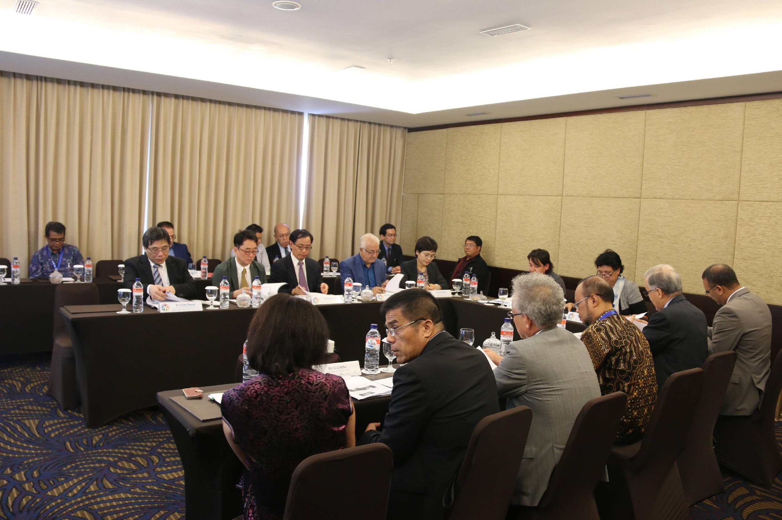
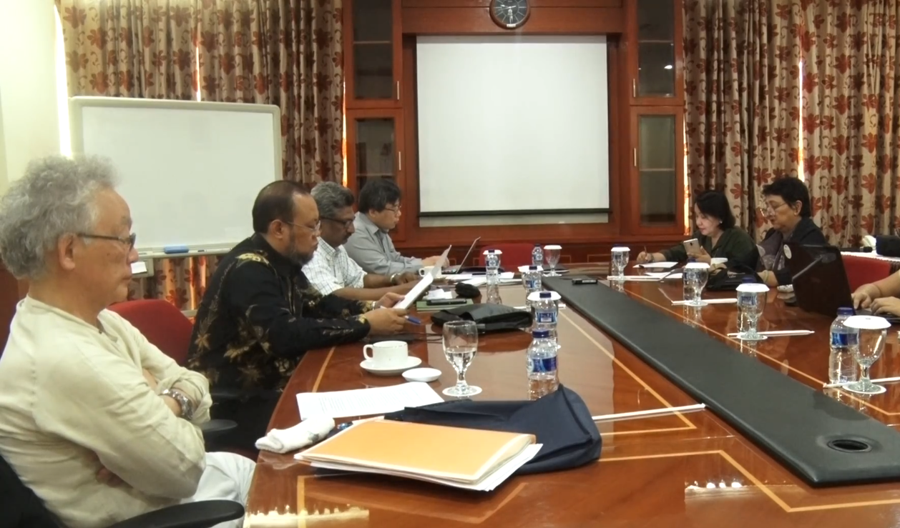
PHASE I
AAOU Task Force on Feasibility Study in Offering Accreditation Services for Technology-Mediated Education and The Expanded Experts Team
AAOU formed a Task Force composed of:
Prof. Drs. Ojat Darojat of Universitas Terbuka, Prof. Dr. Samuel Anbahan Ariadurai Open University of Bangladesh, Prof. Shin Kisugi Of Open University of Japan, Dr. Melinda dP. Bandalaria, and Dr. Grace Alfonsoof UP Open Unversity, we conducted a FEASIBILITY STUDY ON OFFERING OPEN EDUCATION ACCREDITATION SERVICES.
Notes:
AAOU formed a Task Force
to conduct a FEASIBILITY STUDY ON OFFERING OPEN EDUCATION ACCREDITATION SERVICES.

Slide 3
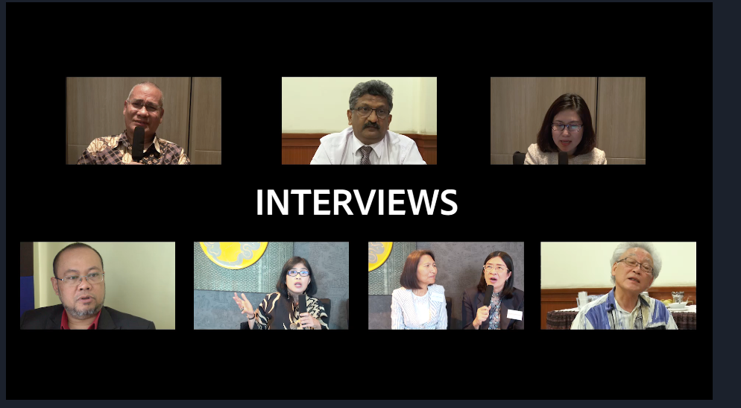
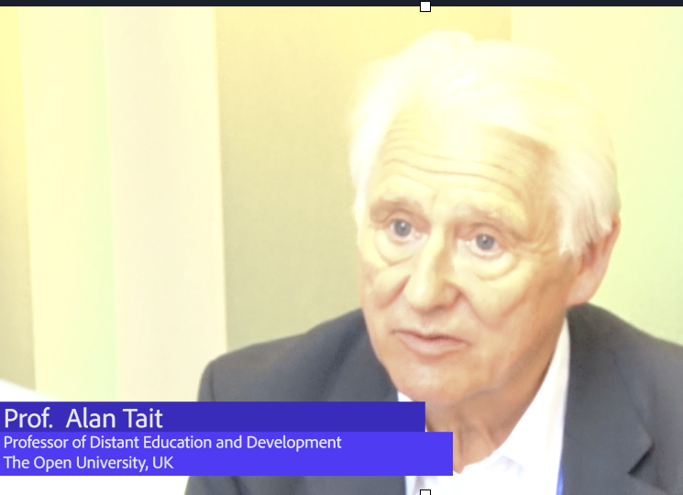
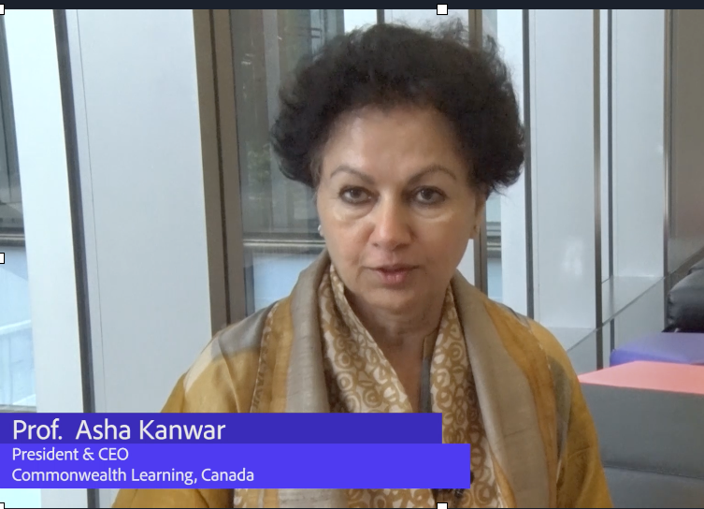
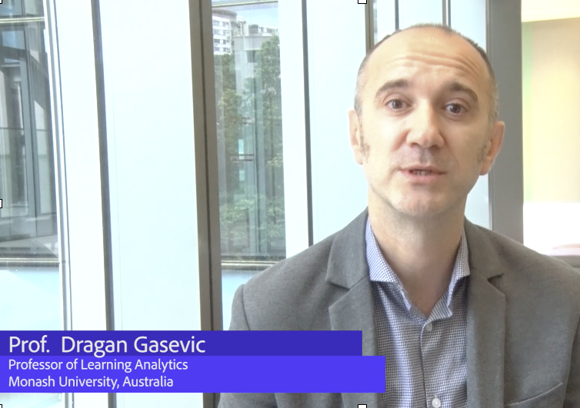
surveys, in-depth interviews, and focus group discussions were conducted among officials, faculty, and senior members of different administrations of open universities, traditional universities, and cyber universities.
t there was a strong interest among
universities and among open
universities, traditional
universities, and cyber univ.
to avail of the services of an
Open Education accreditation
process with this evident
demand we proceeded
with the Phase II of the
Accreditation System.
FEASIBILITY STUDY ON OFFERING OPEN EDUCATION ACCREDITATION SERVICES
Notes:
A series of surveys, in-depth interviews, and focus group discussions among officials, faculty, and senior members administrations of open universities, traditional universities, and cyber universities.
It showed that there is a strong interest among majority of universities and educational institutions to avail of the services of an Open Education accreditation process. Thus with this evident demand, the following year, we proceeded with the continue of the Accreditation System.

Slide 4
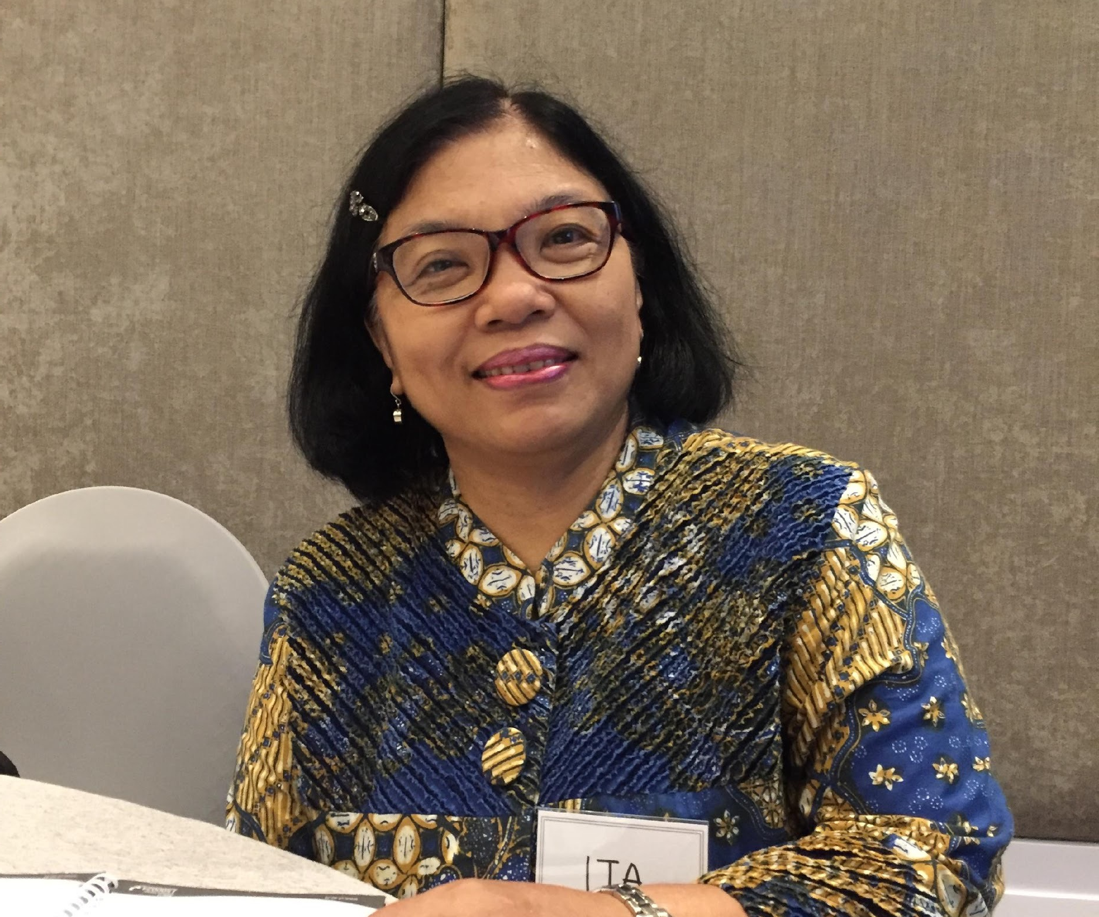
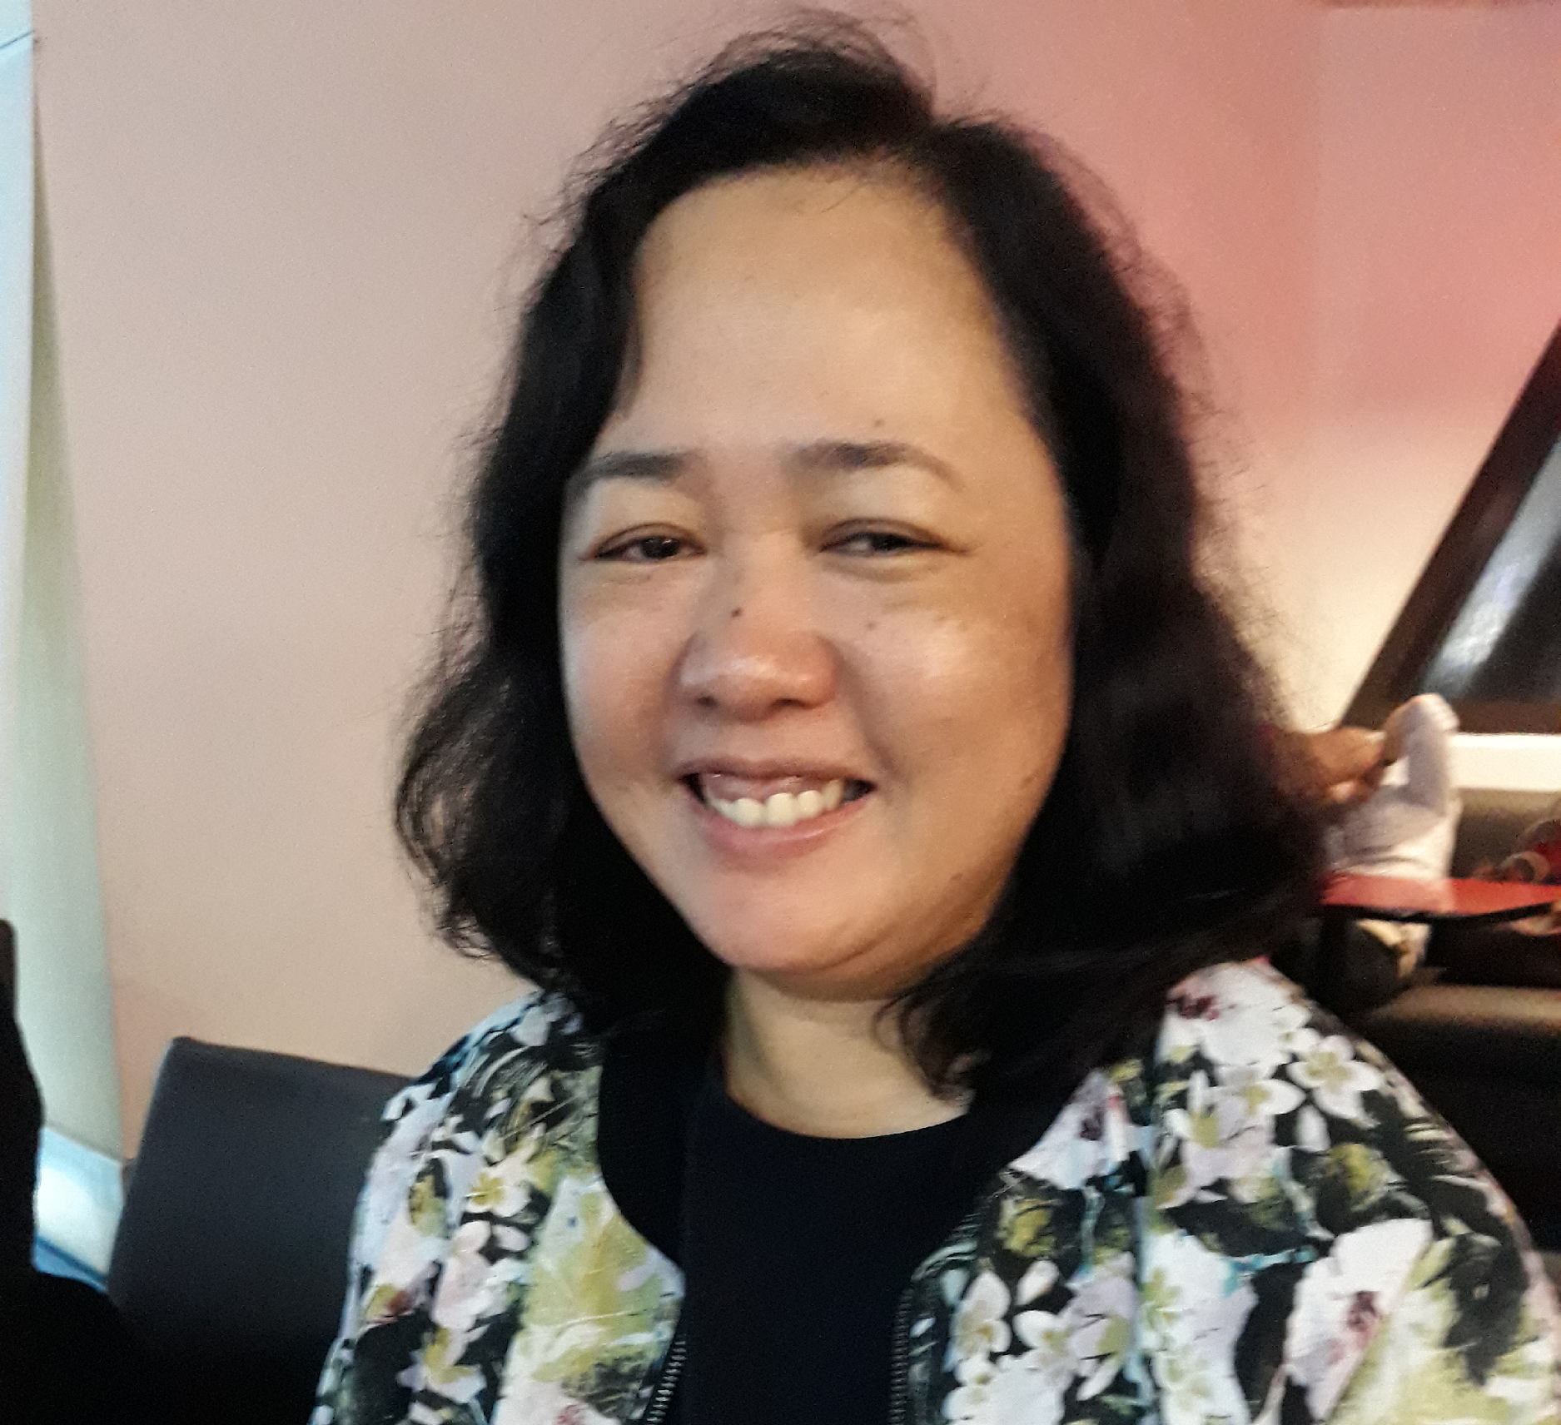
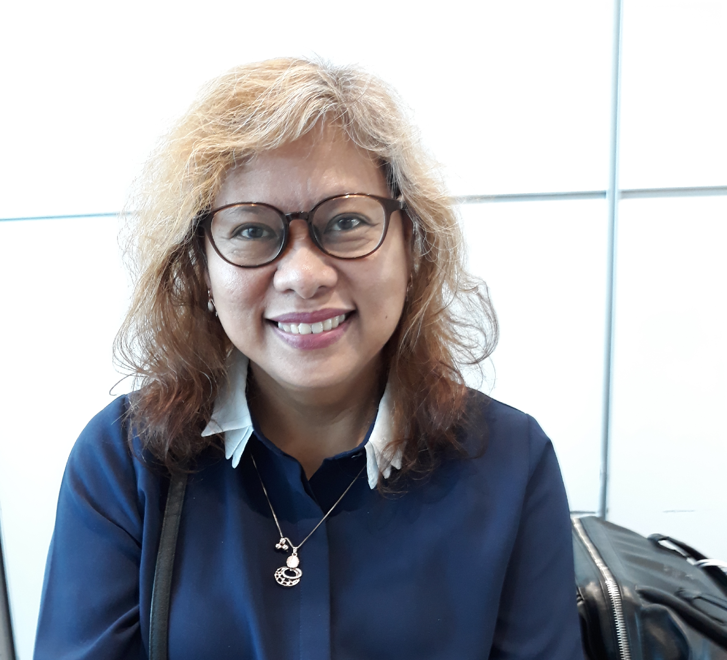
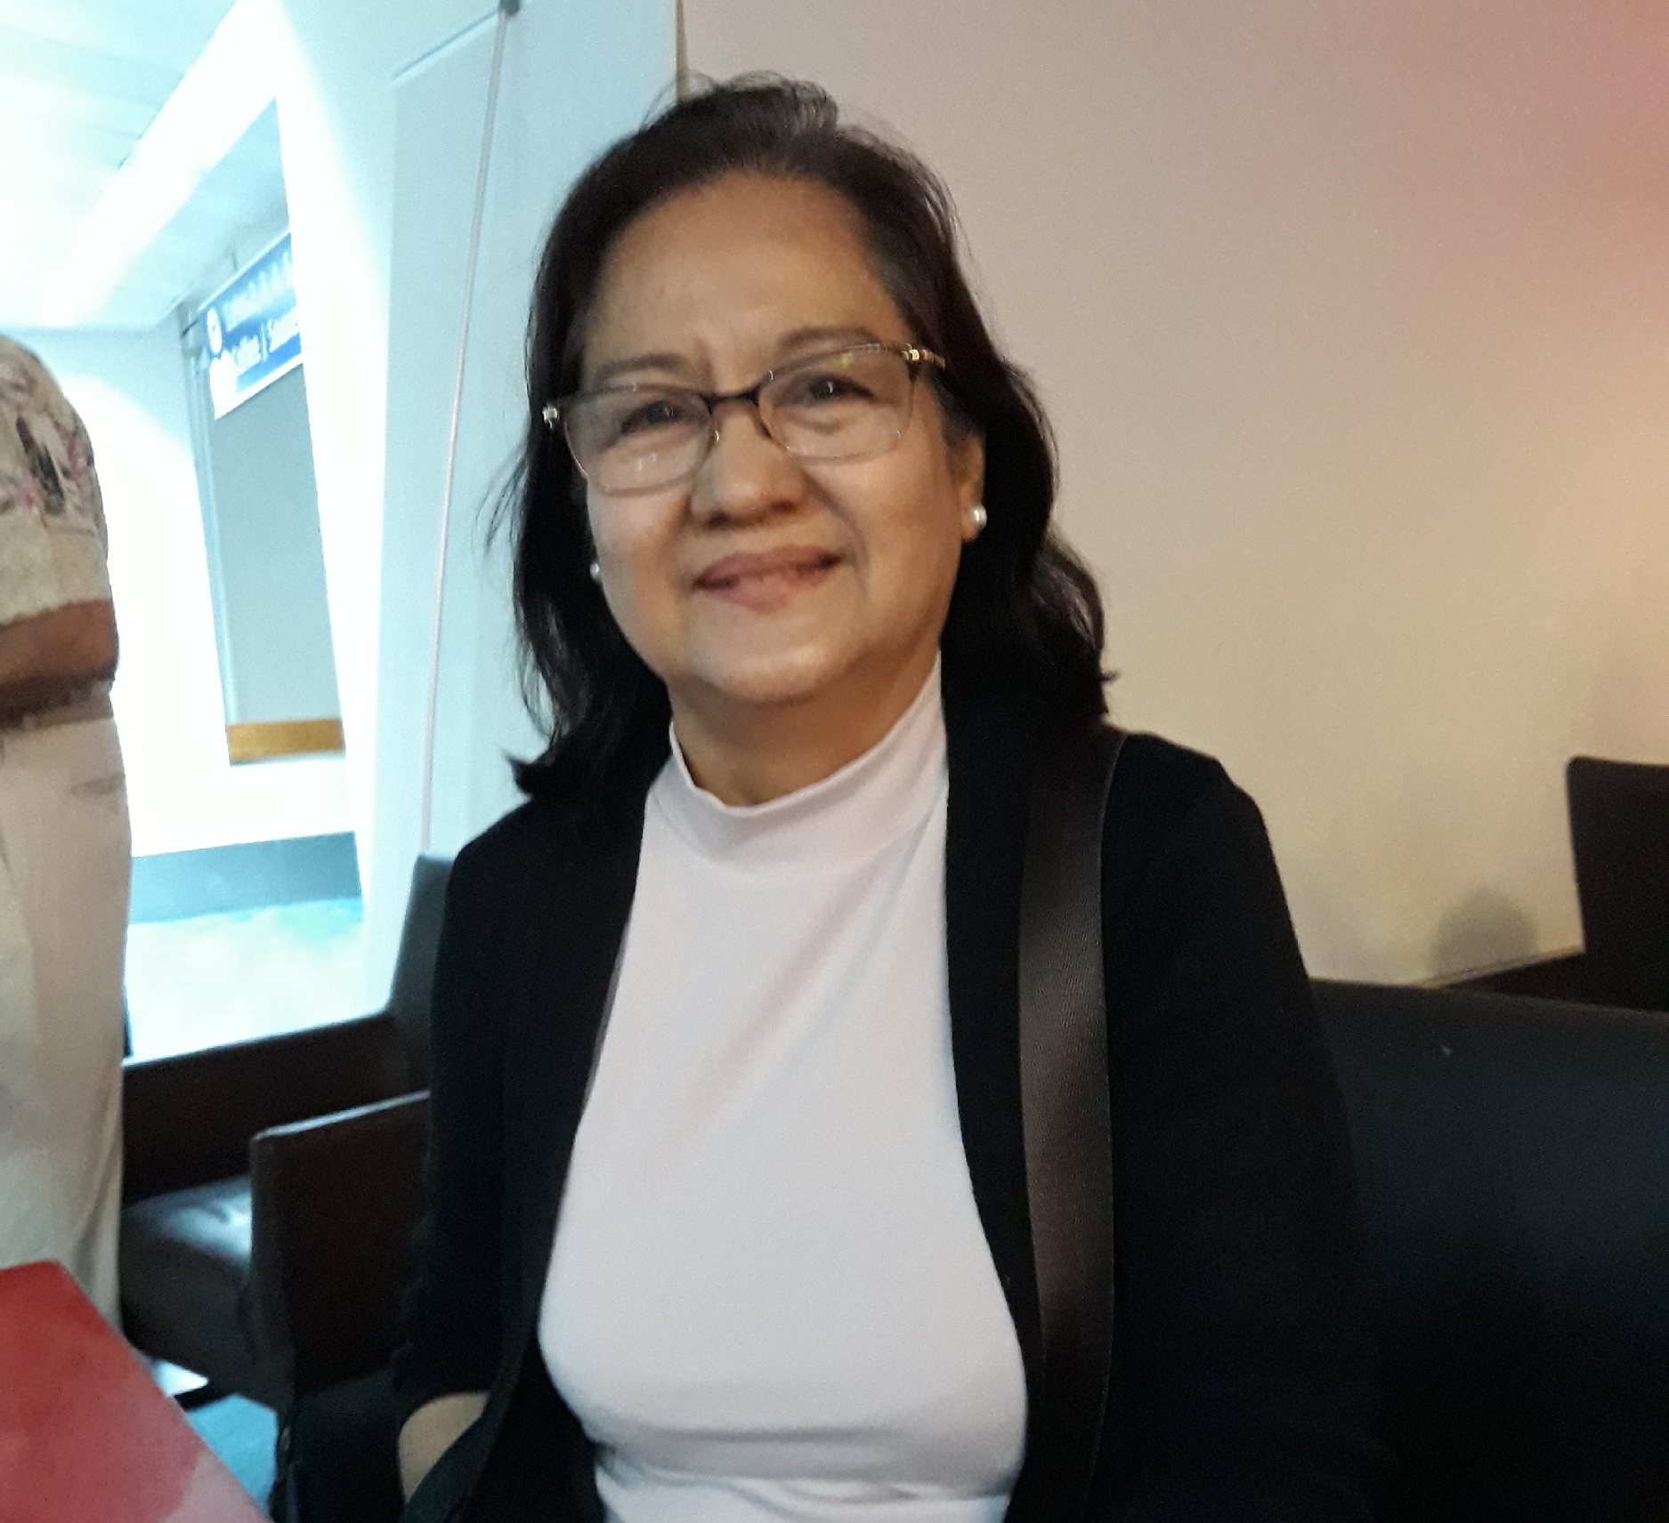
Expanded Experts Meeting in
Surabaya, Indonesia
24-25 July 2019
AAOU Task Force on Accreditation
Notes:
We expanded the group to include members from the ministry and the commission of higher education and the different universities’ experts

Slide 5
TASK FORCE MEMBERS and EXPANDED EXPERTS TEAM
Prof. Dr. Ojat Darojat (Rector, UT)
Prof. Dr. Samuel Anbahan Ariadurai (Vice-Chancellor, OUSL)
Prof. Shin Kisugi (President, OUJ)
Prof. Dr. Melinda dP. Bandalaria (Chancellor, UPOU)
Prof. Dr. Grace Javier Alfonso (Professor, UPOU) (Chair)
Prof. Dr. Melinda Lumanta (Vice Chancellor for Academic Affairs, UPOU)
Dr. Li Kam-Cheong (Director of Research Office, The Open University of Hong Kong)
Prof. Dr. Alyssa Alampay (UP Assistant Vice President for Q.A.)
Dir. Dr. Mary Sylvette Gunigundo (OIC, Director IV, OPS of Commission on Higher Education, Philippines)
Prof. Dr. Paulina Pannen (Ministry of Research, Technology and Higher Education of Indonesia)
Dr. Ir. Kristanti Ambar Puspitasari (Head of the Education Quality Assurance Center at LPPMP-UT)
Ms. Shaira Tanay (Research Assistant)
Notes:
in Quality Assurance to develop and produce the instrument for the Accreditation process.

Slide 6
AAOU International Accreditation System for Quality Assurance of Technology Mediated and Technology Enhanced Education in these
Digital Age
Notes:
“Accreditation System for Quality Assurance of Technology Mediated and Technology-Enhanced Higher Education in Times of Openness in the Digital Age of Technological Disruptions”
has been designed and produced…. it is an accreditation instrument in response to these pressing trends and concerns that are shaping the picture of the “university of the future”.
So we are inviting all universities to avail of
AAOU International Accreditation System forQuality Assurance of
Technology Mediated and Technology Enhanced Education in Times of
Openness in the Digital Age. Contact the AAOU secretariat for more details .

Slide 7
Thank you!

