Slide 1
The 33rd Annual Conference of the Asian Association of Open Universities Lahore-Pakistan Oct. 14-16, 2019
Technical Summary of the Conference
Prof. Dr. Masroor Ellahi Babar T.I.
Dean/ Conference Chair

Slide 2
Structure
Three Days conference
Four Plenary Sessions
Twenty Five Scientific Sessions
More than 450 Registered participants including
119 foreigners from various countries

Slide 3
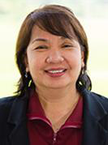
Keynote Speaker Prof. MELINDA DP BANDALARIA Chancellor, University of the Philippines Open University, President AAOU
ATTAINING SDGS THROUGH ODL
Emphasized on the awareness of the goals
How ODL can serve both as a tool and as a platform to attain the SDGs.

Slide 4
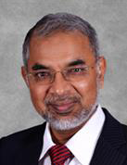
Keynote Speaker Prof DATO’ DR ANSARY AHMED President/ CEO Asia e-University, Malaysia
CHALLENGES FOR POLICY MAKERS AND EDUCATION PROVIDERS IN PAN ASIAN ACADEMIC PROGRAMME DEVELOPMENT AND DELIVERY
He explained how ODL can play its role
internationalization of higher education,
cultural exchange,
and credit transfer program

Slide 5
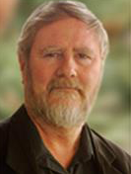
Keynote Speaker Prof. RORY MCGREAL UNESCO/ICDE Chair in OER Athabasca University, CANADA
Open Education Resources (OER) AND FUTURE EDUCATIONAL TECHNOLOGIES
Pointed out new technologies having impact on education
Especially emphasized how Virtual and Augmented Reality
(VR & AR), artificial intelligence (AI) and learning analytics
(LA) can change the future of education in general and ODL
in particular

Slide 6
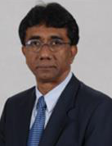
Keynote Speaker Prof. JOHN ARUL PHILLIPS Dean School of Education & Cognitive Science, Asia e University, MALAYSIA
NEW GENERATION LEARNERS IMPACTING PRESENT AND FUTURE OF OPEN DISTANCE LEARNING
Discussed that we should prepare for next generation technologies like personalized learning, micro-learning, mobile learning, multimedia etc.
Focused how ODL would adjusts and accommodate new technologies for future challenges.

Slide 7
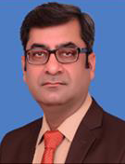
Keynote Speaker Prof. Dr. Rauf-i-Azam Vice Chancellor, University of Education, Lahore, Pakistan
ODL TO TRANSFORM THE LIVES OF MASSES IN PAKISTAN
Pakistan with high level of illiteracy and disparities
ODL has a potential to enhance the literacy rate
Time to start using ODL for lower levels as well.

Slide 8
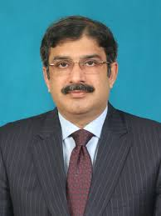
Keynote Speaker Prof. Dr. Zia ul Qayyum Vice Chancellor, Allama Iqbal Open University Islamabad, Pakistan
E- GOVERNNENCE OF ODL: DYNAMICS FRAMEWORK FOR TECHNOLOGY ENHANCED LEARNING
E-governance in ODL institutes.
Using technology enhanced learning for educational and national development

Slide 9
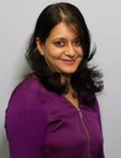
Keynote Speaker MS. SUKAINA WALJI Online Education Project Manager , University of Cape Town, SOUTH AFRICA
FLEXIBILITY OR FRAGMENTATION ON ONLINE ODL
Due to cost cutting and massification of ODL, new methods and technologies are being used which are leading to changes in the field.

Slide 10
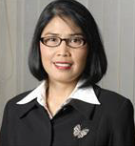
Keynote Speaker Prof. DR TIAN BELAWATI Former Rector , Indonesia Open University, Indonesia
CHALLENGES FOR POLICY MAKERS AND PROVIDERS
Open universities need to convert themselves, their
approaches and systems
They should redefine their purposes, target audiences, and
choices according to the new challenges.

Slide 11
Some of the Key Points of the Papers
Improving Models, Platforms and Systems
Using ODL for self regulated and self directed learning
Different models of blended leaning, using them effectively in online and traditional education systems.
Issues with research and thesis writing

Slide 12
Continued…
Human resource recruitment, retention and training in ODL . ODL teachers shouldt also have competency in tools and technology.
Quality assurance in ODL. Due to geographical distances and very large number of students, maintaining QA is more difficult .
Using artificial intelligence, augmented reality, virtual reality and other modern techniques to improve the working of ODL.

Slide 13
Continued…
Equal access and free education through ODL for all
Improving self directed and self regulated learning through ODL.
Using ODL in the context of CPEC
Improving students’ satisfaction in ODL
E learners’ motivation and academic performance
Use of mobile and virtual labs in bio and pure sciences

Slide 14
Future Directions
Improving ODL Models and Systems
Devising Quality Assurance System for ODL
Using Modern Technologies, Tools and Techniques
Using Innovative Pedagogies
Increasing international cooperation and credit transfer in ODL
Incorporating OLD and Blended Learning to enhance tertiary education.

Slide 15
Thank you Future Lies in ODL..

