Slide 1
ASIAN MOOCs (Massive Open Online Courses)

Slide 2
Asian MOOCs Steering Committee
Genesis: 2016
Tsuneo YAMADA
Kandarpa DAS
Melinda BANDALARIA
Daryono DARYONO
TRAN Thi Lan Thu
Kam Cheong LI
Andy LIEW
UPOU
OUJ
IODL
HOU
OUHK
WOU
UT
ASIAN MOOCs Committee

Slide 3
Milestones
2016: Development and launch of the Asian MOOCs portal
(conceptualised as LMS for MOOCs – members)
2017: Two research initiatives
(a) QA for MOOCs (b) Credit transfer for MOOCs
2018:
a) Call for active participation in the offering of MOOCs from AAOU member institutions
b) Development of the Asian MOOCs Learning Portal (LMS4Asian MOOCs)

Slide 4
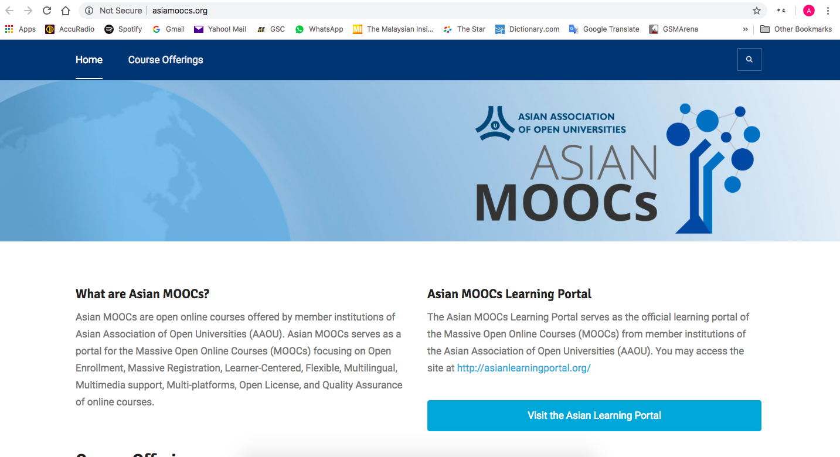
Asian
MOOCs
Portal

Slide 5
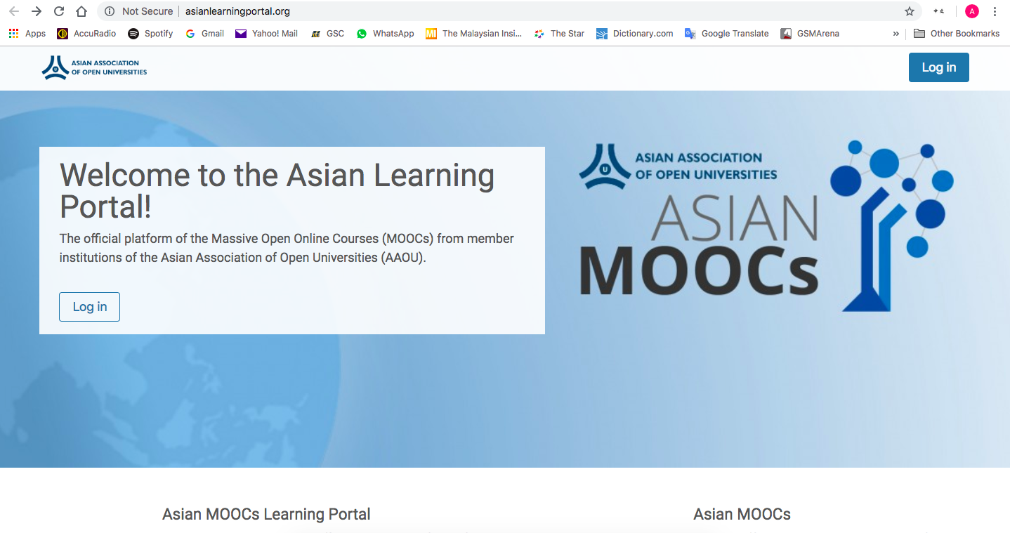
LMS
For
Asian
MOOCs

Slide 6
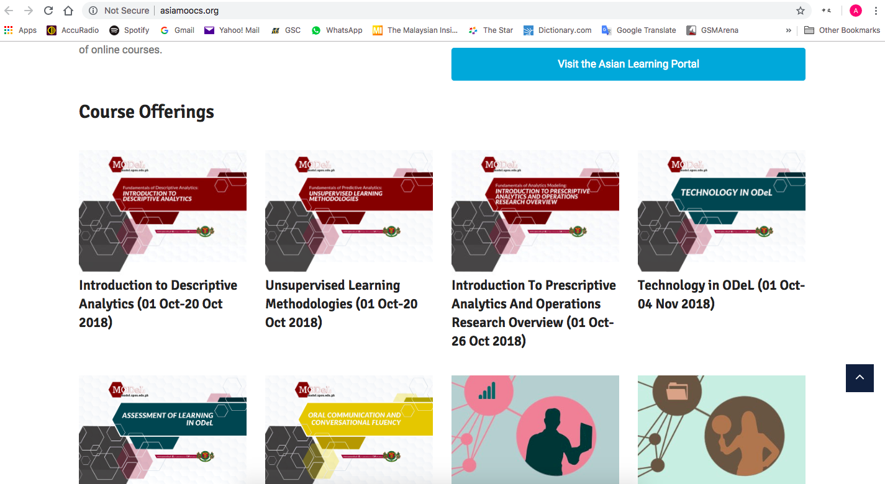

Slide 7
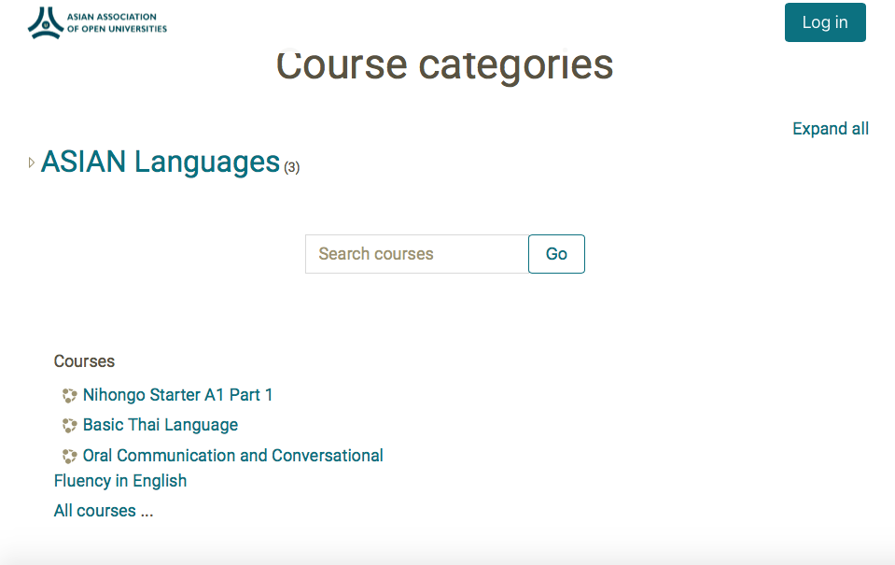
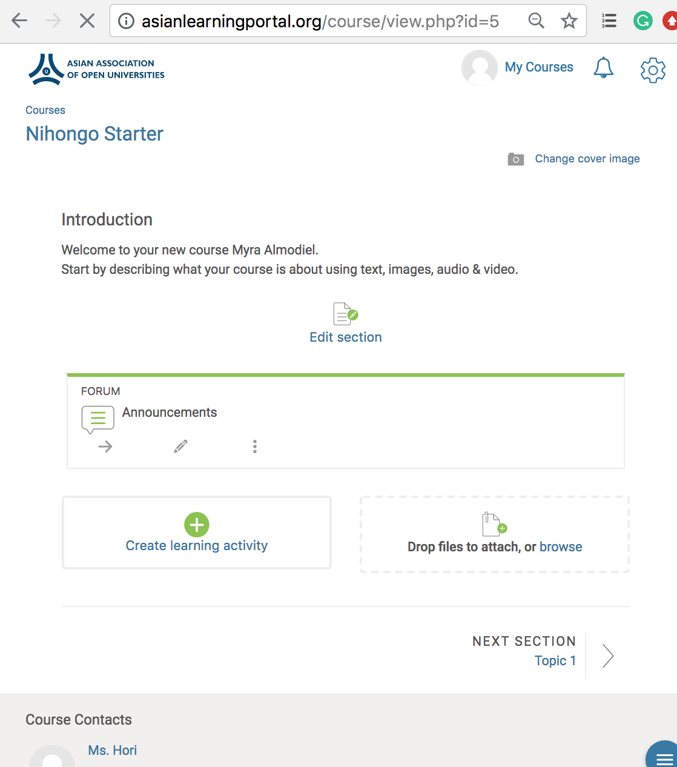
Nihonggo Starter A1 Part 1
Japanese Language Primer Course is comprised of 10 lessons with target 1 lesson per week
Course Duration: 1 Mar - 19 May 2019 (10 weeks)
Platform to pilot the Open Badge System
No. of students: 1,423
Basic Thai Language
Vietnamese
Bahasa

Slide 8
Total No. of Registered Users: 2,182
Philippines - 1,877
Iran - 1
India - 3
Indonesia - 6
Lebanon - 1
Korea - 2
Pakistan - 2
State of Palestine - 1
Vietnam - 1
Japan - 31
Sri Lanka - 1
Turkey - 1
China - 1
US - 19
UAE - 17
Thailand - 6
France - 2
Argentina - 2
Australia - 9
Finland - 1
Canada - 3
Saudi Arabia - 14
Hong Kong - 2
Romania - 1
Kazakhstan - 1
Qatar - 2
Greece - 1
Notes:
*asianmoocs.org domain is no longer available

Slide 9
Total No. of Registered Users: 2,182
Cambodia - 1
Malaysia - 1
Singapore - 7
Brazil - 1
Pakistan - 2
Peru - 1
Nepal - 1
Ireland - 3
New Zealand - 1
United Kingdom - 3
Bangladesh - 2
Egypt - 2
Northern Mariana Islands - 1
Macao - 1
Russian Federation - 1
Admin - 5
Teachers - 4
Students/Guests - 2173
Notes:
*asianmoocs.org domain is no longer available

Slide 10
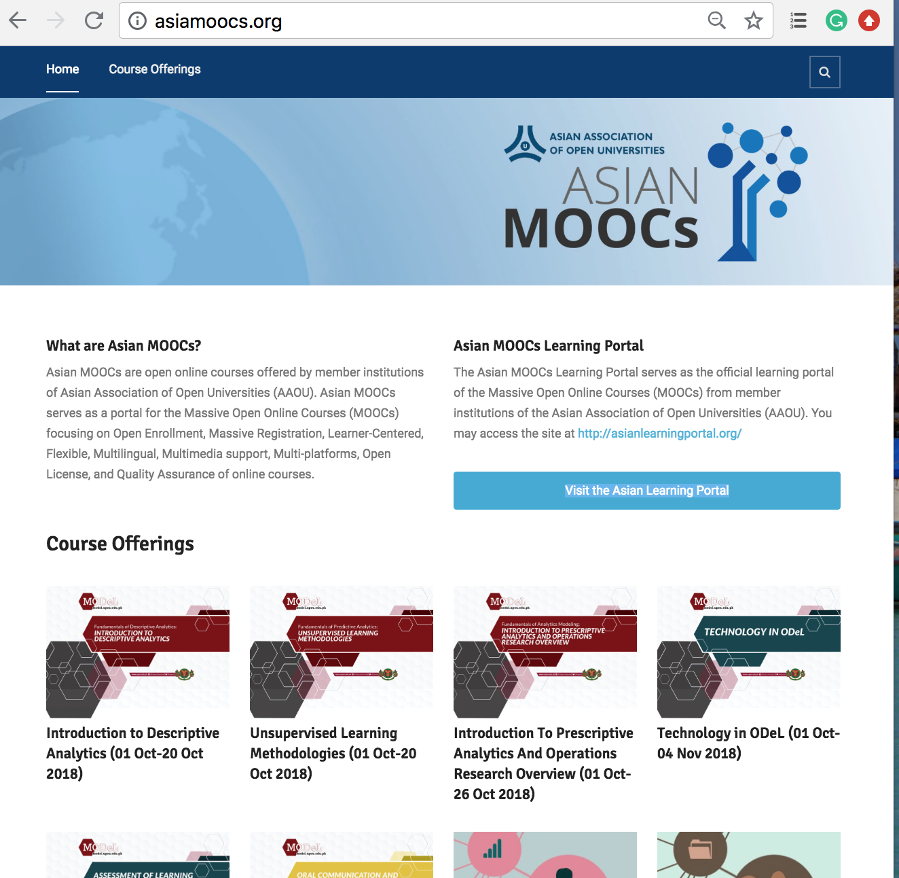
List of MOOCs
Total number of courses: 43
Al-Quds Open University (3)
The Cyber University of Korea (1)
The Open University of Japan (1)
Universitas Terbuka (9)
University of Mumbai (1)
University of the Philippines Open University (19)
Uttarakhand Open University (1)
Sukhothai Thammathirat Open University (7)
Wawasan Open University (2)
Hanoi Open University (1)
The Open University of Sri Lanka (4)

Slide 11
Moving forward
Maintenance of the portal
Asian MOOCs
Asian MOOCs Learning Portal
Digital badge
MOOCs offered by respective institutions
Accredited courses by AAOU
(AAOU certified)
AAOU MOOCs Certification Programmes
An agreed structure
Delivered as MOOCs
Consortium of OUs
e.g. Graduate Certificate in Distance Education (ODL core competency)

Slide 12
An Invitation/Call for Participation:
AAOU Member Institutions to:
Consider enrolling in Asian MOOCs as mechanism for professional development program of faculty and staff
Consider developing MOOCs in area of expertise
If offering MOOCs already, consider inclusion of MOOCs in the Asian MOOCs portal to increase visibility of the courses and invite more learners to enroll
Email: aaou@upou.edu.ph

Slide 13
THANK YOU

