Slide 1
Methods
Thx
Subject Matter
Interpretatif Structural Modeling
Self-Practicum
Course
Conclussion Sugestions
it is not easy to conduct self-practicum activities. Geographical conditions and the spread of students in various places
This study was conducted in November 2018 to April 2019
Contextual relationships between structural Model elements
Result & Discussions
AT THE END
The data processing methods used Interpretative Structural Modeling (ISM)
Model of Self –Practicum Course Management
Data obtained from literary studies, and the opinion of experts in the field of vocational education, social and sincerity. Expert group of 7 people consisting of academics, bureaucrats and private elements.
Methods
students are often not ready to carry out practicum
Presented By
Nu | Elemen | Contextual Relationship
1 | Purposes | G^{i} the corporation support G^{j}
2 | Constraints | K^{i} cause K^{j}
3 | Institutional | L^{i} the corporation support L^{j}
Problems
Problems
The disciplinary self-practicum program at the UT, produced through the ISM analysis covering key purpose elements, is able to apply the theory of becoming a habit in life and as a profession
There is no institutional linkage classification, for now, indicates that the institution that handles the governance of self-practice in UT, the Open University in Indonesia, has been stably integrated.
Self-practicum is practicum which is carried out independently by students in their respective domicile
is a modeling technique developed for strategy policy planning
Distance education is characterized by the learner’s learning autonomy and active involvement
Universitas Terbuka (UT) Indonesia is an institution of higher education that implements a distance learning system, UT requires its students to be able to study independently both on their own initiative and in groups.
But, they are not enough to only be learned through modules, but facilitated with a program of activities designed to be able to be implemented both in real and artificial situations
The methodology and techniques are divided into two parts :
arrangement of hierarchies
the classification of sub-elements
some students had difficulties in accessing practical guidance, obtaining materials and tools, and having qualified and competent instructor
Dem Vi Sara
Maya Dewi Dyah M.
at Universitas Terbuka, Indonesia
Toward to Industrial Revolution 4.0
Faculty of Science and Technology,
Universitas Terbuka, Jakarta, Indonesia.
Jl. Cabe Raya, Pondok Cabe, Pamulang, Tangerang Selatan, 15418, Indonesia
Department of Environmental Engineering,
Universitas Sahid, Jakarta, Indonesia
Jl. Prof. Dr. Supomo, SH, No. 84 Tebet, Jakarta Selatan, 12870, Indonesia
Subject Matter
Based on the literature study have determined three elements (objectives, constraints, institutions) required in the governance of Self-Practicum Program at UT in Indonesia
The ISM is a sophisticated planning methodology used to identify and conclude a wide variety of relationships between factors in a particular problem or issue
Mata Kuliah Berpraktikum
The classification of sub-elements refers to the processed result of the Reachability Matrix (RM) that has fulfilled the rules of transitivity according to the value of Driver-Power (DP) and the value of Dependence (D)
*Purpose :
To Formulate a model of self-practicum courses management
Introduction
Mata Kuliah Praktikum
UT needs to seek breakthrough Eventhough, the modules, guidelines, devices, tools, materials, are already available
is a subject whose final grade depends on not only the laboratorium experiments score, but also online tutorial score (if any) and final exam Score
is a subject whose study materials are nothing but laboratorium experiments materials
Title

Slide 2
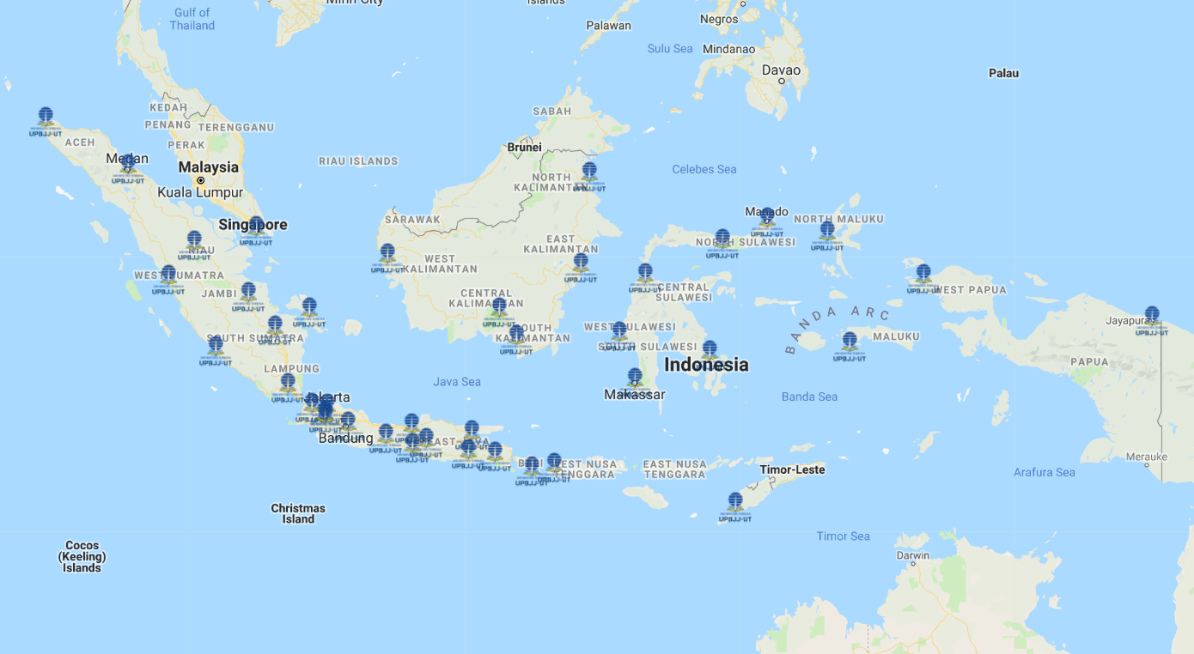
Methods
Thx
Subject Matter
Interpretatif Structural Modeling
Self-Practicum
Course
it is not easy to conduct self-practicum activities. Geographical conditions and the spread of students in various places
This study was conducted in November 2018 to April 2019
39 Region Centres (UPBJJ)
Conclussion Sugestions
Contextual relationships between structural Model elements
AT THE END
Result & Discussions
The data processing methods used Interpretative Structural Modeling (ISM)
Model of management of self-practicum courses
Data obtained from literary studies, and the opinion of experts in the field of vocational education, social and sincerity. Expert group of 7 people consisting of academics, bureaucrats and private elements.
Presented By
Nu | Elemen | Contextual Relationship
1 | Purposes | G^{i} the corporation support G^{j}
2 | Constraints | K^{i} cause K^{j}
3 | Institutional | L^{i} the corporation support L^{j}
students are often not ready to carry out practicum
Methods
The disciplinary self-practicum program at the UT, produced through the ISM analysis covering key purpose elements, is able to apply the theory of becoming a habit in life and as a profession
There is no institutional linkage classification, for now, indicates that the institution that handles the governance of self-practice in UT, the Open University in Indonesia, has been stably integrated.
Problems
is a modeling technique developed for strategy policy planning
Problems
Dem Vi Sara
Maya Dewi Dyah M
The methodology and techniques are divided into two parts :
arrangement of hierarchies
the classification of sub-elements
some students had difficulties in accessing practical guidance, obtaining materials and tools, and having qualified and competent instructor
at Universitas Terbuka, Indonesia
Faculty of Science and Technology,
Universitas Terbuka, Jakarta, Indonesia.
Jl. Cabe Raya, Pondok Cabe, Pamulang, Tangerang Selatan, 15418, Indonesia
demvisara@ecampus.ut.ac.id
Department of Environmental Engineering,
Universitas Sahid, Jakarta, Indonesia
Jl. Prof. Dr. Supomo, SH, No. 84 Tebet, Jakarta Selatan, 12870, Indonesia
maya@usahid.ac.id
Subject Matter
Toward to Industrial Revolution 4.0
A Stand-alone Subject
Practicum Subject
The ISM is a sophisticated planning methodology used to identify and conclude a wide variety of relationships between factors in a particular problem or issue
Based on the literature study have determined three elements (objectives, constraints, institutions) required in the governance of Self-Practicum Program at UT in Indonesia
Bogor
The classification of sub-elements refers to the processed result of the Reachability Matrix (RM) that has fulfilled the rules of transitivity according to the value of Driver-Power (DP) and the value of Dependence (D)
Introduction
*Purpose :
To Formulate a model of self-practicum courses management
UT needs to seek breakthrough Eventhough, the modules, guidelines, devices, tools, materials, are already available
is a subject whose study materials are nothing but laboratorium experiments materials
is a subject whose final grade depends on not only the laboratorium experiments score, but also online tutorial score (if any) and final exam Score
Title

Slide 3
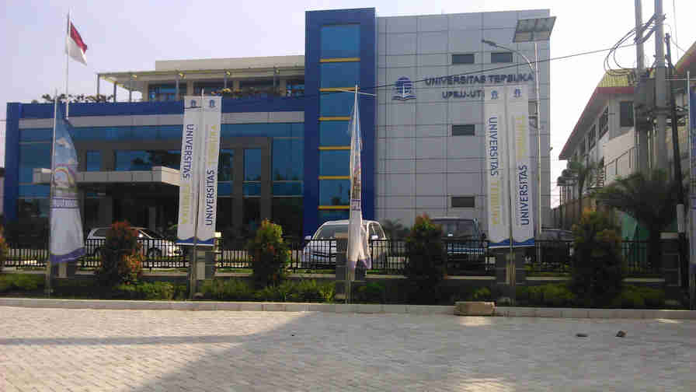
Methods
Thx
Subject Matter
Interpretatif Structural Modeling
Self-Practicum
Course
Conclussion Sugestions
This study was conducted in November 2018 to April 2019
it is not easy to conduct self-practicum activities. Geographical conditions and the spread of students in various places
Contextual relationships between structural Model elements
Result & Discussions
UPBJJ Responsibilities
Information Center
AT THE END
The data processing methods used Interpretative Structural Modeling (ISM)
Methods
Model of management of self-practicum courses
Data obtained from literary studies, and the opinion of experts in the field of vocational education, social and sincerity. Expert group of 7 people consisting of academics, bureaucrats and private elements.
Presented By
Registration Counter
Nu | Elemen | Contextual Relationship
1 | Purposes | G^{i} the corporation support G^{j}
2 | Constraints | K^{i} cause K^{j}
3 | Institutional | L^{i} the corporation support L^{j}
students are often not ready to carry out practicum
The disciplinary self-practicum program at the UT, produced through the ISM analysis covering key purpose elements, is able to apply the theory of becoming a habit in life and as a profession
There is no institutional linkage classification, for now, indicates that the institution that handles the governance of self-practice in UT, the Open University in Indonesia, has been stably integrated.
Problems
is a modeling technique developed for strategy policy planning
Problems
Dem Vi Sara
Learning Material Distributor
Maya Dewi Dyah M
The methodology and techniques are divided into two parts :
arrangement of hierarchies
the classification of sub-elements
some students had difficulties in accessing practical guidance, obtaining materials and tools, and having qualified and competent instructor
at Universitas Terbuka, Indonesia
Faculty of Science and Technology,
Universitas Terbuka, Jakarta, Indonesia.
Jl. Cabe Raya, Pondok Cabe, Pamulang, Tangerang Selatan, 15418, Indonesia
demvisara@ecampus.ut.ac.id
Department of Environmental Engineering,
Universitas Sahid, Jakarta, Indonesia
Jl. Prof. Dr. Supomo, SH, No. 84 Tebet, Jakarta Selatan, 12870, Indonesia
maya@usahid.ac.id
Toward to Industrial Revolution 4.0
Subject Matter
Examination Organizer
A Stand-alone Subject
Practicum Subject
The ISM is a sophisticated planning methodology used to identify and conclude a wide variety of relationships between factors in a particular problem or issue
Based on the literature study have determined three elements (objectives, constraints, institutions) required in the governance of Self-Practicum Program at UT in Indonesia
The classification of sub-elements refers to the processed result of the Reachability Matrix (RM) that has fulfilled the rules of transitivity according to the value of Driver-Power (DP) and the value of Dependence (D)
Introduction
*Purpose :
To Formulate a model of self-practicum courses management
Study Group Coordinator
UT needs to seek breakthrough Eventhough, the modules, guidelines, devices, tools, materials, are already available
is a subject whose study materials are nothing but laboratorium experiments materials
is a subject whose final grade depends on not only the laboratorium experiments score, but also online tutorial score (if any) and final exam Score
Conducting Lab Session
Title

Slide 4
Methods
Thx
Subject Matter
Interpretatif Structural Modeling
Self-Practicum
Course
Subject Matter
Interpretatif Structural Modeling
Self-Practicum
Course
Conclussion Sugestions
Conducted in November 2018 to April 2019
it is not easy to conduct self-practicum activities. Geographical conditions and the spread of students in various places
Contextual relationships between structural Model elements
Using Interpretative Structural Modeling (ISM) through the perception matrix of experts, SSIM, Final Reachability Matrix
Result & Discussions
UPBJJ Responsibilities
Information Center
AT THE END
Methods
Data obtained from literary studies, and the opinion of expert group of 7 people consisting of academics, bureaucrats and private elements.
Model of management of self-practicum courses
students are often not ready to carry out practicum
Presented By
Registration Counter
The disciplinary self-practicum program at the UT, produced through the ISM analysis covering key purpose elements, is able to apply the theory of becoming a habit in life and as a profession
There is no institutional linkage classification, for now, indicates that the institution that handles the governance of self-practice in UT, the Open University in Indonesia, has been stably integrated.
Problems
Problems
is a modeling technique developed for strategy policy planning
Self-practicum is practicum which is carried out independently by students in their respective domicile
Learning Material Distributor
According to Saxena, the program can be devided in to 9 elements
Dem Vi Sara
Maya Dewi Dyah M
some students had difficulties in accessing practical guidance, obtaining materials and tools, and having qualified and competent instructor
at Universitas Terbuka, Indonesia
The output of the ISM analysis :
The Key Elements
The Classification of Elements (Independent, Linkage, Dependent, and Autonomous)
Faculty of Science and Technology,
Universitas Terbuka, Jakarta, Indonesia.
Jl. Cabe Raya, Pondok Cabe, Pamulang, Tangerang Selatan, 15418, Indonesia
demvisara@ecampus.ut.ac.id
Department of Environmental Engineering,
Universitas Sahid, Jakarta, Indonesia
Jl. Prof. Dr. Supomo, SH, No. 84 Tebet, Jakarta Selatan, 12870, Indonesia
maya@usahid.ac.id
Subject Matter
Toward to Industrial Revolution 4.0
The classification of sub-elements refers to the processed result of the Reachability Matrix (RM) that has fulfilled the rules of transitivity according to the value of Driver-Power (DP) and the value of Dependence (D)
Subject Matter
Examination Organizer
A Stand-alone Subject
Practicum Subject
The ISM is a sophisticated planning methodology used to identify and conclude a wide variety of relationships between factors in a particular problem or issue
Based on the literature study have determined three elements (objectives, constraints, institutions) required in the governance of Self-Practicum Program at UT in Indonesia
The ISM is a modeling technique developed for strategy policy planning. ISM is also a structuring tool for a direct relationship.
Integrated inside an academic Subject
*Purpose :
To Formulate a model of self-practicum courses management
Introduction
Study Group Coordinator
Stand-alone Subject by itself
UT needs to seek breakthrough Eventhough, the modules, guidelines, devices, tools, materials, are already available
is a subject whose final grade depends on not only the laboratorium experiments score, but also online tutorial score (if any) and final exam Score
is a subject whose study materials are nothing but laboratorium experiments materials
is a subject whose final grade depends on not only the laboratorium experiments score, but also online tutorial score (if any) and final exam Score
Conducting Lab Session
is a subject whose study materials are nothing but laboratorium experiments materials
Title

Slide 5
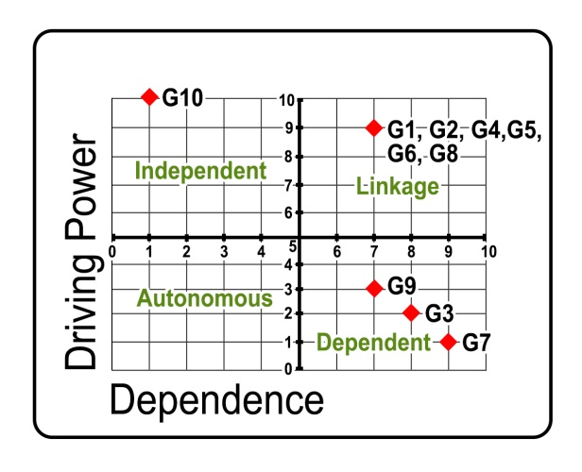
Methods
Thx
Subject Matter
Interpretatif Structural Modeling
Self-Practicum
Course
1. Analysis of Program Purposes Element
This study was conducted in November 2018 to April 2019
39 Region Centres (UPBJJ)
Conclussion Sugestions
AT THE END
The data processing methods used Interpretative Structural Modeling (ISM)
Model of management of self-practicum courses
Result & Discussions
Data obtained from literary studies, and the opinion of experts in the field of vocational education, social and sincerity. Expert group of 7 people consisting of academics, bureaucrats and private elements.
Presented By
The disciplinary self-practicum program at the UT, produced through the ISM analysis covering key purpose elements, is able to apply the theory of becoming a habit in life and as a profession
There is no institutional linkage classification, for now, indicates that the institution that handles the governance of self-practice in UT, the Open University in Indonesia, has been stably integrated.
Self-practicum is practicum which is carried out independently by students in their respective domicile
The methodology and techniques are divided into two parts :
arrangement of hierarchies
the classification of sub-elements
Dem Vi Sara
is a modeling technique developed for strategy policy planning
Methods
Maya Dewi Dyah M
at Universitas Terbuka, Indonesia
Description:
G₁: to create productive environments for optimal learning.
G₂: to achieve academic performance
G₃: improving students in understanding the concept of theory Operational
G₄: to be more responsible for their own learning
G₅: for quality education
G₆: continuing efforts to enable vulnerable and marginalized learners.
G₇: enhancing students in synthesizing
G₈: practical traditional needs
G₉: increasing the student's competence in analyzing
G₁₀: able to apply the theory of becoming a habit in life and as a profession
Department of Environmental Engineering,
Universitas Sahid, Jakarta, Indonesia
Jl. Prof. Dr. Supomo, SH, No. 84 Tebet, Jakarta Selatan, 12870, Indonesia
maya@usahid.ac.id
Faculty of Science and Technology,
Universitas Terbuka, Jakarta, Indonesia.
Jl. Cabe Raya, Pondok Cabe, Pamulang, Tangerang Selatan, 15418, Indonesia
demvisara@ecampus.ut.ac.id
Toward to Industrial Revolution 4.0
Subject Matter
Bogor
The ISM is a sophisticated planning methodology used to identify and conclude a wide variety of relationships between factors in a particular problem or issue
Mata Kuliah Berpraktikum
The classification of sub-elements refers to the processed result of the Reachability Matrix (RM) that has fulfilled the rules of transitivity according to the value of Driver-Power (DP) and the value of Dependence (D)
Introduction
Mata Kuliah Praktikum
is a subject whose final grade depends on not only the laboratorium experiments score, but also online tutorial score (if any) and final exam Score
is a subject whose study materials are nothing but laboratorium experiments materials
Title

Slide 6
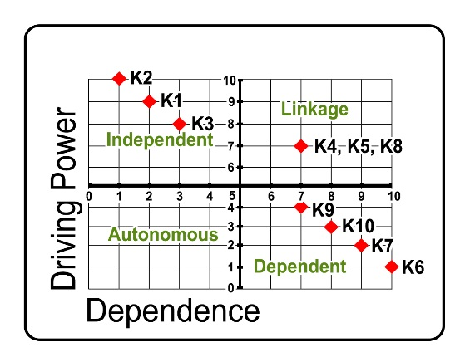
Methods
Thx
Subject Matter
Interpretatif Structural Modeling
Self-Practicum
Course
2. Analysis of Program Constraints Element
This study was conducted in November 2018 to April 2019
39 Region Centres (UPBJJ)
Conclusion Sugestions
Conclusion
The data processing methods used Interpretative Structural Modeling (ISM)
Model of management of self-practicum courses
Result & Discussions
Data obtained from literary studies, and the opinion of experts in the field of vocational education, social and sincerity. Expert group of 7 people consisting of academics, bureaucrats and private elements.
Presented By
The disciplinary self-practicum program at the UT, produced through the ISM analysis covering key purpose elements,is able to apply the theory of becoming a habit in life and as a profession, As a key constraint element as a difficulty of monitoring and supervising of human resources, As a key institutional involve is non-governmental institution.
Self-practicum is practicum which is carried out independently by students in their respective domicile
The methodology and techniques are divided into two parts :
arrangement of hierarchies
the classification of sub-elements
Dem Vi Sara
is a modeling technique developed for strategy policy planning
Methods
Maya Dewi Dyah M
at Universitas Terbuka, Indonesia
Faculty of Science and Technology,
Universitas Terbuka, Jakarta, Indonesia.
Jl. Cabe Raya, Pondok Cabe, Pamulang, Tangerang Selatan, 15418, Indonesia
demvisara@ecampus.ut.ac.id
Department of Environmental Engineering,
Universitas Sahid, Jakarta, Indonesia
Jl. Prof. Dr. Supomo, SH, No. 84 Tebet, Jakarta Selatan, 12870, Indonesia
maya@usahid.ac.id
Toward to Industrial Revolution 4.0
Subject Matter
Description:
K₁ : Self-motivated of student low
K₂ : The difficulty of monitoring and supervising of human resources in the are (geographical location)
K₃ : Student expectation after finish study that unclear
K₄ : Benefits Self-Practice that not implemented
K₅ : Adjustment and management of time
K₆ : Self-directed of student
K₇ : Tuition fees for Open University
K₈ : Student background
K₉ : Methods of learning
K₁₀ : The degree of isolation
Bogor
The ISM is a sophisticated planning methodology used to identify and conclude a wide variety of relationships between factors in a particular problem or issue
Mata Kuliah Berpraktikum
The classification of sub-elements refers to the processed result of the Reachability Matrix (RM) that has fulfilled the rules of transitivity according to the value of Driver-Power (DP) and the value of Dependence (D)
Introduction
Mata Kuliah Praktikum
is a subject whose final grade depends on not only the laboratorium experiments score, but also online tutorial score (if any) and final exam Score
is a subject whose study materials are nothing but laboratorium experiments materials
Title

Slide 7
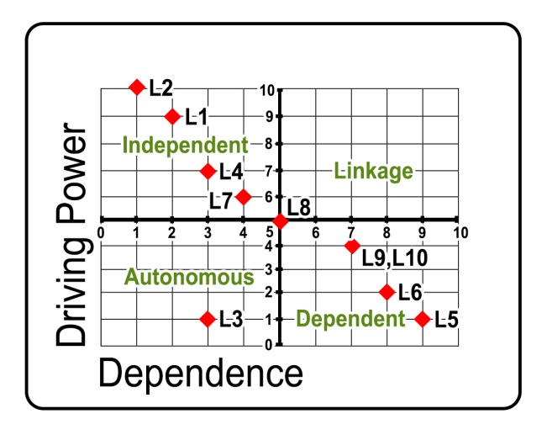
Methods
Thx
Subject Matter
Interpretatif Structural Modeling
Self-Practicum
Course
3. Analysis of Program institutional Element
This study was conducted in November 2018 to April 2019
Conclusion
39 Region Centres (UPBJJ)
Conclusion Sugestions
The disciplinary self-practicum program at the UT, produced through the ISM analysis covering key purpose elements,is able to apply the theory of becoming a habit in life and as a profession, As a key constraint element as a difficulty of monitoring and supervising of human resources, As a key institutional involve is non-governmental institution.
This model is supposed to be an input for UT/ODL directive policy to implement best practicum programe
Acknowledgement
Yoyoh Kurniawati
Ernest Ceti Septyanti
The data processing methods used Interpretative Structural Modeling (ISM)
Model of management of self-practicum courses
Result & Discussions
Data obtained from literary studies, and the opinion of experts in the field of vocational education, social and sincerity. Expert group of 7 people consisting of academics, bureaucrats and private elements.
Presented By
Self-practicum is practicum which is carried out independently by students in their respective domicile
The methodology and techniques are divided into two parts :
arrangement of hierarchies
the classification of sub-elements
Dem Vi Sara
is a modeling technique developed for strategy policy planning
Methods
Maya Dewi Dyah M
at Universitas Terbuka, Indonesia
Faculty of Science and Technology,
Universitas Terbuka, Jakarta, Indonesia.
Jl. Cabe Raya, Pondok Cabe, Pamulang, Tangerang Selatan, 15418, Indonesia
demvisara@ecampus.ut.ac.id
Department of Environmental Engineering,
Universitas Sahid, Jakarta, Indonesia
Jl. Prof. Dr. Supomo, SH, No. 84 Tebet, Jakarta Selatan, 12870, Indonesia
maya@usahid.ac.id
Description:
L₁ : Private Company
L₂ : Independent Non-Governmental Institution
L₃ : Small Micro Enterprises
L₄ : Indonesian Curriculum Developer Association
L₅ : Central Government
L₆ : Provincial Government
L₇ : People of Indonesian Education Organization
L₈ : Small Scale Food Processor Association
L₉ : Local Government
L₁₀ : The Community of Caring Education
Toward to Industrial Revolution 4.0
Subject Matter
Bogor
The ISM is a sophisticated planning methodology used to identify and conclude a wide variety of relationships between factors in a particular problem or issue
Mata Kuliah Berpraktikum
The classification of sub-elements refers to the processed result of the Reachability Matrix (RM) that has fulfilled the rules of transitivity according to the value of Driver-Power (DP) and the value of Dependence (D)
Introduction
demvisara@ecampus.ut.ac.id
maya@usahid.ac.id
Mata Kuliah Praktikum
is a subject whose final grade depends on not only the laboratorium experiments score, but also online tutorial score (if any) and final exam Score
is a subject whose study materials are nothing but laboratorium experiments materials
Title

