Slide 1
Material evaluation and analysis: relevance and appropriateness of course modules of BALIS degree programme offered at Open University of Sri Lanka
Damayanthi Gunasekera
Coordinator-ISU
&
Gayani Lakmali
AAOU 2019 15th October
Pearl Continental Hotel Lahore, Pakistan

Slide 2
Introduction
The success of any ODL programme depends on how well it is designed, executed and evaluated.
Evaluation of each course of the programme demonstrate it’s strengths and inherent shortcomings
Due to that course evaluation constitutes an important function in a ODL system.
The present study aims to evaluate a course materials distributed to distance learners who follow BALIS degree programme offered by the Open University of Sri Lanka

Slide 3
Purpose of the study
To inform that ODL materials differ from other types of learning materials and therefore the existing materials should be adapted so as to create a holistic educational experience to promote active and effective learning in print, and allow to assesment of effectiveness

Slide 4
Background to the study
Bachelor of Arts Honours (BALIS)Degree Programme - 2017
Total credit rate is 120
Delivery mode is traditional
Offered as OUSL offers level 5&6 which consists of 60 creditsof 14 courses currently
Formative and summative evaluation method used
Course includes practical session, presentations, filed visits, projects to develop skills of the students in addition to the activities given in the lesson materials
Third professional degree offered by the OUSL
To whom
Lateral entrants who has completed the Diploma in LIS. LIS Diploma – SLLA, Uni. Of Kelaniya, Uni. of Colombo
Why ? to fill the gap – No undergraduate prog. in distance mode in the country. Student can employed after completion of the Diploma but no learning ladder to step for further education while working. Therefore visible gap exists in higher education sector in producing professional undergraduates in the field.
Hence that OUSL team took the challenges of designing a LIS curriculum.

Slide 5
OUSL experiences
Designing of the Programme
How we developed the structures of the courses;
SLQF guidelines
Application of KSAM model
Blooms taxonomy
Theory of transaction introduced by Moore
UGC approval for the BALIS prog.
Selected and appointed subject experts
Conducted series of workshops to train course managers & lesson writers; informing
role and responsibilities, structure of the lesson and deadline for the completion of writing according to guidelines introduced by the OUSL.
The success and effectiveness of the distance education system “depends heavily on the study material, particularly in the form of printed course material” (Jayaram and Dorababu, 2015).

Slide 6
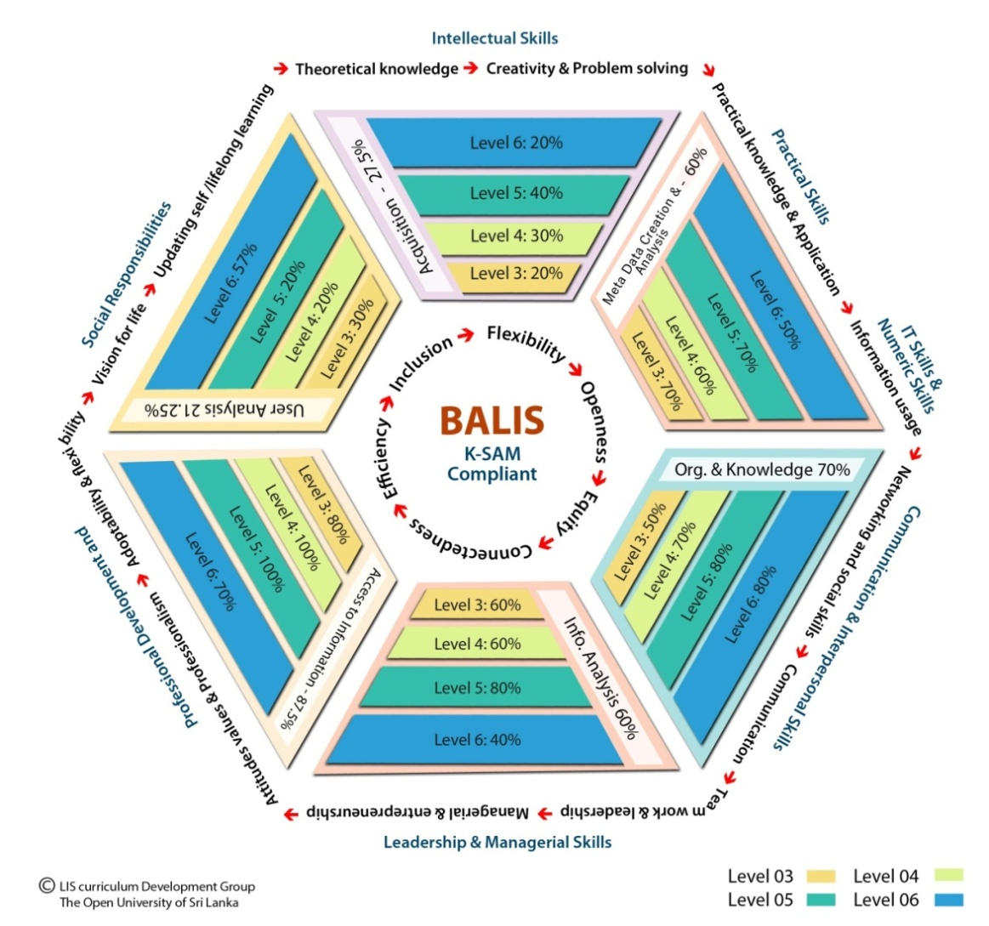
K-SAM model

Slide 7
Cont.
Course material development
Used OUSL house style – Session structure
Embedded support Devices in the content are pre and post question, illustrations, indexes, glossaries, tasks, summary, advance organizer, prior knowledge, references etc.
Structure of the lesson
Introduction
Advance organizer
Content of the session
Activity
Content cont.
Activity
Summary
Learning outcomes
Review questions
Recommended reading/s

Slide 8
Problem of the study
50 students registered to the BALIS prog.
60% is available now to continue the prog.
Why ? Is the problem with course materials
Also we need to awear whether students have achieved set objectives for each course or not, Knowledge and skills were developed or not is a problem.
OUSL guidelines states that evaluation of the course should be done by taking mid-semester student feedback, end of semester feedback or peer feedback through observation.
As Zabidi (2017) states that there are five core activity procedures for print modules, last one is ‘measurement of customer satisfaction’. OUSL library team did all except the evaluation. So study was conducted.

Slide 9
Objectives
To evaluate learner perception for each lesson given in three modules in semester 1
To analyze learner perception for each lesson given in four modules in semester 2
To find out different skills developed by the students.
Research questions
How do students of the BALIS react to various aspects of the Semester 1 printed materials such as content, language, format, style,?
How do students of the BALIS react to various aspects of the Semester 2 printed materials such as content, language, format, style?
What are the skills developed through the programme?

Slide 10
Methodology
The outcome of the study will be production of quality effective lesson materials which assist to create skillful LIS professionals to the filed.
So Type of the research is applied and total number of 70 lesson materials and 23 self learning activity session were evaluated.
Interview and group discussions were used to get feedback from the sample.
Descriptive analysis was carried out through frequency distribution and presents in bar-charts and tables.

Slide 11
Findings HSU5301 – Information & Knowledge Society

Slide 12
HSU5602 – Advanced Library Cataloguing

Slide 13
HSU5602 – Block 2

Slide 14
Answer for the 1st question
How do students of the BALIS react to various aspects of the Semester 1 printed materials such as content, language, format, style,?
HSU5301-80% of students are satisfied with the lessons 4,5,6,8,9 and 10 but indicated that lesson 1,4,5,8 are difficult to understand while 50% said that content of the lesson 3 is not relevant. The way of content is presented and use of difficult technical terms and too much of historical facts given in the content were the affected problems. Rahman (2006) ‘learning materials in ODL system must be simple to interact’
HSU5602-Students are happy with the all lessons given in IPL course and 66% stated that lessons are prepared in an excellent way. Mostly admired the lesson on ‘World cat’.
HSU5603- Students are happy with all lessons on classification and 39% stated that materials are prepared in excellent way. 33% requested more practical sessions on number building

Slide 15
HSU5603 – Advanced library classification

Slide 16
HSU5304 – Indexing & abstracting

Slide 17
HSU5305 – Intellectual Property Law

Slide 18
HSU5306 – Types of Libraries and Information services

Slide 19
HSU5607 – Advance Library Automation

Slide 20
HSU5607 – Advance Library Automation
But still some problem is there (connect with this findings

Slide 21
Answer for the 2nd question
How do students of the BALIS react to various aspects of the Semester 2 printed materials such as content, language, format, style?
HSU5304- 90% stated that more practical session is needed on ‘article abstracting’ while 50% stated lecturer should be changed
53% students stated that text is difficult to understand as difficult technical terms and content is mot motivating to learn were the problems
HSU5305-29% of them stated at the interview that lesson 1 is difficult to understand while 62% stated lesson 02 is difficult to understand.
HSU5306-students are satisfied with all the lessons provided in this course but requested to improve lesson 10 by 16% students
HSU5607-students are not satisfied with the lessons 2,3,4,5,6 and totally satisfied with the other lessons. Also they are satisfied with the summary given in each lesson of this course. More practical sessions were requested.
OUSL students are happy with the Embedded support Devices used in the content.

Slide 22
Skills developed
Answer for the 3rd question
‘To find out different skills developed by the students’
Internet accessing & searching skills (100%)
Time management skills
Peer interaction skills
Presentation skills
Communication skills
Self learning skills
Critical thinking skills (75%)
Multimedia usage skills (70%)
Subject analysis skills (80%)
Classification number building skills (80%)
Database management skills (45%)
English language skills (45%)

Slide 23
Conclusion and suggestions
4,7,9 and 10 lessons of the HSU5301 should be improved by using simple language removing too much of historical facts.
Lesson 10 of HSU5602 should be improved by applying more examples and supporting fact and increase the practical hours for subject analysis.
Lesson 6,7 and 11 of HSU5603 should be improved and increase the practical hours to improve transferable skills.
Lesson 1 ,2,3 and 7 of HSU5304 should be improved by using simple language. Also suggest to reconsider about the structure of the course. More practical hours is suggested.
It is suggested to improve self learning activity 1, 2 and 3 of HSU5305.
It is suggested to improve Lesson 1 of HSU5306 and discussion of positive and negative points of some lessons of the same course is also suggested.
It is suggested that content of the Lesson ,2,3 and 4 of HSU5607 should be improved by using simple language without using technical words.
It is suggested to arrange extra English language classes for BALIS students
It is also suggested to train lesson writers and Course Managers as suggested by Rahman (2006) and responsibilities of Course Managers should be well informed.

Slide 24
BALIS Curriculum
Level 5
Compulsory Courses
HSU5301 | Information and Knowledge Society | 03 | None
HSU5602 | Advanced Library Cataloguing | 06 | HSU 4602
HSU5603 | Advanced Library Classification | 06 | HSU4603
HSU5304 | Indexing and Abstracting Practice | 03 | None
HSU5305 | Intellectual Property Law | 03 | None
HSU5306 | Types of Libraries and Information Services | 03 | None
HSU5607 | Advanced Library Automation | 06 | HSU4306
 | Total Credits at Level 5 | 30

Slide 25
Thank you
Any questions

