Slide 1
E-learners’ Motivation and their Academic Performance in Class: Moderating role of Computer Self-Efficacy in the Use of Learning Management System.
Amna Haider
Psychology Department
Virtual University
AAOU CONFERENCE 2019

Slide 2
Introduction
Researchers proved that many students studying in e-learning system, are motivated to complete all their tasks including assignments, quizzes and other assessment activities via LMS
But, in Pakistan, majority of the students have no or very little exposure with the usage of computers and different software.
They have to face these issues like how to operate computer and how to use given student LMS

Slide 3
Continued...
Do not have sufficient expertise to use computer in an effective manner which ultimately lead towards their low grades and even low self esteem.
Keeping in consideration this fact, moderating role of computer self-efficacy was investigated in relation between e-learners’ motivation and their academic achievement.

Slide 4
Conceptual Definitions
E-learner’s Motivation
Motivation is one of the most important factors which help them in achieving their specific goals. Students who are motivated either to satisfy their learning urge or to get good grades performs better in the class.
Computer Self-Efficacy
It refers to one’s belief on his/her capability to use computers and to perform different academic tasks in an efficient manner by using computer and different web-based applications.
Leaning Management System
Learning management system is a web-based application which serves for as variety of tasks such as students’ enrolment, on-line quizzes, on-line assignments, graded discussion board and moderated discussion boards in which students ask questions to teachers via online and etc.

Slide 5
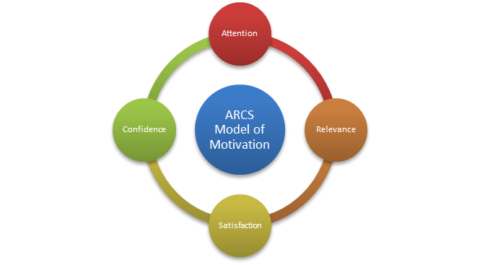
Conceptual Framework The ARCS Model

Slide 6
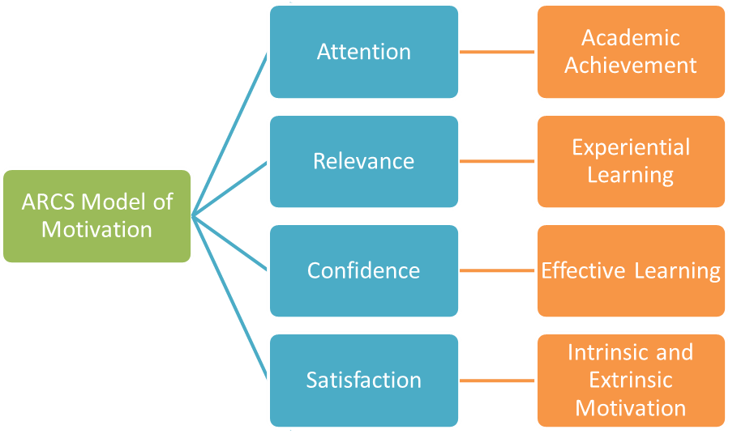
Graphical Representation of ARCS Model & Academic Achievement

Slide 7
Rationale of the Study
In Pakistan, many of the studies have been conducted to investigate the role of motivation and academic performance but this is first study exploring the role of computer self efficacy in relation with motivation and academic performance.
This is the need to explore these variables to understand e-learners needs and reasons behind their performance.
This study might help to understand the role of computer self efficacy in e-learners future performance, self esteem and grades etc.
It will help administrative and relevant authorities including instructors to create more effective learning environment for learners so students with varied computer skills can be accommodated accordingly.

Slide 8
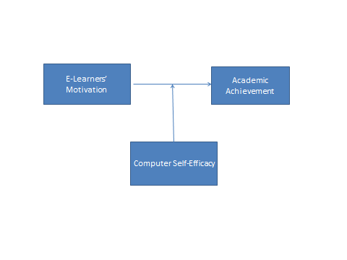
Objectives
Main objectives of the research are:
To investigate relationship between E-learners’ motivation and their academic performance in the class.
To investigate the moderating role of e-learners’ computer self-efficacy in relation between E-learners’ motivation and their academic performance in the class.

Slide 9
Hypotheses
There would be positive relationship between E-learners’ intrinsic motivation and their academic performance in the class.
There would be significant relationship between E-learners’ intrinsic motivation and their academic performance in the class.
There would be positive relationship between E-learners’ extrinsic motivation and their academic performance in the class.
There would be significant relationship between E-learners’ extrinsic motivation and their academic performance in the class.
Computer self-efficacy in the use of LMS will likely to moderate the relationship between E-learners’ motivation and their academic performance in the class.

Slide 10
Methodology
Research Design
Correlation research design was used.
Sample
Data was collected from four different programs i.e., BS Psychology, M.Sc Applied Psychology, MBA and MCS students of Virtual University of Pakistan including both girls and boys .
Purposive sampling strategy was used.

Slide 11
Continued....
Inclusion Criteria
E-learners from Virtual University of Pakistan
Males and Females with age ranged 20-45
Exclusion Criteria
E Learners who are engaged in computer based jobs, any web-based application job were excluded as they had high computer self efficacy which may become the confounding variable.

Slide 12
Procedure
Google form was prepared which comprised of participants’ demographics, MSLQ, CUSE scales.( Include short detail of these scales separately)
Link of questionnaires were shared amongst more than 1000 students of different disciplines.
Response rate was moderate

Slide 13
Ethical Considerations
Researcher got permission from authors of the scales
Researcher got permission to collect data from the concerned HoD.
Informed consent was taken from the participants.
Purpose of the study was shared with participants.
Participants’ information were kept confidential.

Slide 14
RESULTS

Slide 16
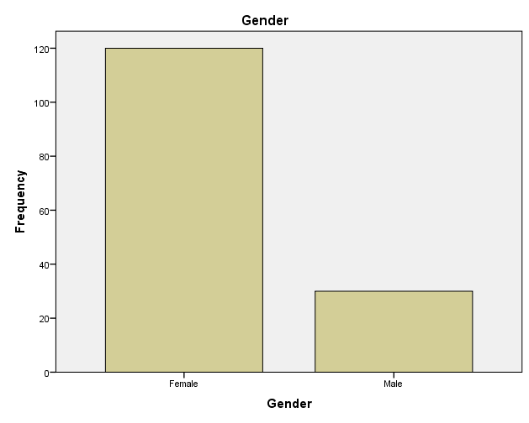
Results

Slide 17
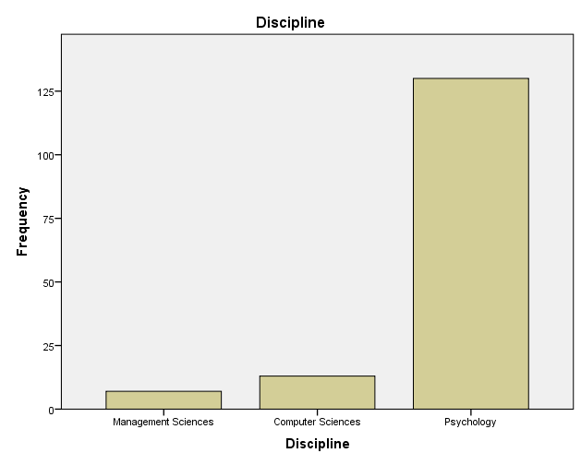

Slide 18
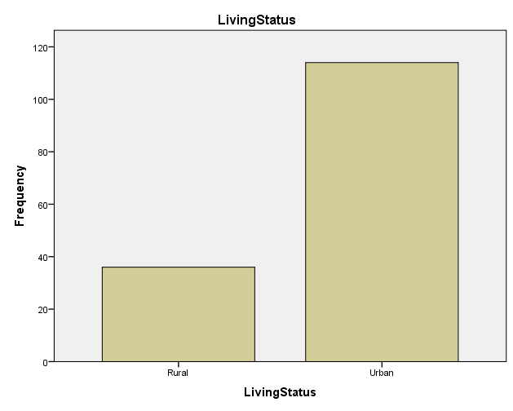

Slide 19
Correlation

Slide 20
Moderation

Slide 21
Continued.....
Results revealed that extrinsic motivation was found non-significant predictor of academic achievement but computer self-efficacy was found significant positive predictor of academic achievement where as interaction effects of extrinsic motivation and computer self-efficacy on academic achievement were found non-significant.

Slide 22
Continued.....

Slide 23
Continued.....
The results revealed that intrinsic motivation was found significant predictor of academic achievement but computer self-efficacy was found non significant predictor of academic achievement where as interaction effects of intrinsic motivation and computer self-efficacy on academic achievement were found significant.

Slide 24
Discussion
Steiner, Gotz and Stieglitz (2013) in their survey found that learner’s perception who values more the components of learning management system and incentives have a positive influence on learners’ motivation.
Radovan (2011) found that students who regulate themselves and are intrinsically motivated achieved higher scores as compared to other students.
Lee and Hwang (2007) found that students who have beliefs that they can use and execute different tasks by using computers are more satisfied with LMS.

Slide 25
References
Steiner, M., Götz ,O., &Stieglitz, S. (2013). The influence of learning management
System components on learners’ Motivation in a large-scale social Learning environment. Thirty Fourth International Conference on Information Systems, Milan. Retrieved from: https://www.researchgate.net/publication/259703812.
Firat, M. (2016). Determining the Effects of LMS Learning Behaviors on Academic
Achievement in a Learning Analytic Perspective. Journal of Information Technology Education. (15)75-87. Retrieved from: http://www.jite.org/documents/Vol15/JITEv15ResearchP075- 087Firat1928.pdf
Lee, J. &Young Hwang, C. (2007). The effects of computer self-efficacy and learning management system quality on e-Learner’s Satisfaction.Kyungpook National University, South Korea. Retrieved from: https://www.lamsfoundation.org/lams2007/pdfs/Lee_Hwang_LAMS2007.pdf
Stewart, C.M., Schifter, C.C., & Selverian, M.E.M. (2010). Teaching and Learning with
technology: Beyond Constructivism. Routledge. Retrieved from: https://trove.nla.gov.au/work/36328701?selectedversion=NBD44988113
Widjaja, A.E. &Victor Chen, J.(2017).Online Learners' Motivation in Online Learning: The
Effect of Online-Participation, Social Presence, and Collaboration. Retrieved from: https://www.researchgate.net/publication/321992187

Slide 26
Kor, H. Erbay, H. & Akmese, O.F. (2016). A Study on the Factors Affecting the Academic Performance of Distance Education Students and Formal Students. Retrieved from:
doi http://dx.doi.org/10.17218/hititsosbil.280829
Radovan, M. (2011). The relation between distance students' motivation, their use of learning strategies, and academic success. The Turkish Online Journal of Educational Technology. 10(01), pp. 216-222.
Saboor, A. Arfeen,U. & Mohti, W.(2015). Comparison of self- efficacy and its impact on Personality between classroom based and web-based learners. City university research journal. 5 (article 14), pp. 359-371.
Akhter, H. & Mahmood, M. (2018). Study of the Impact of Online Education on Student’s learning at University Level in Pakistan. International Journal of Distance Education and E-Learning. 3 (2).
Keller, J. M. (2009). Motivational design for learning and performance: The ARCS model approach. Springer Science & Business Media. Retrieved from:
https://www.learning-theories.com/kellers-arcs-model-of-motivational-design.html
Cassidy ,S. & Eachus, P. (2002). Developing the computer user self-efficacy (cuse) scale: investigating the relationship between computer self-efficacy, gender and experience with computers. J. Educational computing research. 26(2), pp. 133-153.
Anthony, R. & Artino, Jr. (2005). Review of the Motivated Strategies for Learning
Questionnaire. Retrieved from: https://eric.ed.gov/?id=ED499083

