Slide 1
SELF-INSTRUCTION LEARNING MATERIAL QUALITY BASED ON EXPERT PERSPECTIVE
Deddy Ahmad Suhardi
Adhi Susilo
October, 2019

Slide 2
Introduction
In distance education the course materials serve as the major learning resources for students.
The availability of high-quality learning materials are crucial to facilitate the students’ learning process at a distance.
The main media of the Indonesia Open University (Universitas Terbuka/ UT) learning system is printed and non-printed materials.
Self-Instruction Printed Material (SIPM) is a printed learning material and a major component for learning in UT
Printed learning material's reliability is expected to be consistent chapter by chapter.
This research evaluates SIPM's quality on all SIPM material, from subject to topic.
This research also identifies factors or dimensions that determine the differentiation of SIPM's worth from one another

Slide 3
Methodology
Multiple Factor Analysis (MFA) technique to evaluate the material quality of SIPM that is observed repeatedly from chapter to chapter.
This simple analytical technique can explain the role of observations and variables on the whole system (known as compromise).
SIPM content eligibility assessment is conducted in Agribusiness Study Program by a content expert using the SIPM Assessment Questionnaire (15 criteria).
Each SIPM has 135 criteria scores in each chapter. The score variables are coded according to chapter names and criteria.
This data has the same one observational structure and is evaluated repeatedly nine times (chapters) for fifteen criteria

Slide 4
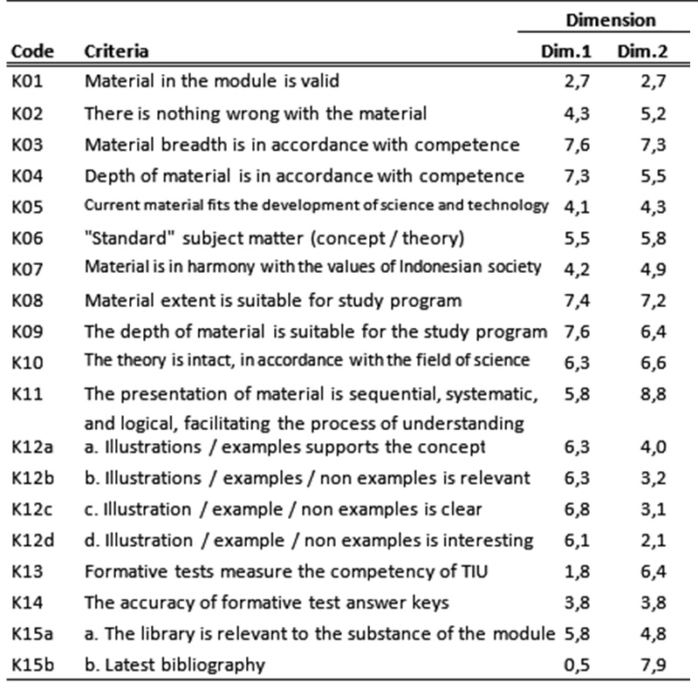
RESULT
Table 1. Percentage of total contribution criteria to the five main dimensions
Almost all criteria contribute to the first dimension (Dim.1), except for the formative test criteria (K13) and library update (K15b).
The first dimension refers to the level of content feasibility
Dim 2 consist of dominantly by: the criteria for the level of material presentation (K11), the breadth of material (K03, K08), and literature (K15b).
The second dimension refers to the level of recency of the material

Slide 5
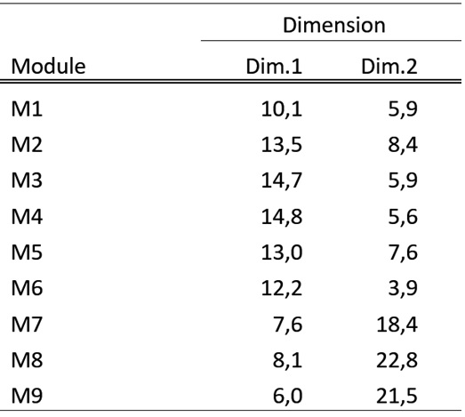
RESULT
Table 2. Percentage of total module contributions to the two dimensions
The level of content feasibility for SIPM (Dim 1) is more determined by the first 6 chapters.
The level of material recency of SIPM (Dim 2) generally occur in the last 3 chapters (chapter 7, 8, 9).

Slide 6
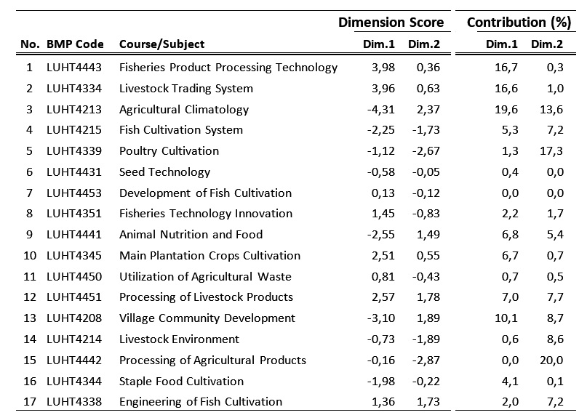
RESULT
Table 3. Individual SIPM’s scores and its contribution to the first two dimensions
SIPM code 1, 2, 3, 5, 13, 15 greatly contribute to the overall material quality of SIPMs.
The quality of SIPMs varies and groups according to the advantages and disadvantages they still have.
Crop Cultivation

Slide 7
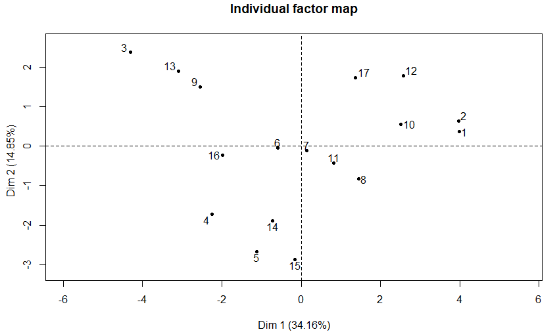
RESULT
The short distance between two or more points indicates the similarity of its quality.
Based on the positions, the quality of SIPM among 3, 13 and 9 is relatively similar.
Figure 1. Position of SIPM material quality in two main dimensions

Slide 8
DISCUSSION
The main dimensions of SIPM material feasibility:
The level of feasibility of the content and scope of the material,
The level of update, and
The first dimension (level of content and coverage) SIPM materials is determined predominantly by material criteria presenting a consistent and balanced method or paradigm of thinking in each module and between SIPM modules.
The second dimension (level of update) of SIPM material has different conditions in each modules.

Slide 9
CONCLUSION
The main dimensions of material feasibility for SIPM are:
The level of feasibility of the content and scope of SIPM material
The level of recency of the material
The quality of SIPM vary by its content feasibility and material recency.

Slide 10
Thank You

