Slide 1
A Descriptive Presentation of the Role of Anadolu University in Distance Education on a Local and Global Scale Dr. Selim Basar Dr. Safak Ertan Comakli Dr. Murat Ertugrul * AAOU 2019 14-16 October 2019 Lahor / Pakistan

Slide 2
Introduction
Anadolu University,
one of the world leaders in ODL;
over one million active students worldwide;
delivers higher education in Turkey and more than 25 countries.
Currently, 58 degree programs in the Faculties of Open Education, Business Administration, and Economic;
highly flexible structure responding rapidly to emerging needs;
(thanks to) qualified human resources and advanced technical infrastructure.

Slide 3
A Brief History
AAOU 2019
14-16 October 2019 Lahor, Pakistan
3/18

Slide 4
AAOU 2019
14-16 October 2019 Lahor, Pakistan
4/18

Slide 5
AAOU 2019
14-16 October 2019 Lahor, Pakistan
5/18

Slide 6
AAOU 2019
14-16 October 2019 Lahor, Pakistan
6/18

Slide 7
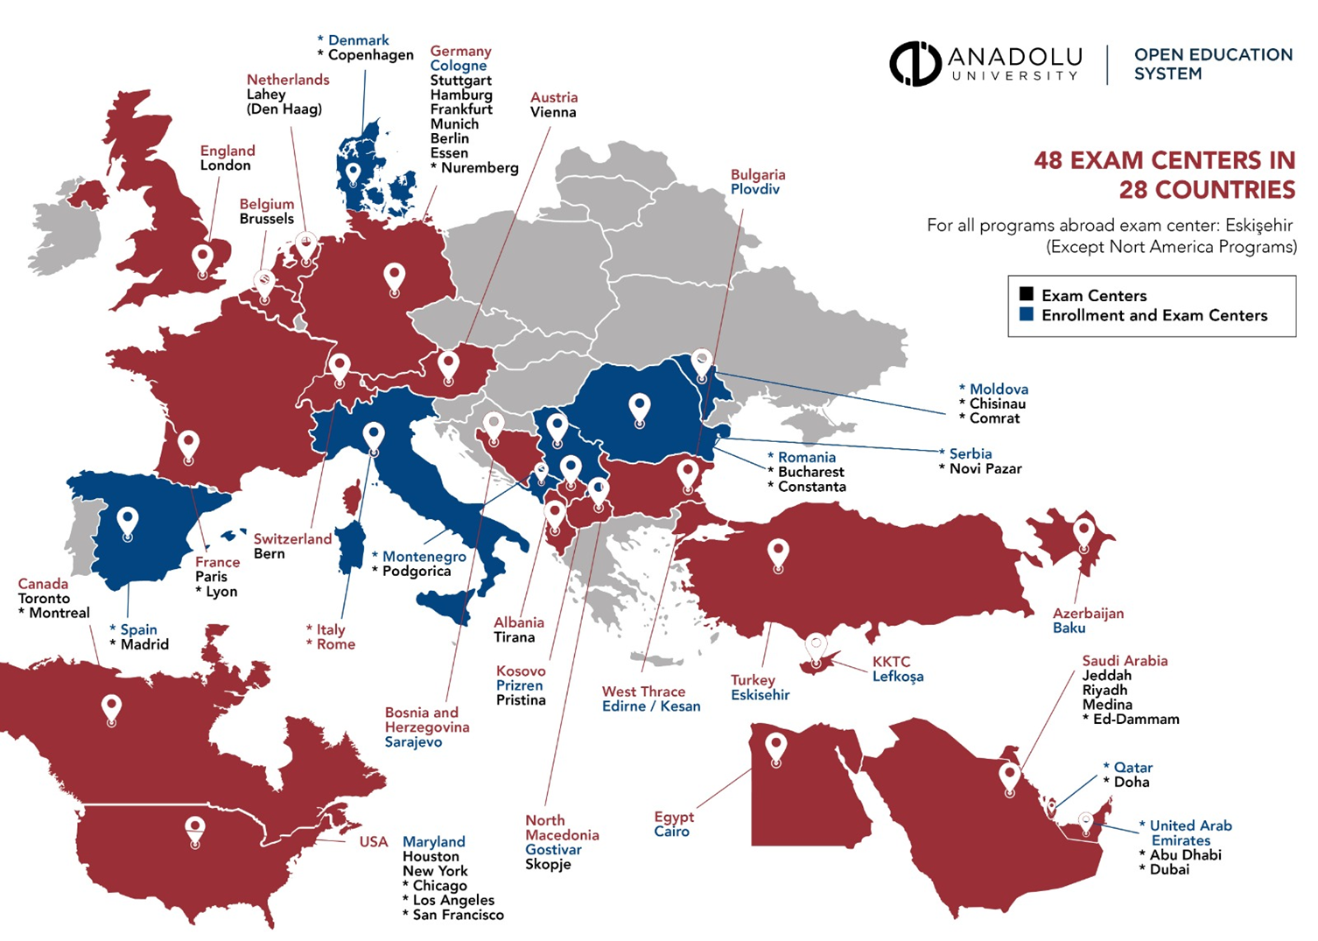
AAOU 2019
14-16 October 2019 Lahor, Pakistan
7/18

Slide 8
AAOU 2019
14-16 October 2019 Lahor, Pakistan
8/18

Slide 9
Tutoring & Mentoring
AAOU 2019
14-16 October 2019 Lahor, Pakistan
9/18
Live Online Classes
Academic Counseling
Student Quality Ambassadors

Slide 10
Student Support Services
AAOU 2019
14-16 October 2019 Lahor, Pakistan
10/18
Oes Student Support
Local Bureaus for Student Services
Open Education System Interaction Center (Call Center)
Career Support
Open Library
Open Science
Online Student Clubs
Alumni Association

Slide 11
AAOU 2019
14-16 October 2019 Lahor, Pakistan
11/18

Slide 12
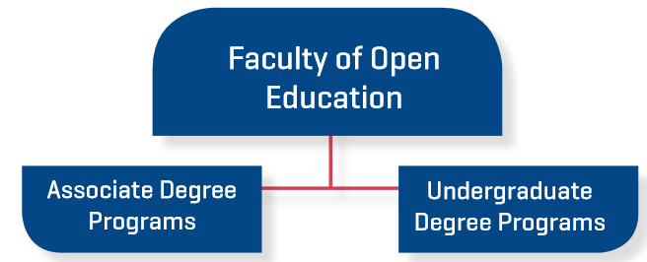
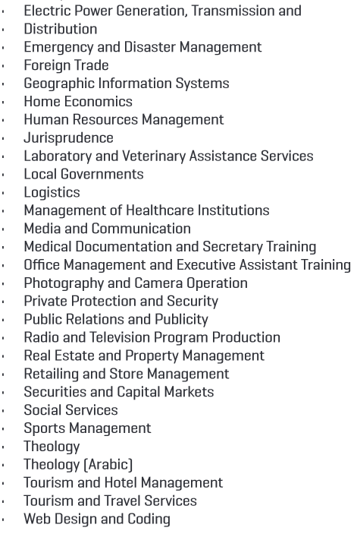
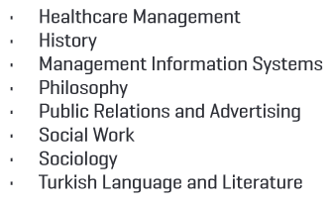
41 Associate Degree Programs
AAOU 2019
14-16 October 2019 Lahor, Pakistan
12/18
OCCUPATIONAL HEALTH AND SAFETY (NEW) SOCIAL MEDIA MANAGEMENT (NEW)

Slide 13
Facts & Figures
AAOU 2019
14-16 October 2019 Lahor, Pakistan
13/18

Slide 14
Facts & Figures
AAOU 2019
14-16 October 2019 Lahor, Pakistan
14/18

Slide 15
Facts & Figures
AAOU 2019
14-16 October 2019 Lahor, Pakistan
15/18

Slide 16
Facts & Figures
AAOU 2019
14-16 October 2019 Lahor, Pakistan
16/18

Slide 17
AAOU 2019
14-16 October 2019 Lahor, Pakistan
17/18

