Slide 1
10/18/16

Slide 2
Analysis and Prospect of Educational Management System in Open Education
Author: Zhijun Guo, Ji Wang
Email: guozhijun@ouchn.edu.cn
Notes:
The title of my paper is ‘Analysis and Prospect of Educational Management System in Open Education’.

Slide 3
Research Background
Over 15 million students enrolled from 1999-2018.
Data on enrollment students, 2009-2018.
Fig. 1 Enrolment of students, 2009-2018
Notes:
Well, first I’d like to introduce the research background.
The open education in China started in 1999. And it has enrolled over fifteen million students from 1999 to 2018.
Figure one shows the data on enrollment students from 2009 to 2018.
From figure one we can see that there are nearly one million students has been enrolled every year.

Slide 4
Research Background
More than 3.5 million ungraduated students.
Tedious educational management business operations, such as select courses, register for examinations, record achievements...
Need a highly efficient educational management system.
Too many types of data need to process.
Summarize the data the educational management system should process.
Notes:
Currently, there are more than 3.5 million ungraduated students studying at The OUC.
It’s a tedious task to manage so much students.
This requires the support of a highly efficient educational management system.
The educational management system needs to process too many types of data.
This study analyzes the educational management system and summarizes the data that the educational management system should process.

Slide 5
Data Flow Analysis of Educational Management Business
Basic data
Personal Information: student number, student name, gender, age, nationality, education level, address, contact information.
Registration Information: registration year, registration term, branch, learning center, and major.
Notes:
First is the basic data.
The basic data includes basic personal information,
such as student number, student name, gender, age, nationality, education level, address, contact information.
It also includes registration information,
such as registration year, registration term, branch, learning center, and major.

Slide 6
Data Flow Analysis of Educational Management Business
Major data
Major data refers to data describing the majors offered by The Open University of China.
Overall requirement.
Module requirement.
Properties of the courses.
Notes:
Major data refers to data describing the majors offered by The Open University of China.
The major data includes:
(1) the overall requirement, which is the lowest graduation credits,
(2) the module requirement, which is the lowest credits for each module,
(3) the properties of the courses included in each module.

Slide 7
Data Flow Analysis of Educational Management Business
Course selection data
Year and semester of course selection.
Learning center where the students are in.
Course ID.
Course name.
Credit of the course.
How many times the course has been selected by the student.
Notes:
At the beginning of each semester, students should choose the courses they want to study in that semester.
The course selection data includes the year and semester of course selection,
the learning center where the students are in,
the course ID, course name, credit, and how many times the course has been selected by the student.

Slide 8
Data Flow Analysis of Educational Management Business
Examination registration data
Year and semester in which the students take the examination.
Learning center where the students registered for the examination.
Courses registered for the examination.
Exam place.
Exam room.
Seat distribution of the examinees in the examination room.
If there is conflict within examination courses.
Notes:
At the end of each semester, students are required to register for the final examination.
The examination registration data includes:
Year and semester in which the students take the examination.
Learning center where the students registered for the examination.
Courses registered for the examination.
Exam place.
Exam room.
Seat distribution of the examinees in the examination room.
If there is conflict within examination courses.

Slide 9
Data Flow Analysis of Educational Management Business
Score data
Title of the course.
Way of examination.
Number of times to take the examination.
Year and semester to obtain the results.
Learning center where the results were obtained.
Final examination results.
Proportion of the results in the final examination.
Comprehensive score.
Personnel who entered the results.
Recorded date-time of the results.
Notes:
After examination is done, the scores need to be saved.
The score data includes:
Title of the course.
Way of examination.
Number of times to take the examination.
Year and semester to obtain the results.
Learning center where the results were obtained.
Final examination results.
Proportion of the results in the final examination.
Comprehensive score.
Personnel who entered the results.
Recorded date-time of the results.

Slide 10
Data Flow Analysis of Educational Management Business
Graduation data
Year and semester of the graduation review.
Major rule used in the graduation review.
Whether the graduation review has passed or not.
If it fails to pass the graduation review, what is the reason for the failure?
If it passes the graduation review, it records the number of the certificate ID allocated to the students.
Whether the student have applied for a degree.
What types of degree the student has applied?
Whether the student has passed the degree review.
Notes:
If the students have completed two and a half years of study
and have completed the courses required by the major rule, they can apply for graduation.
The graduation data includes:
Year and semester of the graduation review.
Major rule used in the graduation review.
Whether the graduation review has passed or not.
If it fails to pass the graduation review, what is the reason for the failure?
If it passes the graduation review, it records the number of the certificate ID allocated to the students.
Whether the student have applied for a degree.
What types of degree the student has applied?
Whether the student has passed the degree review.

Slide 11
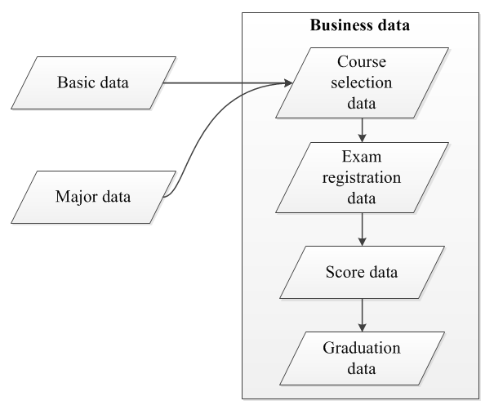
Relationships between data
Basic data is the basis.
Major data is the core.
Others are business data.
Fig. 3 Data Relationship
Notes:
There is a close relationship between these data.
Basic data is the source and the basis of follow-up operations.
Major data is the core, and the whole learning process need the support of the major data.
Course selection data, examination registration data, score data, and graduation data are business data generated in the learning process.
The business data has a strict order.
After the previous data is determined, subsequent business operations can be started.
After the subsequent business operations started, the previous data cannot be changed.

Slide 12
Course Platform System 1.0
Is an educational management system.
Is currently in use at The Open University of China.
Introduced in 2009;.
Serves to tens of millions of students.
Notes:
CPS1.0 is an educational management system,
It is currently in use at The Open University of China,
It was introduced in 2009 and has been used for nearly ten years,
And it has been providing services for tens of millions of students.

Slide 13
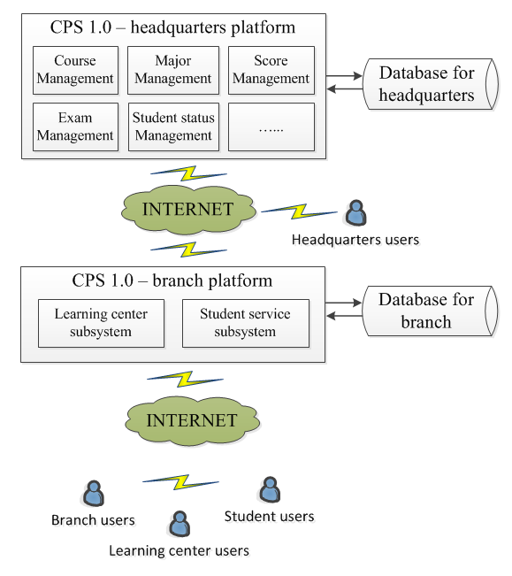
Course Platform System 1.0
Fig. 2 System Architecture of CPS 1.0
Notes:
Figure two shows the system architecture of CPS 1.0.
The system adopts a B/S structure. Users are able to access the platform through a browser.
There is a headquarters platform for headquarters users.
And every branch has their own branch platform.
As there are more than forty branches in The Open University of China,
there are more than forty branch platforms connected with the headquarters platform to exchange data through the Internet.

Slide 14
Weakness of CPS 1.0
Has a large amount of data.
Slows down the smooth operation .
Functions are not up to date.
Notes:
Up to now, CPS has accumulated a large amount of data,
which is the wealth of educational management system.
However because the data volume is too large, it slows down the smooth operations of the system.
And because there are lake of maintain, the functions are not up to date.
So it’s imperative to upgrade the educational management system.

Slide 15
Prospect of Education Management System
Complete the routine educational management business.
Make good use of the massive data the system has accumulated.
Use new technologies.
Provide decision-making service.
Notes:
The next generation educational management system should complete the routine educational management business,
And should make good use of the massive data that the system has accumulated,
And it should use new technologies such as big data, cloud computing, artificial intelligence, and so on.
In addition, it should provide decision-making service for the administration.

Slide 16
Thank You!

