Slide 1
Implementation of digital badges for online and offline course records: Possibilities for micro credentials and quality assurance
Tsuneo YAMADA
The Open University of Japan (OUJ)

Slide 2
Backgrounds

Slide 3
Backgrounds: Digital Transformation in Japan “Society 5.0”
“Super Smart Society” promoted by Japanese government
Human-centered Society to realize both sustainability and the solutions of social issues by advanced technologies to integrate virtual and real spaces

Slide 4
From Society 4.0 to Society 5.0
Society 4.0: Digitization
Society 5.0:
Digital Transformation
Electronic Certificate
（HE）
・extended Transcript
・Certificates
（K-12）
・Grade book
Social Trust Platform in Education
・Lifelong e-Portfolio
・Microcredentials
・Fair and Portable Credit Transfer
・Learner Agency

Slide 5
Backgrounds: NGDLEs
NEXT of LMS

Slide 6
IMS Global: Concept

Slide 7
(Rob Abel, 2016)
CURRICULUM
APPS &
TOOLS
ASSESSMENT
PARTNER
APP
CATALOG
SUPPLIER/
DEVELOPER
ANALYTICS
Seamless Enterprise Integration via IMS Standards
Peer-to-peer network
Click
Stream
LEARNING
PLATFORM/
PORTAL/LOR
Apps
INSTITUTION
ANALYTICS
Data
INSTITUTION
APP
CATALOG
Metadata
Interventions
IMS App Sharing
& Integration
IMS Caliper
Analytics
Framework
STUDENT
INFO/ERP
SYSTEM
Objectives/Pathways
Achievements
IMS ARCHITECTURE
FOR EDUCATIONAL
INNOVATION
IMS Competency Services & Learning Stds Framework
IMS Educational Badges & Extended Transcript

Slide 8
Digital Ecosystem: Inter-operability
To realize both sustainability and optimization at the same time,
technical “Interoperability” is indispensable.
In the e-learning and ICT-enhanced education, IMS technical standards are comprehensive and some are the most advanced.

Slide 9
Digital badges

Slide 10
Digital Badges: Merits
Credential for the digital learning era
Course Providers:
Prevent forgery
Improve the quality of the course
Facilitate the credit transfer
Lifelong Learners:
Manage and Utilize her/his own outcomes (learner-agency approach)

Slide 11
Digital Badges: Characteristics
Digital Credentials for academic degree, competency and skills, and qualification
Issue a unique badge to every recipient by course/program providers
A set of graphical image(s) and metadata
In addition to each achievement, various records, such as personal data of the recipient, the content of the course/program, acquired knowledges and competencies, are certifiable.
Encrypted to avoid falsification
Portable and sharable through the Internet

Slide 12
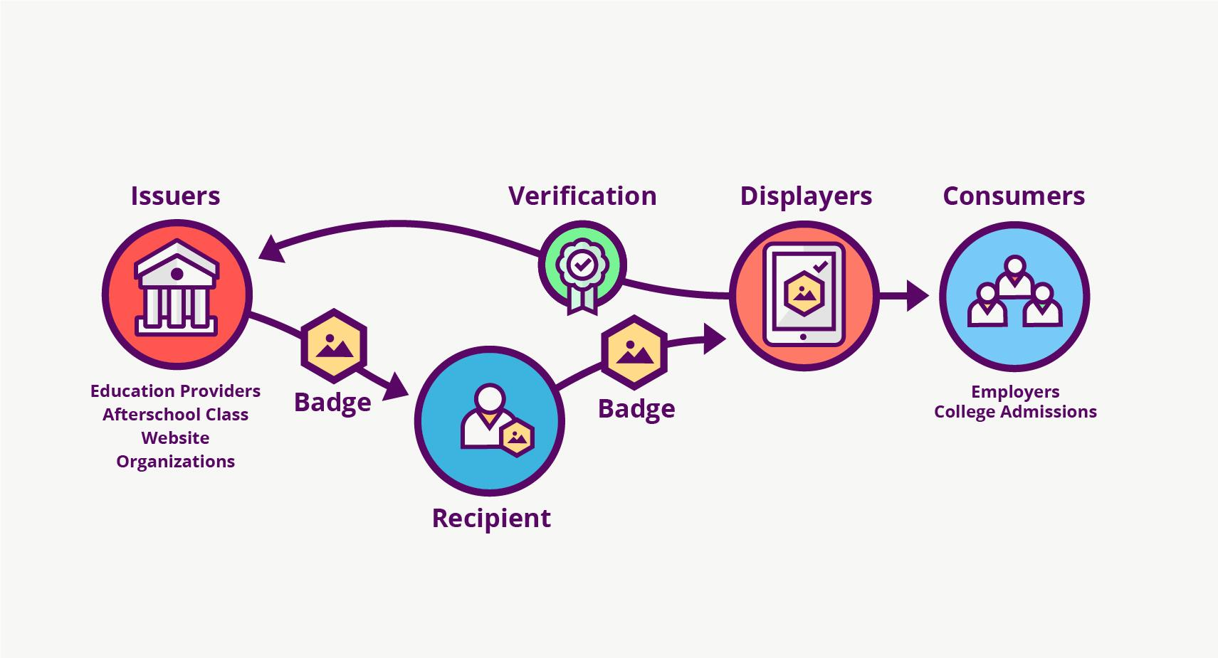
Badge Ecosystem

Slide 13
Technical standards for Digital credentials

Slide 14
IMS Digital Credential Standards
Digital Badge & Credential
Open Badge Version 2 (OBv2)
Comprehensive Learner Record
CASE (Competency and Academic Standards Exchange)

Slide 15
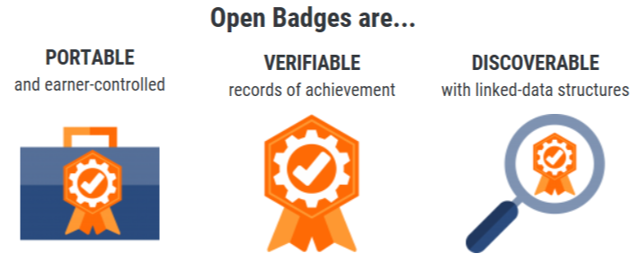
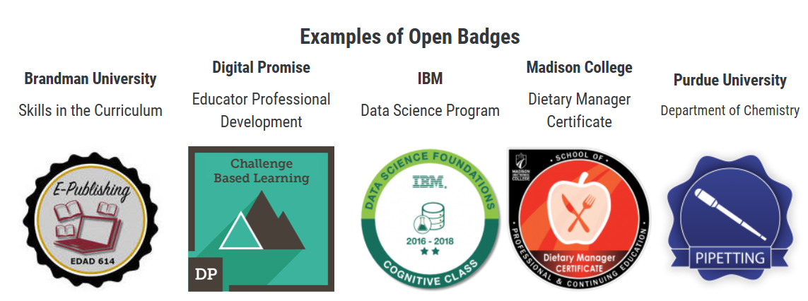
Open Badges (OBv2)
Nine of the top badging platform companies in the world are IMS certified for OBv2.

Slide 16
Open Badges v2
Open Badges are verifiable, portable digital badges with embedded metadata about skills and achievements.
OBv2
Issuer
Recipient
Image
Date issued
Verification
Criteria
Evidence
Alignment
Endorsements
CASE

Slide 17
Challenges at OUJ and the collaborators

Slide 18
Progresses in Digital Badge Projects
OUJ MOOC (from 2014)
“Nihongo Starter A1 Part 1” at Asia Learning Portal
2. OUJ LL Informal Programs
3. OBv2 community promoted at IMS Japan Society

Slide 19
MOOC at Asia Learning Portal
LMS automatically issues a digital badge at each completion of the course or the course unit.
MOOC Course Providers
SNS/Blog
College admission
Job hunting
Students
Staff development

Slide 20
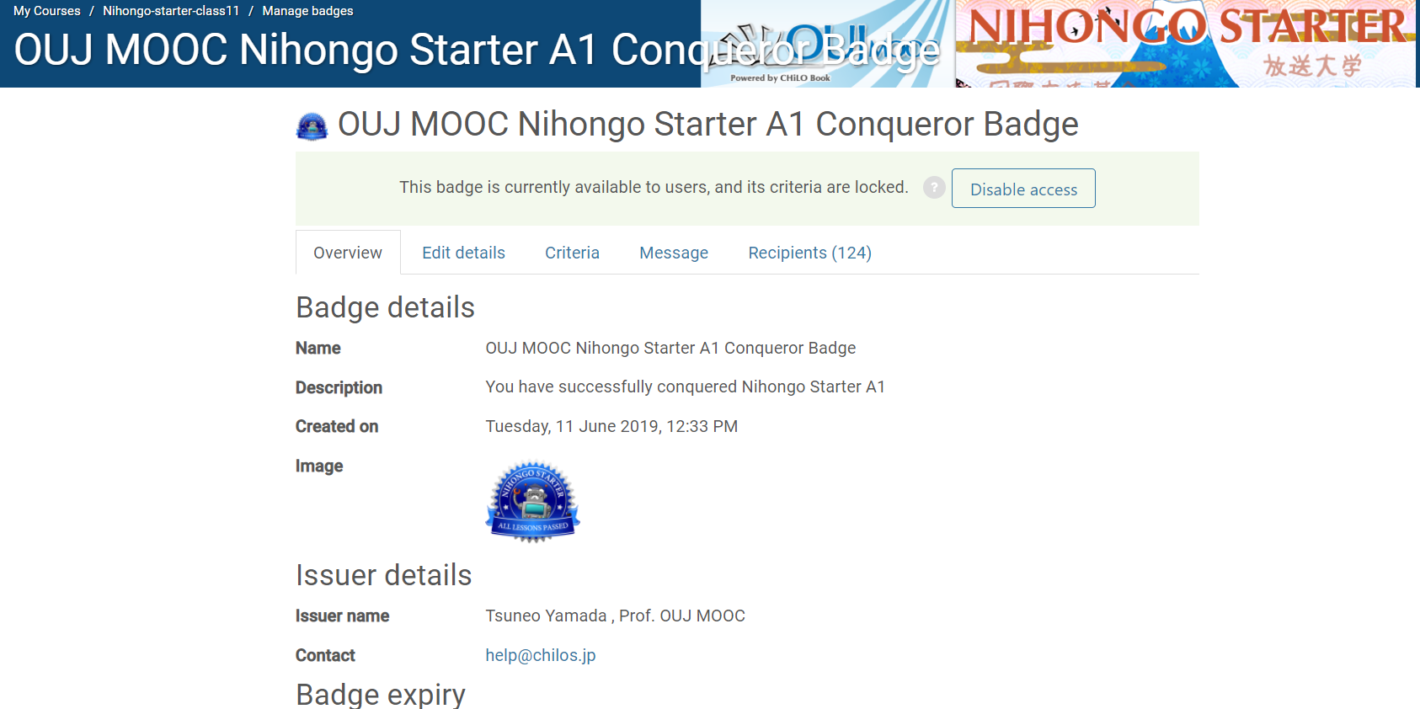
Number of issued badges: “Nihongo Starter” (Japanese Primer)
CLASS 11
Initially Registered 2800+
1 472
2 268
3 191
4 173
5 161
6 152
7 143
8 136
9 127
10 125
Finally
Certified 124
From April 2014, 10 Lessons
CLASS 11 at Asia Learning Portal by UPOU)

Slide 21
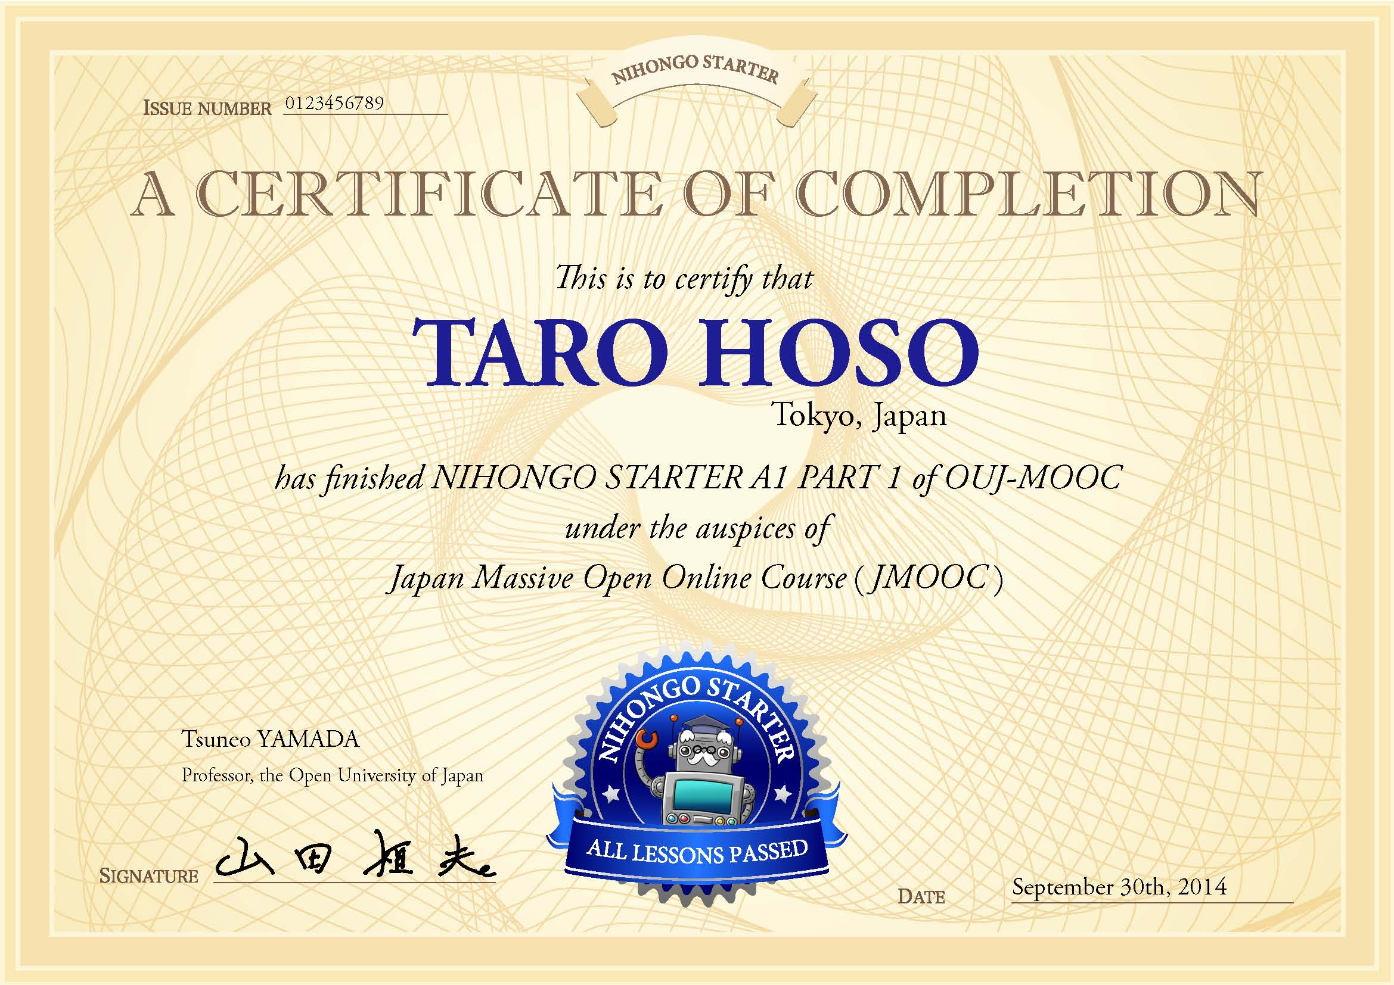
Certificate（Sample）

Slide 22
OBv2 Badge in OUJ informal education
At the pilot stage
For OUJ informal certificate program
Hosted Badge (Server necessary) or Signed Badge (for Blockchain)
Data items (CSV, REST in future)

Slide 23
OUJ LL Informal Programs
Phase 1
Online courses + CBT in Face-to-Face Mode
Achievement Records in LMS are transferred in CSV files
Issue by “Baker” application (semi-automatic)
Recipient can manage using a “wallet”
Phase 2
LMS issues a badge automatically using the basic functions of LMS

Slide 24
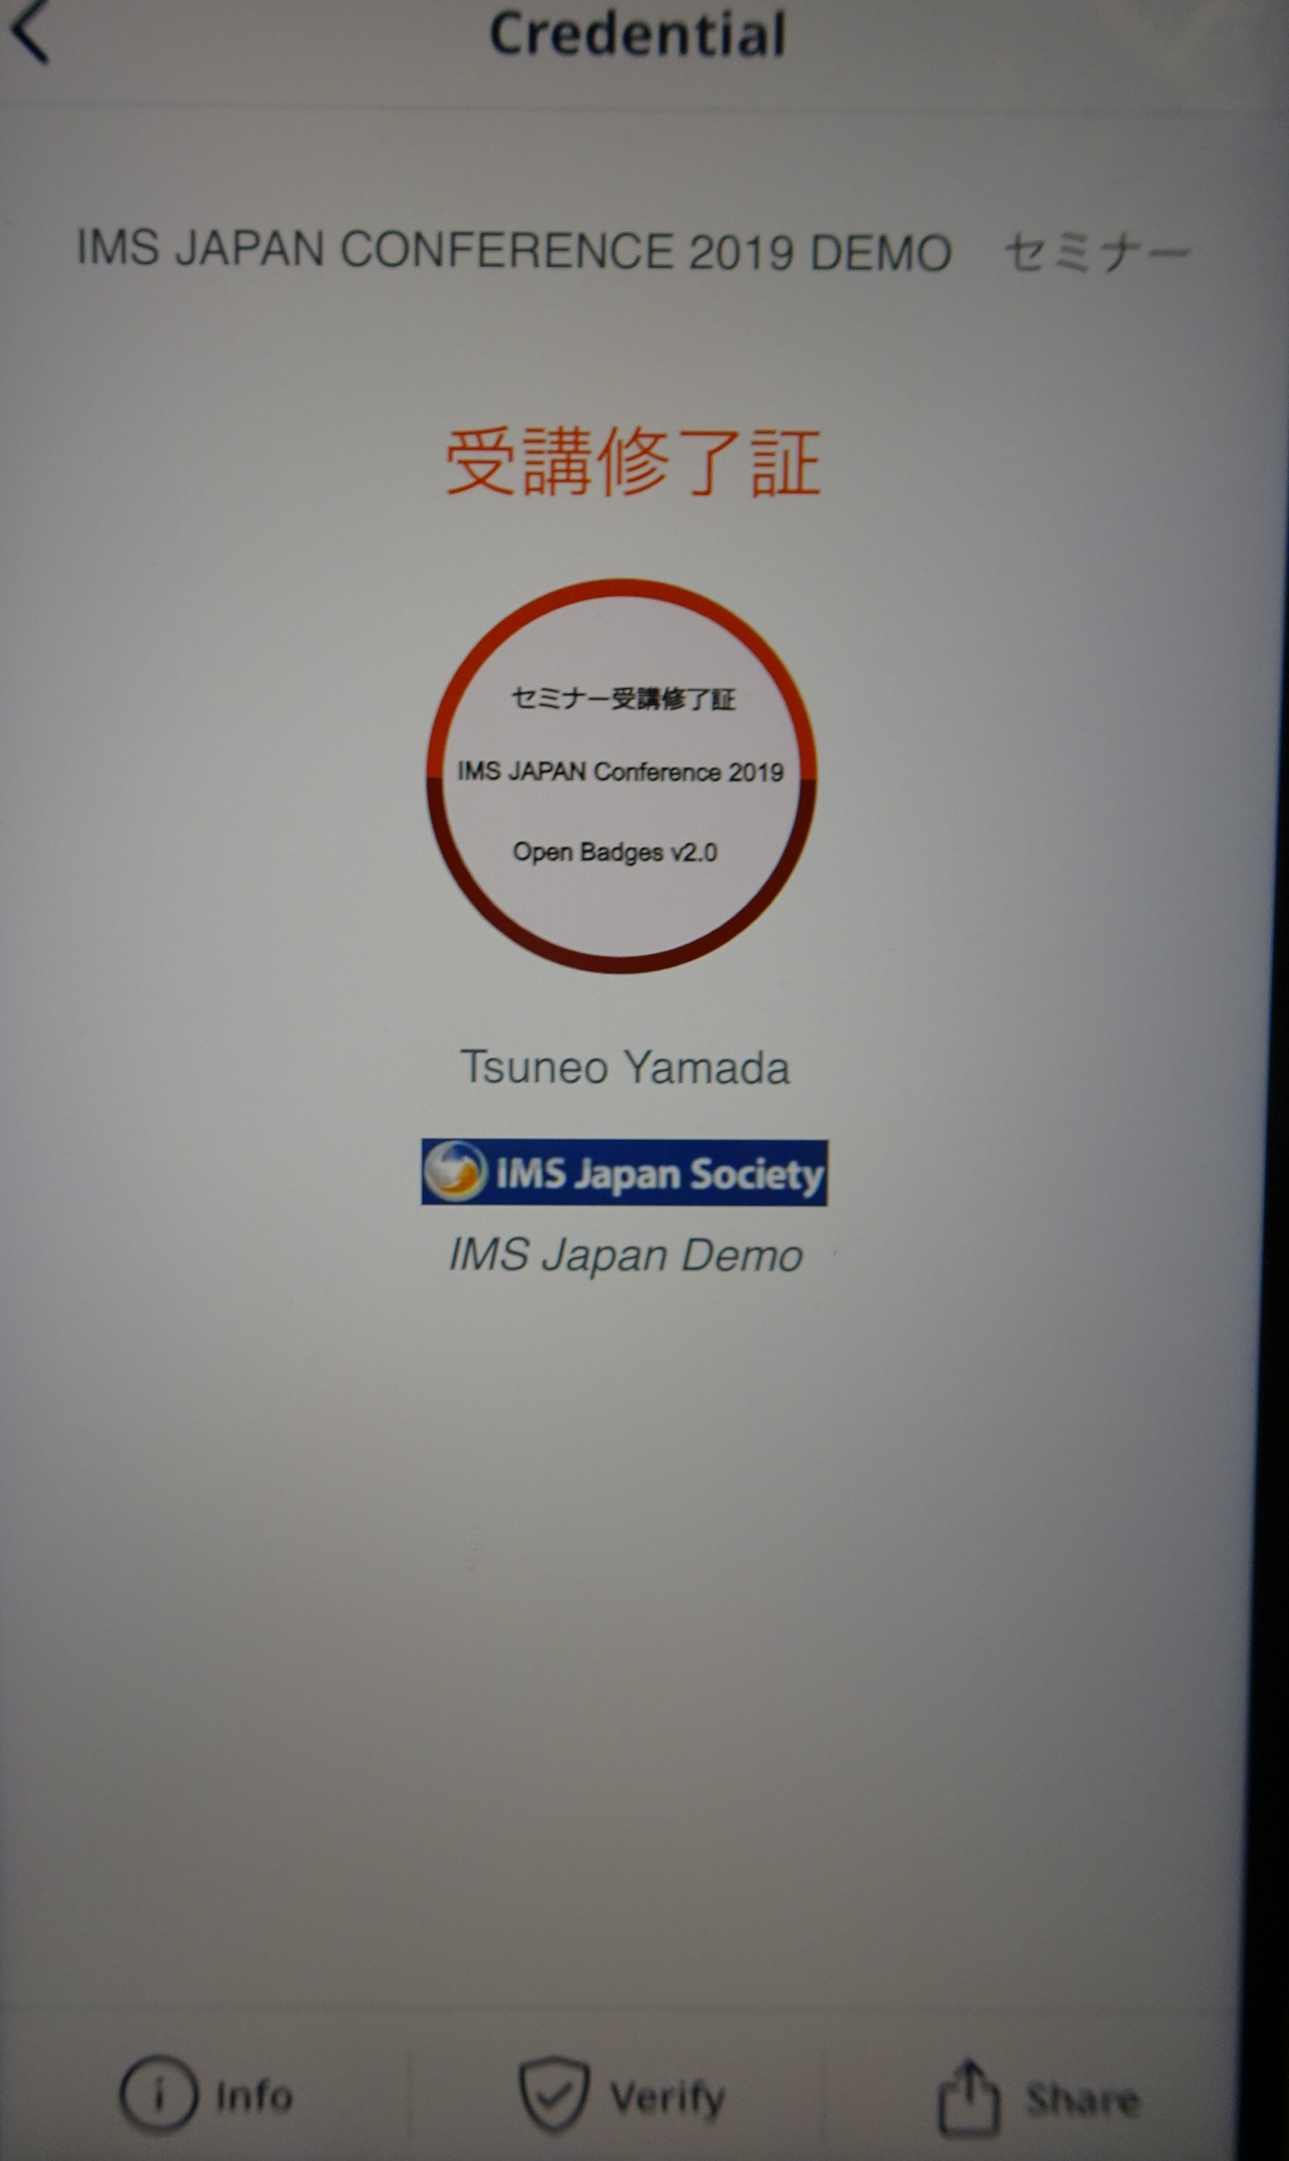
Digital Badge Wallet

Slide 25
IMS Japan Society Digital badge-related standards localization WG
Established in 4 April 2019
The second WG at IMS Japan
3 universities and 8 corporates
Localization and experimental environments for digital badge/credential ecosystem

Slide 26
Digital badge/credential： Service classification by IMS
DB sharing/distribution community
Comsumer
Issuer
Accreditation Inst,
Educational Institutions
Course Providers
AO Exam
Corporate Recruit
Formal Ed
Informal Ed
Host
Issuer
Information Bank
Host
Displayer
Non formal Ed
LMS
DB Manager for Corporate
Recipient
Issuer
Host
Lifelong Learners
Learner Supports
Displayer
K-12
HE
Corporate Training
DB Baker/Maneger
Displayer
DB Wallet

Slide 27
Digital badge/credential： Service classification by IMS
DB sharing/distribution community
内田洋行
TIES
インフォザイン
Comsumer
Issuer
Accreditation Inst,
Educational Institutions
Course Providers
AO Exam
Corporate Recruit
Formal Ed
Informal Ed
Host
QUICK
QUICK
履修データセンター
Issuer
放送大学
Information Bank
Host
Displayer
Non formal Ed
LMS
京都情報大学院大学
Recipient
DB Manager for Corporate
デジタル・ナレッジ
Issuer
サイバー大学
Lifelong Learners
Learner Supports
Host
富士通
SONY GE
Corporate Training
Displayer
K-12
HE
ネットラーニング
DB Baker/Maneger
Displayer
DB Wallet

Slide 28
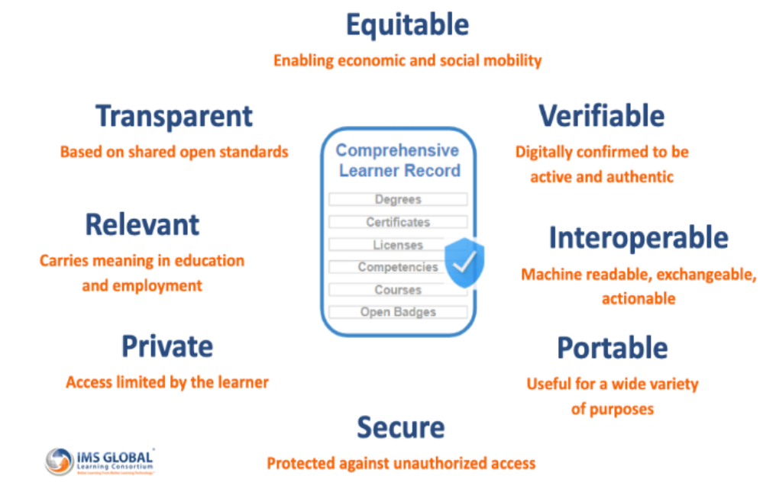
Comprehensive Learner Record

Slide 29
Thank you very much!!
Contact Information
tsyamada@ouj.ac.jp

