Slide 1
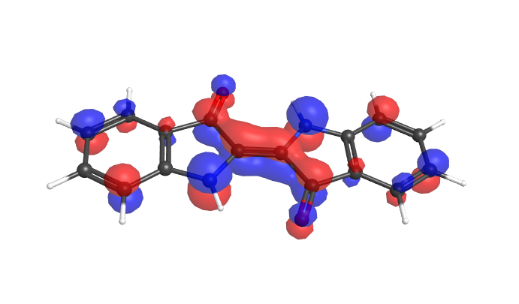
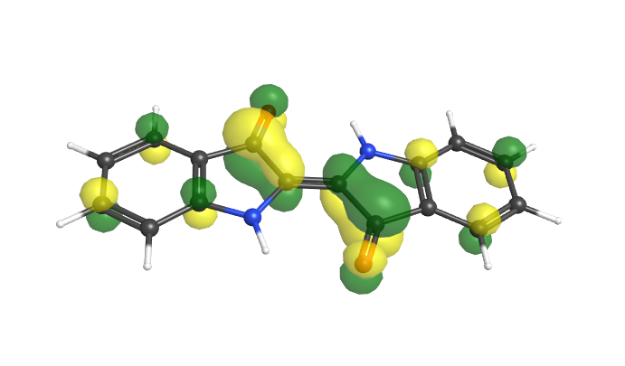
Computational Chemistry as Virtual Laboratory
in Open and Distance Learning
The Open University of Japan
Tomokazu YASUIKE
Oct 14, 2019 AAOU2019 @ Lahore, Pakistan

Slide 2
Methodology of Modern Natural Sciences
(1) Two Ways of Thinking
Deduction
logically derives individual propositions from universal propositions
The conclusion is always correct, but the conlusion is merely an explicit extraction of what was implied in the premises.
“New knowledge cannot be acquired by only deduction.”
Induction
aims at deriving universal propositions from individual propositions
The derived ‘universal’ propositions are not always right.
Even if induction cannot have the same degrees of cetainty as deduction, natural science cannot rely solely on deduction as long as it is an empirical science.

Slide 3
Methodology of Modern Natural Sciences
(2) Hypothetico-deductive method
Modern natural sciences utilize the advantages of both methods simultaneously to compensate for their disadvantages.
Experiments
Analysis of observations
Predictions to be checked
Induction
Deduction
Hypotheses
Theory
Hypotheses are validated and organized as theory “by experiments”.
Experiment is indispensable, and laboratory works have been incorporated into educational curriculums in variety of fields of science.

Slide 4
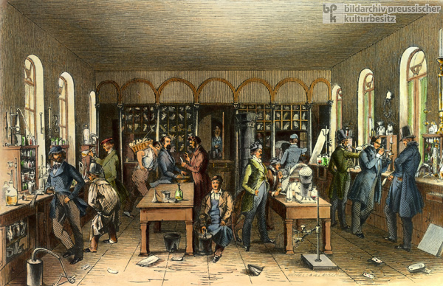
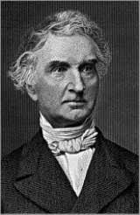
Introduction of Laboratory Works in Chemical Education
One of the earliest examples
Liebig’s chemical laboratory at University of Giessen (1824~)
J. von Liebig
His laboratory has been going to produce 20 graduates every year. At that time, it was criticized as “To train good successors, disciples should be limited to one or two in his lifetime, and his method of education is to make only second-class chemical engineers.”

Slide 5
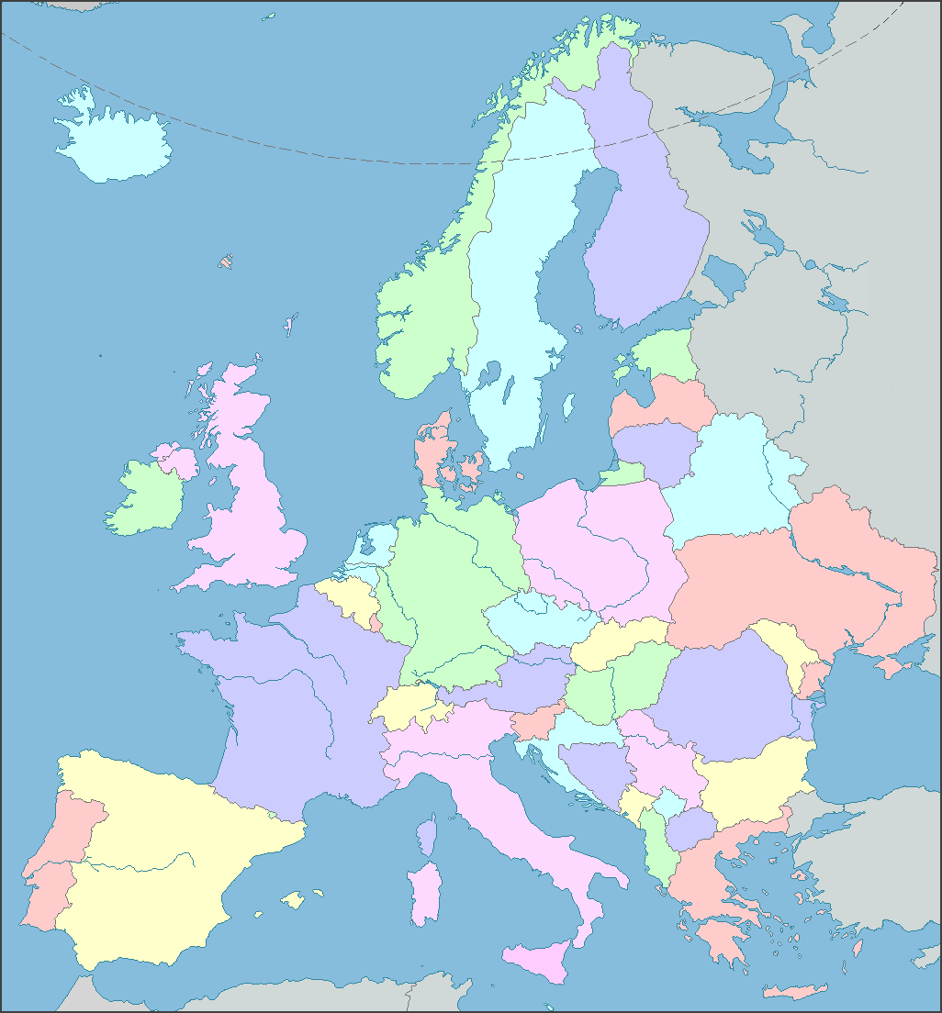
Liebig’s Big Success
Over 700 students → 60 professors
Nobel Prize in Chemistry
1901 J. H. van’t Hoff
1902 H. E. Fischer
1903 S. A. Arrhenius
1904 W. Ramsay
1905 J. F. W. A. von Baeyer
Zinin
(St. Petersburg)
Williamson
(London)
Hoffman
(Berlin)
Kekule
(Bonn)
Wurtz
(Paris)
Redtenbacher
(Wien)
Merz
(Zürich)
His system of education in laboratory has spread via his students.
Since Liebig’s success, laboratory works have been incorporated into educational curriculums, but they are not suitable for distance education.

Slide 6
Experimental Activities in Traditional Courses of OUJ
(1) Broadcast lectures on TV, radio, and the Internet
Demonstration experiments are offered in many lectures.
Super-cooled state and a real-time freezing of sodium acetate
Limitation: Heat of solidification is invisible!

Slide 7
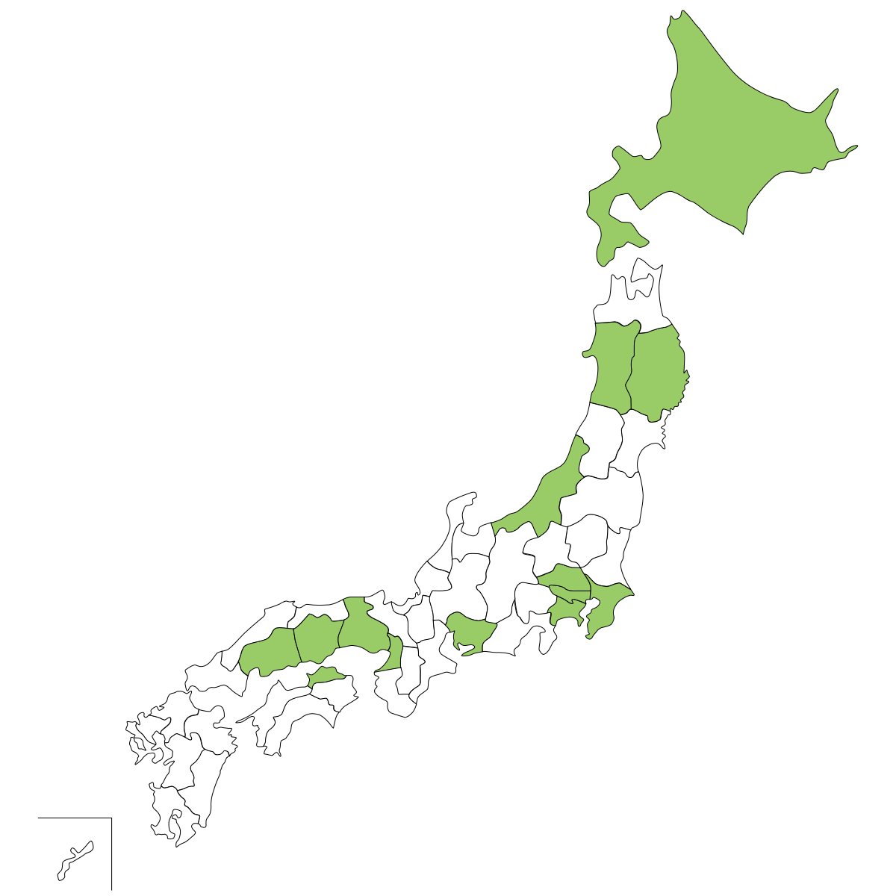
Experimental Activities in Traditional Courses of OUJ
(2) Schooling
More direct type of teaching system to offer laboratory works
3000 schoolings per year at nationwide 50 study centers (SCs)
Situation is not ideal:
50~60 courses per year offer experimental activities
Only 8 school hours per each course
Not systematic training, “two-day experience”
Only 16 SCs have laboratories
(not uniformly distibuted)
Our facility is not enough to offer systematic experimental trainings.
But, the increase of facilities is not realistic.

Slide 8
Skills Considered to be Acquired in Experimental Courses
“Online courses as complement to laboratory works”
Possible purposes for laboratory works in education (Carnduff and Reid 2003)
Illustrating key concepts
Seeing things for ‘real’
Introducing equipment
Training in specific practical skills and safety
Teaching experimental design
Developing observational skills
Developing deduction and interpretation skills
Developing teamworking skills
Showing how theory arises from experimentation
Reporting, presenting, data analysis and discussion
Developing time management skills
Enhancing motivation and building confidence
Developing problem solving skills

Slide 9
Skills Considered to be Acquired in Experimental Courses
“Online courses as complement to laboratory works”
Possible purposes for laboratory works in education (Carnduff and Reid 2003)
Illustrating key concepts
Seeing things for ‘real’
Introducing equipment
Training in specific practical skills and safety
Teaching experimental design
Developing observational skills
Developing deduction and interpretation skills
Developing teamworking skills
Showing how theory arises from experimentation
Reporting, presenting, data analysis and discussion
Developing time management skills
Enhancing motivation and building confidence
Developing problem solving skills
The highlighted items are related to the hypothetico-deductive skill.

Slide 10
Online Courses for Training Hypothetico-Deductive Skills
Many skills to be acquired in laboratory works are
– not necessarily related to real chemical substances and equipment
– related to the hypothetico-deductive method for conducting researches
To develop the hypothetico-deductive skills of students, the interactivity of online courses would be highly effective.
The first step of the hypothetico-deductive method is “observation”.
We should offer some objects to be observed for students.
“Molecules in Computer”
We can almost completely generate molecules in computer by solving the Schrödinger equation without any phenomenological assumptions.
Computational Chemistry as Virtual Laboratory

Slide 11
Difficulty of Computational Chemistry and WebMO system
Application of computational chemistry has not been so easy…
Input
Output
#N HF/6-31G(d) SP
CH4O
0 1
C 0.00000000 0.00000000 0.00000000
O 0.00000000 -1.42897800 0.00000000
H 0.88345500 -1.82239000 0.00000000
H 0.51390100 0.36335000 0.88999600
H 0.51390100 0.36335000 -0.88999600
H -1.02756200 0.36335100 0.00000000
SCF Done: E(RHF) = -115.035417970 A.U. after 11 cycles
NFock= 11 Conv=0.40D-08 -V/T= 2.0015
**********************************************************************
Population analysis using the SCF density.
**********************************************************************
Orbital symmetries:
Occupied (A') (A') (A') (A') (A') (A") (A') (A') (A")
Virtual (A') (A') (A') (A") (A') (A') (A") (A') (A') (A")
(A') (A') (A') (A") (A') (A') (A') (A") (A') (A")
(A') (A') (A") (A') (A") (A') (A') (A') (A')
The electronic state is 1-A'.
Molecular Orbital Coefficients:
1 2 3 4 5
O O O O O
Eigenvalues -- -20.55531 -11.26674 -1.36018 -0.92679 -0.69352
1 1 C 1S -0.00002 0.99574 -0.07092 -0.17664 -0.02379
2 2S 0.00029 0.02762 0.12959 0.34281 0.04089
3 2PX -0.00002 0.00005 0.00430 -0.01725 0.19504
4 2PY -0.00036 -0.00078 -0.09810 0.06607 0.20650
5 2PZ 0.00000 0.00000 0.00000 0.00000 0.00000
6 3S 0.00003 -0.01207 0.05005 0.32322 0.09211
7 3PX 0.00026 0.00006 0.00513 0.00418 0.09111
8 3PY 0.00019 -0.00053 -0.00096 0.03841 0.06222
9 3PZ 0.00000 0.00000 0.00000 0.00000 0.00000

Slide 12
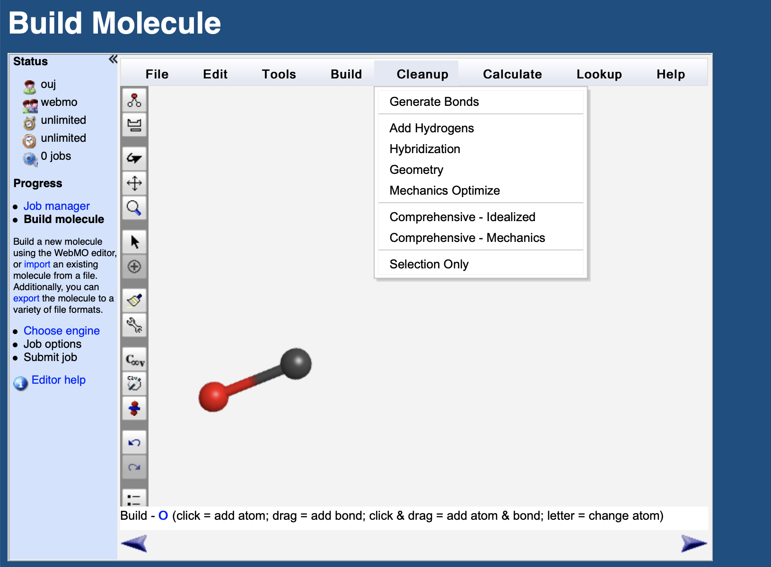
Difficulty of Computational Chemistry and WebMO system
We employed the GUI-based tool called “WebMO” by Schmit and Pollick.
Students can easily build molecules by combining GUI tools of atom addition, bond addition, rotation and zoom. Th GUI is also helpful to visualize results.
The functions of user and job managements are served. Moreover, it is free from the problem about the computer environments of students because the system is implemented by the Web technology.

Slide 13
Outline of Our Online Course
“Computational Approaches to Materials and Environmental Sciences”
– for graduate students
– consists of 15 lectures
– video lectures for scientific contents and quizzes
– movie instructions for the operations of the WebMO system

Slide 14
Details of the Course
After the introduction of the first 3 lectures, chemical concepts are presented with the corresponding computational methods. The chemical ideas to have been learned in undergraduate courses are confirmed by the actual calculations by students.
Computational simulations in sciences
Electronic structure of molecules
Usage of WebMO, visualization of molecular properties
Electron correlation
Stable structures of molecules
Electronic excited states: color of molecules
Chemical reactions: topography of potential energy surfaces
Stereo selectivity in Diels-Alder reactions

Slide 15
Evaluation and Future Perspectives
Pros
The evaluation results of the course by professionals were good.
Some students enjoyed computational chemistry by performing their own calculations based on their interests.
Cons
The ratio of students who achieve the passing grade is not high.
Many graduate students hardly had knowledge of ‘undergraduate’ quantum chemistry.
Future Improvement
They seemed to hesitate to tackle things they do not understand. We should emphasize the spirit of “practice makes perfect” for a chance of revision.
We might need to make the course on computational chemistry for undergraduates.

Slide 16
Summary
1) The laboratory works are indispensable in chemistry education, but they are difficult to be offered in the open and distance teaching system.
2) The skills to be acquired in such activities are classified by its degree of real experience and interactivity. Classified skills should be offered separately by demonstration experiments in broadcast lectures, student experiments in schooling lectures, and virtual laboratory in online lectures.
3) The online lectures are considered to be suitable for training the hypothetico-deductive ways of thinking.
4) The virtual laboratory approach for open and distance education of chemistry would be applicable and effective in the other fields of natural sciences.
Thank you for your attention

