Slide 1
Challenges in Teaching Probability Distributions through Open Distance Learning: Experiences and Insights
by
Saleha Naghmi Habibullah
Professor of Statistics,
Kinnaird College For Women,
Lahore, Pakistan
saleha.habibullah@kinnaird.edu.pk,
salehahabibullah@gmail.com

Slide 2
Abstract
Open Distance Learning is a relatively new phenomenon in developing countries such as Pakistan and, even though the world has entered the new millennium, in these countries, many teachers and students are still unfamiliar with the ODL methodology.

Slide 3
There exist relatively few open universities in the third world and, as such, production of course-modules through the ODL methodology can be regarded as a significant contribution on the part of the few professors and lecturers who make this effort despite a variety of challenges.

Slide 4
This paper presents an account of a course on probability distributions developed and rendered by the author for a leading university of Pakistan during 2018-19.

Slide 5
Probability being a tedious mathematical topic, the paper highlights the challenges that were encountered with reference to a number of phenomena:
elongation of time-durations of modules due to lengthy derivations involved in some of the topics,
difficulty-level of some of the complex core concepts of probability, an extra-ordinarily large number of preparatory sessions for the more intricate topics,
total time required for course-completion, alteration in the sequence of recordings, and
preparation of time-added slides-sets subsequent to recording for purposes of post-production.

Slide 6
Experiences gained provide important insights for the optimization of similar projects to be undertaken by open universities in this part of the world.

Slide 7
Introduction
Open Distance Learning is not a very old system of education as compared with the conventional on-campus education system. It began in the 19th century and was practiced mostly in the developed countries.
In short, Distance Education is referred to as the system of education where students are able to learn independently without the need of classrooms.

Slide 8
Students who are unable to go to school due to insufficient financial condition of the parents can have education by earning by themselves.
In the same way, as teachers are separated from students, they do not get a personal touch of the students.

Slide 9
In the wake of ODL, due to less attention to this system, not many theories developed regarding distance education, which diminished the visibility of its identity.

Slide 10
However, a set of reliable distance learning theories have begun to emerge only recently classifying the theories as
(i) independence and autonomy,
(ii) industrialization of teaching and
iii) interaction and communication.

Slide 11
A wide variety of media are used to deliver numerous educational programmes to students.
According to Simonson et al (2000), ‘‘the term distance education have been applied to a tremendous variety of programmes serving numerous audiences via a wide variety of media’’.

Slide 12
So, ODL systems have proven themselves a way for people to gain education, which otherwise would not be possible.

Slide 13
However, when comparing with conventional forms of education, the provision of distance education requires considerably greater planning, larger upfront infrastructure costs and more complex student and administrative support systems.

Slide 14
In many developing countries around the globe as well as in Pakistan, unfortunately, many teachers and students are still unaware of the ODL methodology, even though the world has entered the new millennium.

Slide 15
With the existence of relatively few open universities in the third world, the production of course-modules and the curriculum development through the ODL methodology can be regarded as a significant contribution on the part of the few professors and lecturers who are making such an effort despite a variety of impediments.

Slide 16
This paper presents an account of challenges faced by the author during the development of a course on probability distributions during 2018-19 for a leading university of Pakistan.

Slide 17
These include elongation of time-durations of modules, difficulty-level of some of the core concepts of probability, an excessively large number of preparatory sessions for the more difficult topics and total time required for course-completion, among others

Slide 18
Experiences of the author outlined in the paper provide important pieces of information and understanding that can be utilized for promoting best practices in the process of course-development for relatively difficult mathematical courses such as those on probability and probability distributions.

Slide 19
Literature Review
In this section, we present an outline of a few articles picked up from the literature pertaining to the ODL methodology.
Henze and Nejdl (2001) proposed an adaptive educational hyper media system which facilitates adaptation of distributed learning materials.

Slide 20
It is based on the key concept for calculating estimations on a consumer’s changing knowledge for various information resources and a Bayesian Network engine.

Slide 21
It helps in the implementation of creative teaching approaches, ascertain conceptual models for designing courses and enables guided tours, intelligent example retrieval and further adaptive navigation support.

Slide 22
Henze and Nejdl (2001) commented that adaptive hypermedia courseware benefits from being distributed over the Web.
Content can always be kept up-to-date, discussions and interactions between instructors and learners can be supported and new courses can easily be distributed to the students.

Slide 23
Nevertheless, in the opinion of the authors, adaptive hypermedia systems are - even in the web context - still stand-alone systems as long as they lack the ability to integrate and adapt information from arbitrary places in the web.

Slide 24
The authors proposed an adaptive educational hypermedia system which facilitated adaptation of distributed learning materials.

Slide 25
The proposed system was based on an indexing concept for various information resources and a Bayesian Network engine for calculating estimations on a user’s changing knowledge.
Advantages and problems in designing adaptive open corpus hypermedia were discussed in a concluding section.

Slide 26
Hung and Zhang (2008) conducted a study with data mining (DM) techniques to analyze various patterns of online learning behaviors, and to make predictions on learning outcomes.

Slide 27
Statistical models and machine learning DM techniques were implemented to analyze nearly 18,000 server logs to investigate 98 undergraduate students’ learning behaviors in an online business course in Taiwan.

Slide 28
Not only did the study scientifically identify students’ behavioral patterns and preferences in the online learning processes, differentiated between active and passive learners, and found important parameters for performance prediction.

Slide 29
The study demonstrated how data mining techniques might be utilized to help improve online teaching and learning with suggestions for online instructors, instructional designers and courseware developers.

Slide 30
Durksen et al. (2016) focus on Self-Determination Theory (SDT) and express the opinion that, although it is one of the most well-known approaches to gain motivation for achievement, research is lacking on one of the basic psychological needs of SDT i.e. relatedness.

Slide 31
They assert that one new educational avenue where relatedness may be of particular importance is Massive Open Online Courses (MOOCs), where there are unparalleled opportunities for either relatedness or isolation.

Slide 32
The authors carried out a research based on a sample of over 1000 participants the purpose of which was to use Bayesian networks (BN) to establish probabilistic relationships between learners’ basic psychological needs with reference to one MOOC.

Slide 33
Participants of the survey completed a revised Basic Student Needs Scale proposed by Betoret and Artiga (2011) and, in order to come up with the best structural understanding of SDT within a MOOC learning environment, analysis of the data involved the development of a BN probabilistic model.

Slide 34
The best fitting BN model included autonomy, competence, and relatedness with a probabilistic accuracy of 77.4%.

Slide 35
It was found that participants with high autonomy had an 80% probability of having a moderate level of competence whereas relatedness emerged as distinct from the autonomy and competence relationship.

Slide 36
As such, the authors concluded that the notion that relatedness may be a distinct need was supported, at least in this context, and that further research-studies would need to be carried out on the subject.

Slide 37
Course on Probability Distributions
In the Fall of the year 2017, the author was contacted by a well-known university of Pakistan that operates according to the ODL methodology for the development of a Course on Probability Distributions for the students of the newly commenced MSc Statistics Program subsequent to a two-year BA/BSc.

Slide 38
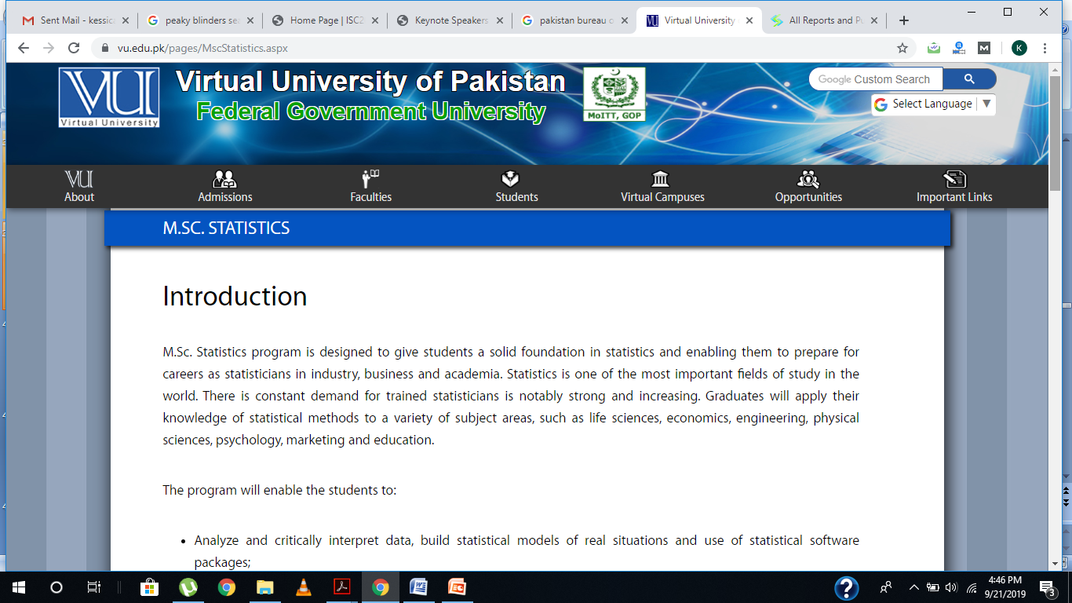

Slide 39
The work commenced in early 2018, the first few weeks focusing on the selection of the book that was to be recommended as the textbook for this Course.

Slide 41
Once this process was completed, the author engaged one of her former MPhil student to work with her as Assistant Course Developer for the accomplishment of this project (the entire payment to the ACD to be made from the author’s own pocket).

Slide 42
The ACD commenced work on this assignment by assisting the author in the preparation of a concise Course Outline which was sent to the relevant academic department of the university for approval.

Slide 44
Once the course outline was approved by the university, the author was required to prepare a very detailed outline of the modules that were to be recorded by her, including, for each module, the learning outcomes, indication of the relevant page numbers of the textbook and the estimated time-duration of the module.

Slide 46
The recording-phase of the project commenced in the summer of 2018, soon after the approval of the detailed outline mentioned above.

Slide 48
The main objective of the author was to present the various concepts of probability, theorems, proofs and derivations in such a clear way that no confusion whatsoever remains in the minds of the students.

Slide 49
The difficulty-level of some of the concepts necessitated allocation of a non-trivial amount of time for the preparation of slide-sets required for the modules on those topics so that the objective of clarity could be achieved satisfactorily.

Slide 51
The process of recording of modules took a number of months, the last few recordings being accomplished in the summer of 2019. A total of 187 modules were recorded by the author in order to cover the course contents properly.

Slide 52
Challenges

Slide 53
Elongation of Time-Durations of Modules
According to the guidelines provided by the University, the time-duration of each module was to be five to seven minutes.

Slide 54
However, due to her style of explaining everything in-depth and with full clarity, the author noticed that she was not being able to complete the modules in the stipulated time-period.

Slide 55
In particular, topics involving mathematical derivations and proofs required much longer time as, for any such topic, it was not possible to stop in the middle of a derivation.

Slide 56
Difficulty Level of Some Concepts
Being developed for a Masters program, the course contained a number of advanced-level topics such as characteristic function, bivariate normal distribution, conditional expectation, etc.

Slide 57
Each such topic required careful planning and design in order to enable the students to focus on the meanings of the concepts, mathematical derivations where necessary and real-life applications where applicable.

Slide 58
Extra-Ordinarily Large Number of Preparatory Sessions
Some of the topics such as those mentioned in Sub-Section 4.2 involved complex mathematical concepts that presented an unusual challenge: the need to devote an extra-ordinary amount of time to dig out the in-depth meanings of the concepts and to prepare slides in such a way that everything would be clear to the students.

Slide 59
In particular, the concepts that were to form an integral part of the discussion pertaining to the bivariate normal distribution were so intricate that the author had to put in hours upon hours of her evening time for a substantial number of days in order to accomplish the slides pertaining to this distribution.

Slide 60
Alteration in the Sequence of Recordings
Given the extremely hectic professional schedule related to her position as full-time professor at a well-recognized higher education institution of Pakistan, at a number of occasions, the author was unable to find, prior to a time-slot scheduled for recording, time for finalization of the slides delivered to her by the Assistant Course Developer a few days ago.

Slide 61
This resulted in the need to alter the sequence of recordings as the author would pick up the forthcoming easier topics, deferring the more difficult ones to a later date.

Slide 62
Immediately after each set of recordings, the author would create a record of the actual sequence of the recordings accomplished on that day which was a great help toward the end of the Project when the sequence of the recordings had to be brought back to the original sequence approved by the university.

Slide 63
A Considerably Large Amount of Recording Time
According to the guidelines provided by the university, the author was required to complete 1350 minutes of video-recording of course-modules.

Slide 64
Approximately half-way through the course of the recordings, the author realized that the overall duration of the recordings completed till that time was much greater than what it should have been according to the guidelines keeping in view the amount of course content that was yet to be covered.

Slide 65
This resulted in the author obtaining special permission from the university to pick up the more important topics, merge some of the topics and other such techniques to bring the overall recording time under control.

Slide 66
Despite a considerable amount of “downsizing”, given the fact that the author felt that some of the important topics could simply not be ignored, she ended up with about 1850 minutes of recording.

Slide 67
Preparation of Time-Added Slides-Sets
Being a senior person used to a particular style of teaching, the author was uncomfortable with the idea of using a sympodium for purposes of recording.

Slide 68
As such, in the very beginning, it was decided that a multimedia screen would be placed in front of her immediately under the camera enabling her to alternate between looking directly into the camera and looking at the screen to read the mathematical material (which would not be noticed by the persons watching the module).

Slide 69
The advantage was the freedom that the author had to be as expressive as she wanted to be; the disadvantage was that this method of recording required the process of post-production which meant preparation of another set of slides by the Assistant Course Developer --- the time-added slide-sets that were required for facilitation of the university video-editor responsible for the process of post-production.

Slide 70
Total Time Required For Course-Completion
Although, in general, for any course, the university requirement was that the process of course-development be completed in a span of three to six months, in the author’s case it took more than a year.

Slide 71
The reason is easily understandable keeping in view the author’s commitments and responsibilities as a full-time professor.

Slide 72
Insights Gained
The experiences reported in Section 4 lead to the following remarks:

Slide 73
Lengthy Derivations
Courses such as the one on Probability Distributions are likely to involve a large number of mathematical derivations, some of which involve a number of steps rendering their exposition considerably lengthy.

Slide 74
Keeping in view the fact that it is simply not possible for an instructor to abandon a derivation half-way, flexibility needs to be incorporated in the guidelines pertaining to time-durations of modules. theorems and proofs.

Slide 75
The widely accepted notion that, in the present-day world, the attention span of a student cannot be longer than five to seven minutes needs to be put aside in the case of exposition of rigorous mathematical

Slide 76
Total Recording Time
Keeping in view
the difficulty-level and
(ii) the length of the derivations and proofs of theorems that are an integral part of mathematical courses such as the one on probability distributions, flexibility needs to be incorporated in the guidelines pertaining to the overall time-duration of modules pertaining to such courses.

Slide 77
If the rigor of the mathematical content demands a detailed rendering of each and every step, it is highly probable that the overall recording time will be considerably more than that which might be appropriate for non-mathematical courses.

Slide 78
Senior Academics
Intricate mathematical topics such as probability distributions require in-depth knowledge of the subject which requires either an extra-ordinary intellect or, more often than not, many years of experience in teaching these concepts.

Slide 79
As such, in general, the more senior a Course Instructor is, the better for the students who are being taught through the ODL methodology.

Slide 80
However, the more senior a faculty-member is, the greater the probability of he or she being excessively busy due to an over-tight schedule and being uncomfortable with equipment such as sympodium, graphic tablet, etc.

Slide 81
Keeping in view the benefits to be reaped by engaging senior academics having proven track records of excellence in teaching, universities operating through the ODL system should allow
a period of eight to ten months for the recording of the course modules and
(ii) provision of an Assistant Course Developer (to be paid by the university) in the case of such persons.

Slide 82
Concluding Remarks
In this paper, we have presented an account of a course on probability distributions developed and rendered by the author for a leading university of Pakistan during 2018-19.

Slide 83
Probability being a relatively difficult mathematical topic, the paper highlights the challenges that were encountered with reference to a number of phenomena including elongation of time-durations of modules due to lengthy derivations involved in some of the topics, difficulty-level of some of the complex core concepts of probability,

Slide 84
an extra-ordinarily large number of preparatory sessions for the more intricate topics, the need to bring alterations in the sequence of recordings, preparation of time-added slides-sets subsequent to recording for purposes of post-production and total time required for course-completion

Slide 85
Lessons learnt and experiences gained provide valuable insights for the uplift and enhancement of the process of course-development by open universities, some of which have been presented in the second-last section of this paper.

Slide 86
References
Betoret, D. and Artiga, G. ( 2011). “The relationship among student basic need satisfaction, approaches to learning, reporting of avoidance strategies and achievement”, Electronic Journal of Research in Educational Psychology, 9(2), 463–496.
Durksen, T. L., Chu, M., Ahmad, Z. F., Radil, A. I. and Daniels, L. M. (2016). “Motivation in a MOOC: a probabilistic analysis of online learners’ basic psychological needs”, Social Psychology of Education: An International Journal, 19(2), 241-260.
Henze, N. and Nejdl, W. (2001). “Adaptation in Open Corpus Hypermedia”, International Journal of Artificial Intelligence in Education, 12(4), 325-350.
Hung, J. and Zhang, K. (2008). “Revealing Online Learning Behaviors and Activity Patterns and Making Predictions with Data Mining Techniques in Online Teaching”, Boise State University ScholarWorks Educational Technology Faculty Publications and Presentations, Department of Educational Technology collections.
Simonson, M., Smaldino, S., Albright, M. and Zvacek, S. (2000), Teaching and Learning at a Distance: Foundations of Distance Education, 4th edition, ISBN-13: 978-0-13-513776-5, ISBN-10: 0-13-513776-4.

