Slide 1

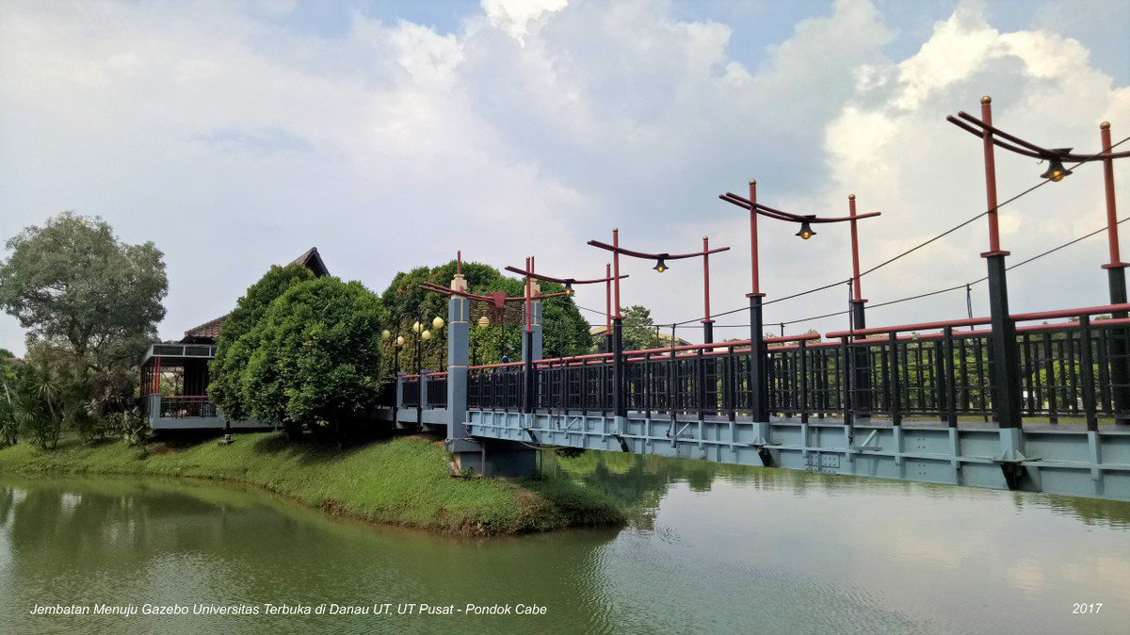

Open university beyond 2020
Challenges For Policy Makers And Providers
Tian Belawati
The 33rd Annual Conference of the Asian Association of Open Universities
Lahore, 14-16 October 2019

Slide 2

GENERATIONS OF ODL

Slide 3


GENERATION OF ODL
Conventional DL
Modern (online) DL
Correspondence Model
Multi Media &
Tele Learning Model
The Flexible Learning & Intelligent Flexible Learning Model
Networked/
Connectivitism Model
Mid 19th century:
U of London’s external studies
The birth of
open universities
The birth of
E-learning, online learning, mobile learning, ubiquitous learning,cyber learning, virtual learning, distributed learning, dll.
The birth of MOOCs (Massive Open Onlince Courses)
Based on Taylor, 1999
Based on Taylor, 2001

Slide 4

DEVELOPMENT OF ONLINE LEARNING
1980’s
Internet @ universities
1990’s
Modems
Graphics interface & colors
2000’2
WiFi
Multi-media PCs
Social Media
Creative Commons
OERs
2010’2
Smart-phones & Tablets
PC’s & Modems
E-mail
First LMS
First online course
Web-based LMS
Online journals
The web
Web-based ViCon
MOOCs & Micro Learning
Digital Credentials
Learning Analytics
Mainstreaming online education
2020 & Beyond
OL Pioneers
OL Early Adopters
OL Followers
OL going Mainstream
Morten F. Paulsen, 2019

Slide 5

TECHNOLOGY TRENDS IN EARLY 2020’S

Slide 6
Virtual & Augmented Reality
Artificial Intelligence
Broadband for Everyone
Wireless Power
3D Printing
Hologram
Google Glass
Internet of Things
Blockchain
Crowd-sourcing

Slide 7
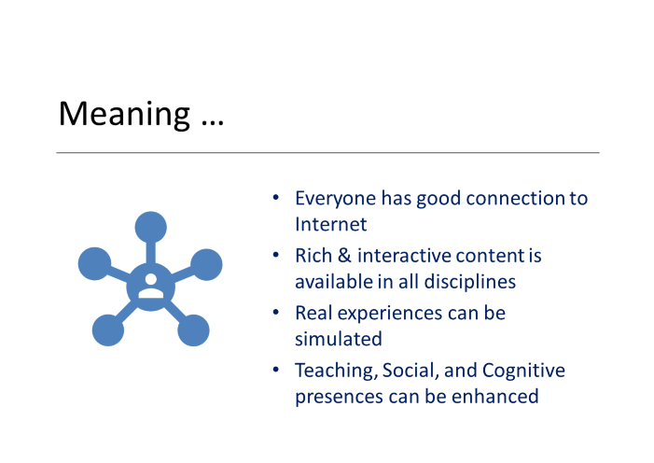

Slide 8

LEARNING TRENDS

Slide 9
Leading to …
Personalized & Freedom of Pace
Open Curriculum & Pedagogy
Real Experience
Online & Streaming
Personalized learning
Unbundling education
Mobile learning
Online synchronous
New concept of openness

Slide 10
Personalised learning, unbundling and lifelong learning will lead to a totally different university: less ‘physical’, more network-based, and belonging to a larger (regional) knowledge infrastructure.
The importance of full curricula and degree certificates will decrease, step-by-step certification in combination with continuing education will increase in importance.
Bert van der Zwaan – Utrecht University, 2019
The Landscape of Higher Education
https://enqa.eu/wp-content/uploads/2019/04/The-landscape-of-higher-education-in-2020-and-beyond-two-levels-of-change.pdf

Slide 11
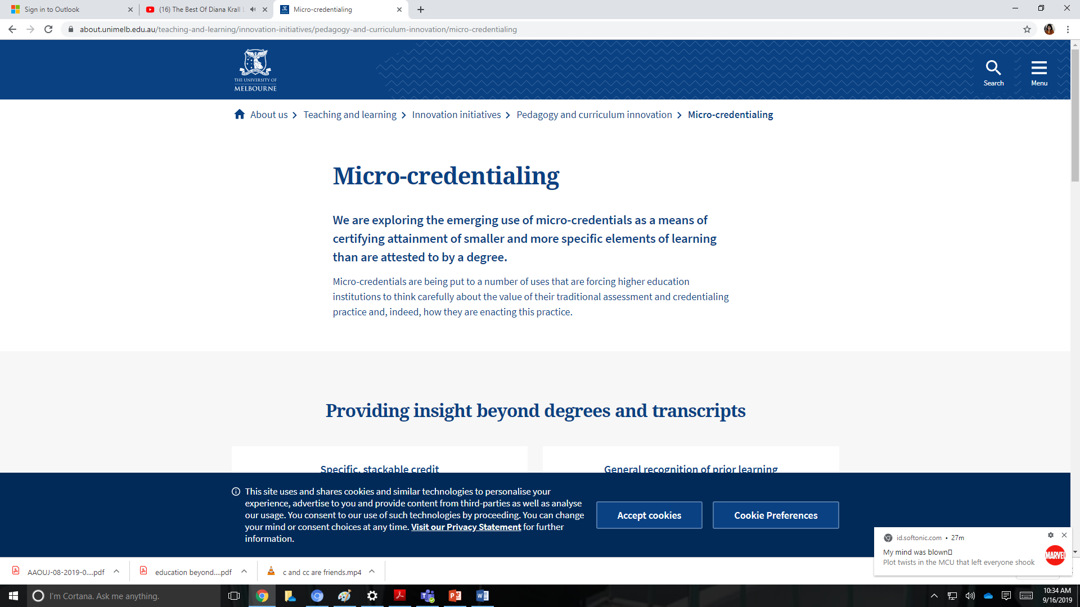
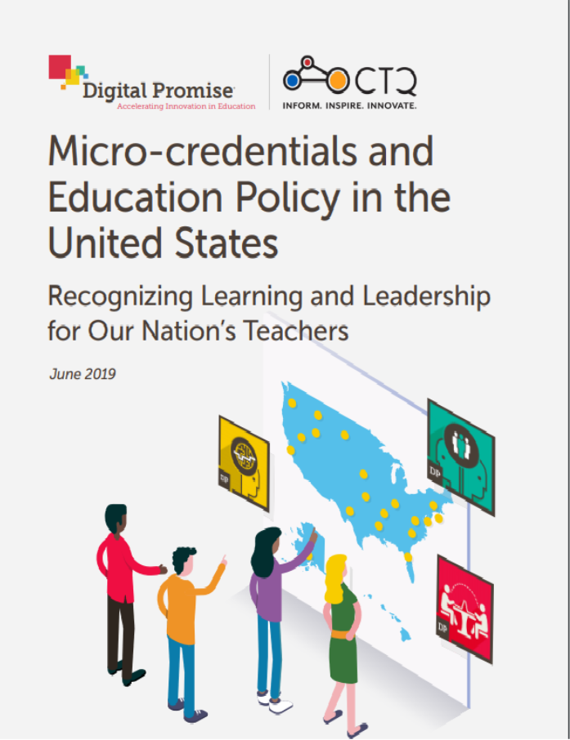

Slide 12

MOOCs Micro Credentials – Stackable Courses
(Class Central, 2019)
Microcredentials on the Market Today
Platform | Microcredentials | Average $ | Average Duration (Months)
Coursera | Specialization, | 245.51 | 5
 | MasterTrack Certificate | 2,596.67 | 5
 | Professional Certificate | 3,121.99 | 6
edX | XSeries | 267.62 | 5
 | MicroMasters | 962.98 | 9
 | Professional Certificate | 542.51 | 5
Udacity | Nanodegree | 887.03 | 4
FutureLearn | Program | 540.33 | 4
 | Graduate Diploma, Graduate Certificate | 8,626.98 | 7
Kadenze | Program | 700.00 | 3

Slide 13

Even spiderman goes mobile …
Hang on, just typing up my assignment
https://www.studyinternational.com/news/future-online-learning-look-like-report/ (Pic Source: Giphy)

Slide 14
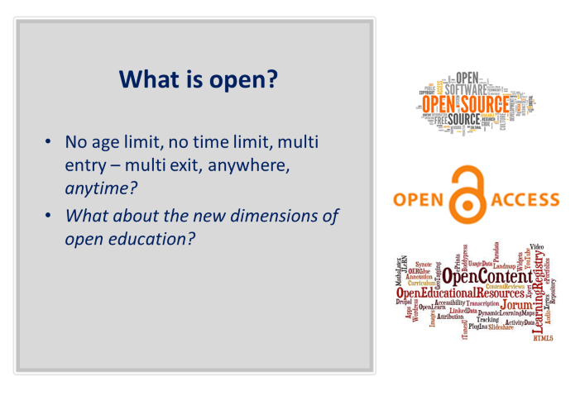

Slide 15
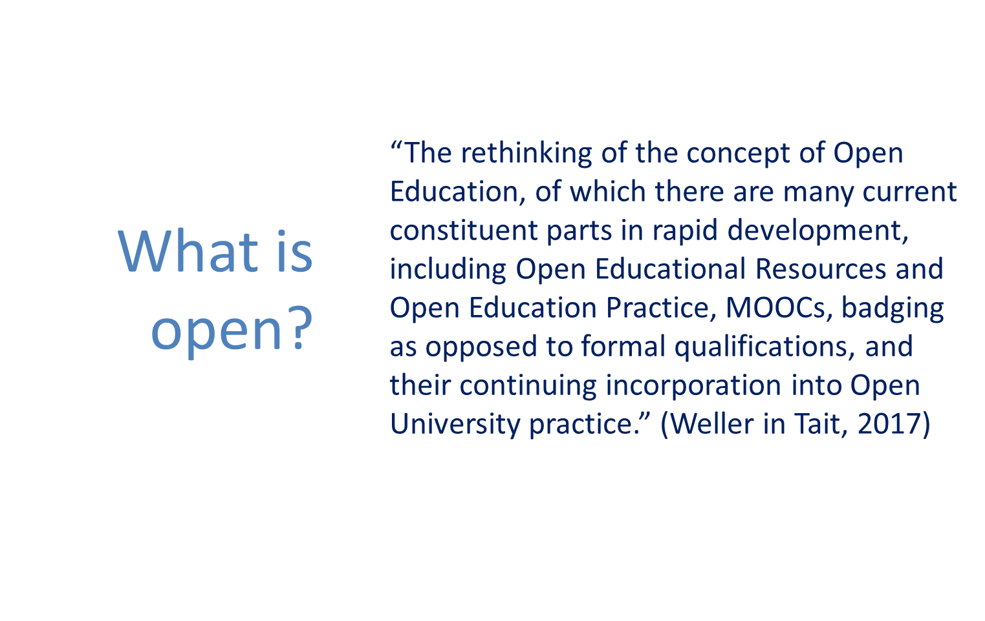

Slide 16

Can we turn ourselves upside down …?

Slide 17

Most OUs are still characterized with …
Massive Offering
Budget depends on students’ fees and books selling
Traditional degree programs
Highly structured curriculum
Standardized learning system
Standardized academic calendar for everyone
Multi media learning packages
Highly structured pedagogy
Asynchronous learning system

Slide 18
Paul (2016 in Tait, 2017) noticed:
difficulties in “brand differentiation” for Open Universities today, faced with digital innovation in a wide range of other higher education institutions.
capacity for resistance to change in Open Universities, in particular as regards the realization of the digital revolution for learning and teaching

Slide 19
Contact North
A recent report in Innovation in Online Learning (27 case studies) shows only 4 are from Open Universities, suggesting that innovation in this field is seen as lying primarily outside OUs
innovation … are marginal to the core character of Open Universities
https://teachonline.ca/ pockets-innovation/international
& https://teachonline.ca/sites/default/files/pdfs/26_breakthrough_innovations_at_the_worlds_ open_universities.pdf

Slide 20
Tait (2017) mentioned two important questions:
Are open universities experiencing what Professor David Vincent called “founding father syndrome”?
  … a set of attitudes … trapped emotionally and intellectually in the early institutional model and are unable or unwilling to consider the need for its revision, and to imagine new avenues for development personal communication.
Do Open Universities risk becoming the equivalent of the mainframe computer companies that did not notice or prepare for the arrival of personal computers, and who disappeared?

Slide 21

CHALLENGES

Slide 22
HOW DO WE GO ABOUT …
Quality & Accreditation ?
Privacy and Ethics?
Cost structure & Business Model?
What is quality?
  Students’ GPA? Completion rates? Learning packages?
Do we still need accreditation? Who would have the authority?
How do we protect student’s privacy in the context of big data and learning analytics
Which ethical norms are we referring to?
How do we do our business models?
Where do we get income from?

Slide 23
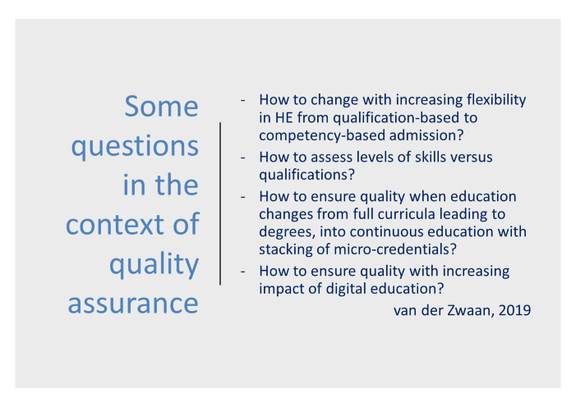
QUALITY ISSUES

Slide 24
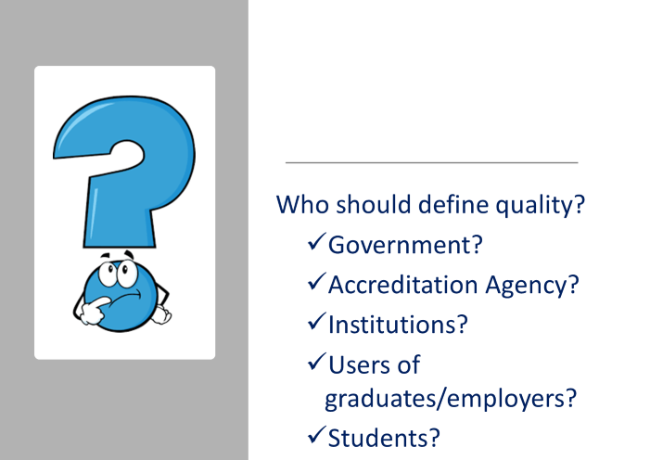

Slide 25
PRIVACY AND ETHICS
Bates (2016)
New technology, such as data trawling and the ability to combine data from completely different sources, as well as automated analysis, completely changes the game, raising the following questions:
  who determines what data is collected and used within a learning management system?
  who ensures the security of student (or instructor) data?
  who controls access to student data?
  who controls how the data is used?
  who owns the data?

Slide 26
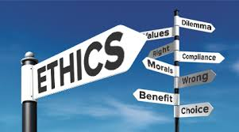
ICDE proposed core issues in relation to Learning Analytics
        Data ownership and control
        Transparency
        Accessibility of data
        Validity and reliability of data
        Institutional responsibility and obligation to act
        Communications
        Cultural values
        Inclusion
        Consent
        Student agency and responsibility
Notes:
Data ownership and control: who owns the data, for what, for how long, is there national/international legislation on privacy to comply to, how can students access and or alter data, etc.
Transparency: how and what student data is collected, analysed and used, for whose benefit, etc
Accessibility of data: relate to both the determination of who has access to raw and analysed data, and to the ability of students to access and correct their own data
Validity and reliability of data: data collected and analysed is both accurate and representative of the issue being measured as well as up-to-date; proxy measures should be used with caution, ensure that data sets are complete and sufficient to enable robust calculations to be made, models used to analyse, interpret and communicate learning analytics to stakeholders (support staff, advisers, faculties, students) should be sound, free from algorithmic bias, etc.
Institutional responsibility and obligation to act: A key principle is to consider whether access to knowing and understanding more about how our students learn brings with it a moral obligation to act
Communications: how to communicate the result of analysis to students (“We are just checking how you are doing… or whether you have registered for your exam…; rather than : ‘we think that you have a 15% probability of not registering for your exam”
Cultural values: understanding and interpreting data are necessarily more complex. A measure of participation or engagement may differ in different contexts. It is clear also that measures established as being correlated with successful or unsuccessful outcomes are likely to differ in different geographies and cultures.
Inclusion: there is a danger that certain categories of students will be identified negatively as particularly at risk …there are ethical issues relating to inclusion and exclusion if such interactions relate predominantly to the institution’s desire to protect its success rates
Consent: consent is to be sought at this stage, it should be coupled with transparency (of purpose, of data collected, etc.) and potentially with a later option to withdraw consent
Student agency and responsibility: Where feasible, it is recommended that institutions seek to engage students in applications of learning analytics. students can be more actively involved in helping the institution to design and shape interventions that will support them. By engaging students with the development and implementation of learning analytics, we are better able to: ensure that students understand their responsibility for keeping personal information up to date (and can give informed/meaningful consent), achieve a more accurate interpretation of data relating to student behaviours, improve understanding of what forms of intervention and support are most appropriate, understand how to tailor a student’s learning journey to meet their needs, potentially as a
personalised learning path, Produce outcomes that students will find useful and be able to respond positively to, which might include a decision to continue or discontinue with their studies.

Slide 27
‘NEW’ BUSINESS MODEL

Slide 28

CONCLUDING REMARKS
Challenges for OU leaders
Understanding new definition of ‘openness’
Balancing Personalization vs massification
Balancing Degree-based Programs vs Micro Credentials (& Stackable course offering)
Finding new quality measures and quality assurance system
Identifying more sustainable business models
Keeping up with relevant technologies

Slide 29


