Slide 1
Universities in the Era of Disruptions and Social Commitments
Melinda dela Peña Bandalaria, PhD
Chancellor & Professor, UP Open University
President, Asian Association of Open Universities
33rd AAOU Annual Conference; 14-16 October 2019
VUP, Lahore, Pakistan

Slide 2
"The changes are so profound that, from the perspective of human history, there has never been a time of greater promise or potential peril. My concern, however, is that decision-makers are too often caught in traditional, linear (and non-disruptive) thinking or too absorbed by immediate concerns to think strategically about the forces of disruption and innovation shaping our future."
https://www.forbes.com/sites/bernardmarr/2018/08/13/the-4th-industrial-revolution-is-here-are-you-ready/#4c803584628b

Slide 3
The Buzz words of IR4.0
Data driven
Machine connected to another machine (M2M; Internet of Things)
Artificial Intelligence
Big Data
Internet of Things
Physical-biological-computational convergence (Cyber-physical systems)

Slide 4
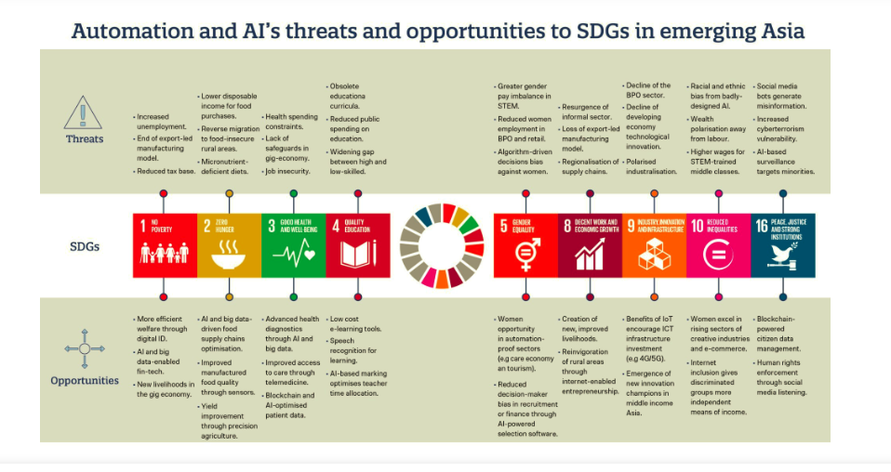
University Social Responsibility and Commitment:
Contributing to the attainment of the Sustainable Development Goals (SDGs)

Slide 5
President of the UN General Assembly (in 2016):
“very few human beings in the world know anything about the UN’s Sustainable Development Goals”
…if every school curriculum in the world incorporates the SDGs, every school teaches them, and every young person in the planet is made aware of them as rights and responsibilities, the world will stand a very good chance of attaining the goals by 2030”..

Slide 6
Asia’s SDG Progress as of 2018:
Progress has been made towards some SDGs but the rate of progress is insufficient (Goal 1; Goal4: Goal 7)
For more than half the SDGs, progress is stagnant or heading in the wrong direction. (Goal 2; Goal 9; Goal 10; Goal 11; Goal 13; Goal 14; Goal 15; and Goal 16)
Negative trends: Goals 6; 8; and 12)
Lack of progress towards SDG 17 could undermine the progress towards all other SDGs

Slide 7
Challenges to Universities in the era of disruptions and social commitments
….”at the center of disruptions and development
are human beings”..

Slide 8
Challenges to Universities in the era of disruptions and social commitments towards sustainability
Inclusion in the teaching- learning environment (no one left behind)
Curricula for future-ready degrees
Curricula and teaching for future-ready Leaders
Curricula and teaching strategies that would develop the next century competencies
Need to partner with industries

Slide 9
Challenges to Universities in the era of disruptions and social commitments towards sustainability
More than half (56 percent) of the salaried workforce from Cambodia, Indonesia, the Philippines, Thailand and Vietnam stand to lose their jobs as technologies including 3D printing, nanotechnology and robotic automation could disrupt the region’s manufacturing sector (ILO Study, 2016)
Re-skills the current workforce (provide lifelong learning opportunities)

Slide 10
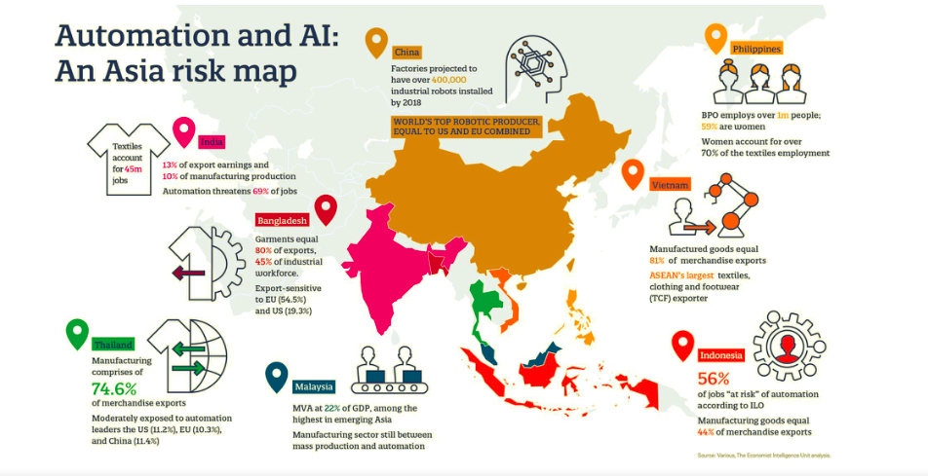
https://medium.com/@UNDPasiapac/making-the-fourth-industrial-revolution-count-for-sustainable-development-in-asia-and-the-pacific-22c351ddd4bf

Slide 11
Challenges to Universities in the era of disruptions and social commitments towards sustainability
Less than a quarter of educational institutions in Asia have a full digital strategy in place. More than half (53 percent) are in progress with specific strategy but 24 percent have limited or no strategy in place.
(survey by Microsoft for its Microsoft Asia Digital Transformation Study from October to November 2016 with 265 respondents from higher education institutions and universities)
Full digital strategy in place
PR
VR
XR
MR
AR
We are entering a new space—a "metaverse"—where experiences are available on demand—a world where the lines of the physical and digital are blurred. These developments will not happen overnight, but they will eventually take us into a new realm. We are at the dawn of an amazing journey that will profoundly transform the learning environment, our institutions, and the human experience itself.

Slide 12
Open and Distance Learning: 2020 and Beyond
Open university system as the University of the Future

Slide 13
Thank you!!

