Slide 1
Examining the Use of Digital Learning Platforms by Educators for Knowledge Acquisition and Improvements in Teaching Practices: Future-Learn by “The Open University”
Ms. Neelam Yaqoob
Research Department
Canvass Analysis, Islamabad, Pakistan
canvassanalysis@gmail.com
Ms. Tahira Bibi
Lecturer EPPSL Department
Allama Iqbal Open University, Islamabad, Pakistan
tahira.naushahi@aiou.edu.pk
Mr. Malik Omer Mansoor
Research Department
Canvass Analysis, Islamabad, Pakistan
muhammadomermansoor@gmail.com

Slide 2
THE OPEN UNIVERSITY
The Open University (OU) is a public research university
Biggest university in the UK for undergraduate education.
The majority of the OU's undergraduate students are based in the United Kingdom and principally study off-campus; many of its courses (both undergraduate and postgraduate) can also be studied anywhere in the world.
The OU was established in 1969 and used the original television studios and editing facilities for the transmission of information to the students. The first student enrolled in the OU was in January 1971.
The university awards undergraduate and postgraduate degrees, as well as non-degree qualifications such as diplomas and certificates or continuing education units.

Slide 3
THE OPEN UNIVERSITY
With more than 174,000 students enrolled, including around 31% of new undergraduates aged under 25 and more than 7,400 overseas students, it is the largest academic institution in the United Kingdom (and one of the largest in Europe) by student number, and qualifies as one of the world's largest university.
Since its foundation, more than 2 million students have studied its courses. It was rated top university in England and Wales for student satisfaction in the 2005, 2006 and 2012.
It was ranked 36th in the country and 498th in the world by the Center for World University Rankings in 2018.

Slide 4
THE OPEN UNIVERSITY
The OU won the Teaching Excellence and Digital Innovation categories in The Guardian University Awards 2018.
Like other UK universities, the OU actively engages in research. The OU's Planetary and Space Sciences Research Institute has become particularly well known to the public through its involvement in space missions.
Scientists from The Open University are supporting one of a series of ground-breaking missions by NASA to go back to the Moon.
It is a prime example of the world-leading lunar research carried out by OU academics, which includes researching methods that may help build future habitats. The OU has teamed with NASA Goddard Spaceflight Centre (in cooperation with the European Space Agency) to develop an instrument called PITMS (Prospect Ion Trap Mass Spectrometer) to monitor the very thin atmosphere near the surface of the Moon. The instrument will be carried to the Moon in 2021 by a commercially-provided lander, under NASA’s Artemis program

Slide 5
FUTURELEARN
FutureLearn is a digital education platform founded in December 2012. The company is jointly owned by The Open University and SEEK Ltd. It is a Massive Open Online Course (MOOC) learning platform, and as of 2018 included 143 UK and international partners, including non-university partners.

Slide 6
FUTURELEARN
FutureLearn was launched with 12 university partners, seeking those who "consistently rank at the top". The 12 founding partners are: The Open University, University of Birmingham, University of Bristol, Cardiff University, University of East Anglia, University of Exeter, King's College London, Lancaster University, University of Leeds, University of Southampton, St Andrews University, and University of Warwick.
The launch was described as a move to 'fight back' and provide a space for UK institutions to engage in the MOOC space.
According to Financial Times, Futurelearn was the first platform to enable students to earn credits towards a degree from a top UK university from their tablets and smartphones, 2016

Slide 7
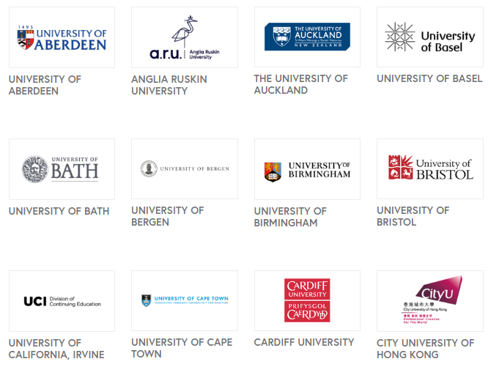
AFFILIATED UNIVERSITIES

Slide 8
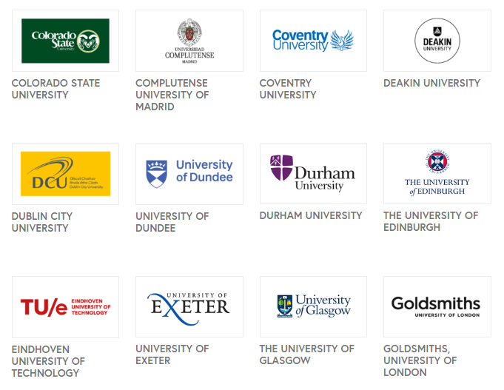
AFFILIATED UNIVERSITIES

Slide 9
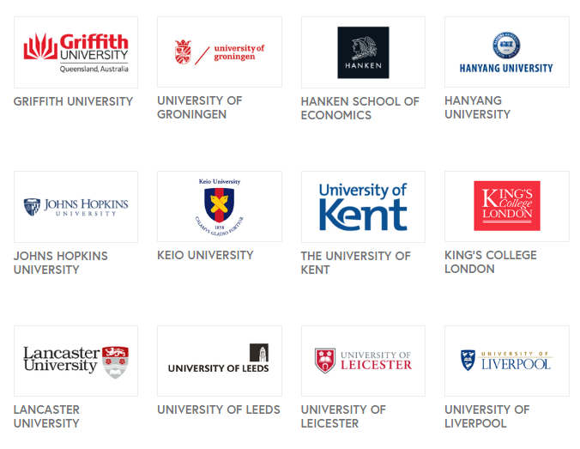
AFFILIATED UNIVERSITIES

Slide 10
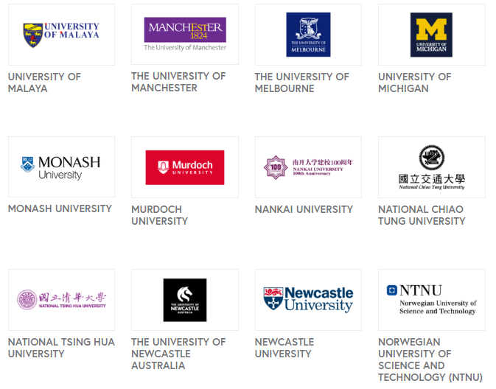
AFFILIATED UNIVERSITIES

Slide 11
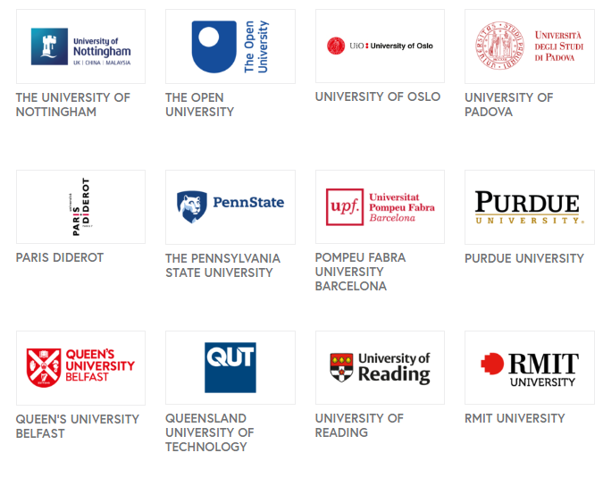
AFFILIATED UNIVERSITIES

Slide 12
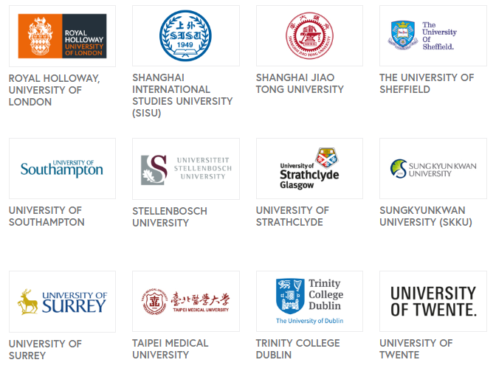
AFFILIATED UNIVERSITIES

Slide 13
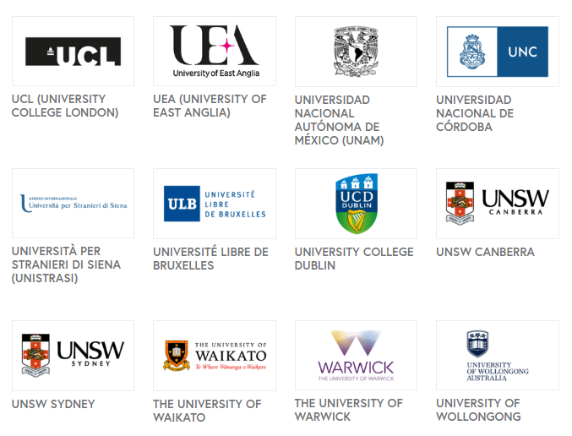
AFFILIATED UNIVERSITIES

Slide 14
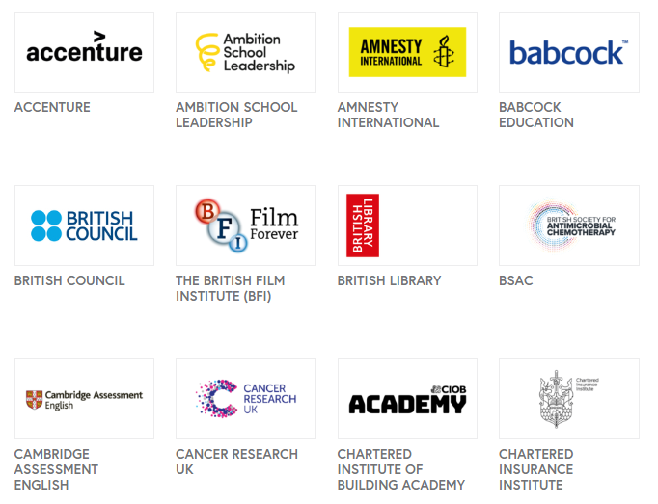
SPECIALIST ORGANISATIONS

Slide 15
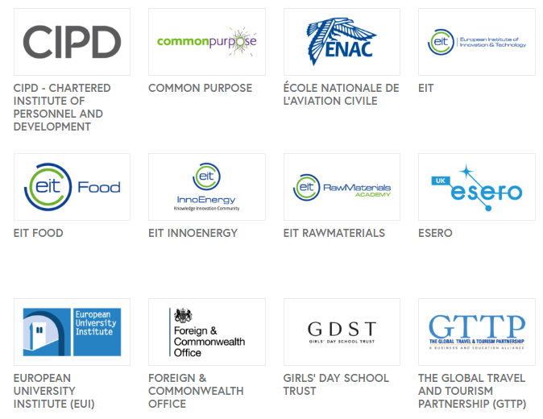
SPECIALIST ORGANISATIONS

Slide 16
SPECIALIST ORGANISATIONS

Slide 17
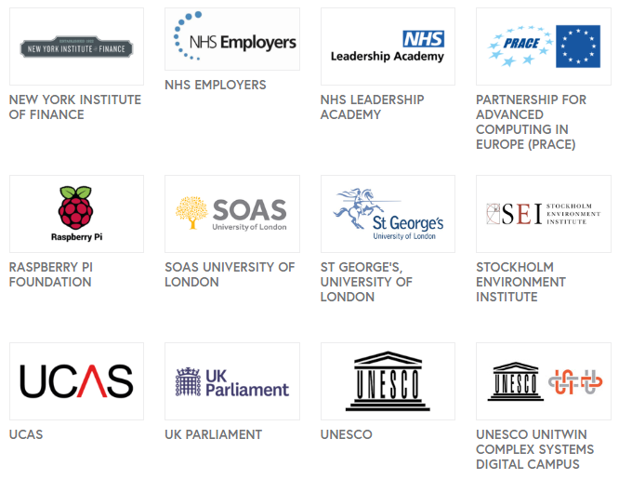
SPECIALIST ORGANISATIONS

Slide 18
SPECIALIST ORGANISATIONS

Slide 19
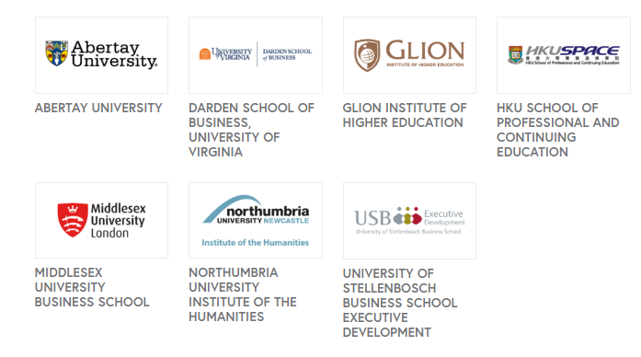
CENTRES OF EXCELLENCE

Slide 20
ASSOCIATE PARTNERS

Slide 21
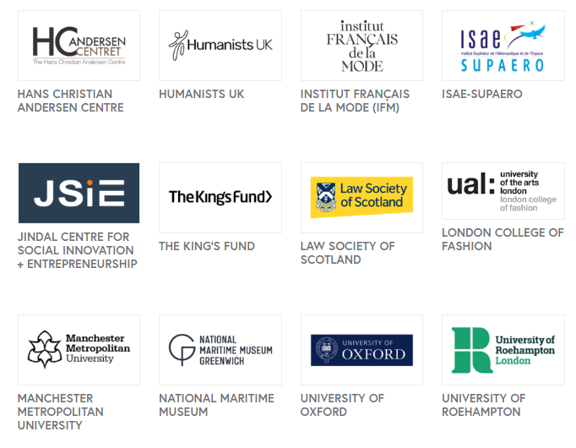
ASSOCIATE PARTNERS

Slide 22
ASSOCIATE PARTNERS

Slide 23
PROBLEM STATEMENT
Technological advancements have opened new horizons for the learners and educators.
FutureLearn being one of the biggest and widest digital learning platform can be used to inculcate the globalization in distance educational scenario of Pakistan or any other region.
It was assumed that the knowledge about digital learning platforms specifically FutureLearn should be explored to unfold the new domains and chapters in the educational opportunities of global market.

Slide 24
OBJECTIVES OF THE STUDY
Educator’s knowledge about the digital learning platforms (FutureLearn).
Utilization of digital learning platforms (FutureLearn) for advanced learning and professional development, and
Benefits gained by educators from digital learning platforms.

Slide 25
METHODOLOGY
Qualitative approach with semi-structure interviews.
Population was “Education Department of AIOU”.
Criteria:
Snow ball purposive sampling (M.Phil Qualified or have 10 or above years of teaching experience.
20 participants selected as sample.
17 participants provided the data for the study.
Thematic analysis with the support of Nvivo 12 Software.

Slide 26
THEMATIC ANALYSIS
Knowledge of Digital Learning Platforms, specifically “FutureLearn”.
Utility of digital learning platforms (FutureLearn)
Learning opportunities and professional capacity building of postgraduate level educators and
Benefits of digital learning platforms for educators.

Slide 28
Theme 1
Knowledge of Digital Learning Platforms, specifically “FutureLearn”.
Only 05 participants provided the views that they are totally unaware about the digital learning platforms.
Majority of the participants stated that they have the knowledge about digital learning platforms, but are not aware about the FutureLearn specifically.

Slide 29
Theme 1
Knowledge of Digital Learning Platforms, specifically “FutureLearn”.
Confusion between digital learning platforms (FutureLearn, edX, and Coursera) and digital learning platform creation tools (Moodle, LMS, MOOCS, Google Classroom, ExpertusOne).
Another confusion is that few educators considered social media platforms and other online resources like e-mails and blogs as a digital learning platforms.

Slide 30
Theme 2
Utility Of Digital Learning Platforms (FutureLearn)
Majority of the participants were of the view that they have utilized some kind of digital learning platform for their advanced learning and professional development during their professional career.
An alarming finding was that MOST of the educators have never used any of the FutureLearn programs for their professional learning or capacity building.
Only one participant notified the enrollment and completion of FutureLearn course.

Slide 31
Theme 3 & 4
Learning Opportunities and Benefits
Interactive Communication
Diversified Knowledge Experiences
Time Management
Autonomy, Flexibility and Openness
Updated Knowledge from Global Perspective
Professional Capacity Building
Inclusive and Blended Learning

Slide 32
CONCLUSION
Even after having so much benefits and advantages of digital learning platforms, the area is still confused in the minds of the educators at the university level
Due to this confusion and ambiguity, the utilization of the digital learning platforms is getting affected, however as digital learning platforms can play a great part in professional capacity building of educators.
Knowledge about FutureLearn is limited, and even those who have the knowledge do not utilize the learning opportunities provided by the FutureLearn for their professional development and advanced learning.

Slide 33
RECOMMENDATIONS
Awareness should be created in the universities especially in the open universities about digital learning platforms.
Faculty of the universities should be provided training regarding the utilization of digital learning platforms for their personal and professional growth and development.
More and more institutes, especially those from the developing countries should collaborate and associate themselves with such platforms, both at institutional and individual level.

Slide 34
REFERENCES
www.Futurelearn.com
www.open.edu
www.britishcouncil.com
www.courser.com
www.edx.com

Slide 35
THANK YOU

