Slide 1
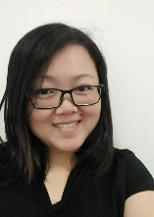
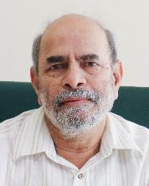
Perception of Distance Learners on Nanolearning Videos as an Educational Tool
Michelle Loh Woon Har
Phalachandra Bhandigadi
Jasmine Selvarani Emmanuel

Slide 2
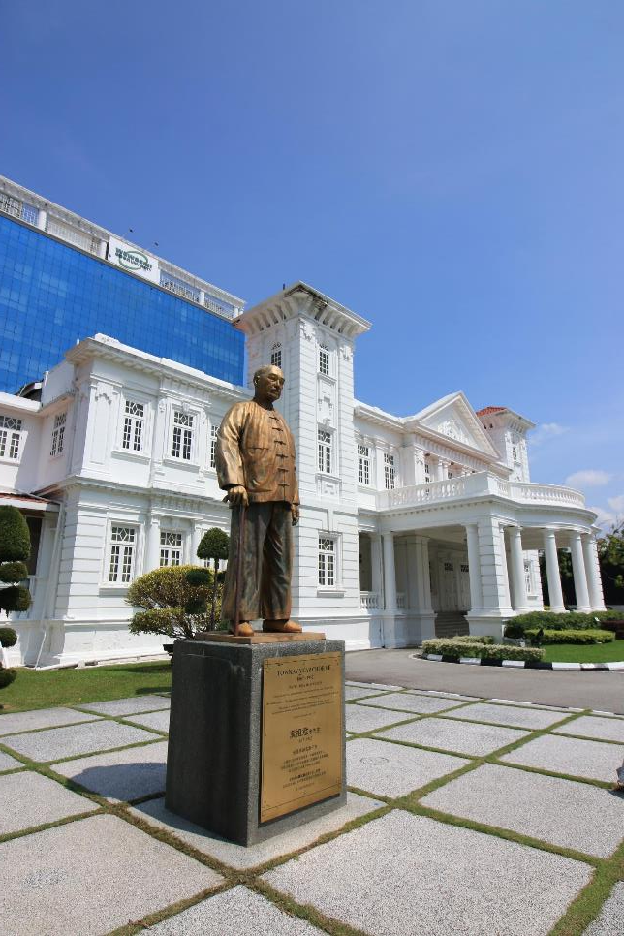
“
To provide Malaysians access to quality higher education via open distance learning regardless of their educational, ethnic or socio-economic background.
02
Introduction

Slide 3
Who are our students?
03
School leavers
Mature workers
Full-time parents
In between jobs
English is not first language
Selamat pagi
你好
வணக்கம்
Apa cita tek?
Introduction

Slide 4
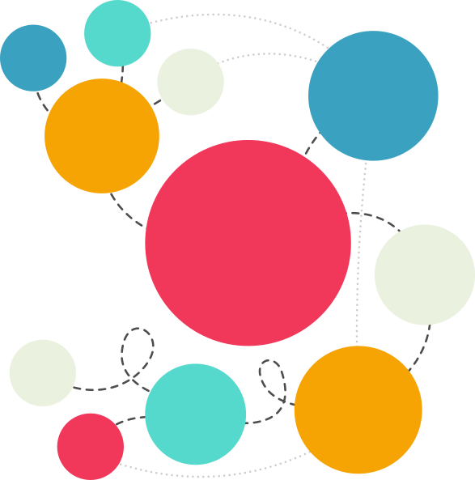
What is a nanolearning video?
04
Learning in small chunks
Targeted learning
Self-contained
Delivery for mobile devices
A combination of media
One learning objective
Multimedia
Nanolearning video
Convenient
Mobile
learning
Bite-sized
Introduction

Slide 5
Our problem
05
New distance learners struggle to adapt to computer-based learning in a virtual classroom.
Technological proficiency is critical to distance learners’ success in an open learning environment.
New distance learners need to find the confidence and motivation to follow new educational trends.
Problem statement

Slide 6
What scholars say
06
Dabbagh (2007): The current profile of the open distance learner is characterised as emerging, responsive to rapid technological innovations and new learning paradigms, and progressively including a younger age bracket.
Prensky (2001): Digital natives grew up with technology and live their daily lives online as opposed to the digital immigrants who grew up in environments where predominantly printed sources were being used.
Clausing et. al. (2003): Digital natives are completely at ease chatting online, while listening to music on Spotify, and expertly googling for answers to topic- related questions for their assignments.
Prior et al. (2016): Students might use technology more for social or entertainment purposes, but not for learning.
Today’s distance learners need help on how to use technology effectively for learning.
Literature review

Slide 7
What scholars say
07
Rajendra & Suhana (2018): Multimedia can be defined as a Web-based interactive computer-mediated application that includes various combinations of text, sound, still images, audio, video, and graphics.
Tatjana & Dragomir (2015): Visual is a win-win tool for digital natives and the design for e-learning should be bite-sized (nanolearning) to cater to a world where learning becomes increasingly mobile.
Burke, Snyder, & Rager (2009): YouTube offers familiarity to digital natives who are accustomed to using technology such as the Internet, video blogging and text messaging.
Alexa (2016): YouTube, as the second-most visited website on the Internet, is commonly used by students to access information in relation to their studies.
Nanolearning videos on YouTube can help to facilitate learning in an online environment.
Literature review

Slide 8
What we want to achieve
08
To discover distance learners’ perception on nanolearning videos.
To improve current video delivery process.
To develop self-regulated and independent learning skills in an open learning environment.
Research objectives

Slide 9
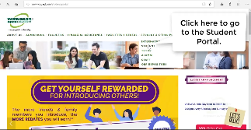
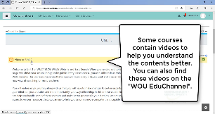
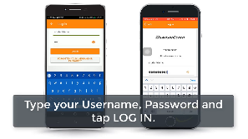
Our method
09
3 nanolearning videos for Learning Skills for University Studies course.
Uploaded videos to YouTube.
Embedded videos into the Learning Management System.
Played videos during tutorial session.
Collected student Feedback.
Video 1 guided students how to access the University website.
Watch
Video 2 teaches students to learn the functions of the learning management system.
Watch
Video 3 introduces mobile app to access courses on-the-go.
Watch
Methodology

Slide 10
Our participants’ profile
10
74%
56.3%
Data collection

Slide 11
What we found
11
83.9%
75.9%
77.7%
Findings

Slide 12
What we found
12
89.3%
84.8%
84.8%
Findings

Slide 13
What we found
13
98.2%
99.1%
93.7%
Findings

Slide 14
What our students say
14
97.3% think the nanolearning videos have benefitted them in their learning.
87.5% want more nanolearning videos developed.
“[The videos are] very helpful for an external student like me. I have downloaded the [Moodle] app ... and used it this morning while waiting for a client.”
“… videos were very useful and helpful for the ODL student like me … convenient for me to access to the Forum, LMS, Course Material and as well as discussion anywhere and anytime…”
Discussion

Slide 15
Challenges that we face
15
Finding a balance to produce nanolearning videos that appeal to a wide range of distance learners.
Identifying the topic(s) and accurately producing the nanolearning videos that fit within the specific timeframe.
Convincing our Course Coordinators (Instructors) that the quality of the nanolearing videos adds value to their courses.
Challenges

Slide 16
To sum it up
16
Nanolearning videos are useful for better understanding of the course content at Wawasan Open University.
Further research will be a comparison on students’ performance before and after using nanolearning videos for learning.
Conclusion

Slide 17
References
17
Alexa (2016) The Top 500 Sites on the Web Retrieved from http://www.alexa.com/topsites
Burke, S. C., Snyder, S. L., & Rager R. C. (2009). An assessment of faculty usage of YouTube as a teaching resource. Internet Journal of Allied Health Sciences and Practice, 7(1), 1-8.
Clausing SL. Kurtz DL. Prendeville J. Walt JL. Generational diversity—The Nexters. AORN J. 2003;78:373–379.
Dabbagh, N. (2007). The Online Learner: Characteristics and Pedagogical Implications. Contemporary Issues in Technology and Teacher Education, 7(3), 217-226. Waynesville, NC USA: Society for Information Technology & Teacher Education. Retrieved August 6, 2019 from https://www.learntechlib.org/primary/p/22904/.
Prensky, M. (2001). "Digital Natives, Digital Immigrants Part 1", On the Horizon, Vol. 9 No. 5, pp. 1-6. https://doi.org/10.1108/10748120110424816
Prior D. D., Mazanov, J., Meacheam, D., Heaslip, G. and Hanson J. (2016). “Attitude, Digital Literacy and Self Efficacy: Flow‐On Effects for Online Learning Behavior”, Internet and Higher Education, Vol. 29, pp. 91‐97.
Rajendra, Made & Made Sudana, I. (2018). The Influence of Interactive Multimedia Technology to Enhance Achievement Students on Practice Skills in Mechanical Technology. Journal of Physics: Conference Series. 953. 012104. 10.1088/1742-6596/953/1/012104.
Tatjana, M., & Dragomir, Ć. (September 2015). Millennials’ Way of E-learning and Communication in the Digital Era. The Sixth International Conference on e-Learning (eLearning-2015). Belgrade, Serbia.
References

Slide 18
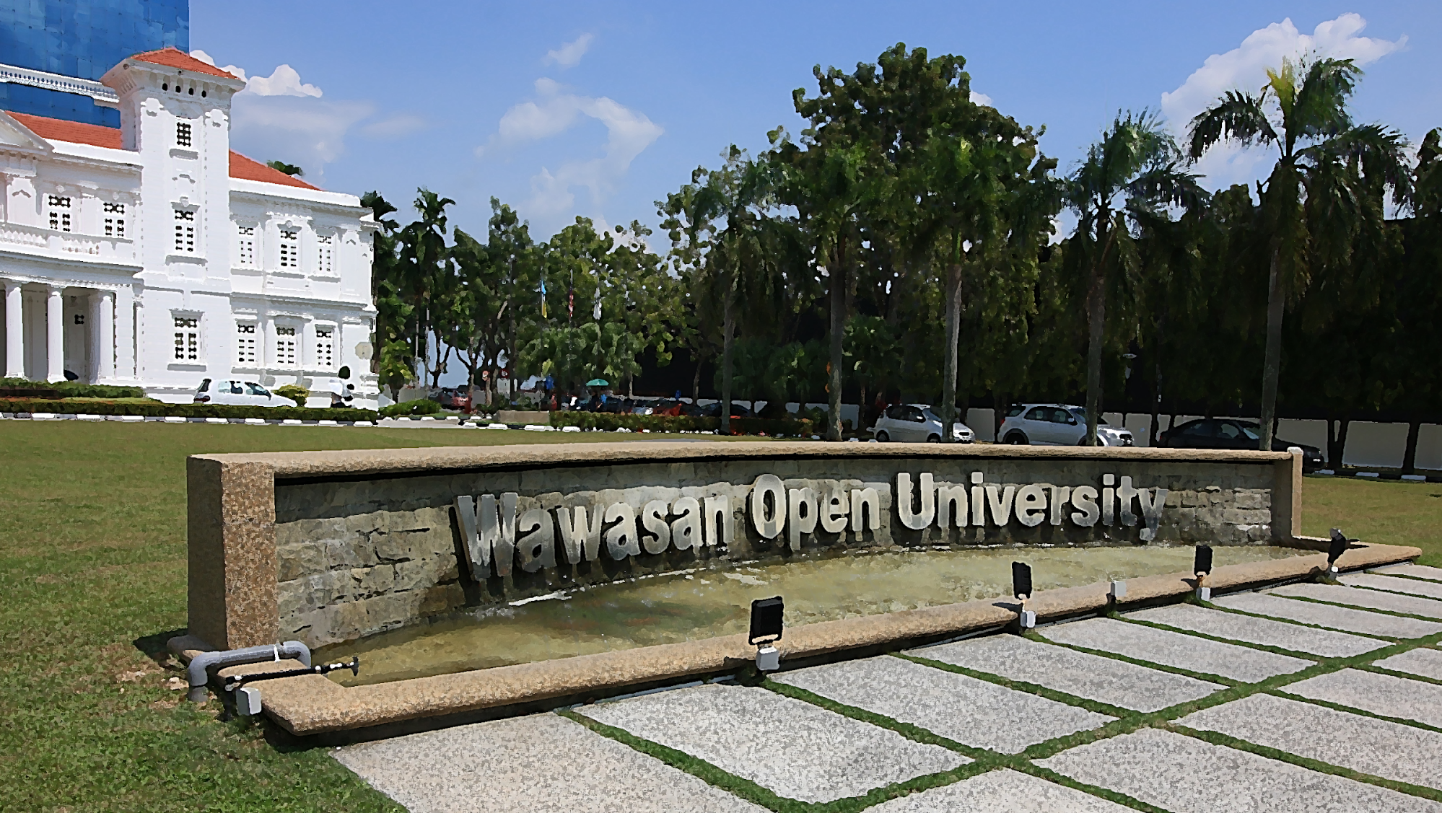
michelleloh@wou.edu.my

