Slide 1
Design, Usage and Impact of Virtual University Mobile LMS Application on Students Learning of Virtual University of Pakistan
Shahid Minhas

Slide 2
Introduction
ICT developments had a profound impact on various fields including education.
The key component of distance learning is its Learning Management System (LMS) that is both available in web-based and mobile application form.
Virtual University of Pakistan launched the VULMS
Mobile Android App for its students on 14th August 2017.

Slide 3
Purpose of the study
Aimed at exploring student’s perception pertaining to the design, use and impact of VU Mobile LMS application on students’ learning.
To explore the usage of VU Mobile LMS application among students at VUP.
To investigate the impact of VU Mobile LMS application on students learning at VUP.

Slide 4
Research Methodology
It is a quantitative study in which the three aspects on VU Mobile LMS application have been studied i.e. design, usage and impact.
Survey methodology had been used in this study.
200 students was selected through purposive sampling technique.

Slide 5
Literature Review
The revolution in Information and communication technologies (ICTs) have changed the concept of traditional classrooms. The phenomena of virtual learning is not new to people.
Due to the increased usage of internet, even mobile phones are frequently used in the third world countries to access available information Annetta, Cheng & Holmes (2010).

Slide 6
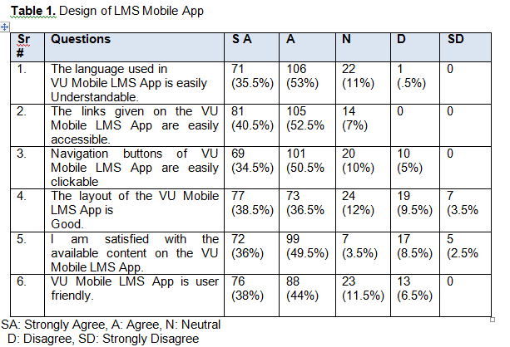
Data Analysis

Slide 7
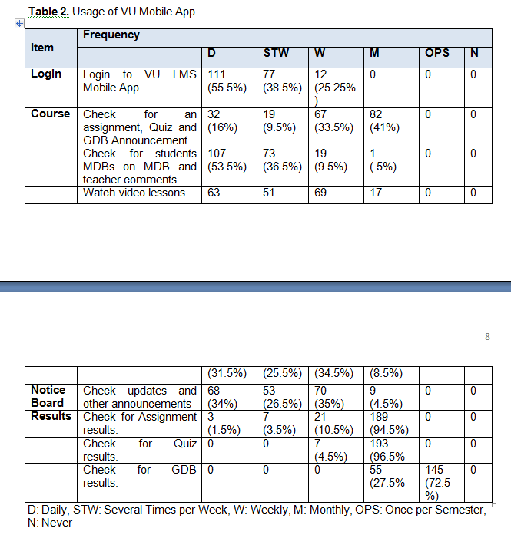
Data Analysis

Slide 8
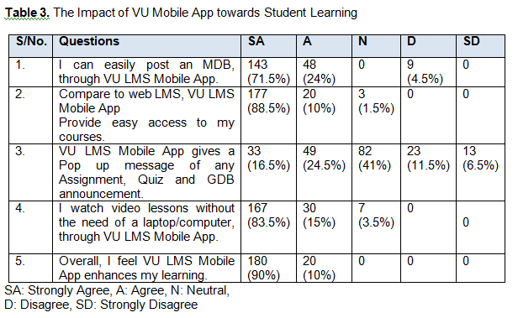
Data Analysis

Slide 9
Discussion
Students are satisfied with the design of the VU mobile LMS application.
Students use it frequently to access their courses and get the required information instantly.
Students find it an easy way to navigate through the application to access course material and watch video lessons.
Mobile LMS application is important in saving time of student and making learning more convenient.
The result support the study other related studies on the same point affirmed that students prefer mobile learning apps than LMS for accessing their courses.

Slide 10
Conclusion
VU mobile application is an effective resource for students learning in distance learning-based environment.
It is designed to cope with the learning needs of students and to provide them with an easy access.
Students can ubiquitously access the application

Slide 11
Conclusion & Recommendations
VU mobile application is an effective resource for students learning in distance learning-based environment.
It is designed to cope with the learning needs of students and to provide them with an easy access.
Students can ubiquitously access the application.
links to other reading contents to be provided in the interface to make courses more interesting for learning.

Slide 12
Thank you all

