Slide 1
Cyber Security and Digital Forensics as a Preventive and Repressive Step to Overcome Cheating in Online Tutorials
delivered at the AAOU seminar on October 14-16, 2019 at Pearl Continental Hotel, Lahore, Pakistan

Slide 2
INTRODUCTION
Technological Development
University Adaptation and Innovation in Learning
ONLINE / E-LEARNING TUTORIAL
Notes:
We cannot be separated by technology. As the institution which educates learners, we should adapt to the development of technology and innovate e-learning. I have divided this presentation into 5 main sections. First, Introduction. Second, the steps to anticipate violations in the online tutorials. Third, settings in e-learning of Open University in Indonesia. Fourth, Preventive formula. Fifth, the countermeasure.
Ladies and gentlemen,
the big question is why should E-learning / Online Tutorial’s settings be arranged for anyone who will interact there (e-learning) both students and tutors. E-learning is a distribution of knowledge that is a modification of technological developments that aim to be able to reach people everywhere who have limited time, cost and also place of study. As in Indonesia, which is also well-known as an archipelago country, we really need online tutorials to access education as the form of the efforts to practice article 31 paragraph 1 in Indonesian Constitution, “every citizen has the right to have education.

Slide 3
Online Tutorial In Indonesia
E-learning to become a primadona in learning media in Indonesia because among others
1. Indonesia is an archipelagic state so the cost of education will be relatively cheaper by using e learning
2. Providing equal distribution of education to anyone, anywhere and anytime in Indonesia.
MAP OF INDONESIA
but raises a any problems that must be resolved
Notes:
Indonesia consists of 17,500 (seventeen thousand five hundred) islands and 267 million inhabitants who are currently receiving a demographic bonus in fact of productive age of 15-64 years old from 183.36 million people or 68.7% the total population of Indonesia.

Slide 4
Category of Indonesian Open University students by age
25 – 34 Years
40 – 44 Years
104.093
Or
35.39 %
18.567
Or
6.35 %
< 25 Years
35 – 39 Years
>44 Years
113.527
Or
38,82%
35.257
Or
12.06 %
21.021
Or
7.19 %
Notes:
This is directly proportional to the number of Indonesian Open University students who have registered according to the data (of this), stated that Indonesia Open University students currently based on age groups are dominated by Millennial generation, Generation X and Y, which are aged between <25 years <44 years, basically they are generations of technology literate and full of curiosity, so that the number of participation in online tutorial / E-learning activities in Indonesia also increases from year to year.

Slide 5
The online tutorial is very suitable in Indonesia because it can answer the problems of distance, time and place faced by Indonesian Open University students
1
Increase learning interactions (enhance interactivity) Online distance learning that is carefully designed and implemented can increase the level of learning interaction between learners with learning material, learners with instructors, and between learners and other learners.
2
Facilitate learning interactions from anywhere and at any time (time and place flexibility) Learners can interact with learning resources anytime according to the availability of time and wherever he is, because learning resources are packaged electronically and available to be accessed by learners through online learning.
3
Facilitate the improvement and storage of learning materials (easy updating of content as well as archivable capabilities). The facilities available in online learning technology and various software that continues to grow also help facilitate the development of electronic learning materials.
4
Having a wider reach (potential to reach a global audience). Online distance learning that is flexible in terms of time and place, makes the number of learners that can be reached by learning activities through online learning more and more widely open to anyone who needs it.
Notes:
E-learning is very suitable in Indonesia because it has advantages to answer the problem of distance, time and place faced by students of the Indonesian Open University, namely:
Increase learning interactions (enhance interactivity) Online distance learning that is carefully designed and implemented can increase the level of learning
Facilitate learning interactions from anywhere and at any time (time and place flexibility)
Have a wider reach (potential to reach a global audience). Online distance learning that is flexible in terms of time and place
Facilitate the improvement and storage of learning materials (easy updating of content as well as achievable capabilities).

Slide 6
Research methods used
Qualitative research
From of the critical issues researched and sought the best formula in the concept

Slide 7
Problem Online Tutorial In Indonesia
Online Learning Method
ASYNCHRONOUS
(Online / E-learning Tutorials)
Vulnerable to being misused like JOKI
The language used is not good / polite (ETIKA)
SYNCHRONOUS
(Webminar/E-Seminar)
Problem
So Need Regulations
Notes:
E-learning at the Open University of Indonesia is still growing and improving, along with an increase in the number of students and student participation in tutorial activities, of course there are many obstacles encountered in online tutorials in Indonesia. In Online Learning Method, we have 2 forms, ASYNCHRONOUS and SYNCHRONOUS. Some problems often occur in the former. The problems are like the use of jockey and the language used in learning process or ethics.
1. Jockey.
A Jockey is someone who becomes a substitute for doing (e-learning) by getting rewards / or not getting rewards directly. Jockeys can occur because there are several factors / indicators that affect the diverse backgrounds of Indonesian Open University students so that they have different orientations in their work: firstly, these students only need a diploma as job demands or prerequisites for occupying certain positions. Secondly, the ones who are financially so good but they want to graduate quickly that they can pay people to do things for them or with the excuse of not being able to follow the tutorial because of work and so on.
2. Communication
Good communication methods through E-Learning is needed since it is a scientific class substitution forum that sometimes use direct or indirect expressions that open the possibility of having some misunderstandings or misinterpretations in the sentences used in the implementation of the discussion. It sometimes offenses parties who are interacting in the e-learning process (students with students or students with their tutors).

Slide 8
basic idea
=
face to face class
E-Learning
Notes:
We Have to see the entire system and ethics in formal class where student-teachers or student- tutor experience face to face learning activities. It is Essential to be informed to students or future students to understand that e-learning. Is as formal and serious as class conventional in university. The students have to follow the rules and regulations. They are also expected to act policy and appropriately, they shouldn’t use informal I slang language to the tutor, they should express their thoughts based on logical fact under norms regulated in the class.

Slide 9
Steps to Anticipate Violations in the Online Tutorial
Hacker
Jockey
Tutorial
There must be
Preventive steps
Tutorial Etic
Plagiarism
Online Tutorial
Repressive steps
SERIOUS CRIME IN THE WORLD OF EDUCATION
Notes:
As we Know some problems in e-learning process could occur since it is internet based ( Hacker , Jokey,tutorial etic, plagiarism) Therefore, in my opinion plagiarism is included in the category of serious criminal acts in the world of education, so it is necessary to provide education that is still essential to all education personnel not to commit to it and avoid it.
Since education is the process of changing attitudes & behavior of a person or a group of people in order to make them be more mature human beings through teaching and learning effort intelligence ( Intellectual, emotional and spiritual intelligence ) . Educator (educational institution) to responsible to build a good educational culture.
There for, we should practice two main steps to anticipate those problem, 1. preventive steps and repressive step.

Slide 10
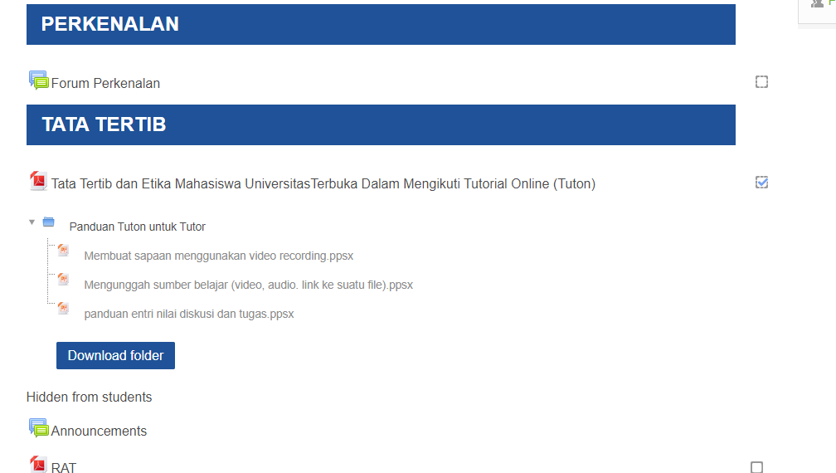
the current Open University eLearning display in Indonesia
currently the code of conduct regarding online tutorials is only embedded when introducing eleraning which is sometimes overlooked by students, should warnings about the code must be delivered at all times when elearning is accessed
Notes:
Because a display is not to steps ignored, not interesting, seems unimportant, so should be arranged more seriously with to display every eLearning login or use sticker until sounds to alert students that it contains important massage.

Slide 11
Current order
the application and enforcement mechanism when violations occur in tutorial online must be confirmed and traced in order to obtain clear and concrete evidence
Notes:
Meaning word “must be confirmed and traced” is need some improvement to be deliver some regulation to student so it looks important and must be considered.

Slide 12
preventative formulation
external factors
internal factors
Try not to save the password in the browser you are using because if it is not logged out
Using a Unique and Strong Password
Protect against Suspicious Messages and Content
Develop of verification of entry or through 2 steps of the Open University e-learning application
The use of the Face Lock Method in verifying steps in and out of e-learning applications or users must take pictures of themselves before and after following the tutorial/elearning
Development of a live chat / video chat method that is like using Instagram or Facebook
Notes:
There are two possibilities that cause the violations : external ( like hacker, recklessness, the weakness of the password) and internal factor (the student him/her self).

Slide 13
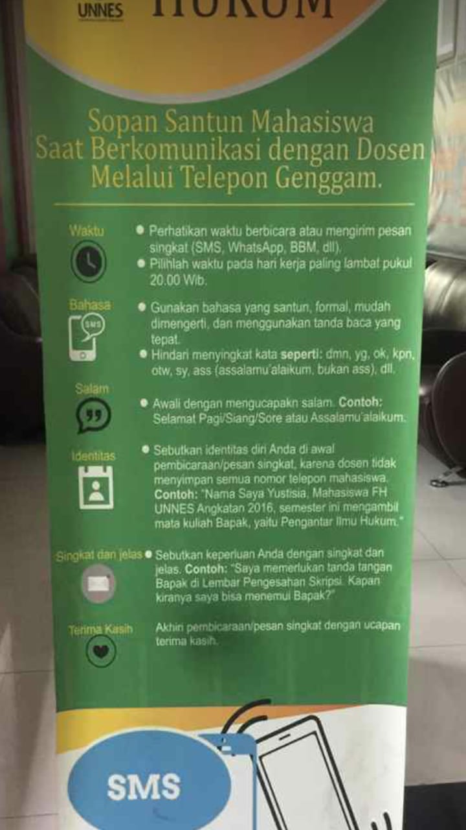
Settings regarding ethics in e-learning
the essence of teaching is not only to educate but also to make people civilized (ethical)
Because the communication media used are through writing, of course, it must be regulated regarding the selection of good words to respond to each response on the discussion page, both students and tutors, because sometimes every word and punctuation used is not quite right, causing different interpretations. from who reads it.

Slide 14
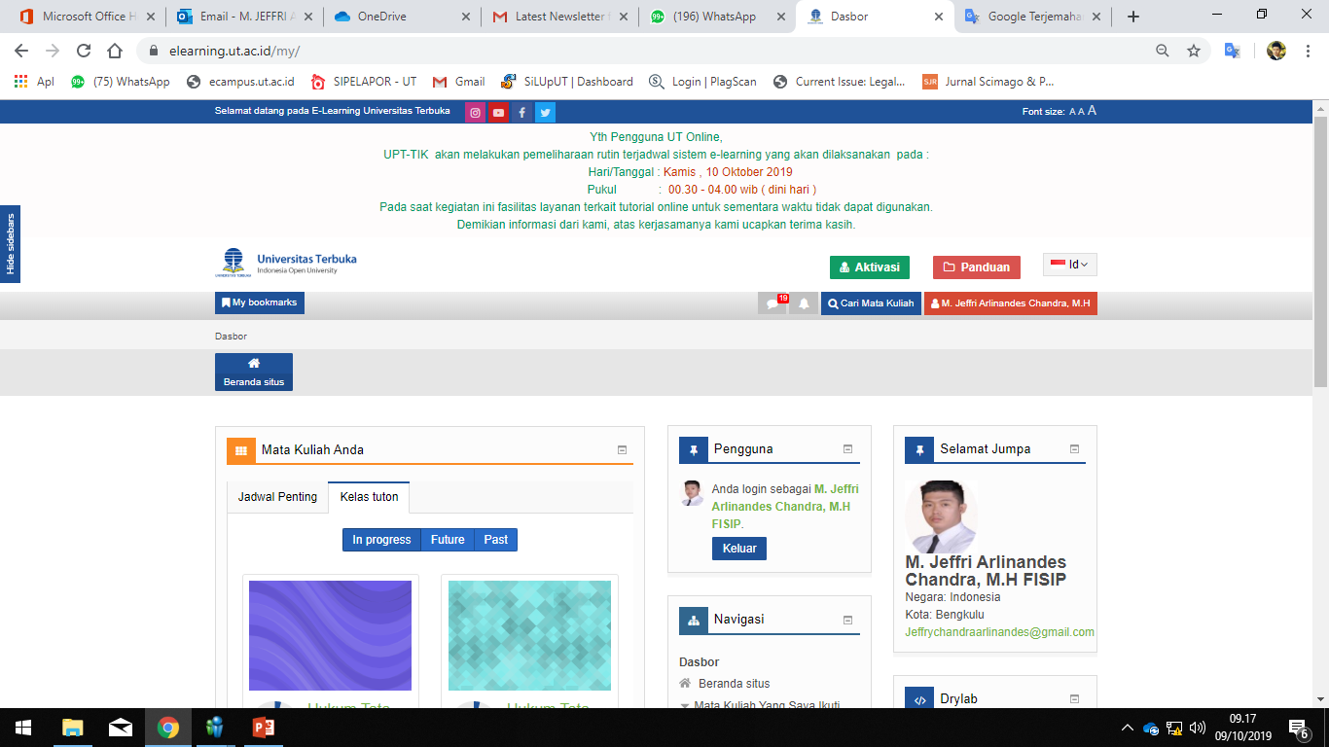
conclusions in preventive efforts are…
Giving prevention efforts must be carried out massively and continuously so that it becomes a habit and is always remembered by everyone who reads it
Because
as well as flight attendants who always demonstrate safety procedures on an airplane even though passengers may have often boarded the plane, or signs on the road as a reminder to always be orderly in traffic.
Notes:
What should be done is : do it again and again ! Even though you’ve already learning is since it is essential to be read and understood.
It is expected that the regulation and order from university are included on agreements in every login activities in tutorial online.

Slide 15
if prevention can not be done then there must be countermeasures
Through forensic data must be revealed violations committed through data collection, testing, analysis and conclusions so that the suspension of sanctions can be given clearly.
Search for IP address of the device used
Basically e-Learning users, both tutors and students identified as cheating, will tend to use the same IP address or the same device in accessing the e-learning.
2. Develop of a supervisory system (online proctoring) that supervises students and tutors who have been identified as cheating so that they can be seen through the data provided, either photos or other things, so that someone who accesses the service is entitled or not.
3. The develop Video Conference media that can be used by supervisors, students and tutors is not only to ensure that the right people have the right to access it can also be a means to animate class through online discussion.
Notes:
Still we may sometimes find some ignorant or irresponsible students who intentionally break the rules. We can not ignore then or everything we’re done become useless. We need to give punishments or academicals sanctions.
How to collect the evidence ? I will show you 3 main strategies : 1. search for IP address of the device used, 2. develop supervisory system (online proctoring), 3. Develop of video conference media.
sanctions can be in the form of warnings, official reprimands and temporary dismissals in tuton for all courses attended in one semester, and give a value of "0" for discussion and assignment if proven plagiarized.

Slide 16
the final Conclusion
which must be done
Repressive Way
Preventive Way
Search for IP address of the device used
Develop of a supervisory system (online proctoring)
The develop Video Conference media
Settings regarding ethics to be habit
The use of the Face Lock Method
users must take pictures of themselves before and after following the tutorial/elearning
Development of a live chat / video

Slide 17
and finally…
An Indonesia's education experts
Being, an educator must set an example of good action, being in the middle or among students, the teacher must create initiatives and ideas, from behind a teacher must provide encouragement and direction

Slide 18
Thank You!
Jeffri.chandra@ecampus.ut.ac.id

