Slide 1

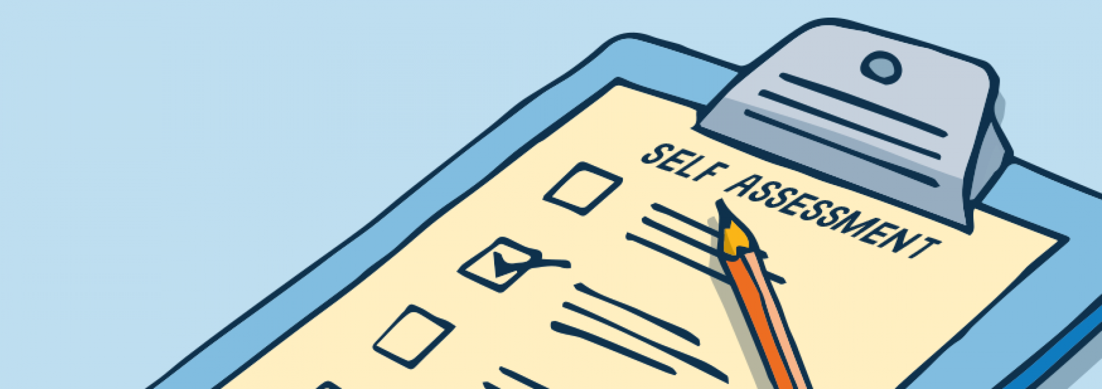
THE USE OF SELF-ASSESSMENT GUIDELINES
TO SUPPORT DISTANCE LEARNERS’ ONLINE COLLABORATIVE WRITING
Lidwina Sri Ardiasih
Juhana
(Universitas Terbuka)
Pearl Continental Hotel, Lahore Pakistan
October 15, 2019

Slide 2
Introduction & Aims
describing the process of OCW using a self-assessment guidelines
identifying the benefits of using writing self-assessment guidelines in OCW
analyzing the learners’ perceptions of using writing self-assessment guidelines in their OCW activities.
ODE with its flexibility → challenged to provide best quality learning materials & learning supports with technology
Essay Writing through Online →
Online Collaborative Writing
Independent Assessment → self-assessment guidelines
Purposes of collaborative learning → develop learners’ independence and autonomy

Slide 3
Self-assessment Guidelines for Collaborative Writing: Advantages
Writing → progressive activity (Oshime & Hogue, 1999)
Writing is difficult (Nunan, 1989) → inappropriate grammar (Kitchakarn, 2014), lack of linguistic competencies (Nunan, 1989) & develop writing (Mustaque, 2014)
ODE → Independent Assessment as pedagogical tools (Bourke, 2016)
Reflective intelligence → ability to self-assess (Broadfoot, 2000)
self-assessment of writing → involves integrating writing with information from external sources (Lin-Siegler, et.al., 2015) → Self-regulation strategies & self-assessment guidelines & rubrics
Advantages (Remmen & Frøyland, 2014):
1. Develop collaborative writing
2. Identify the relevance of the theory & guidelines in practice
3. Improve mindset during writing process

Slide 4
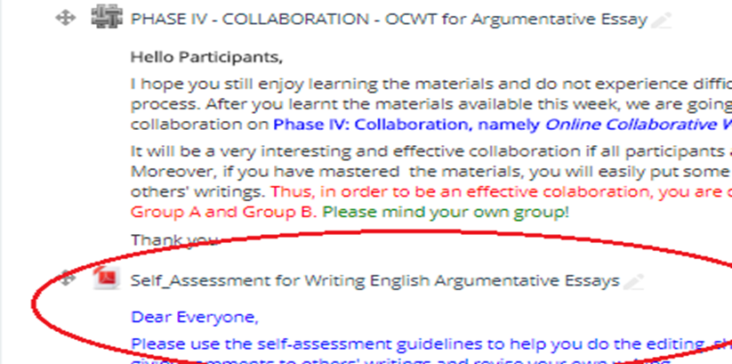
The Process of OCW with Self-Assessment Guidelines
Positive Impacts of OCW Process (Posey & Lyons, 2010):
1. Understand collaborative process
2. Equip groups with critical thinking & Collaborative problem solving
3. Monitor groups & involve them in deeper level of OCW
4. Integrate structured checks & feedbacks

Slide 5
Components of Self-Assessment Guidelines
& Questions (Examples)
Brainstorming:
Did I do brainstorming ......?
Outline development:
Did I make an outline of the ideas....?
Title Rules
Writing a rough draft
Genre-based writing characteristics (Argumentative):
- Use of assertion
- Use the correct way of argument
- Use of illustration
Organization:
Paragraph components, consistency, unity, coherence, cohesion, Patterns & transition signals
Structure:
Grammar →
Did i use technical words?
Punctuation →
Did I use punctuation marks correctly?
Vocabulary:
Choice of words →
Did I use well-chosen words..?
Spelling →
Did I choose correct spelling ...?

Slide 6
RESULTS
Learners’ Perceptions
87% → Positive Comments
e.g.
1. well-presented guidelines
2. good as a medium of reflections
3. clear, detail, and very helpful
4. easily complete the collaborative writing task
5. comprehensive and easy to understand
6. effective for analyzing learners’ writing weaknesses

Slide 7
DISCUSSION
- most participants were very enthusiastic in joining these learning activities & satisfied with this technique.
- Wiki allows students to optimize the process of writing their argumentative essays through collaborating activities.
- The use of self-assessment guidelines → positive and supporting impacts on the implementation of this technique

Slide 8
OCWT can train students to collaborate to get agreement on a concept or learning material that is learned
Keys to the success of studying at the ODE institution is the independence and autonomy of managing the sources and learning processes by the learners
Self-assessment guidelines can be used by learners to measure the extent of their writing skills

Slide 9




