Slide 1










The 33rd Annual Conference of the Asian
Association of Open Universities
Learning Material Development
at Universitas Terbuka:
Quality and Management Perspectives
Lidwina Sri Ardiasih
Ludivica Endang Setijorini
Tengku Lufiana
UNIVERSITAS TERBUKA INDONESIA
Lahore - Pakistan, Oct 14th – 16th, 2019

Slide 2
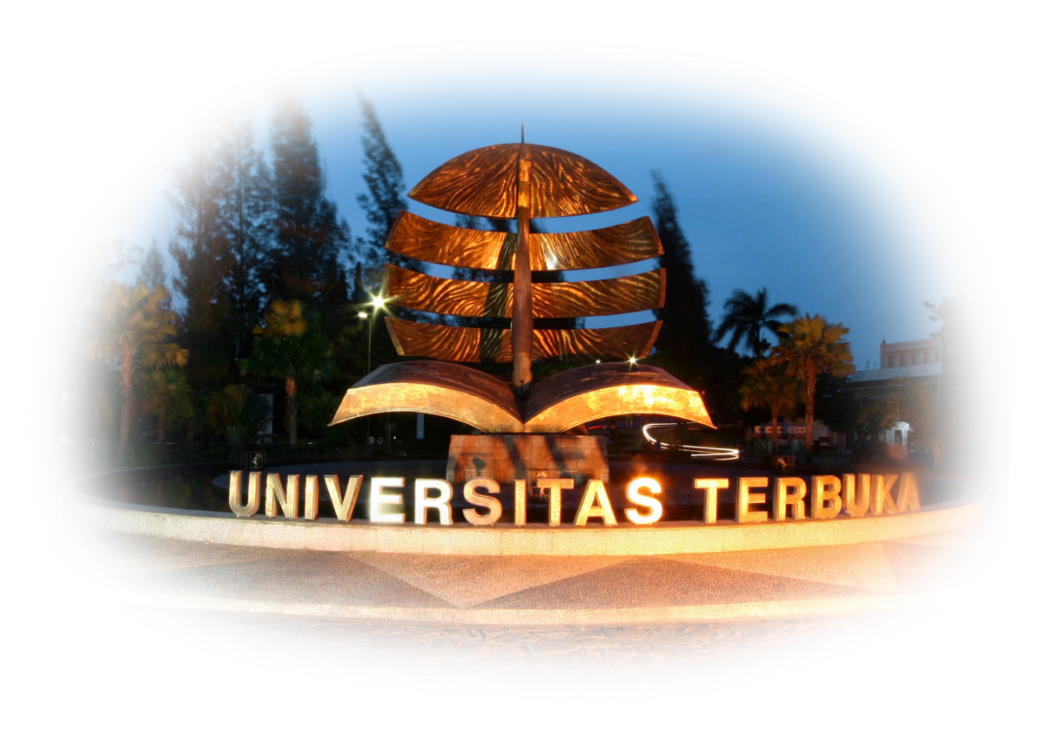
Introduction
Learning Materials → important component
Creative & Innovative
online learning
atmosphere
appropriate approach
Role of ODE Institutions
Strategic benefit to education → skilled staff & insfrastructure
Universitas Terbuka (UT) Indonesia
Established – May 4, 1984
state-owned single mode distance higher education institution
Total numbers of students 292.465
derived into methods
to produce meaningful learning activities

Slide 3
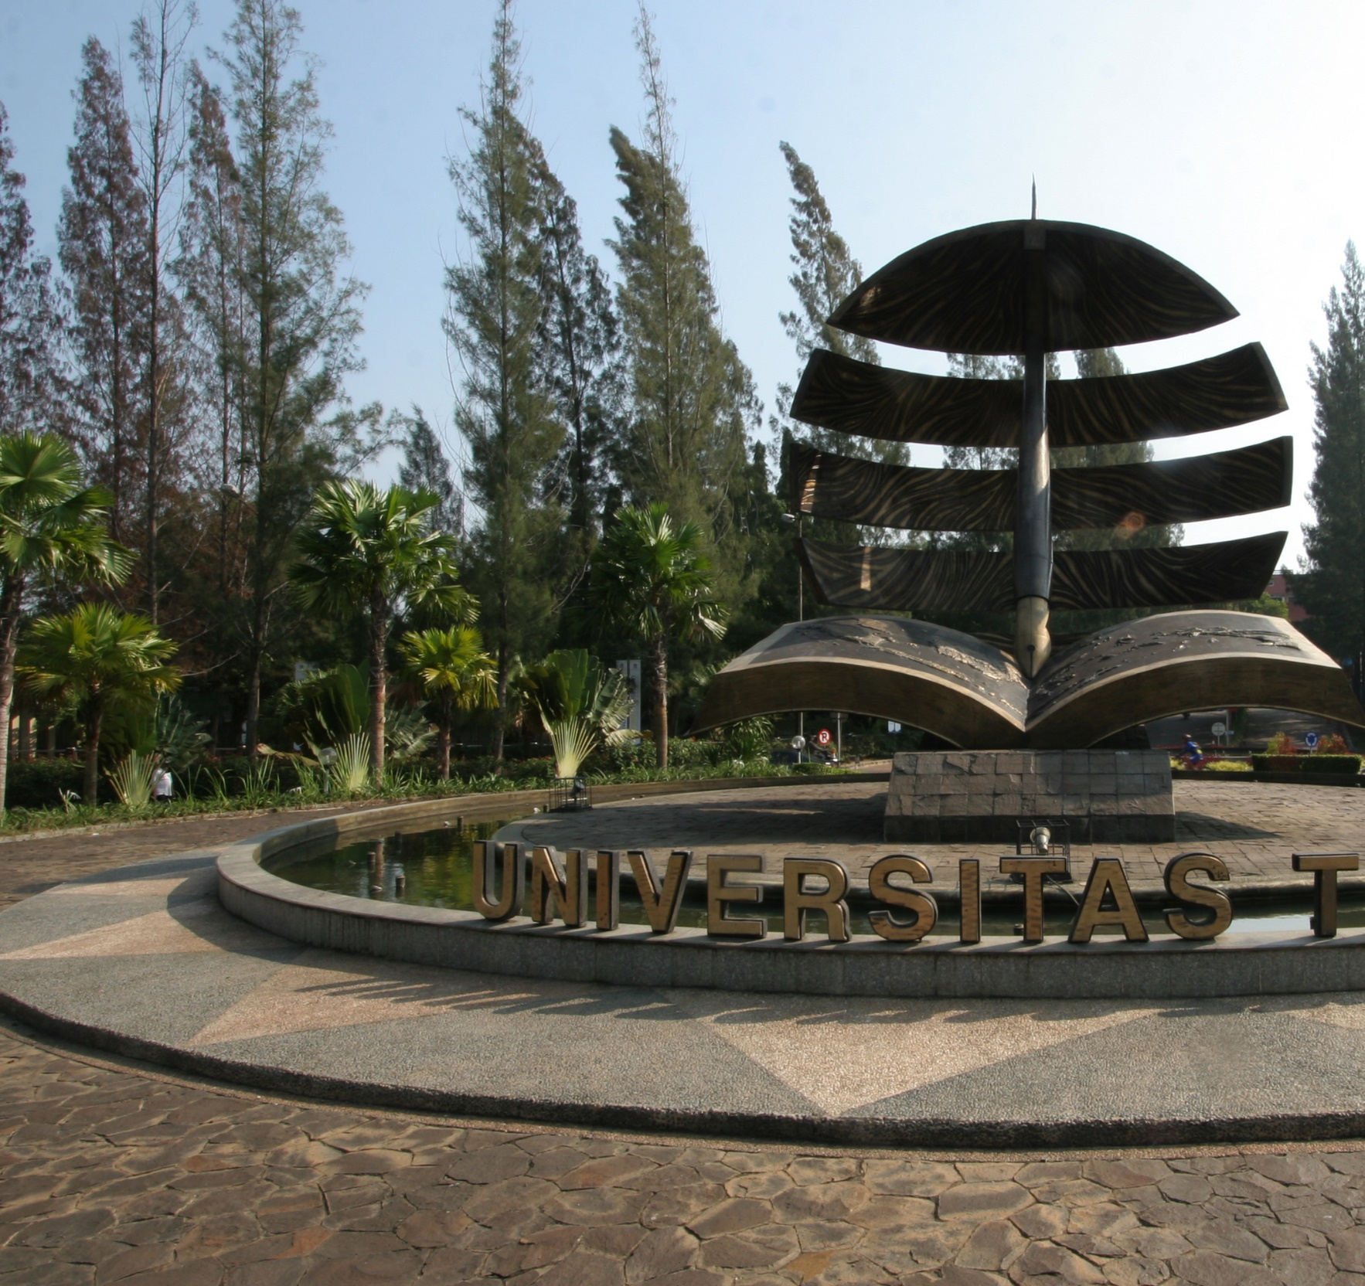

Aims
discussing material development at an ODE institution
describing the material development process at UT
analyzing course managers’ perceptions towards the material development process at UT & the quality of the products

Slide 4
Learning and Material Development
fits Learners’ Needs
TOMLINSON (2003): Material Adaptation
Characteristics:
Student-centered
Shearer (2007):
printed learning materials → still offered as the major learning materials
Flexible and Optional
Simonson, Smaldino, & Svacek (2014)
e-Books → electronic versions of printed books → the digital revolution
Open to various ideas and point of view
Relevant
Universal
Printed
Audio
Video/Multimedia
Authentic

Slide 5
Research Method
Qualitative Approach
focusing on the printed learning material development at UT
Observation
learning material development process
Documents
material analysis
Online Survey
to gain some information about
the course managers’ perceptions

Slide 6
Results & Discussion
Learning Material Development at UT
Process
Course managers’ responsibilities
(UT’s staff)
Academic partnerships
State & private universities
Recruitment
MDs & CRs
Communication & progress
Final editing
Recruiting learning material developers (MDs)
Recruiting content reviewers (CRs)
Finalizing manuscripts into masters
Ensuring communication with MDs and CRs runs well
Ensuring quality of the content and its delivery

Slide 7
Results & Discussion
Learning Material Development at UT
Faculties | ≤ 5 years | 6 -7 years | 8 – 12 years | Revision Process | Total
Faculty of Education and Teacher Training | 122 | 128 | 15 | 67 | 322
Faculty of Science and Technology | 51 | 41 | 18 | 81 | 191
Faculty of Law, Social, and Political Sciences | 291 | 15 | 0 | 21 | 327
Faculty of Economics | 48 | 21 | 1 | 14 | 84
Graduate Programs | 26 | 6 | 4 | 14 | 50
Total | 538 | 201 | 38 | 197 | 974
Source: UT Strategic Plan, 2014-2017
2018
4 faculties - 92 course managers – 111 materials
Producing Materials
involved → 1) course managers (faculties) , 2) instructional designers,
3) script team & 4) production team (multimedia production centre)

Slide 8
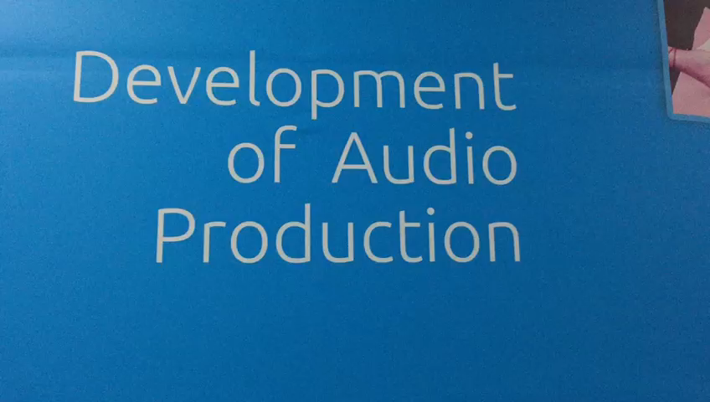
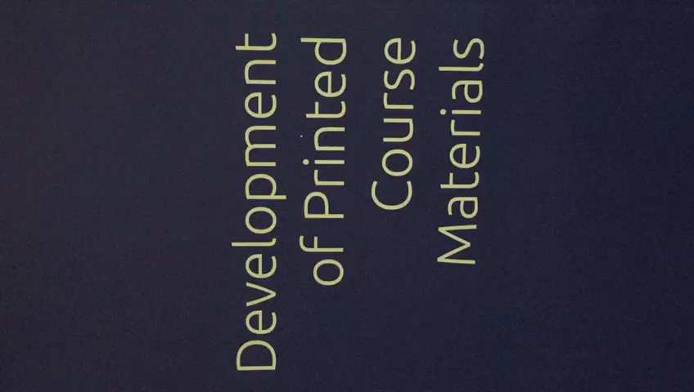
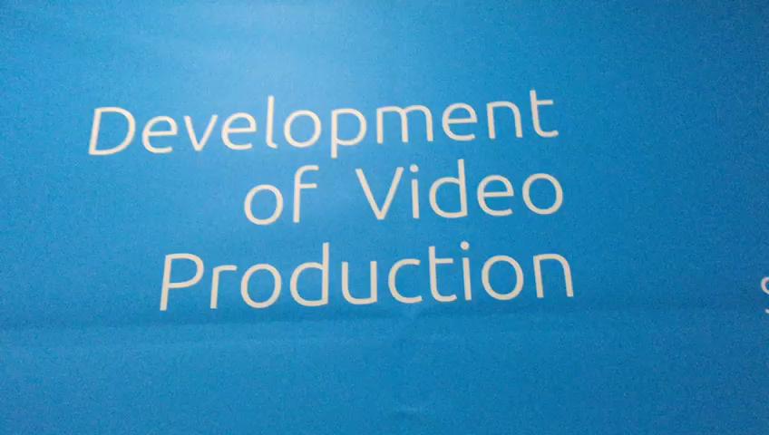
Results & Discussion
Learning Material Development at UT

Slide 9
Results and Discussion
Survey Results
Process of Recruiting MDs & CRs
Recruiting MDs and CRs with
relevant subjects
Easy 83.33%, Difficult 16.67%
Frequent communication with MDs and CRs
Easy 73.81%, Difficult 26.19%
Receiving Final Products from MDs & CRs on time
Easy 60%, Difficult 40%
Process of Content Reviewing
Completeness of
review process
On Time 67.50%, Late 32.50%
Allignment of review results with timeline
On Time 67.50%, Late 32.50%
Receiving final review
Easy 60%, Difficult 40%
Quality of Content
Satisfying reviewed contents
Agree 87.18%, Disagree 12.82%
No major revision
Agree 51.28%, Disagree 48.72%
Fulfilled standard of
content quality at UT
Agree 87.50%, Disagree 12.50%

Slide 10
Results and Discussion
Survey Results
Time is not managed well
Miscommunication among teams
Content/substances are not updated
Lack of up-to-date references
Constraints

Slide 11
Conclusion
The development of learning materials for ODE learners
very challenging (time management and communication
among the development team)
UT as an ODE institution
applies the learning materials development that needs a long
and complex process.
Limited number of academic staffs
recruited material developers and content reviewers
from other institutions

Slide 12



Recommendation
Once the course managers get the list of the MDs and CRs, they have to actively communicate with both parties, from the beginning up to the end of the material development process.
Course managers have to ensure that the content/substances have fulfilled the standards applied at UT, particularly for the materials in relation to policies/regulations or the use of up-to-date references.
Course managers
manage the time allocated for developing the learning materials to avoid the tardiness of the manuscript’s finalization

Slide 13
LIDWINA SRI ARDIASIH
UNIVERSITAS TERBUKA INDONESIA
Lidwina@ecampus.ut.ac.id
Mobile: +62 81310033593

